Slide 1
Cloud (AWS, Azure, PCF)
Ayan Sengupta

Slide 2
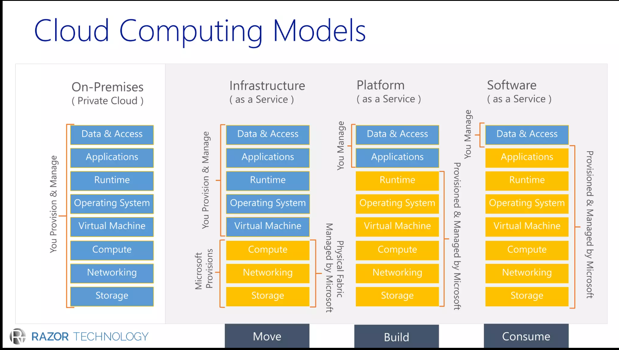

Slide 3
AWS

Slide 4
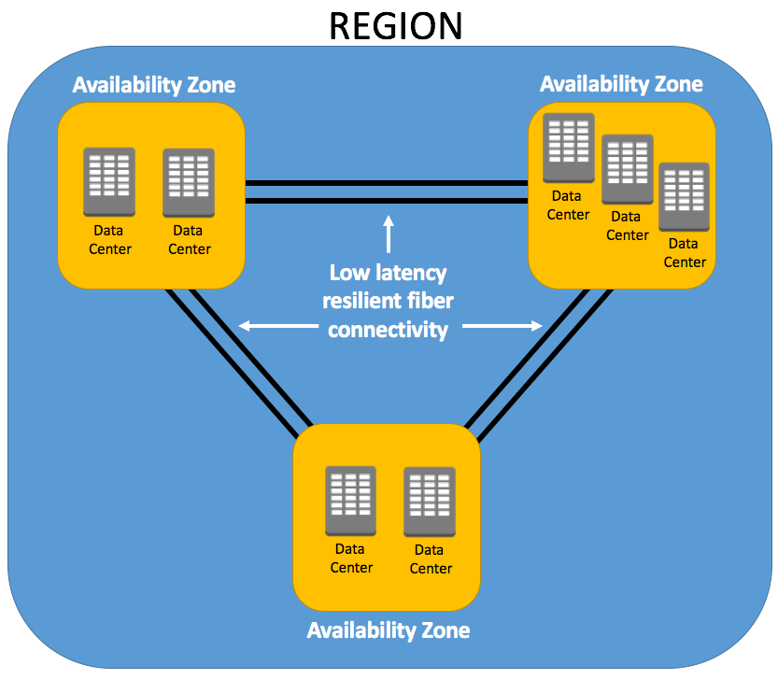
Availability
AWS has the concept of a Region, which is a physical location around the world where we cluster data centers.
Availability Zone (AZ) is one or more data centers with redundant power, networking, and connectivity in an AWS Region.
Each AWS Region consists of a minimum of three, isolated, and physically separate AZs within a geographic area

Slide 5
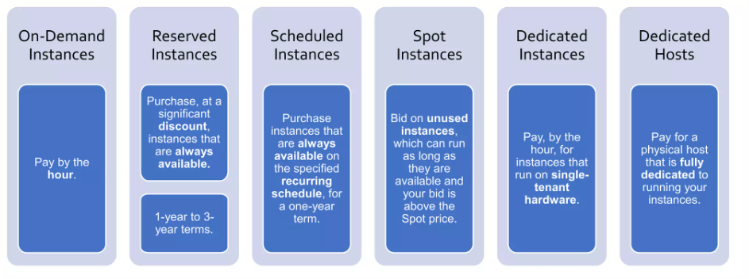
Compute - VM
EC2 – virtual servers in the cloud
EC2 Auto Scaling – add or remove EC2 instances according to conditions you define
Types :
General Purpose [balance of compute, memory and networking resources]– M*, T*
Compute Optimized [high performance processors] – C*
Memory Optimized [process large data sets in memory]– R*, X*, z*
Accelerated Computing [hardware accelerators to perform functions, such as floating point number]– P*, G*, T* etc
Storage Optimized [high, sequential read and write access to very large data sets on local storage.]– I*, D*, H*
HPC Optimized [high-performance processors such as large, complex simulations and deep learning workloads]– H*

Slide 6
Compute - PaaS
Elastic Beanstalk – Run and scale web application as PaaS
AWS Elastic Beanstalk is an easy-to-use service for deploying and scaling web applications and services developed with Java, .NET, PHP, Node.js, Python, Ruby, Go, and Docker on familiar servers such as Apache, Nginx, Passenger, and Internet Information Services (IIS).
You can simply upload your code, and AWS Elastic Beanstalk automatically handles the deployment, from capacity provisioning, load balancing, and auto scaling to application health monitoring. At the same time, you retain full control over the AWS resources powering your application and can access the underlying resources at any time.

Slide 7
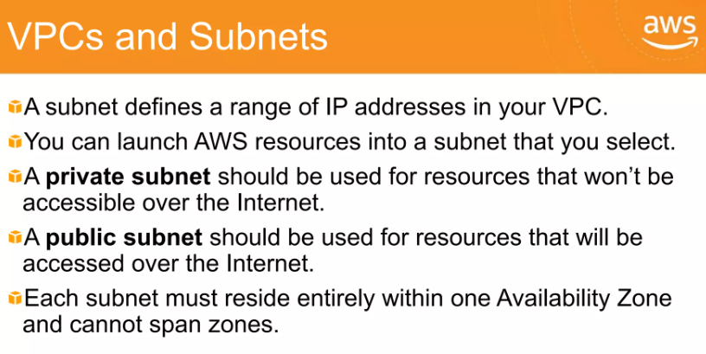
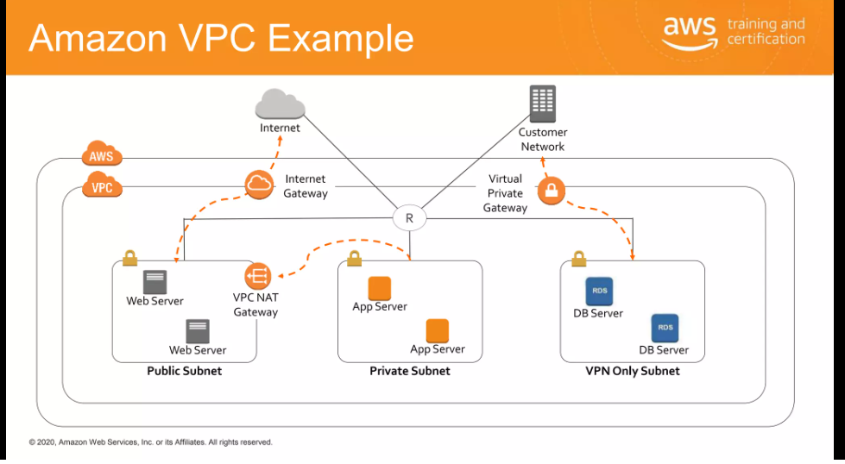
Networking - VPC
Virtual Private Cloud - Define and launch AWS resources in a logically isolated virtual network
Internet Gateway – request/response from/to internet
Virtual Private Gateway – VPN connection between AWS VPC and Corporate network

Slide 8
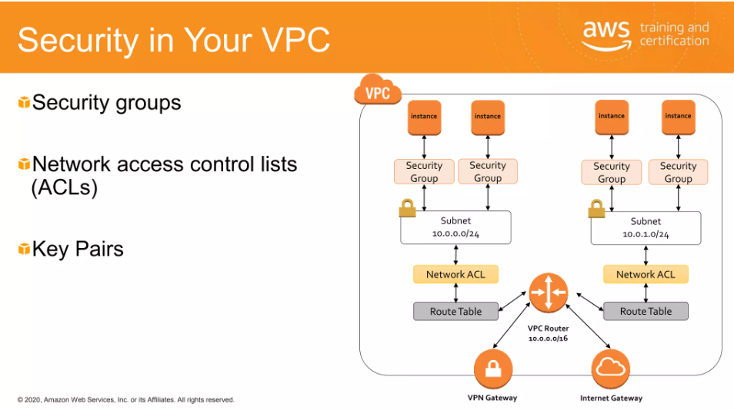
Networking – ACL & Security Group
Access Control List (ACL)
is a virtual firewall for a subnet
Stateless packet filtering
Security Group
Is a virtual firewall for an EC2 instance
Stateful packet filtering

Slide 9
Networking – Route 53
Amazon Route 53 is a highly available and scalable cloud Domain Name System (DNS) web service. It is designed to give developers and businesses an extremely reliable and cost-effective way to route users to internet applications by translating human-readable names, such as www.example.com, into the numeric IP addresses, such as 192.0.2.1, that computers use to connect to each other. Amazon Route 53 is fully compliant with IPv6 as well.

Slide 10
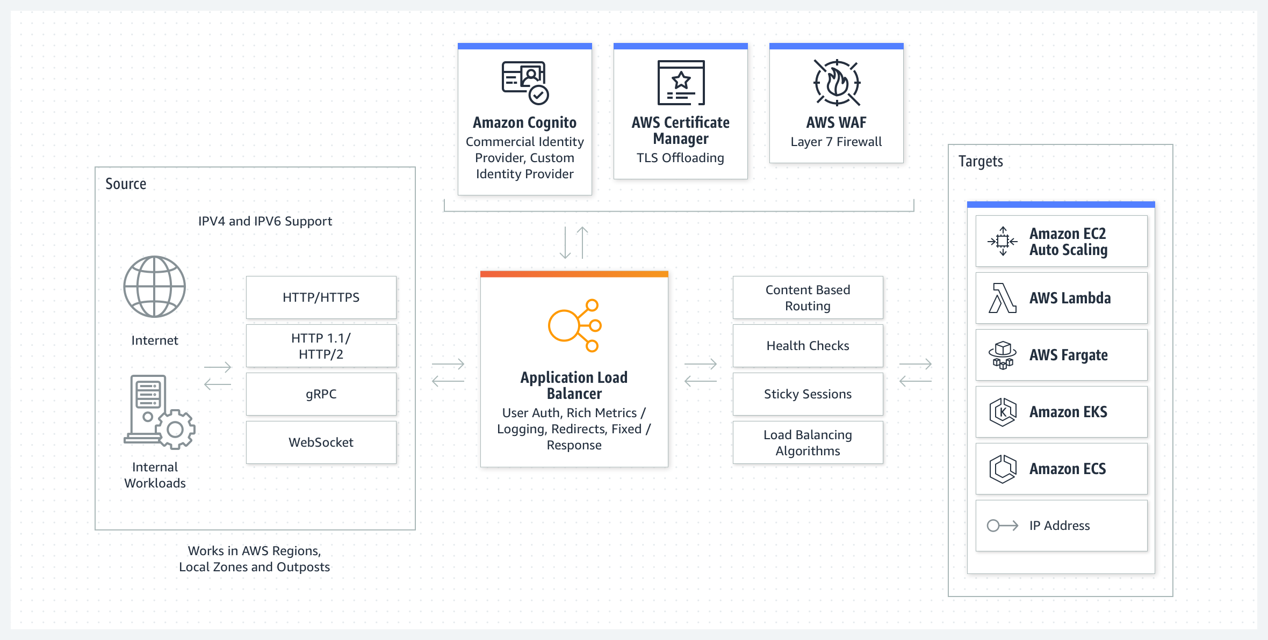
Networking – Elastic Load Balancing
Elastic Load Balancing (ELB) automatically distributes incoming application traffic across multiple targets and virtual appliances in one or more Availability Zones (AZs).

Slide 11
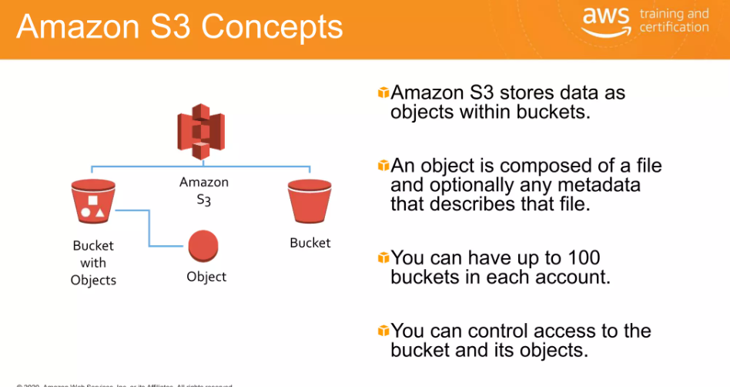
Storage –S3, S3 Glacier
S3 Glacier storage classes
Long-term, secure, durable storage classes for data archiving at the lowest cost and milliseconds access

Slide 12
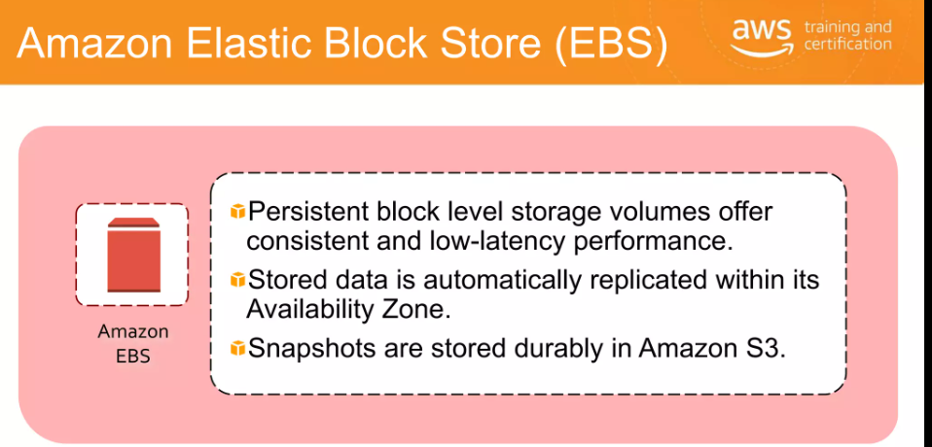
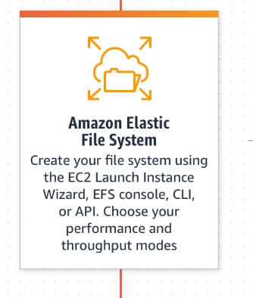
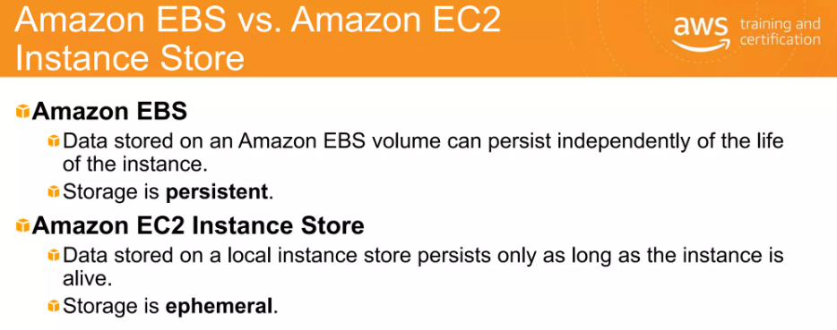
Storage – EBS, EFS
Elastic File System
Serverless, fully elastic file storage

Slide 13
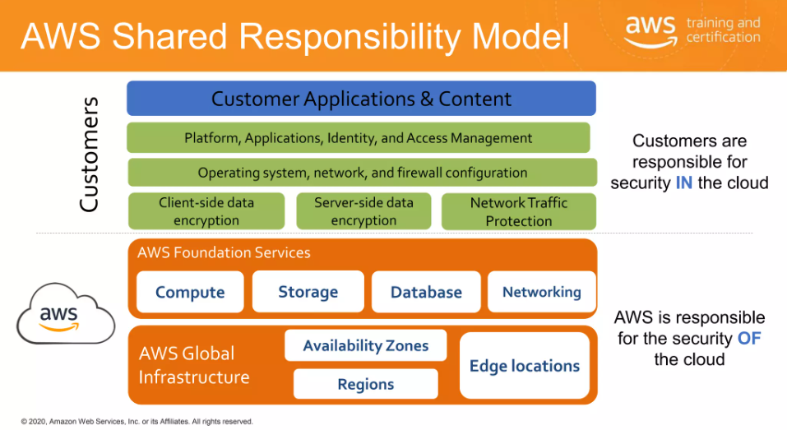
Security
Identity and Access Management
AWS Identity and Access Management (IAM) enables you to securely control access to AWS services and resources for your AWS users, groups, and roles. Using IAM, you can create and manage fine-grained access controls with permissions, specify who can access which services and resources, and under which conditions. IAM allows you to do the following:
Cognito
Amazon Cognito lets you add user sign-up, sign-in, and access control to your web and mobile apps quickly and easily. With Amazon Cognito, you can scale to millions of users and supports sign-in with social identity providers such as Apple, Facebook, Twitter, or Amazon, with SAML 2.0 identity solutions, or by using your own identity system.
WAF is a web application ﬁrewall that helps protect your web applications or APIs against common web exploits and bots that may affect availability, compromise security, or consume excessive resources. AWS WAF gives you control over how traffic reaches your applications by enabling you to create security rules that control bot traffic and block common attack patterns, such as SQL injection or cross-site scripting.
GuardDuty is an intelligent threat detection

Slide 14
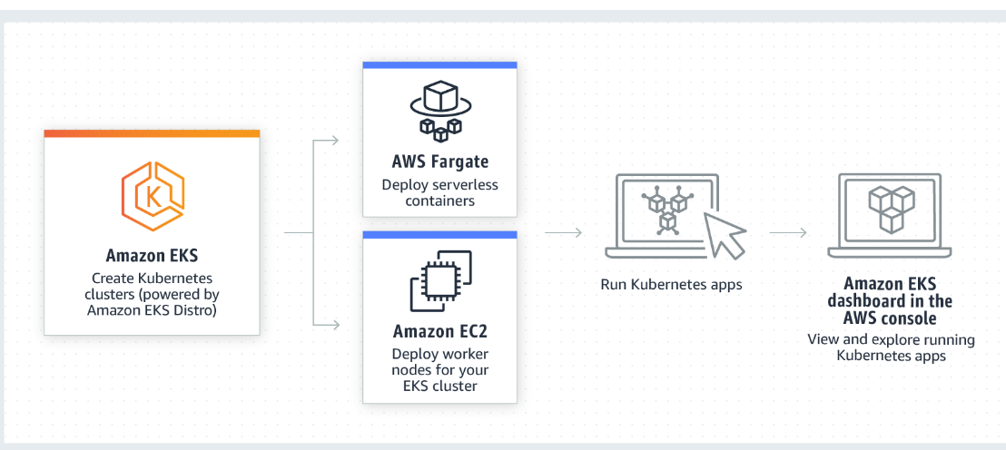
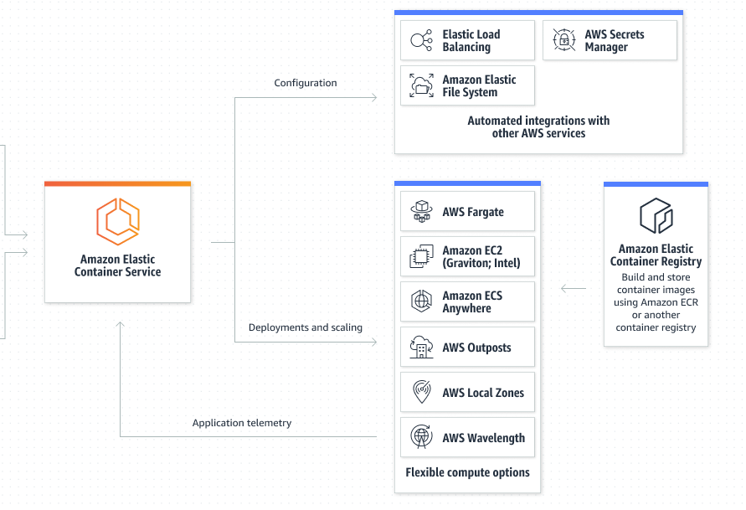
Container
ECS is a Docker based native offering
EKS makes it easy to deploy, manage, and scale containerized applications using Kubernetes on AWS.
Fargate
Serverless compute for containers

Slide 15
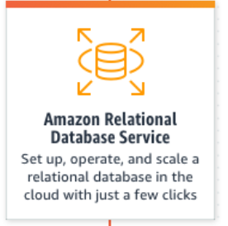
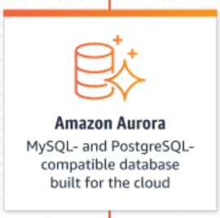
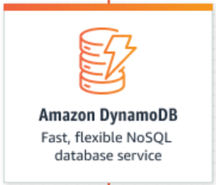
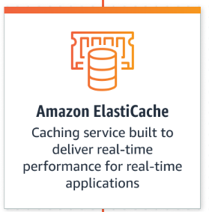
Database
RDS – Managed Relation Database Service for MySQL, Postgres, Oracle, SQL Server, MariaDB
Aurora High performance and availability at global scale with full MySQL and PostgreSQL compatibility
DynamoDB
Secure, serverless, NoSQL database with limitless scalability and consistent single-digit millisecond performance
ElastiCache is a fully managed, Redis- and Memcached-compatible service

Slide 16
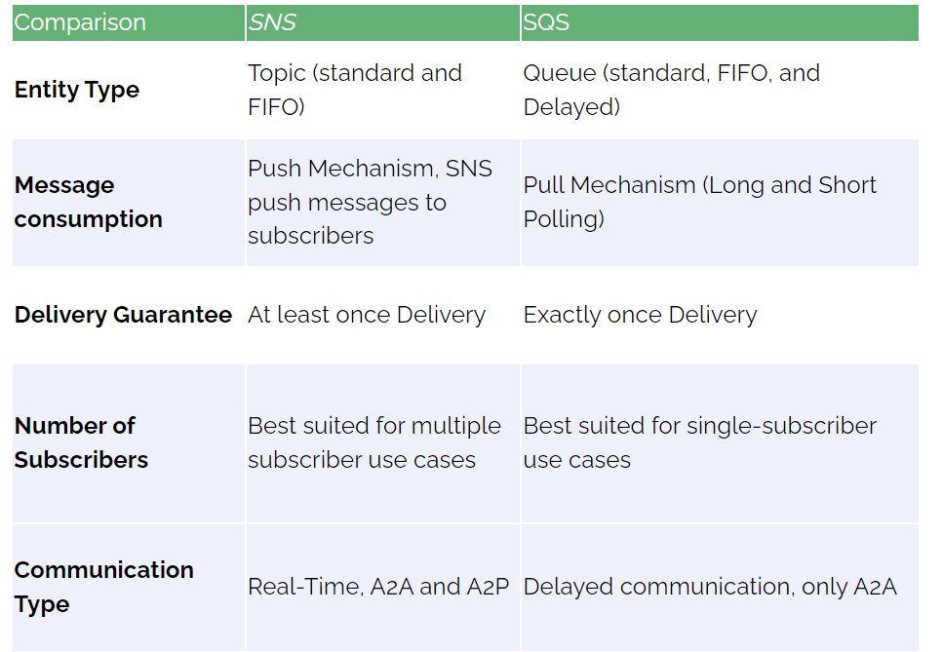
Messaging
Simple Queue Service SQS lets you send, store, and receive messages between software components at any volume, without losing messages or requiring other services to be available.
Simple Notification Service SNS – Fully managed pub/sub service

Slide 17
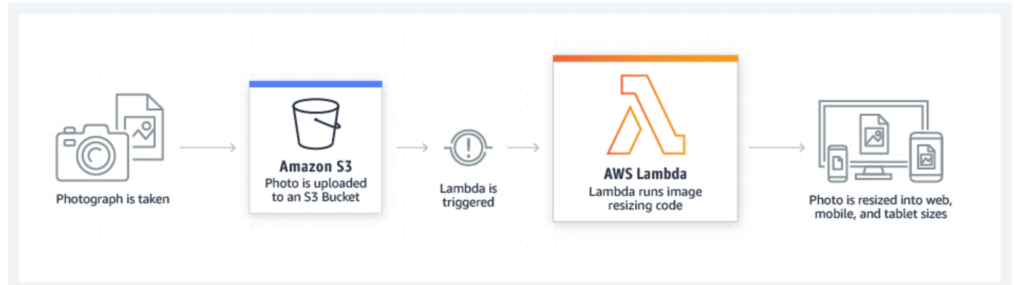
Serverless
AWS Lambda lets you run code without provisioning or managing servers.

Slide 18
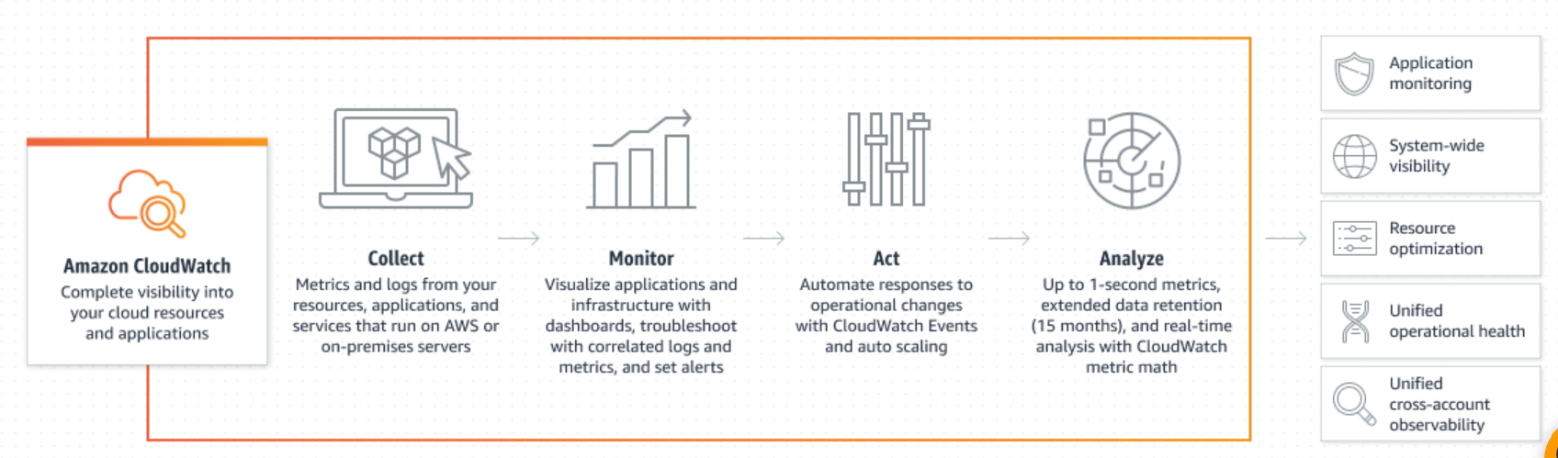
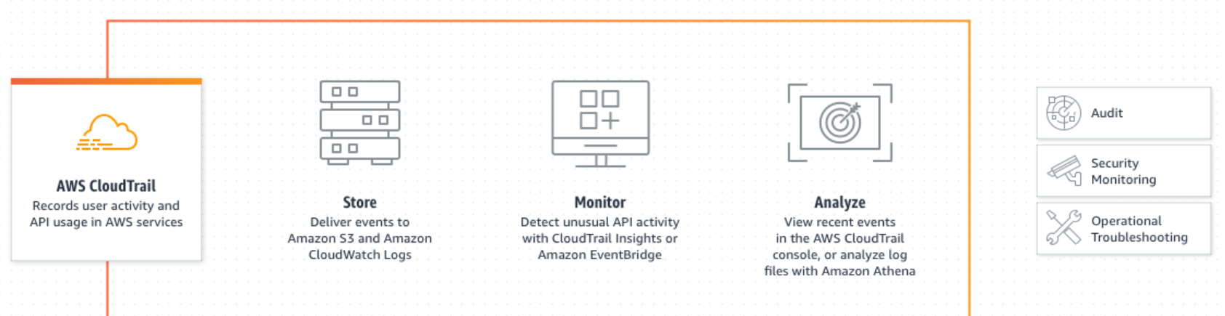
Monitoring

Slide 19
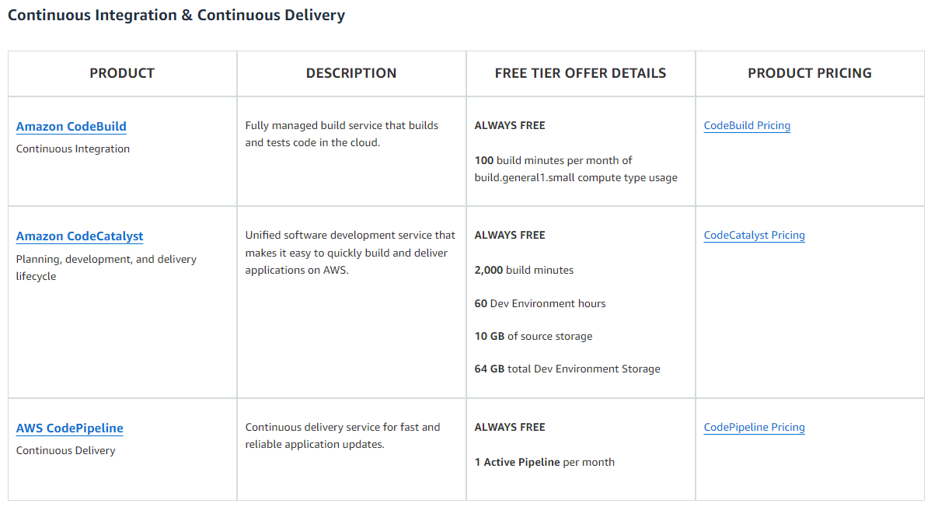
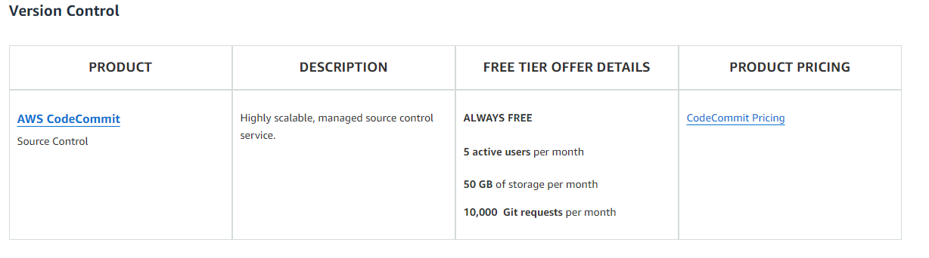
DevOps

Slide 20
AI/ML
SageMaker
Build, train, and deploy machine learning (ML) models for any use case with fully managed infrastructure, tools, and workflows

Slide 21
Azure

Slide 22
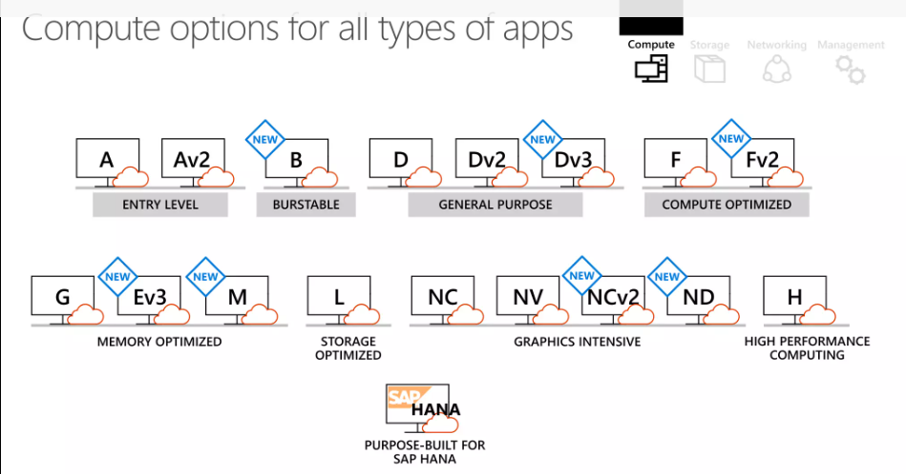
Compute - VM
Virtual Machines
Create Linux and Windows virtual machines (VMs) in seconds and reduce costs.

Slide 23
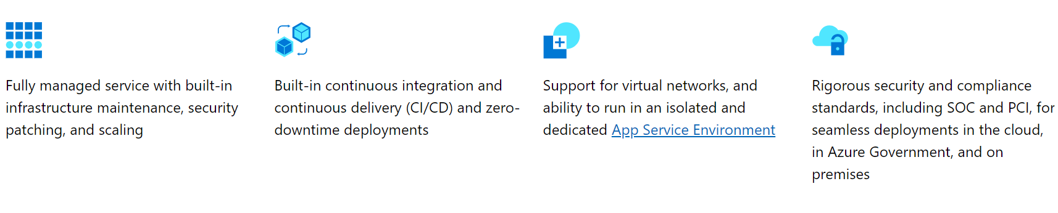
Compute - PaaS
App Service - Quickly build, deploy, and scale web apps and APIs on your terms. Work with .NET, .NET Core, Node.js, Java, Python, or PHP in containers, or running on Windows or Linux.

Slide 24
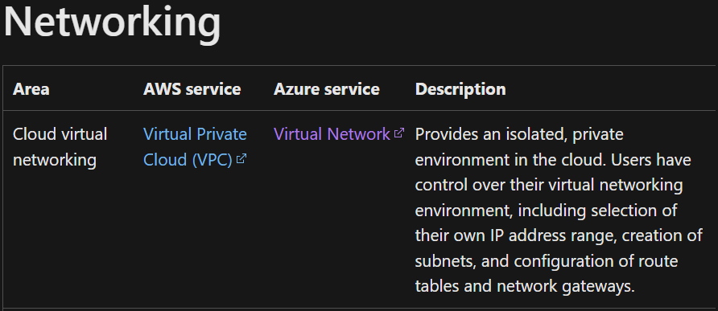
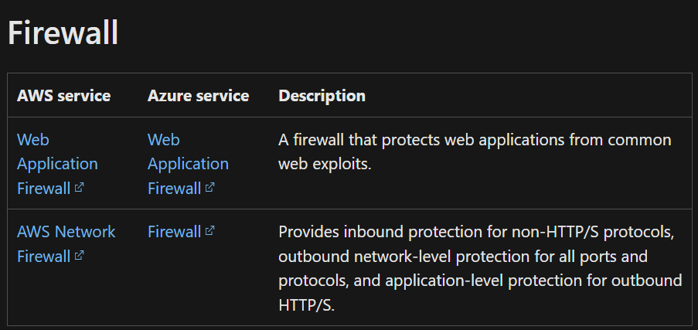
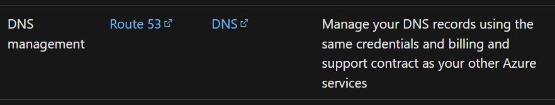
Networking

Slide 25
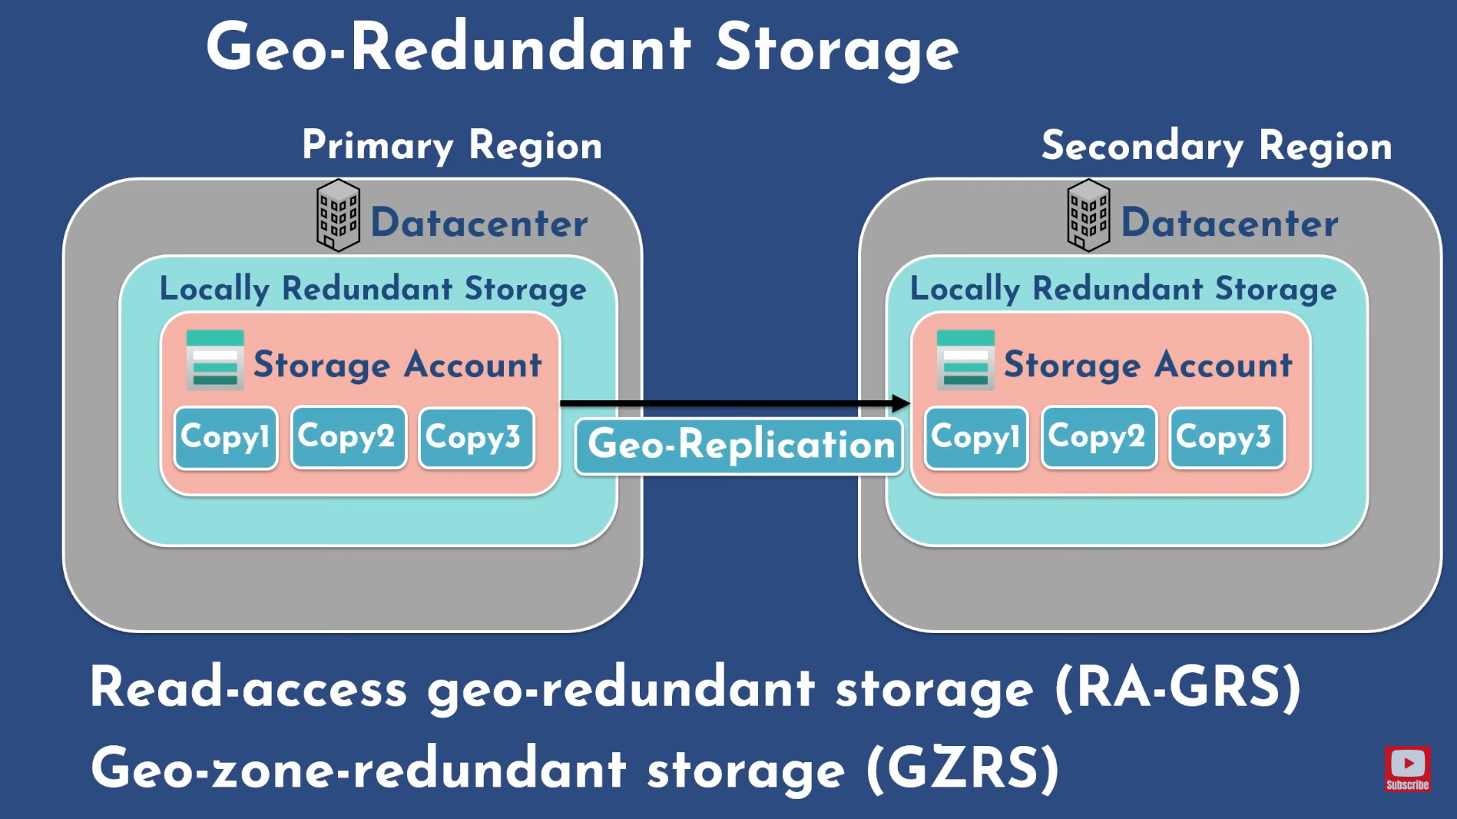

Slide 26
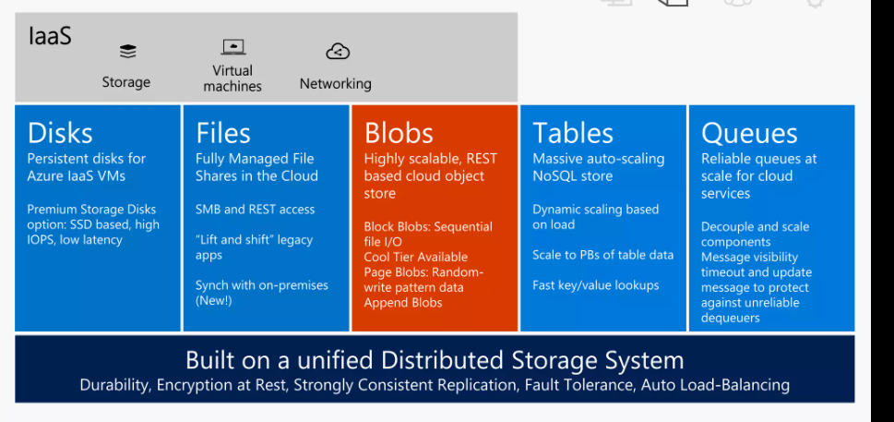
Storage

Slide 27
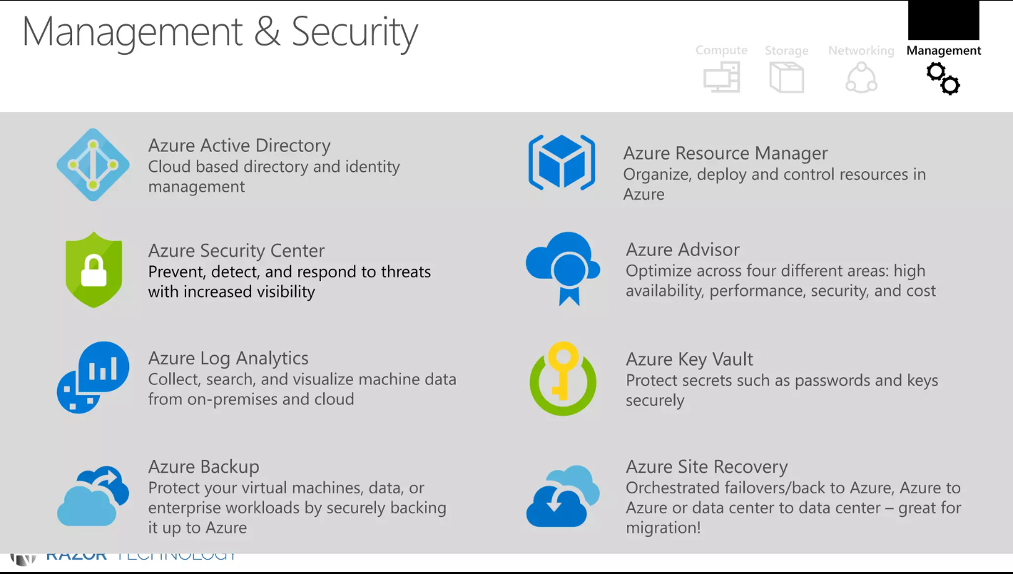

Slide 28
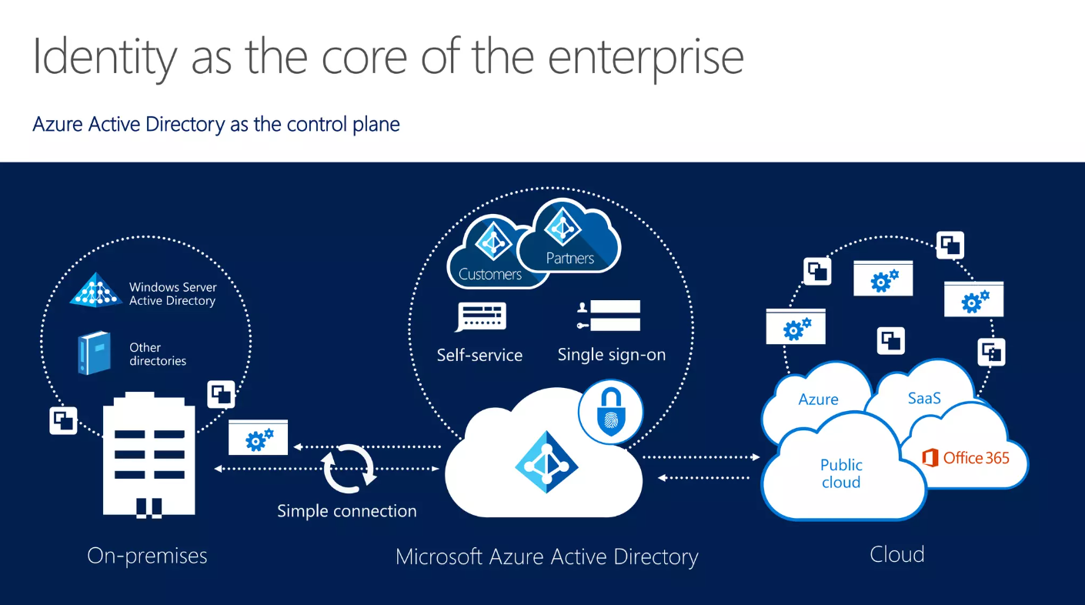
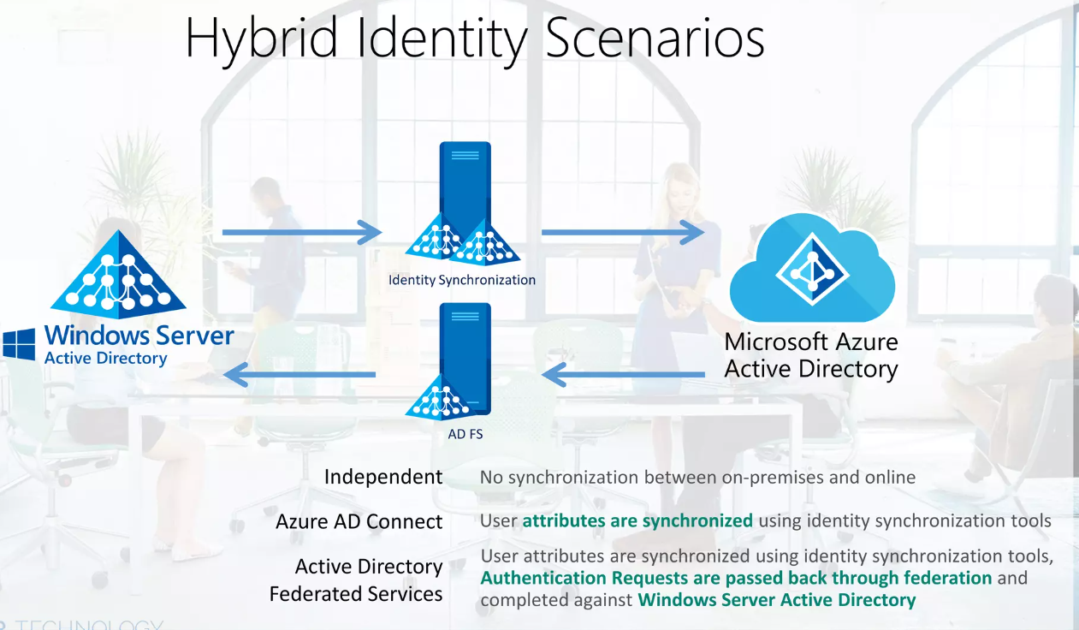
Security
Important : Ability to sync on-prem Windows AD with cloud Azure AD

Slide 29
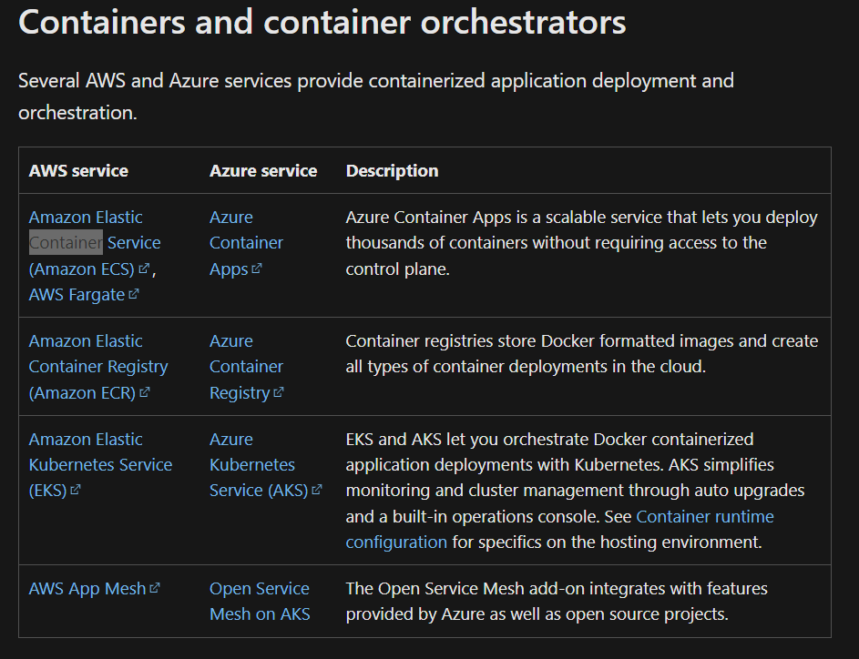
Container

Slide 30
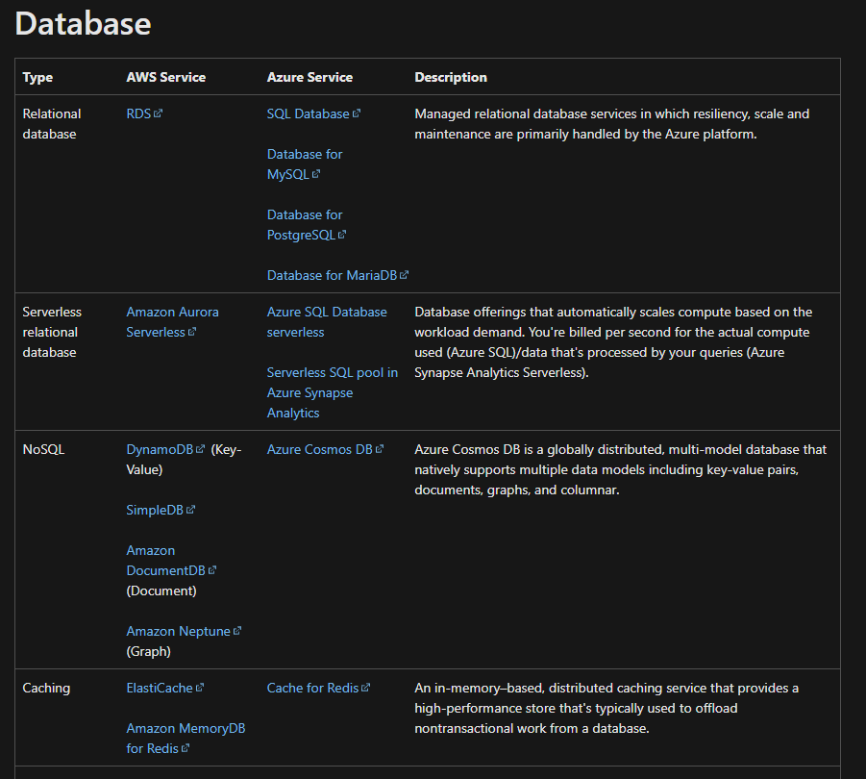
Database

Slide 31
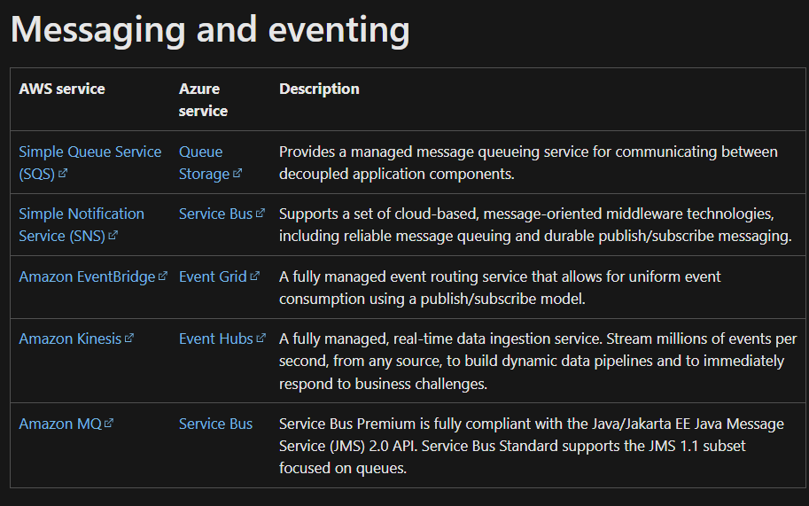
Messaging

Slide 32
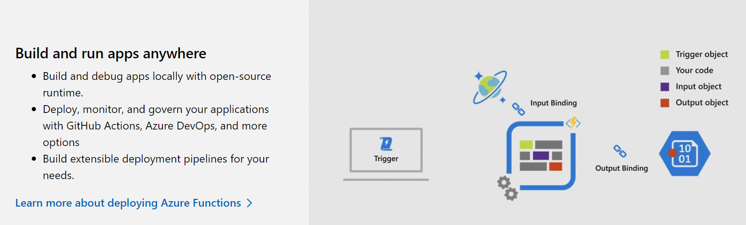
Serverless- Azure Functions

Slide 33
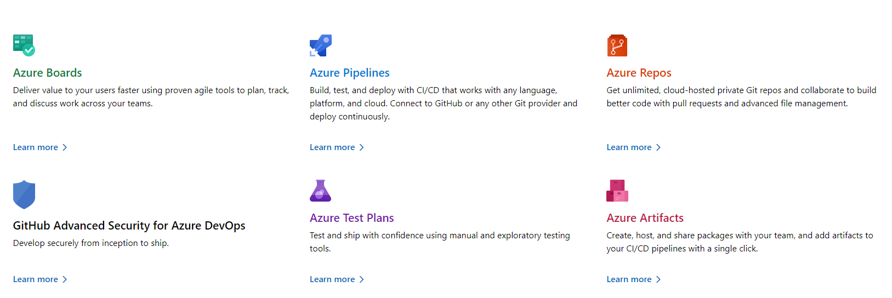
DevOps

Slide 34
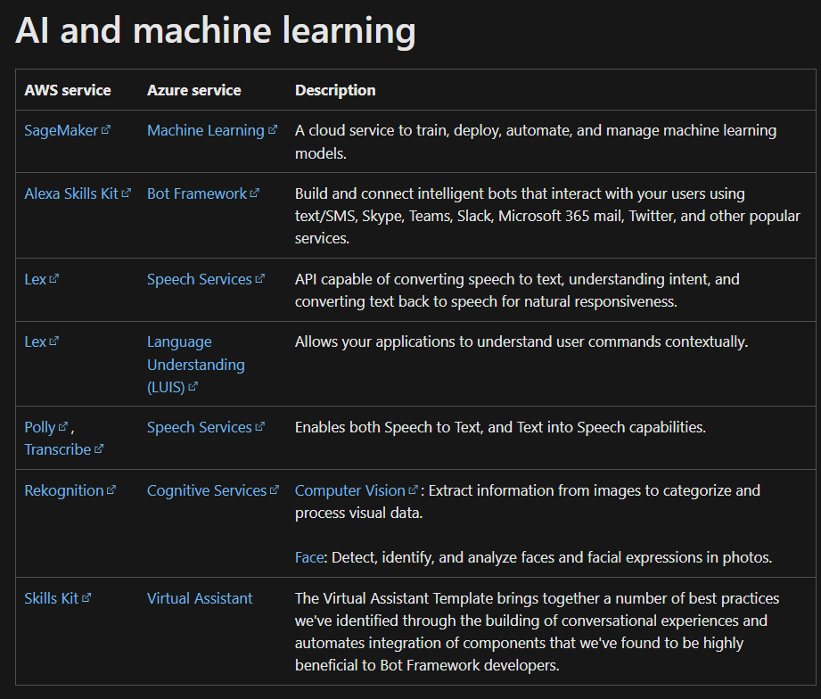

Slide 35
VMWare Tanzu

Slide 36
Tanzu Application Service – PaaS (PCF)
TAS is based on Cloud Foundry technology, an open-source application platform whose tangled origins go back to VMware in 2009. It was then spun out to Pivotal Software, which handed the core software to the Cloud Foundry Foundation and was then re-acquired by VMware to become part of Tanzu. TAS, and Cloud Foundry, uses BOSH to package and deploy applications. "TAS does not run on Kubernetes. TAS runs on BOSH," said McLuckie. "We have invested significantly in work to get TAS on Kubernetes, but what we discovered was, to get to the full Zen of TAS, the three Rs, that fully orchestrated repaving of your application, rotating of certificates, etc, was going to take a fair bit of work."
The company made the decision to create TAP as an alternative platform optimized for Kubernetes, rather than adapting TAS. "Our intent is to product TAS-compatible APIs on top of this eventually, because there is value in converging everything on a united baseline, but the reality for most of our customers is that TAS works pretty well for what it does.

Slide 37
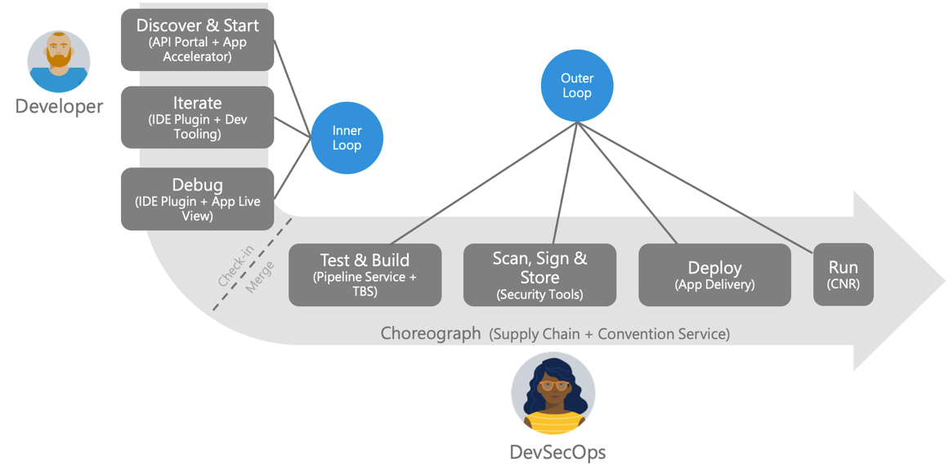
Tanzu Application Platform - PaaS for Kubernetes

Slide 38
Red Hat OpenShift

Slide 39
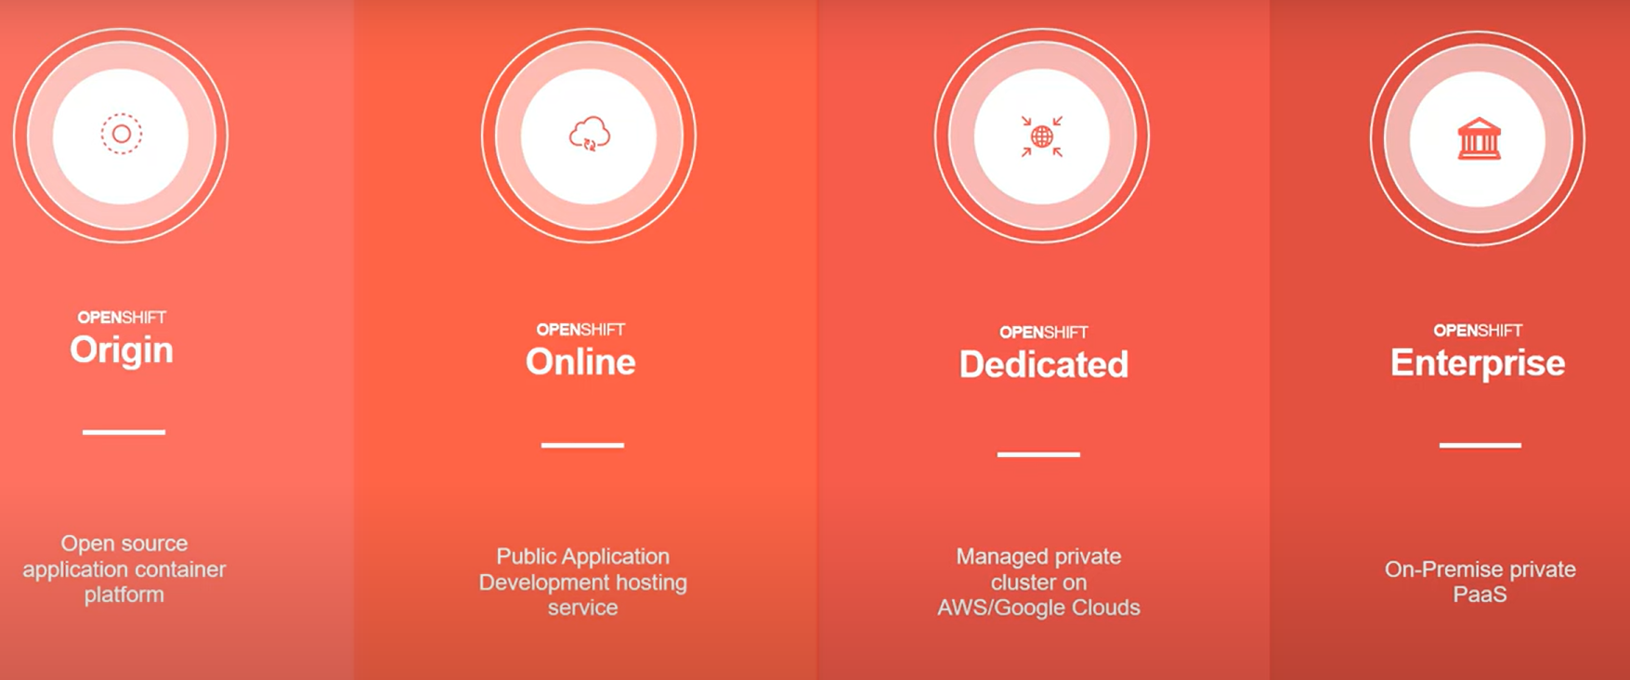
OpenShift Container Platform
A hybrid cloud PaaS built around Linux containers orchestrated and managed by Kubernetes on a foundation of RHEL

Slide 40
References
https://www.slideshare.net/AmazonWebServices/aws-technical-essentials-day-234995748
https://docs.aws.amazon.com/whitepapers/latest/aws-overview/introduction.html
https://azure.microsoft.com/en-in/products
https://learn.microsoft.com/en-us/azure/architecture/aws-professional/services
https://www.slideshare.net/d501159/microsoft-azure-cloud-services-102313997
https://tanzu.vmware.com/developer/tv/talk/141/

