Slide 1

Apache
Ayan Sengupta

Slide 2
Overview
“Apache Kafka is an open-source distributed event streaming platform”
“Kafka is a distributed, partitioned, replicated commit log service. It provides the functionality of a messaging system, but with a unique design”

Slide 3
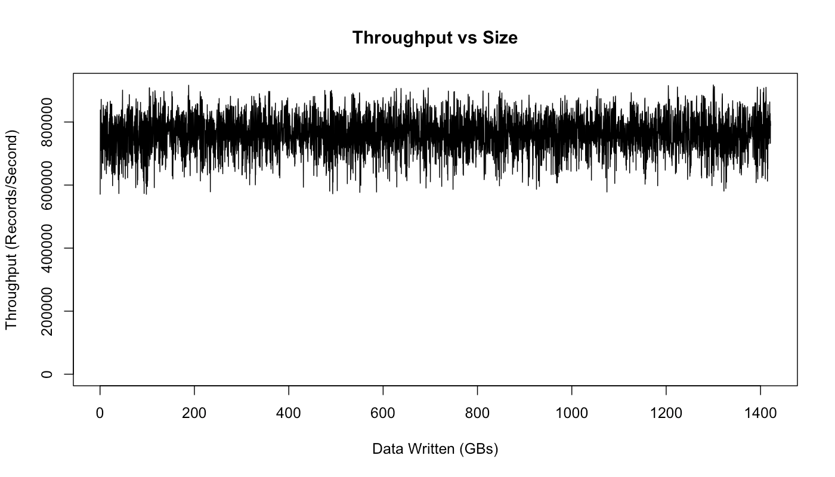
How fast is Kafka?
“Up to 2 million writes/sec on 3 cheap machines”
Using 3 producers on 3 different machines, 3x async replication
Only 1 producer/machine because NIC already saturated
Sustained throughput as stored data grows
Slightly different test config than 2M writes/sec above.

Slide 4
Why is Kafka so fast?
Fast writes:
While Kafka persists all data to disk, essentially all writes go to the page cache of OS, i.e. RAM.
Fast reads:
Very efficient to transfer data from page cache to a network socket
Linux: sendfile() system call
Combination of the two = fast Kafka!
Example (Operations): On a Kafka cluster where the consumers are mostly caught up you will see no read activity on the disks as they will be serving data entirely from cache.

Slide 5
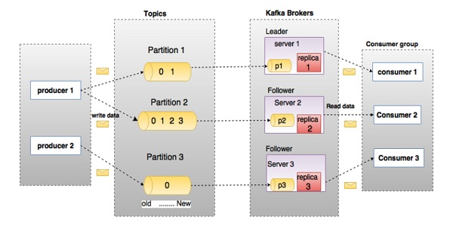
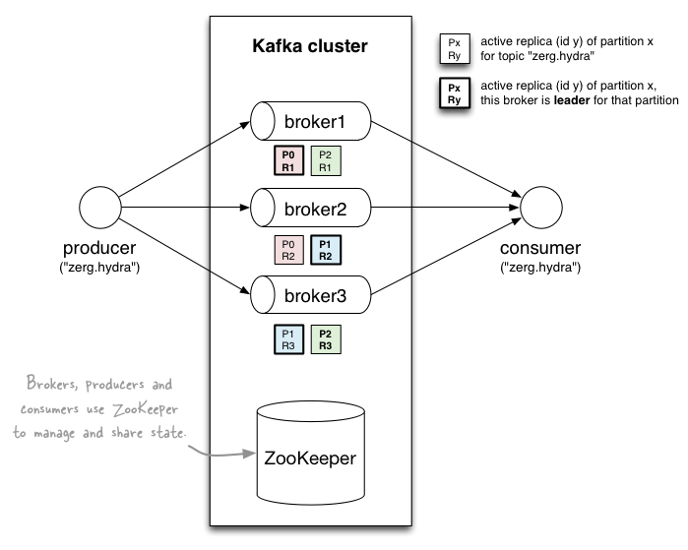
Kafka Components
Producers write data to brokers.
Consumers read data from brokers.
All this is distributed.
Data is stored in topics.
Topics are split into partitions, which are replicated.
Replicas are backups of a partition. They are never read or write data.
Each partitioned message has a unique sequence id called as offset
Collection of brokers are called as Kafka cluster.
Leader is the node responsible for all reads and writes for the given partition.
If the leader fails, one of the follower will automatically become the new leader.

Slide 6
Roles of ZooKeeper in Kafka
In Kafka Brokers
Registration of Broker: Kafka brokers register with ZooKeeper to enable other brokers and clients to find and contact them, and ZooKeeper keeps track of active brokers and their connection information.
Membership of Cluster: ZooKeeper keeps track of the Kafka cluster's active brokers and stores membership information, allowing for dynamic cluster membership changes and a current view.
Controller Election: ZooKeeper makes the controller election process easier by ensuring that only one broker is the controller at any given time.
Cluster Events and Alerts: ZooKeeper sends alerts to Kafka brokers about cluster events and changes. For example, if a broker fails or quits the cluster, ZooKeeper can alert the other brokers.
In Kafka Consumers
Cluster Coordination: ZooKeeper is responsible for arranging consumer groups in Kafka and keeping track of active groups and their members, as well as group membership information such as customers and partitions.
Group Membership and Rebalancing: ZooKeeper simplifies group membership management by assigning partitions fairly among active consumers and coordinating the partition reassignment process when group membership changes.
Offset Commitment: Kafka consumers store their current offset, which can be managed by ZooKeeper, which maintains committed offset information for each consumer group.
Consumer Metadata: ZooKeeper saves consumer-related metadata, which other components or monitoring systems can utilize to track the progress and status of individual consumers or consumer groups.
https://www.scaler.com/topics/kafka-tutorial/the-role-of-zookeeper-in-the-kafka-cluster/

Slide 7
Topics
Topic: feed name to which messages are published
Example: “zerg.hydra”
Kafka prunes “head” based on age or max size or “key”
Producer A1
Kafka topic
Producer A2
…
…
new
Producer An
Older msgs
Newer msgs
Producers always append to “tail”
(think: append to a file)
Broker(s)

Slide 8
Topics
Consumer group C1
Consumers use an “offset pointer” to
track/control their read progress
(and decide the pace of consumption)
Consumer group C2
Producer A1
Producer A2
…
…
new
Producer An
Older msgs
Newer msgs
Producers always append to “tail”
(think: append to a file)
Broker(s)

Slide 9
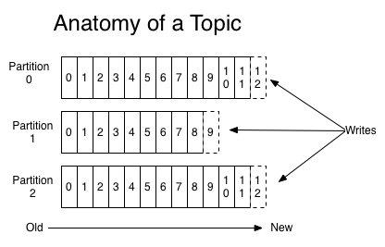
Partitions
A topic consists of partitions.
Partition: ordered + immutable sequence of messages that is continually appended to
How does Kafka handle message ordering across multiple partitions?
Kafka only guarantees message ordering within a single partition. Across multiple partitions, there is no guarantee of message ordering. If global ordering is required, it's typically achieved by using a single partition for the topic, but this limits scalability. For use cases requiring ordering and scalability, it's common to use a partition key that ensures related messages go to the same partition.

Slide 10
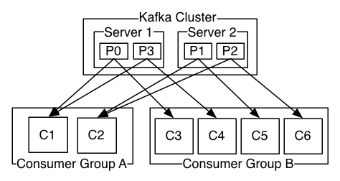
Partitions
#partitions of a topic is configurable
#partitions determines max consumer (group) parallelism
cf. parallelism of Storm’s KafkaSpout via builder.setSpout(,,N)
Consumer group A, with 2 consumers, reads from a 4-partition topic
Consumer group B, with 4 consumers, reads from the same topic

Slide 11
Partition offsets
Offset: messages in the partitions are each assigned a unique (per partition) and sequential id called the offset
Consumers track their pointers via (offset, partition, topic) tuples
Consumer group C1

Slide 12
Replicas of a partition
Replicas: “backups” of a partition
They exist solely to prevent data loss.
Replicas are never read from, never written to.
They do NOT help to increase producer or consumer parallelism!
Kafka tolerates (numReplicas - 1) dead brokers before losing data
LinkedIn: numReplicas == 2 → 1 broker can die

Slide 13
Acknowledgements in Kafka
Message delivery semantics: (Consumer side)
At most once: Messages may be lost but are never redelivered.
At least once: Messages are never lost but may be redelivered.
Exactly once: Each message is delivered once and only once. The choice depends on the specific use case and can be configured through producer and consumer settings.
Producer Acknowledgements in Kafka
acks=0: No acknowledgment (fire and forget)
acks=1: Leader acknowledgment only
acks=all: Full ISR (In-Sync Replica) acknowledgment The choice affects the trade-off between latency and durability. Higher levels of acknowledgment provide stronger durability guarantees but increase latency.

Slide 14
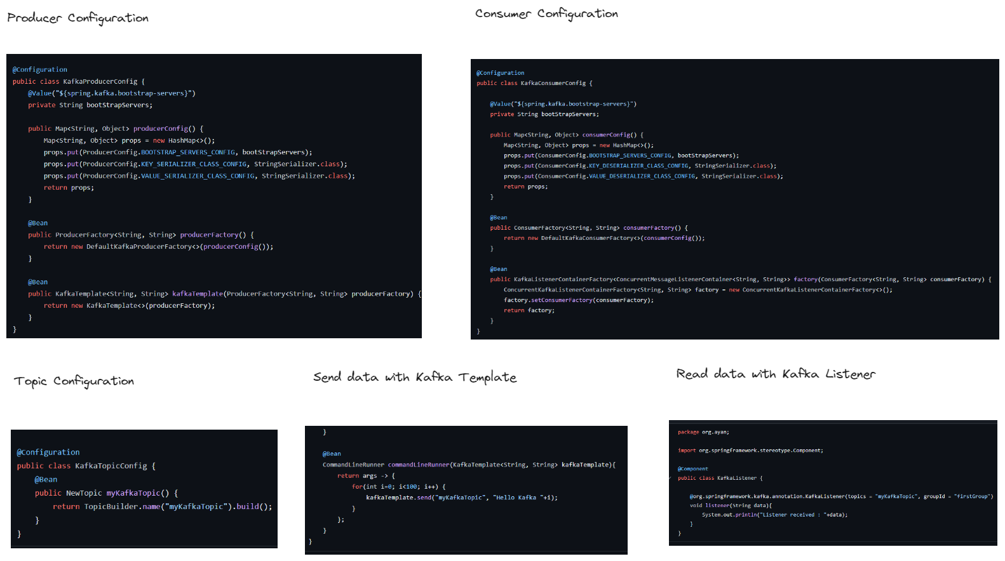
Sample implementation - https://github.com/as6485/springkafka

Slide 15
RabbitMQ vs Kafka
 | RabbitMQ | Kafka
Architecture | Supports complex architecture Exchange type: Direct, Fan out, Topic, Header-based | Publish/subscribe based
Performance | 4K-10K messages per second | 1 million messages per second
Consumer Mode | Smart broker/dumb consumer | Dumb broker/smart consumer
Message Retention | Acknowledgment based. It deletes messages after they’re consumed. | Policy-based (e.g., 30 days)
Message ordering | Unsupported. | Message ordering is provided via its partitioning. By message key, messages are sent to topics.
Message priorities | You can set message priorities in RabbitMQ and consume messages in the order of highest priority. | Unavailable

Slide 16
When to use RabbitMQ vs Kafka
It's important to understand that RabbitMQ and Kafka are not competing message brokers. Both were designed to support data exchange in different use cases where one is more suitable than the other.
Event stream replays
Kafka is suitable for applications that need to reanalyze the received data. You can process streaming data multiple times within the retention period or collect log files for analysis.
Log aggregation with RabbitMQ is more challenging, as messages are deleted once consumed. A workaround is to replay the stored messages from the producers.
Real-time data processing
Kafka streams messages with very low latency and is suitable to analyze streaming data in real time. For example, you can use Kafka as a distributed monitoring service to raise alerts for online transaction processing in real time.
Complex routing architecture
RabbitMQ provides flexibility for clients with vague requirements or complex routing scenarios. For example, you can set up RabbitMQ to route data to different applications with different bindings and exchanges.
Effective message delivery
RabbitMQ applies the push model, which means the producer knows whether the client application consumed the message. It suits applications that must adhere to specific sequences and delivery guarantees when exchanging and analyzing data.

Slide 17
References
https://kafka.apache.org/intro
https://en.wikipedia.org/wiki/Apache_Kafka
https://medium.com/analytics-vidhya/introduction-to-apache-kafka-88ebd24eb962
https://docs.google.com/presentation/d/1jPU6soIDn7W1F4CtUADuB4r3ujrebwHmxIoDhOLb_ok/htmlpresent
https://www.csee.umbc.edu/~shadam1/491s16/lectures/04-Kafka.pptx
https://www.simplilearn.com/kafka-vs-rabbitmq-article
https://aws.amazon.com/compare/the-difference-between-rabbitmq-and-kafka/#:~:text=RabbitMQ%20sends%20and%20queues%20messages,a%20specific%20topic%20and%20partition.

