Slide 1

Ayan Sengupta

Slide 2
Overview
“MongoDB is a source-available cross-platform document-oriented database program. Classified as a NoSQL database program, MongoDB uses JSON-like documents with optional schemas.”

Slide 3

What is
MongoDB is an open source, document-oriented database designed with both scalability and developer agility in mind.
Instead of storing your data in tables and rows as you would with a relational database, in MongoDB you store JSON-like documents with dynamic schemas(schema-free, schema less).
{
"_id" : ObjectId("5114e0bd42…"),
“FirstName" : "John",
“LastName" : "Doe",
“Age" : 39,
“Interests" : [ "Reading", "Mountain Biking ]
“Favorites": {
"color": "Blue",
"sport": "Soccer“
}
}

Slide 4
Scheme Free
RDBMS vs MongoDB
MongoDB does not need any pre-defined data schema
Every document could have different data!
RDBMS |  | MongoDB
Database |  | Database
Table |  | Collection
Row |  | Document (JSON, BSON)
Column |  | Field
Index |  | Index
Join |  | Embedded Document
Partition |  | Shard
{name: “will”,
eyes: “blue”,
birthplace: “NY”,
aliases: [“bill”, “ben”],
loc: [32.7, 63.4],
boss: ”ben”}
{name: “jeff”,
eyes: “blue”,
loc: [40.7, 73.4],
boss: “ben”}
{name: “brendan”,
boss: “will”}
{name: “matt”,
weight:60,
height: 72,
loc: [44.6, 71.3]}
{name: “ben”,
age:25}

Slide 5
Features Of
Document-Oriented storage
Full Index Support
Replication & High Availability
Auto-Sharding
Aggregation
MongoDB Atlas
Various APIs
JavaScript, Python, Ruby, Perl, Java, Java, Scala, C#, C++, Haskell, Erlang
Community

Slide 6
ACID vs BASE
MongoDB is ACID compliant post v4.0
ACID stands for:
Atomicity: Ensures that a transaction is either fully completed or not executed at all.
Consistency: Guarantees that a transaction brings the database from one valid state to another.
Isolation: Ensures that concurrent transactions do not interfere with each other.
Durability: Once a transaction is committed, it remains so, even in the event of a system failure.
BASE stands for:
Basically available - Ensuring the availability of data by distributing it across different nodes in a distributed database.
Soft state - The database itself doesn’t impose consistency, instead placing this responsibility on developers.
Eventually consistent - Consistency should ultimately be achieved, but isn’t guaranteed for individual transactions.

Slide 7
Important Components
mongosh – Shell
Compass – GUI
Atlas – Managed Service hosted on AWS/Azure/GCP
Serverless
Dedicated
Shared (Free Tier)

Slide 8
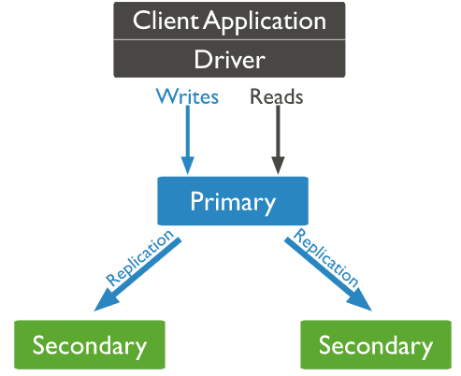
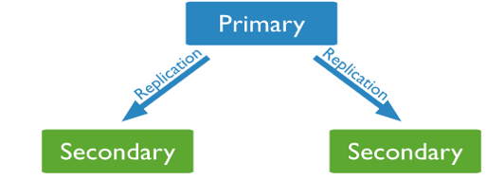
Replication
Replication provides redundancy and increases data availability.
With multiple copies of data on different database servers, replication provides a level of fault tolerance against the loss of a single database server.
Copy of database
Copy of database

Slide 9
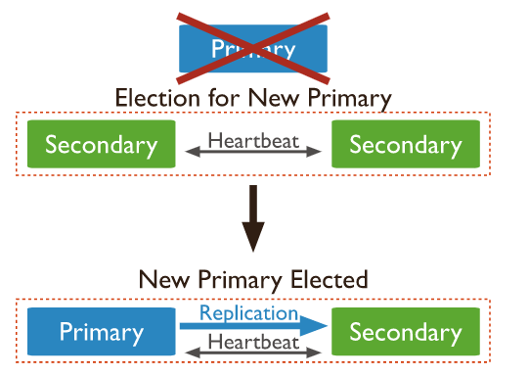
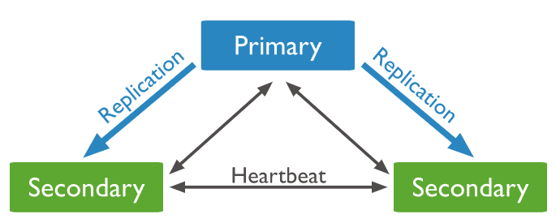
Replication

Slide 10
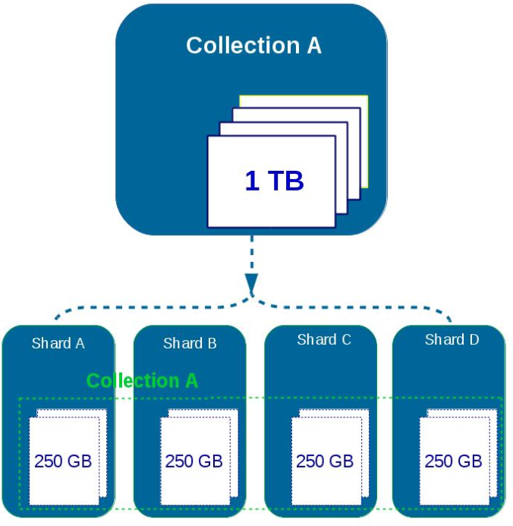
Sharding
Sharding is a method for distributing data across multiple machines.
MongoDB uses sharding to support deployments with very large data sets and high throughput operations.

Slide 11
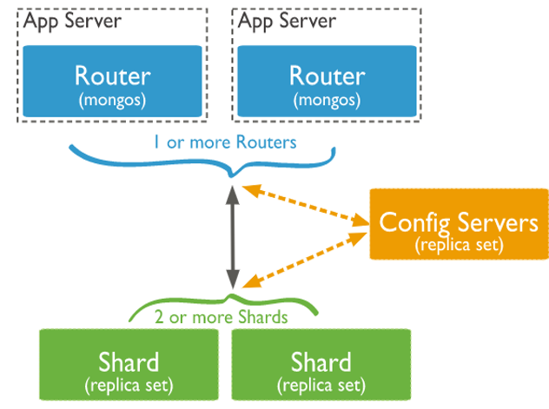
Sharding Architecture
Shard is a Mongo instance to handle a subset of original data.
Mongos is a query router to shards.
Config Server is a Mongo instance which stores metadata information and configuration details of cluster.

Slide 12
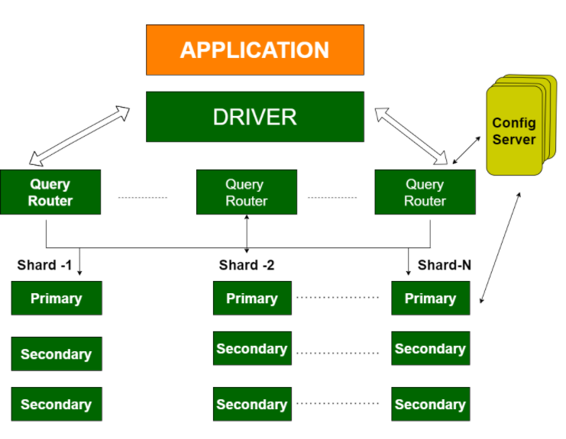
Sharding/Replication
Replication Split data sets across multiple data nodes for high availability.
Sharding scale up/down horizontally when it is required for high throughput

Slide 13
Aggregation in MongoDB
The Aggregation Framework in MongoDB is a powerful tool for performing data processing and transformation on documents within a collection.
It works by passing documents through a multi-stage pipeline, where each stage performs a specific operation on the data, such as filtering, grouping, sorting, reshaping and computing aggregations.
This framework is particularly useful for creating complex data transformations and analytics directly within the database.
db.sales.aggregate([ { $match: { status: "completed" } }, // Filter completed sales { $group: { _id: "$product", totalSales: { $sum: "$amount" } } }, // Group by product and sum the sales amount { $sort: { totalSales: -1 } } // Sort by total sales in descending order ])

Slide 14
Data consistency in MongoDB
MongoDB provides several mechanisms to ensure data consistency:
Journaling: MongoDB uses write-ahead logging to maintain data integrity.
Write Concerns: It specify the level of acknowledgment requested from MongoDB for write operations (e.g., acknowledgment from primary only, or acknowledgment from primary and secondaries).
Replica Sets: Replication ensures data is consistent across multiple nodes, and read concerns can be configured to ensure data consistency for read operations.

Slide 15
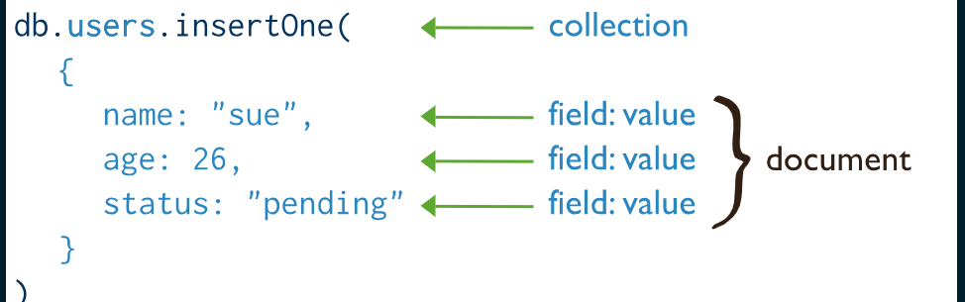
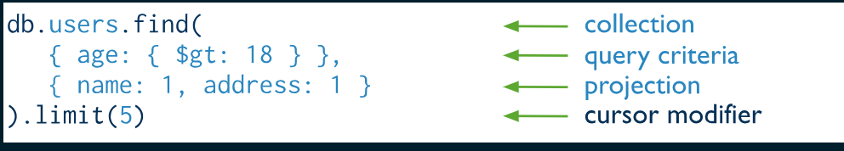
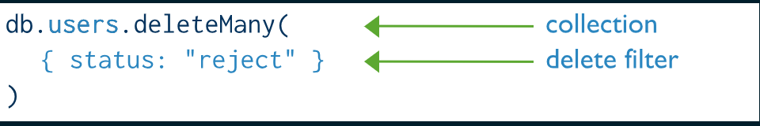
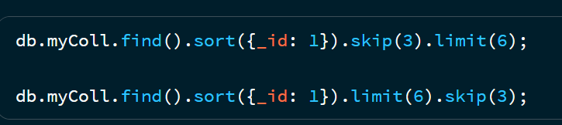
CRUD operations
https://www.mongodb.com/docs/manual/crud/

Slide 16
MongoTemplate and MongoRepository
The MongoTemplate follows the standard template pattern in Spring and provides a ready-to-go, basic API to the underlying persistence engine. The repository follows the Spring Data-centric approach and comes with more flexible and complex API operations, based on the well-known access patterns in all Spring Data projects.
MongoTemplate provides "atomic" out-of-the-box operations updateFirst, updateMulti, findAndModify, upsert... which allow you to modify a document in a single operation. The Update object used by these methods also allows you to target only the relevant fields.
MongoRepository only gives you the basic CRUD operations find, insert, save, delete, which work with POJOs containing all the fields. This forces you to either update the documents in several steps (1. find the document to update, 2. modify the relevant fields from the returned POJO, and then 3. save it), or define your own update queries by hand using @Query.

Slide 17
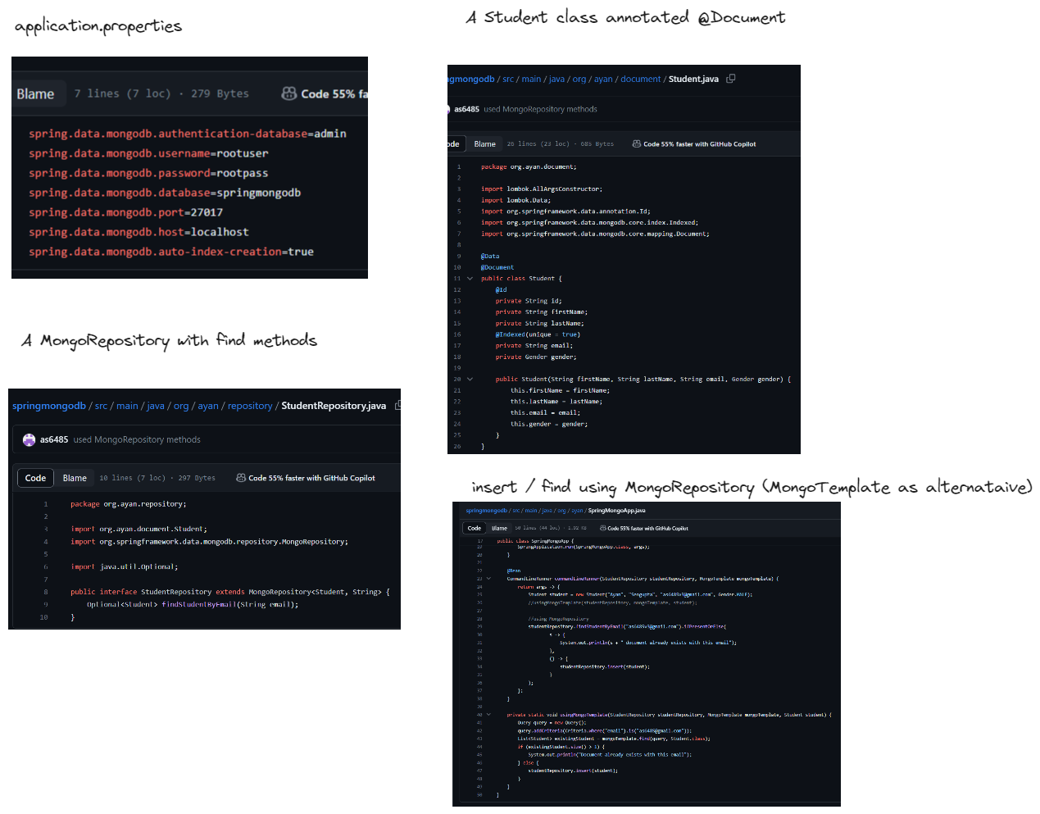
Sample implementation - https://github.com/as6485/springmongodb

Slide 18
References
https://en.wikipedia.org/wiki/MongoDB
https://www.mongodb.com/
https://slideplayer.com/slide/9859102/
https://stackoverflow.com/questions/17008947/whats-the-difference-between-spring-datas-mongotemplate-and-mongorepository

