Slide 1
Redis
Ayan Sengupta

Slide 2
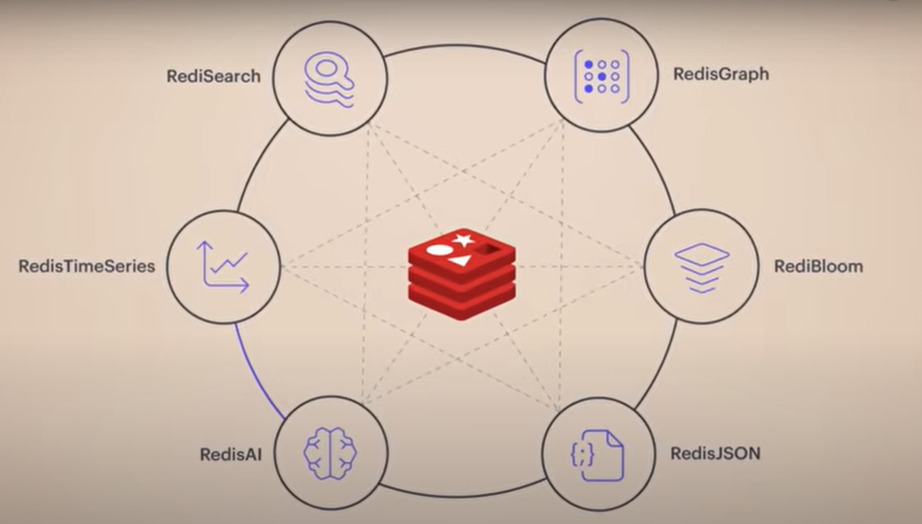
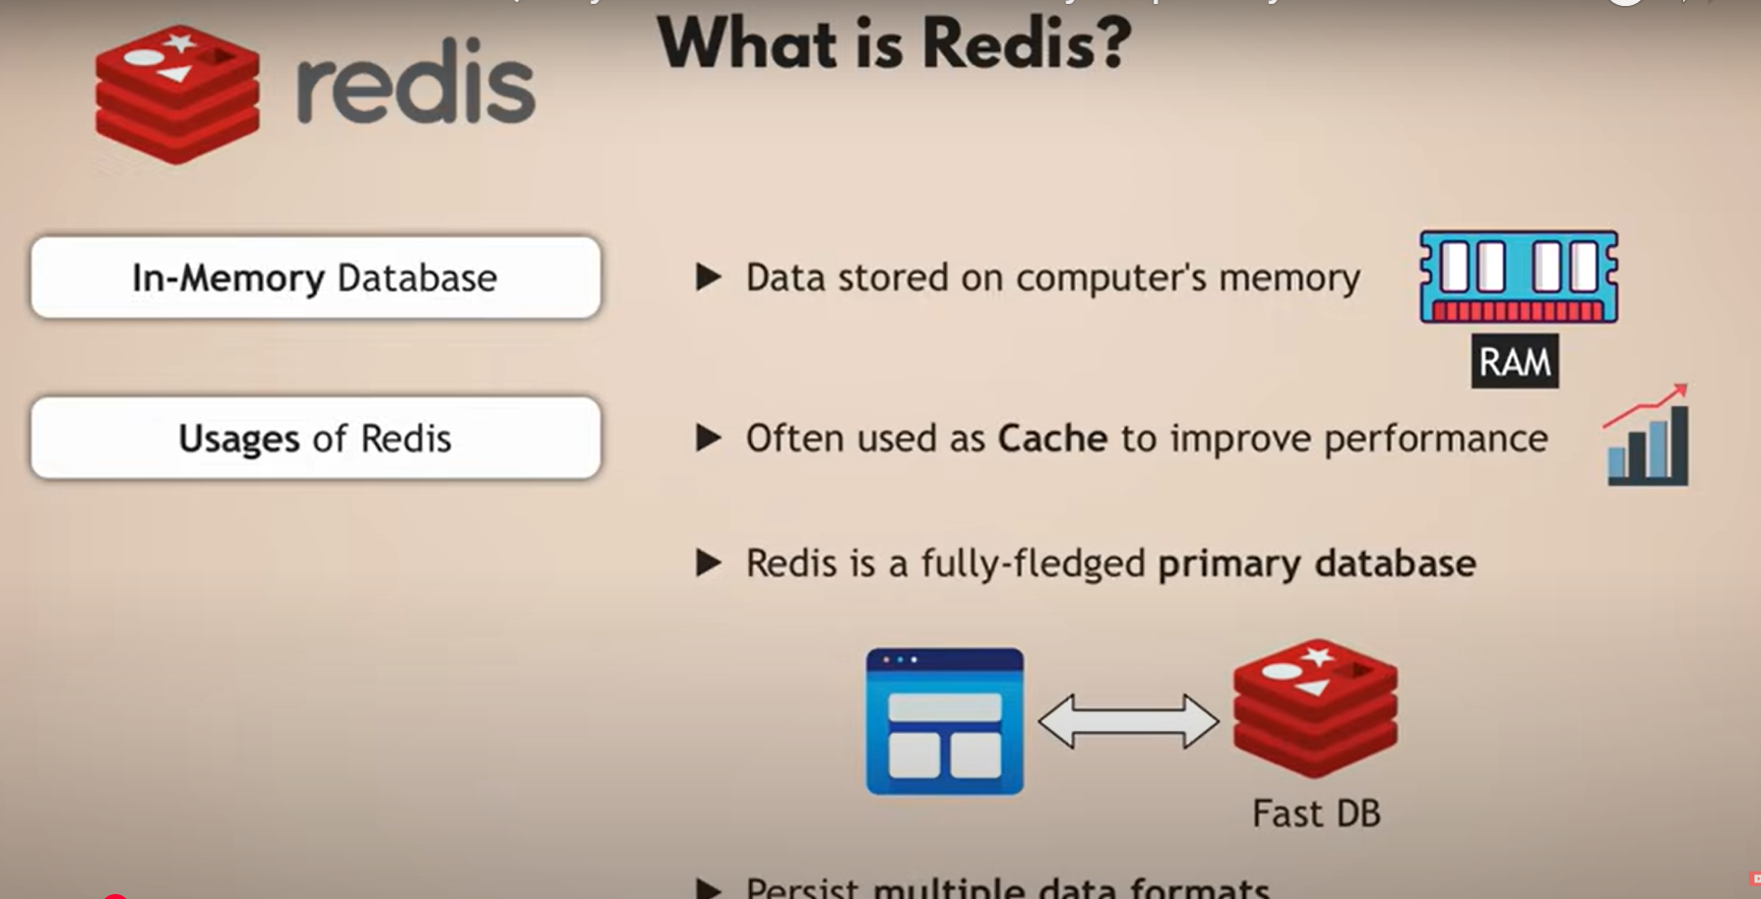
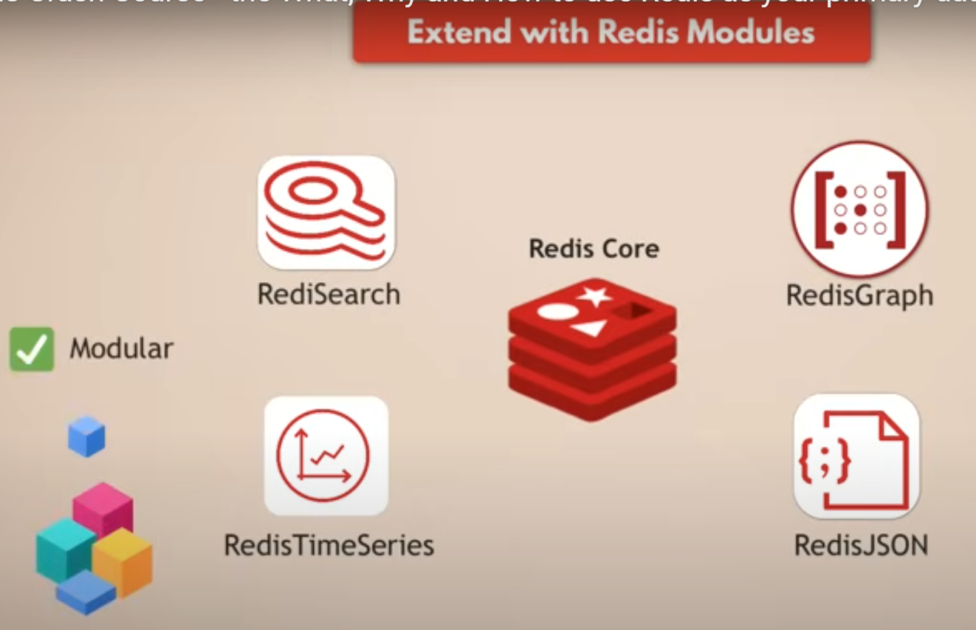
What is Redis
On top of being a cache it can also be used as a fully fledged database with multiple data formats
It’s modular design extends Redis Core into other modules like RediSearch, RedisGraph, RedisJSON, RedisTimeSeries

Slide 3
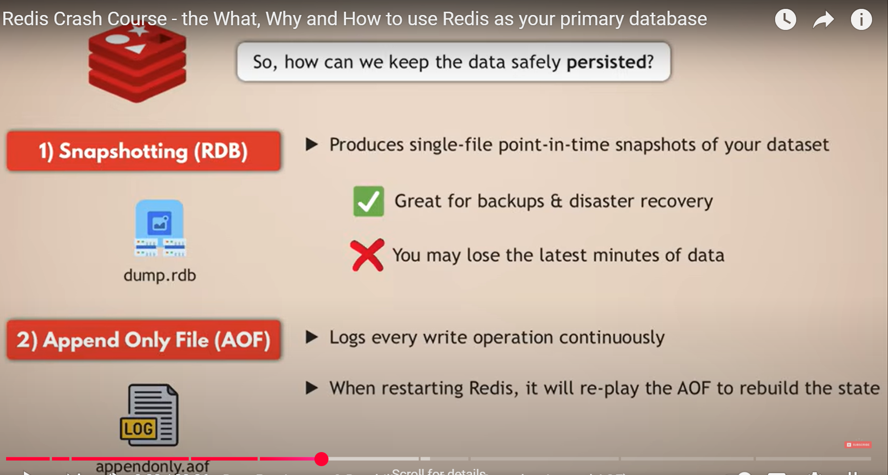
How is the data kept safe

Slide 4
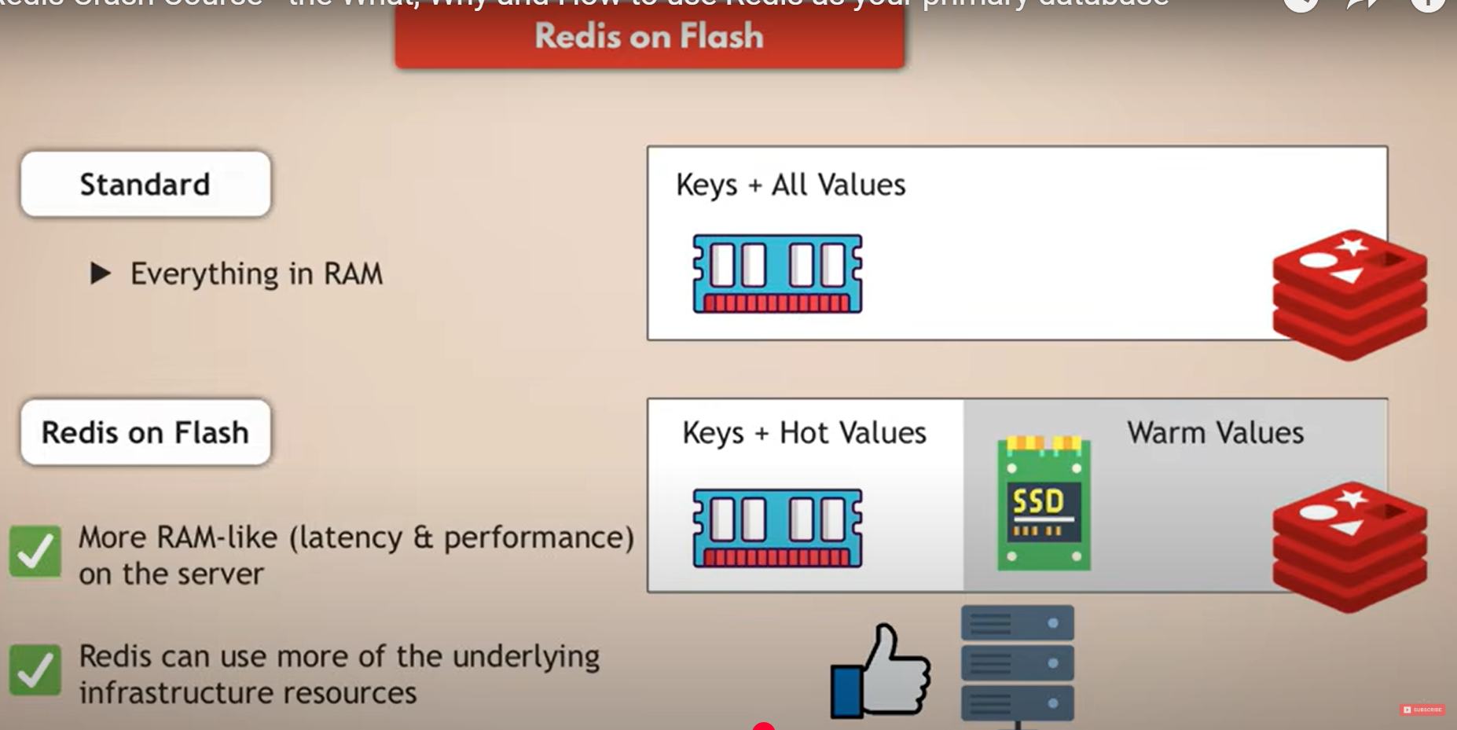
Cost Optimization with Redis on Flash (SSD)
Since Ram is expensive a way to optimize cost is to use SSD for “warm” values

Slide 5
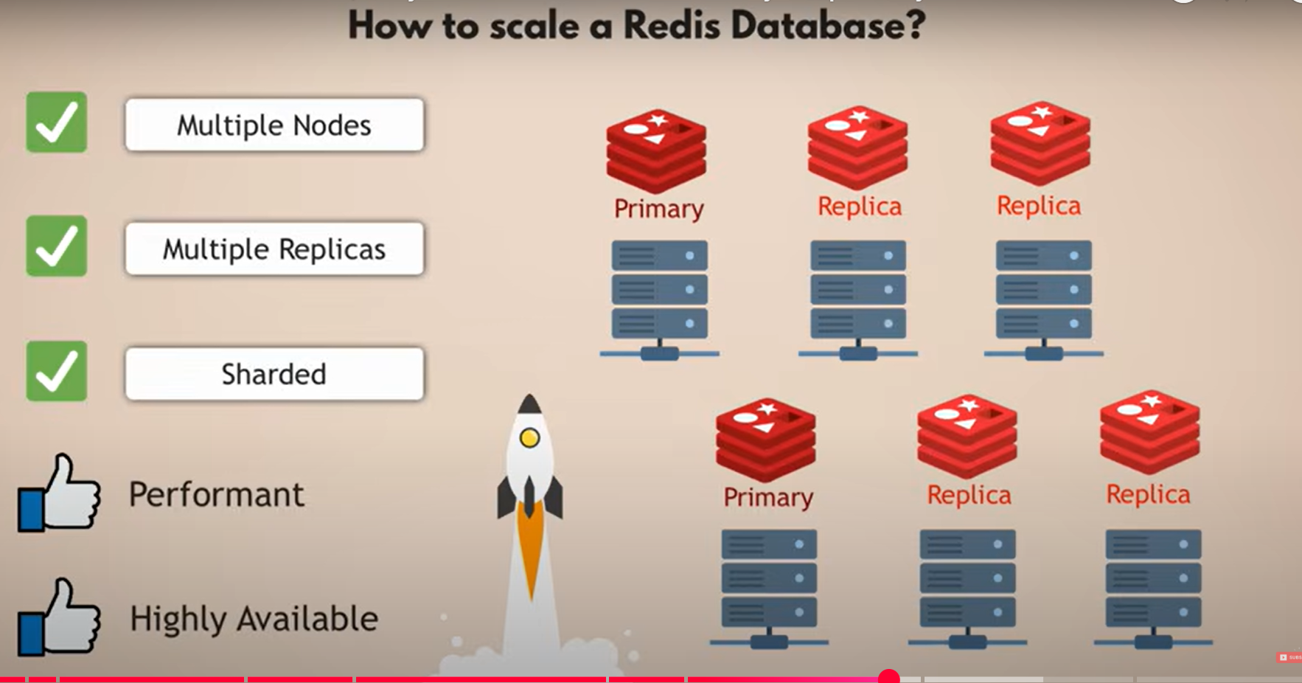
Scaling (Sharding + Replication)
Shard A
Shard B

Slide 6
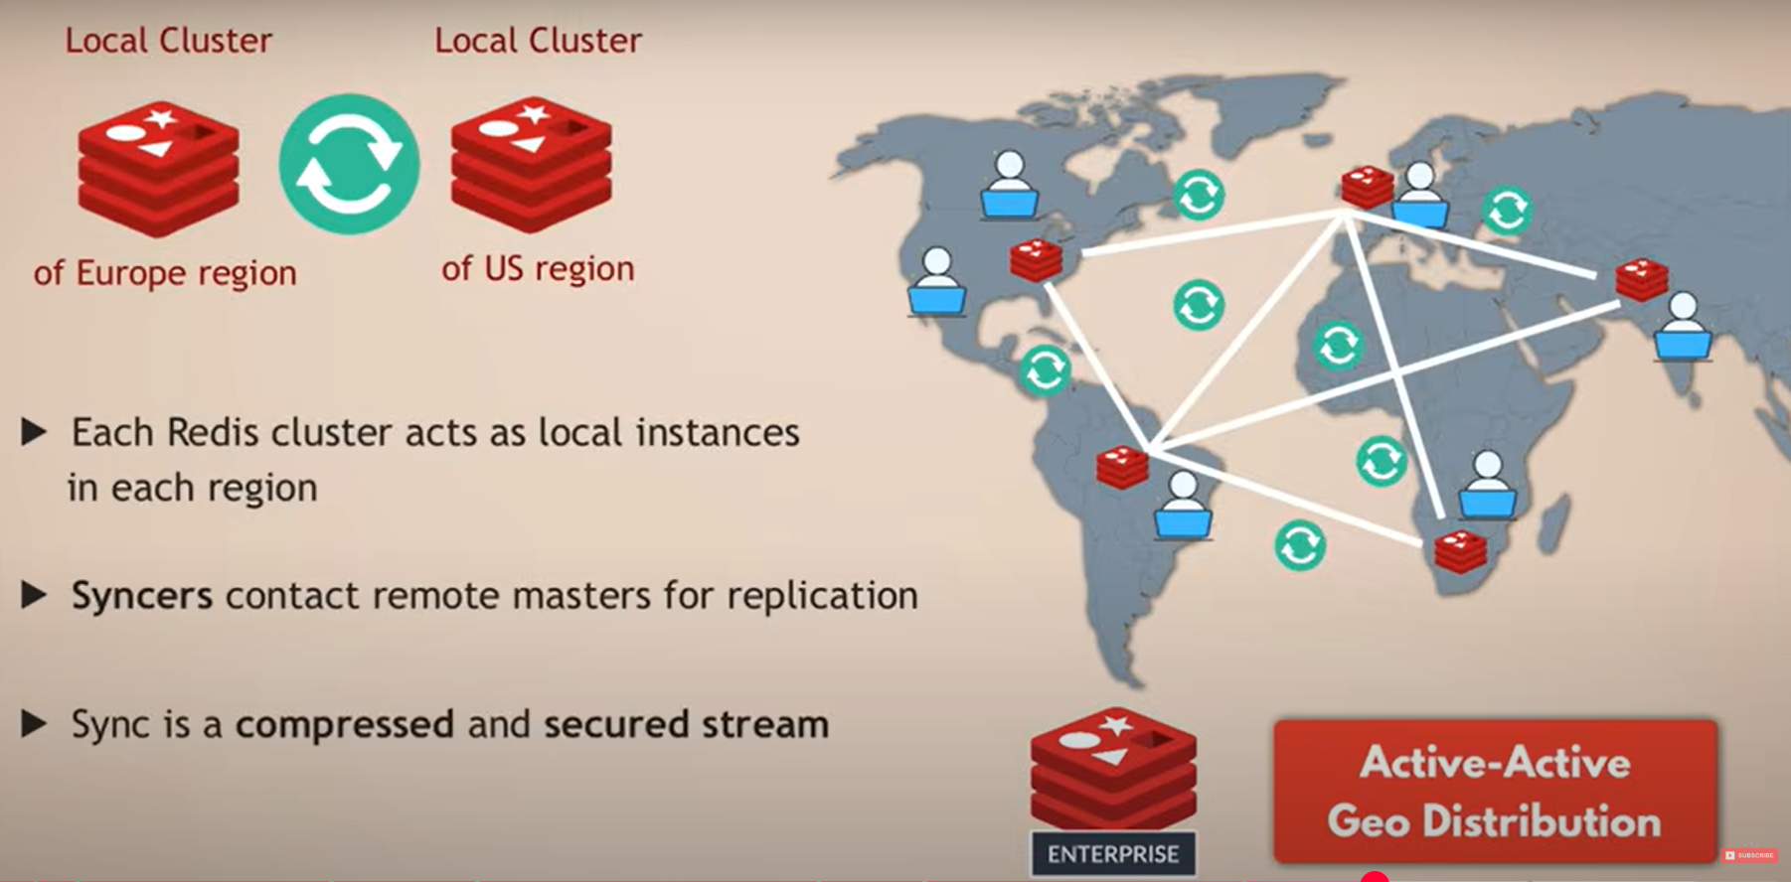
HA – Active-Active Geo Distribution

Slide 7
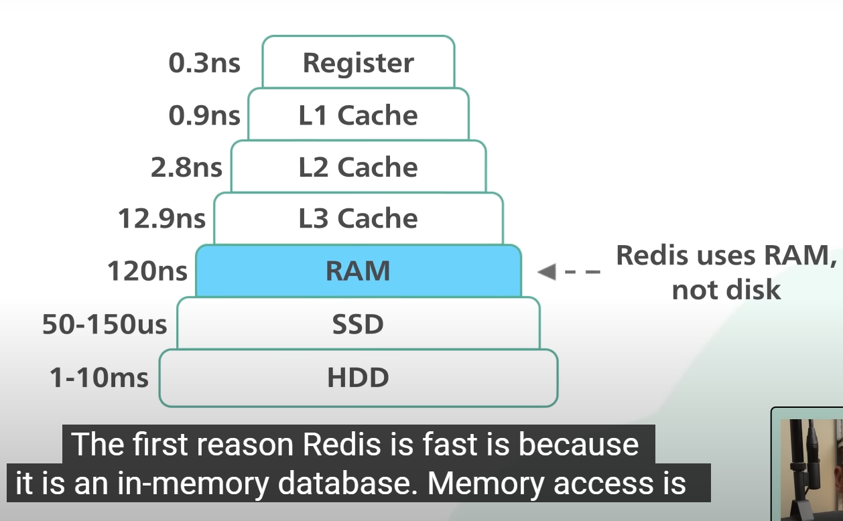
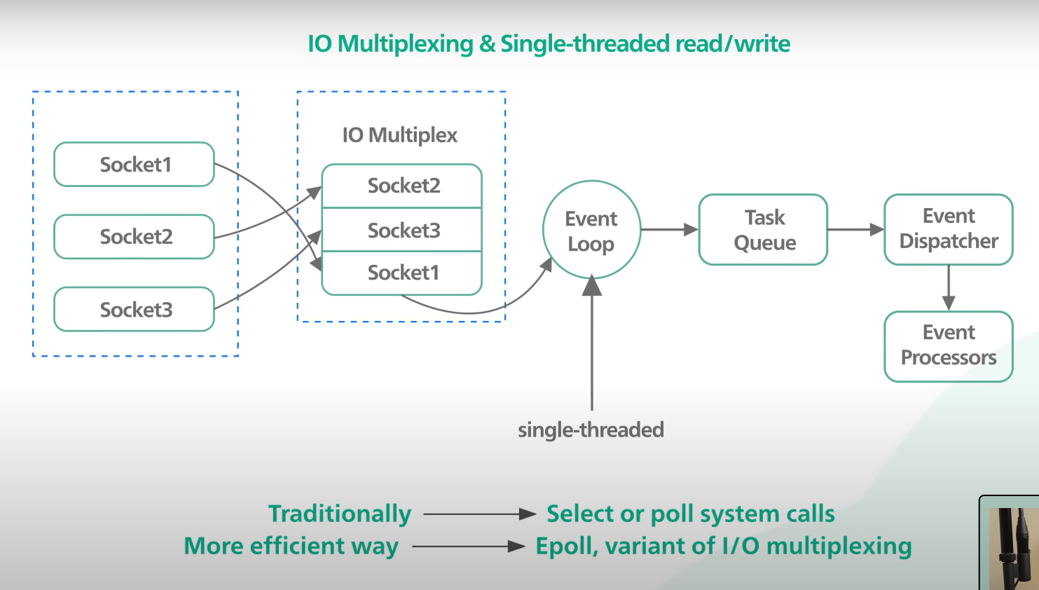
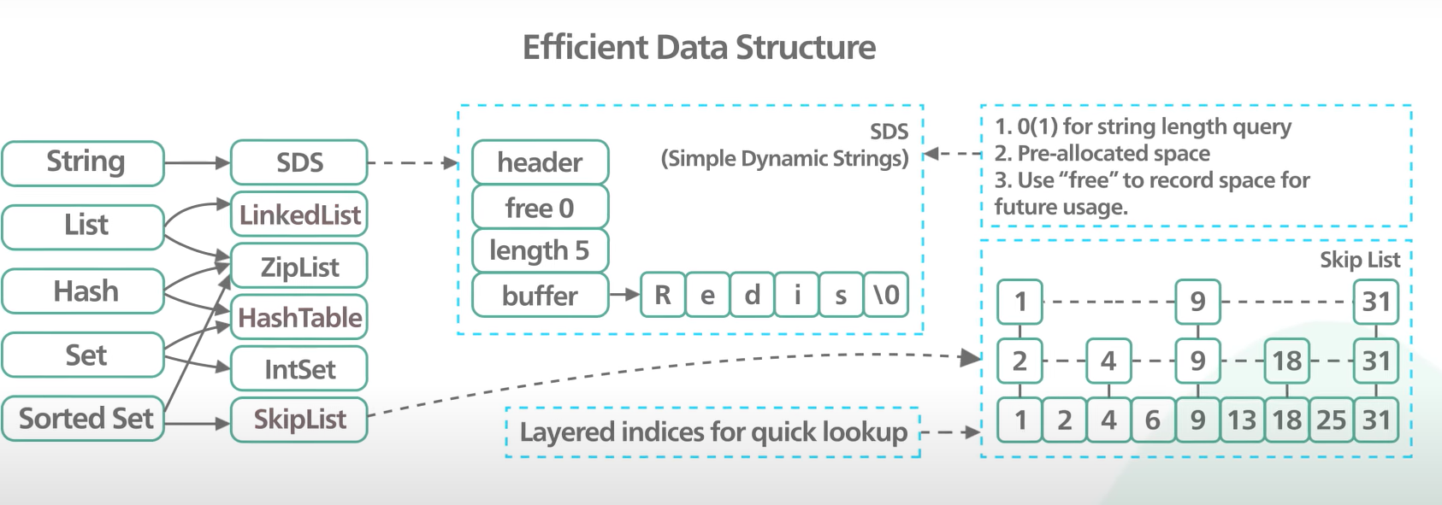
Why is Redis Fast
1. Memory based (obviously)
2. Single Event Loop above avoids complexity of multi threaded pessimistic locking. It uses IO Multiplexing to achieve concurrency
3. Efficient data structures that don’t need to worry about persisting to disk

Slide 8
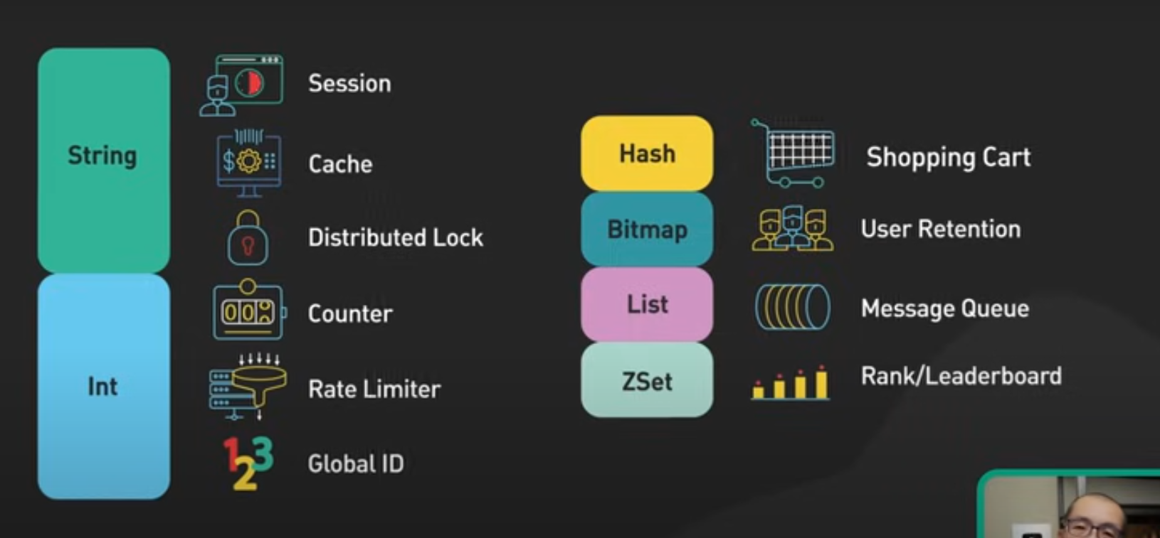
Top Use Cases

Slide 9
References
https://www.youtube.com/watch?v=OqCK95AS-YE
https://www.youtube.com/watch?v=5TRFpFBccQM

