Slide 1
BPMN
Ayan Sengupta

Slide 2
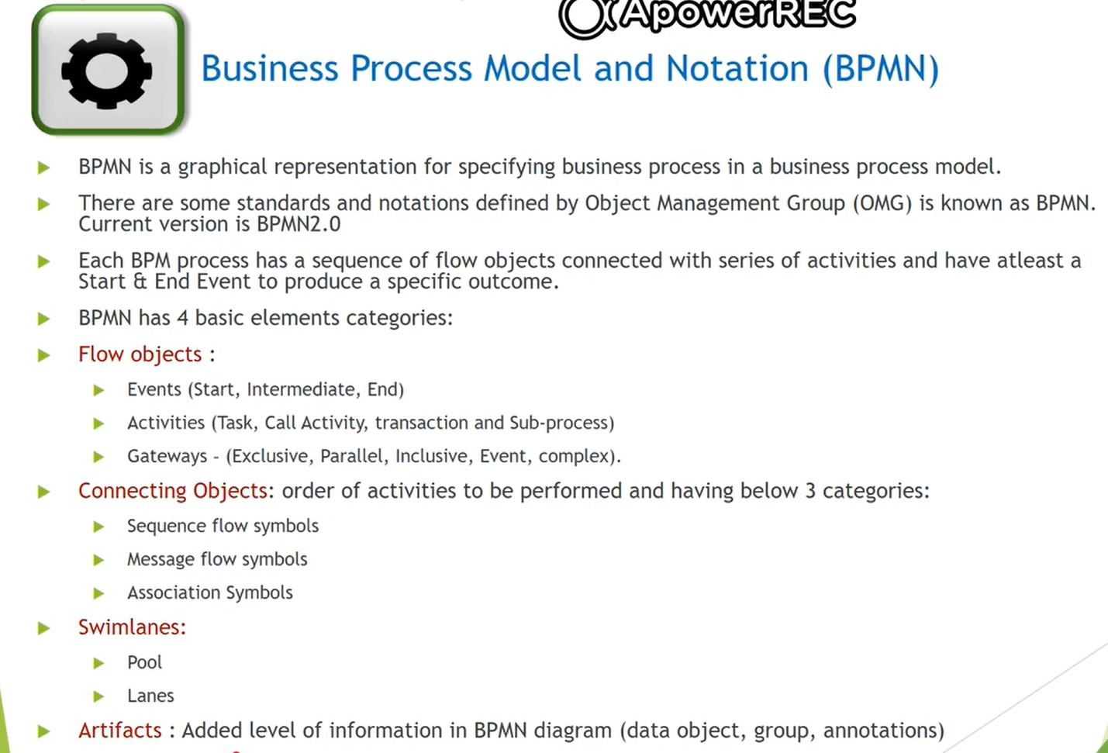

Slide 3
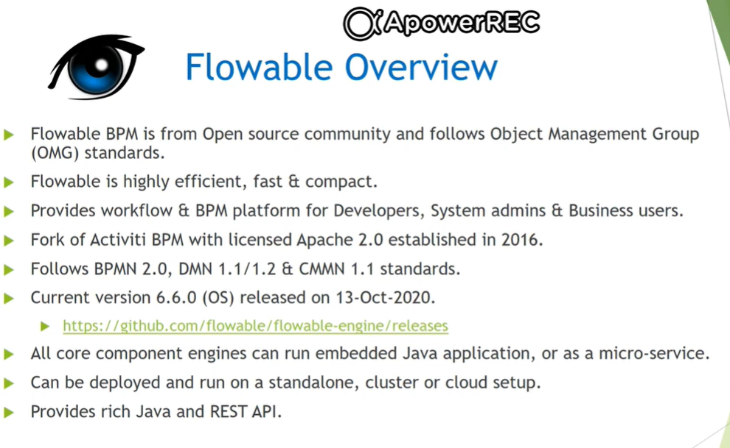

Slide 4
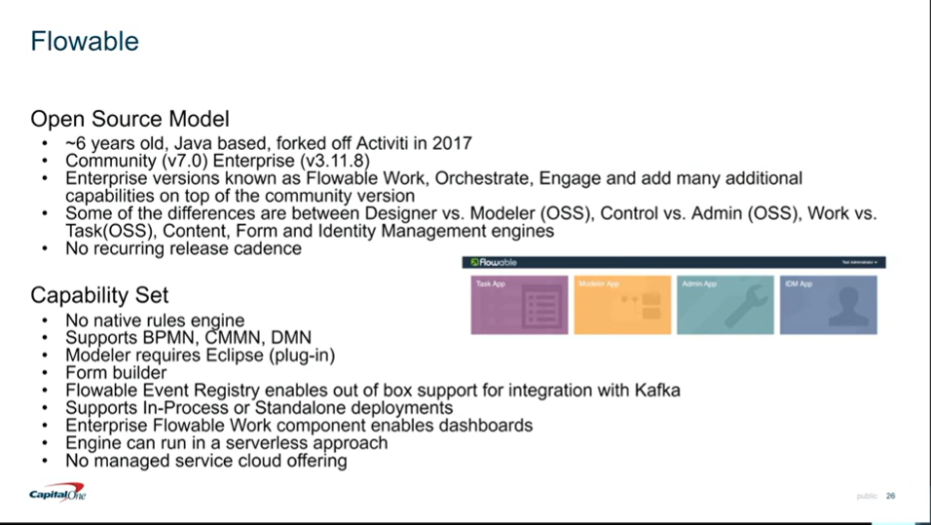
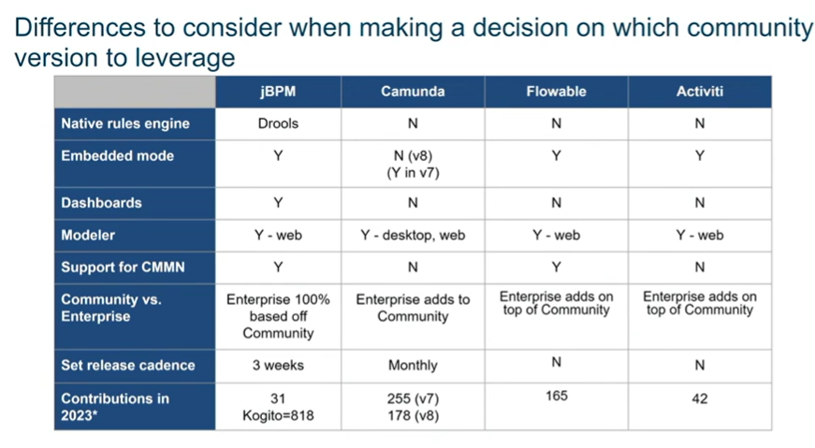
Comparison
https://www.youtube.com/watch?v=4MtpLt39WQU

Slide 5
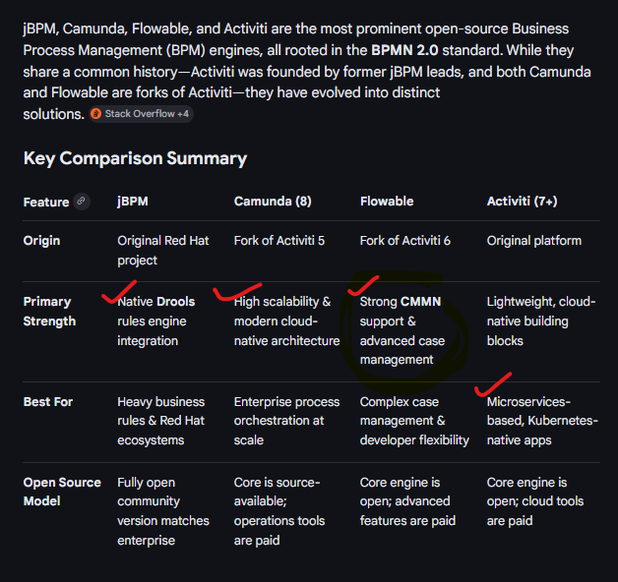
Comparison - General
Detailed Product Insights
1. jBPM (by Red Hat)
Unique Selling Point: It is the only engine with a built-in Business Rules Management System (Drools), allowing for advanced rule-based decisioning out-of-the-box.
Architecture: Heavily investing in the Kogito project, which is a next-generation, cloud-native, and serverless-ready evolution of jBPM.
Licensing: Offers a very open model where the community version is essentially the enterprise version minus the Red Hat support.
2. Camunda
Focus: Shifting toward Process Orchestration. With Camunda 8, it moved to a standalone-only mode (using the Zeebe engine) to solve scalability issues often found in embedded deployments.
Collaboration: Provides excellent tools like the Camunda Modeler for developer-business alignment.
Deployment: No longer supports an "embedded" Java mode in version 8, favoring a remote engine approach for better microservices isolation.
3. Flowable
Case Management: Offers the most robust support for CMMN (Case Management Model and Notation) and DMN, making it ideal for processes that aren't strictly linear.
Performance: Refactored the original Activiti engine into a "v6 engine" that provides more predictable and consistent execution scopes.
Developer Friendly: Known for its lightweight footprint and ease of running in serverless environments like AWS Lambda.
4. Activiti (Alfresco)
Cloud Native: The current version (Activiti 7) is built from the ground up for Kubernetes and Docker, focusing on being a set of "cloud-native building blocks".
History: After the Flowable fork in 2016, the original Activiti project became quieter but has since reinvented itself as a lightweight automation platform for modern infrastructures.

Slide 6
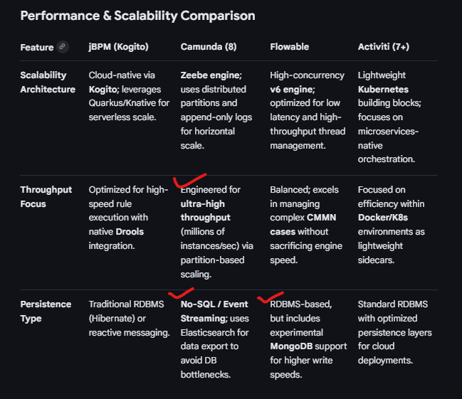

Slide 7
References
https://www.youtube.com/watch?v=mEQzR9cTnn8&list=PLOjnr_4lopxbTz-W1rF9PiYU2JYjqCUMw&index=2
https://www.youtube.com/watch?v=wa4ehhzYZrA&list=PLOjnr_4lopxbTz-W1rF9PiYU2JYjqCUMw&index=4

