Slide 1
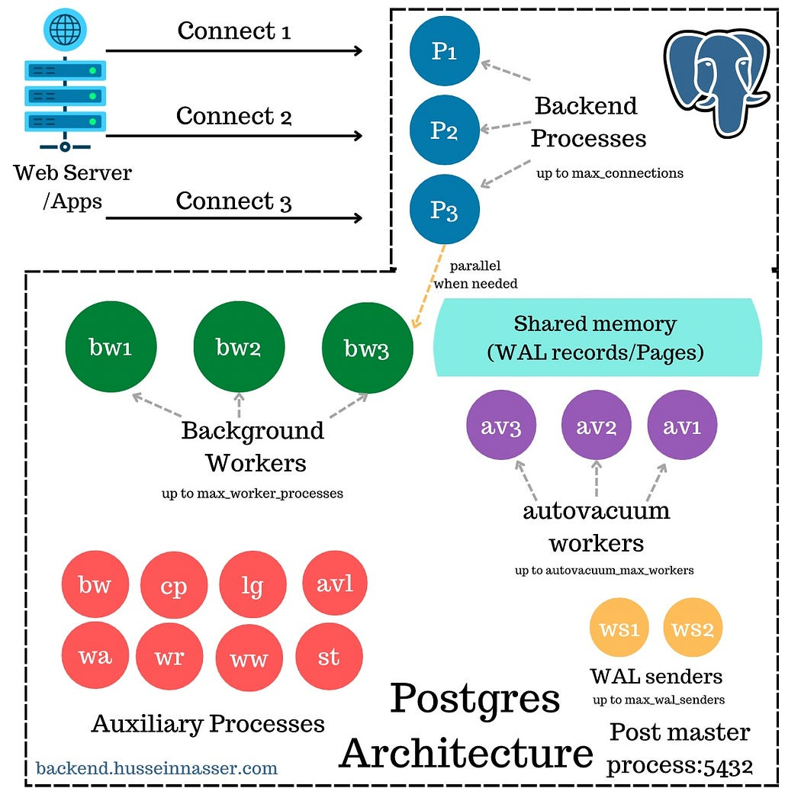

Slide 2
Repmgr

Slide 3
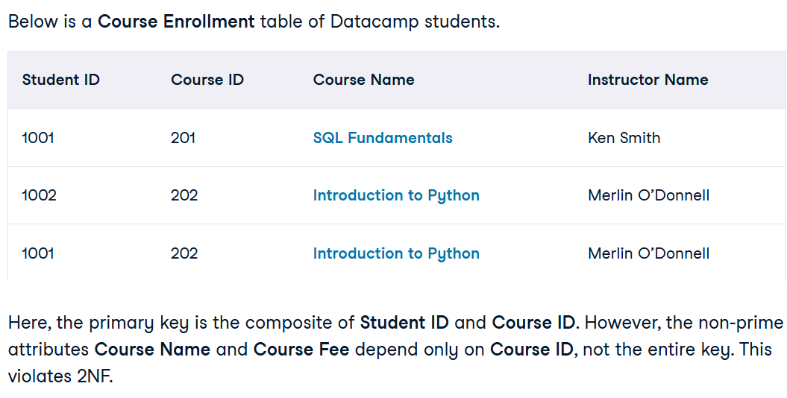
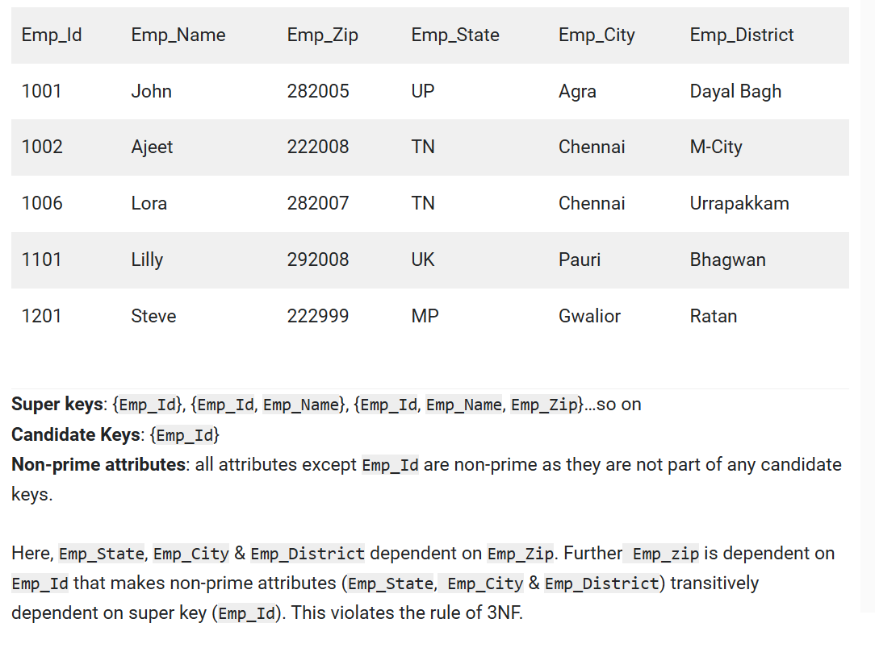
Normalization
1NF : domain of an attribute should have only atomic values
2NF: 1NF + No non-prime attribute is dependent on the proper subset of any candidate key of table. i.e. No partial dependency on the key.
3NF : 2NF + Transitive functional dependency of non-prime attribute on any super key should be removed.

Slide 4
Reference
https://medium.com/@hnasr/postgresql-process-architecture-f21e16459907
https://www.postgresql.org/docs/current/tutorial-arch.html
https://www.youtube.com/watch?v=XzAP6LqXg9o&list=PLwxrtuGg5dNGv4jvDY3TEddn2HIn4-uF9&index=8

