Slide 1
Wildlife Detection And Monitoring
1)MUTHU BANGARU.N –RA2111003011163
2)KOUSHIK MAHATO-RA2111003011164
3)ARVIND KRISHNA-RA2111003011165

Slide 2
Abstract
Wildlife detection and monitoring are crucial for conservation efforts, biodiversity studies, and understanding ecological dynamics.
Firstly, traditional methods such as camera traps, radio telemetry, and acoustic monitoring are discussed, highlighting their continued relevance alongside technological innovations.
Next, the integration of remote sensing, including satellite imagery and drones, is explored, demonstrating their utility in large-scale habitat assessment and population estimation.
Additionally, the role of sensor networks, bioacoustics, and environmental DNA (eDNA) in wildlife detection is examined, showcasing their potential for real-time monitoring and species inventorying.

Slide 3
Abstract
In conclusion, this review underscores the transformative impact of technological advancements on wildlife detection and monitoring, emphasizing the need for interdisciplinary approaches and collaborative efforts to address conservation challenges and safeguard global biodiversity.
the landscape of wildlife detection and monitoring has undergone a remarkable transformation fueled by technological innovation.
Ultimately, the future of wildlife detection and monitoring lies in our ability to harness the full potential of emerging technologies while remaining grounded in ethical principles and a commitment to sustainability.

Slide 4
Introduction
Wildlife detection and monitoring play pivotal roles in understanding ecosystems, conserving biodiversity, and mitigating human-wildlife conflicts.
Over the past decades, advancements in technology have revolutionized the methodologies and capabilities within this field, offering unprecedented opportunities for researchers, conservationists, and policymakers alike.
In this rapidly evolving landscape, the symbiotic relationship between technology and conservation science is becoming increasingly evident. From the deployment of camera traps and radio telemetry to the utilization of satellite imagery and artificial intelligence, the toolbox available for wildlife researchers is expanding at an unprecedented pace.

Slide 5
Introduction
Moreover, the democratization of technology through citizen science initiatives and community engagement has empowered individuals worldwide to contribute meaningfully to wildlife monitoring efforts. By fostering collaboration and knowledge sharing, these grassroots initiatives are transforming the way we perceive and address conservation challenges.
However, alongside these advancements come ethical considerations and challenges. Balancing the benefits of data-driven insights with the need to respect wildlife privacy and welfare remains a critical issue. Furthermore, ensuring the equitable distribution of resources and access to technology is essential for fostering inclusive and sustainable conservation practices.
As we embark on this exploration of wildlife detection and monitoring, it is essential to recognize the interconnectedness of ecological systems and human societies.

Slide 6
Motivation
Conservation Imperative: The alarming rates of species decline and habitat loss underscore the urgent need for effective conservation strategies. Wildlife detection and monitoring provide essential data for assessing population trends, identifying conservation priorities, and implementing targeted interventions to protect vulnerable species and ecosystems.
Ecosystem Health: Wildlife plays integral roles in ecosystem functioning, from regulating populations of prey species to influencing nutrient cycling and seed dispersal. Monitoring wildlife populations and behaviors allows us to gauge the health and resilience of ecosystems, thereby informing management practices aimed at preserving ecosystem services and biodiversity.
Human-Wildlife Conflict Mitigation: As human populations expand and encroach upon natural habitats, conflicts between humans and wildlife escalate. Monitoring wildlife movements and behaviors helps identify areas of conflict, develop mitigation strategies, and foster coexistence between humans and wildlife, ultimately reducing negative interactions and promoting community livelihoods.

Slide 7
Motivation
Public Engagement and Education: Wildlife detection and monitoring initiatives offer opportunities for public engagement and education. Citizen science projects, in particular, empower individuals to contribute to scientific research, raise awareness about conservation issues, and foster a sense of stewardship towards the environment.
Global Challenges: Climate change, habitat fragmentation, invasive species, and other anthropogenic pressures pose significant threats to wildlife worldwide. Effective detection and monitoring programs provide essential data for understanding and responding to these challenges, informing adaptive management strategies and policy decisions at local, regional, and global scales.
Scientific Discovery: Studying wildlife provides invaluable insights into animal behavior, evolutionary processes, and ecological dynamics. Advanced monitoring technologies enable researchers to uncover new discoveries, refine ecological theories, and expand our understanding of the natural world.

Slide 8
Literature Review: Advancements in Wildlife Detection and Monitoring
Traditional Methods: Historically, wildlife detection relied heavily on manual observation, trapping, and tracking techniques. Camera traps emerged as a game-changer, enabling non-invasive monitoring of wildlife populations and behaviors.
Artificial Intelligence and Machine Learning: Recent advancements in artificial intelligence (AI) and machine learning (ML) have revolutionized data analysis and interpretation in wildlife monitoring. AI-powered algorithms can automate species identification, behavior recognition, and data processing tasks, significantly reducing the time and effort required for data analysis.
Challenges and Future Directions: Despite the numerous advancements in wildlife detection and monitoring, several challenges remain, including data integration, standardization of methodologies, and ethical considerations. Addressing these challenges requires interdisciplinary collaboration, capacity building, and the development of innovative solutions tailored to specific conservation contexts. Moving forward, future research should focus on integrating emerging technologies, enhancing data sharing mechanisms, and implementing adaptive management strategies to address conservation priorities effectively.

Slide 9
Challenges and Limitations in Existing Wildlife Detection and Monitoring Systems:
Data Integration and Standardization: One of the primary challenges in wildlife monitoring is the integration and standardization of data collected from diverse sources and methodologies. Different monitoring programs may use varying protocols, sampling techniques, and data formats, making it difficult to compare and synthesize findings across studies. Harmonizing data standards and promoting interoperability among monitoring initiatives is essential for maximizing the utility of collected data.
Technological Constraints: Despite significant advancements, technological limitations still pose challenges in wildlife detection and monitoring. Remote sensing technologies may be constrained by cloud cover, sensor resolution, and data processing capabilities. Similarly, field-deployed monitoring devices, such as camera traps and acoustic sensors, may face challenges related to battery life, data transmission, and environmental durability, limiting their effectiveness in
long-term monitoring applications.
Spatial and Temporal Coverage: Achieving adequate spatial and temporal coverage remains a challenge in wildlife monitoring, particularly in remote or inaccessible regions. Limited resources and logistical constraints may restrict the deployment of monitoring equipment and the frequency of data collection efforts. As a result, gaps in spatial coverage and temporal resolution may hinder the comprehensive understanding of wildlife populations and their habitats.

Slide 10
Objectives of the Project:
Enhance Wildlife Conservation: The primary objective of the project is to contribute to the conservation of wildlife and biodiversity by implementing effective detection and monitoring strategies.
Improve Data Collection and Analysis: Another key objective is to improve the efficiency, accuracy, and reliability of wildlife data collection and analysis. This includes deploying advanced monitoring technologies, optimizing sampling protocols, and integrating diverse datasets to generate comprehensive insights into wildlife populations, behaviors, and ecological dynamics.
Enhance Technological Integration: The project aims to leverage cutting-edge technologies, such as remote sensing, artificial intelligence, and environmental DNA analysis, to enhance wildlife detection and monitoring capabilities.
Promote Collaboration and Capacity Building: The project seeks to foster collaboration among stakeholders, including researchers, conservation practitioners, government agencies, and local communities.
Raise Awareness and Engagement: Lastly, the project aims to raise awareness about wildlife conservation issues and engage stakeholders in conservation action. This involves conducting outreach and education campaigns, fostering citizen science participation, and promoting public involvement in wildlife monitoring and conservation initiatives.

Slide 11
Innovation Idea for the Project: "Smart Wildlife Monitoring Network"
The innovation idea for the project involves the development and implementation of a "Smart Wildlife Monitoring Network" (SWMN) that integrates cutting-edge technologies to enhance wildlife detection and monitoring capabilities. The SWMN utilizes a combination of sensor networks, artificial intelligence (AI), and Internet of Things (IoT) devices to collect, analyze, and disseminate real-time data on wildlife populations and their habitats.
Artificial Intelligence (AI): Develop AI-powered algorithms for automated species detection, classification, and behavior recognition based on data collected from sensor networks. Machine learning techniques will enable the system to distinguish between different species, identify individual animals, and track their movements over time.
Benefits:
Enhances Wildlife Conservation: The SWMN provides comprehensive data on wildlife populations and their habitats, enabling evidence-based conservation decision-making and adaptive management strategies.
Improves Efficiency and Accuracy: Automation and real-time monitoring capabilities increase the efficiency and accuracy of wildlife data collection and analysis, reducing resource requirements and enhancing data quality.
Provides researchers with access to high-resolution wildlife monitoring data, facilitating ecological research, and contributing to scientific knowledge and understanding of ecosystem dynamics.

Slide 12
Scope and Application of the Project:
The scope of the project extends across various aspects of wildlife conservation and management, with applications spanning terrestrial, aquatic, and aerial environments.
The project's innovative approach to wildlife detection and monitoring offers broad-ranging implications for biodiversity conservation, ecosystem management, scientific research, and community engagement.
Overall, the scope and application of the project are multifaceted, encompassing a wide range of activities and stakeholders involved in wildlife conservation and management.
By integrating innovative technologies, scientific research, community engagement, and policy support, the project aims to advance biodiversity conservation and promote sustainable development practices that benefit both people and nature.

Slide 13
Architecture of the Wildlife Monitoring Network:
Sensor Nodes: Sensor nodes are deployed across targeted wildlife habitats and equipped with various sensors, including cameras, acoustic sensors, GPS trackers, and environmental sensors.
Artificial Intelligence (AI) Algorithms: AI-powered algorithms are developed for automated species detection, classification, and behavior recognition based on data collected from sensor networks.
Internet of Things (IoT) Devices: IoT devices, such as drones, mobile applications, and environmental monitoring stations, complement sensor networks by providing additional data sources and functionalities.
Security and Privacy Measures: Security and privacy measures, including encryption, access control, and data anonymization, are implemented to protect sensitive wildlife data and ensure compliance with privacy regulations.

Slide 14
Proposed Modules and Algorithm Descriptions for the Wildlife Monitoring Network
Automated Species Detection Module: Algorithm Description: This module utilizes artificial intelligence (AI) algorithms to automatically detect and classify wildlife species from sensor data streams. The algorithm employs machine learning techniques, such as deep learning and convolutional neural networks (CNNs), trained on labeled datasets to recognize species-specific features and patterns.

Slide 15

UML Diagrams

Slide 16
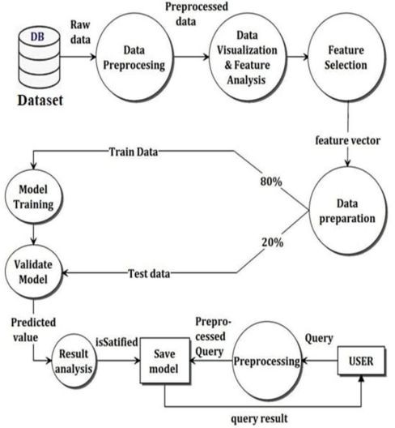

Slide 17
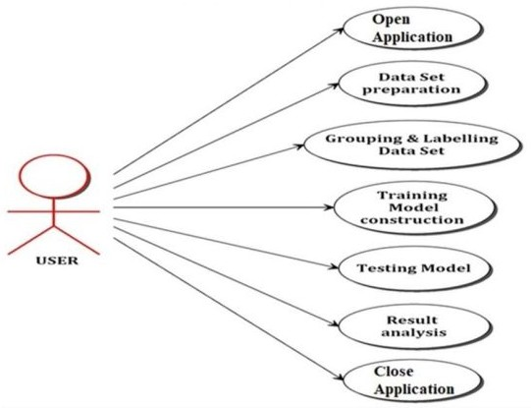

Slide 18
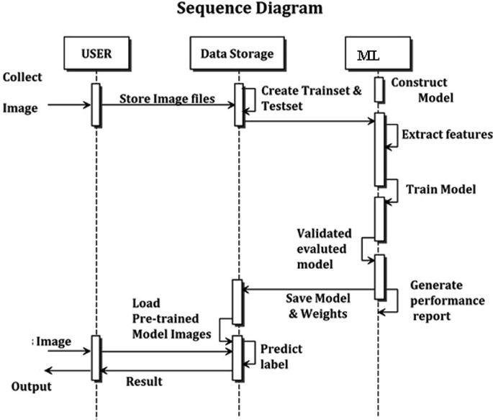

Slide 19
THANK YOU

