Slide 1
ESTIMATING TFP
Using the ENTERPRISE SURVEYS
Kuala Lumpur

Slide 2
Estimation of total factor productivity (TFP)
Explanation of outputs not explained by the use of inputs (capital, labor, intermediates)
The use of micro-level data allows researchers to explore how TFP varies over heterogeneous firm characteristics
…But the estimation faces difficulties
Lack of data coverage
Wide variance even within narrowly defined industries (Syverson 2011)
Data are often only available in monetary terms… revenues (P*Q) not widgets (Q)
Endogeneity problems (a productive firm sets its capital and labor inputs knowing its underlying efficiency)

Slide 3
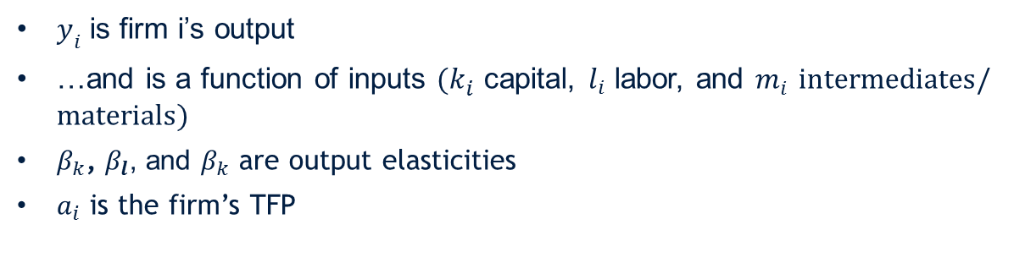
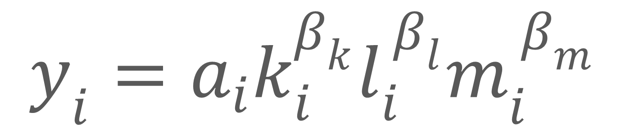
Cobb-Douglas Production Function
$y_{i}=a_{i}k_{i}^{β_{k}}l_{i}^{ β_{l}}m_{i}^{ β_{m}}$
$y_{i}$ is firm i’s output
…and is a function of inputs $(k_{i}^{ }$ capital, $l_{i}^{ }$ labor, and $m_{i }^{ }intermediates/materials)$
$β_{k}$, $β_{l}$, and $β_{k}$ are output elasticities
$a_{i}$ is the firm’s TFP

Slide 4
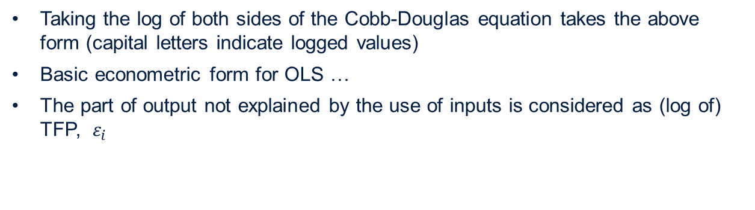
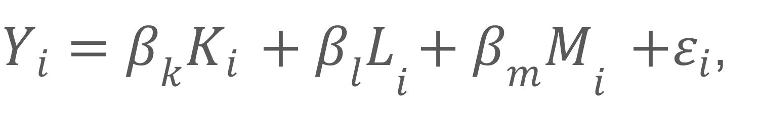
Estimation
$Y_{i}=β_{k}K_{i}{ + β_{l}L}_{i}{+ β_{m}M}_{i }+ε_{i}$,
Taking the log of both sides of the Cobb-Douglas equation takes the above form (capital letters indicate logged values)
Basic econometric form for OLS …
The part of output not explained by the use of inputs is considered as (log of) TFP, $ε_{i}$

Slide 5
Revenues, Not Widgets
Ideally we would want to know the physical units of output (widgets, Q) produced by physical inputs (workers, machines, and materials)
Why?
Prices of output and inputs can be ignored
The residual is closer to measuring only productivity …
Not market power
Nor brand recognition
But very often only monetary measures are available
Revenues (P*Q) for Y
Must also use monetary measures for K (capital expenditure), L (wage bill), and M (cost of intermediates)
More likely in the case of multi-product producers and broad micro data sets
To distinguish this is often called Revenue TFP or TFPR (Foster et al 2008)

Slide 6
Use of the Enterprise Surveys to estimate TFP(R)
The ES are nationally representative survey data of the formal private sector …
The data link performance measures to measures of the business environment
…and can incorporate several firm characteristics
But sample sizes can be limited due to budget and non-response
By being representative, they can include widely different activities
Across sectors (garment manufacturing compared to electronics)
Within sectors (canning of fish and brewing of beer are both in the same grouping at the ISIC two-digit level)

Slide 7
Use of the Enterprise Surveys to estimate TFP(R), Cont’d
Previous efforts using ES to calculate TFP by the WBG
Calculate within each economy – assume that TFP varies across industries but their relative use of capital, labor, and materials do not
Auto manufacturing in India is more productive than textiles, but each are treated as if they have the same labor (capital, intermediates) intensity
NOTE: regressions run at the economy level, include industry dummies (very sensitive to industry definitions and availability by survey)
2) Calculate across economies – assume that average TFP differs by economy and by industry, but intensities are the same
NOTE: regressions run by pooling economies, include industry dummies. Less sensitive to industry definitions, but can only say the relative TFP difference between Ecuador and Equatorial Guinea

Slide 8
Current Estimation Method
3) Calculate TFP across economies within sectors – assumes that production functions are different across sectors (manufacturing of leather products is different than manufacturing of chemicals)
…AND that the average level of TFP differs by economy…

Slide 9
Current Estimation Method, Additional Issues
ISSUE 1:
Assumes the same output elasticities across all economies.
Equipment manufacturing in Sri Lanka uses the same technology as in Sweden
ISSUE 2:
Limited data coverage
ISSUE 3:
Use of survey weights
There are thousands more textile manufacturers in China
than in Costa Rica…are they counted the same?
ISSUE 4:
Outliers

Slide 10
Current Estimation Method, Additional Issues
ISSUE 1:
Assumes the same output elasticities across all economies.
Equipment manufacturing in Sri Lanka uses the same technology as in Sweden
Estimates run only within WBG income-level group…elasticities vary across these groups
ISSUE 2:
Limited data coverage
An industry-income group must have n>=120 to have an estimate. An economy-industry must have n>=15 to be included
ISSUE 3:
Use of survey weights
There are thousands more textile manufacturers in China
than in Costa Rica…are they counted the same?
Survey weights are used but not on a relative scale. In the estimation China has much more weight. Assume that technology is somewhat fungible
ISSUE 4:
Outliers
Variety of outlier procedures are performed to measure robustness

Slide 11
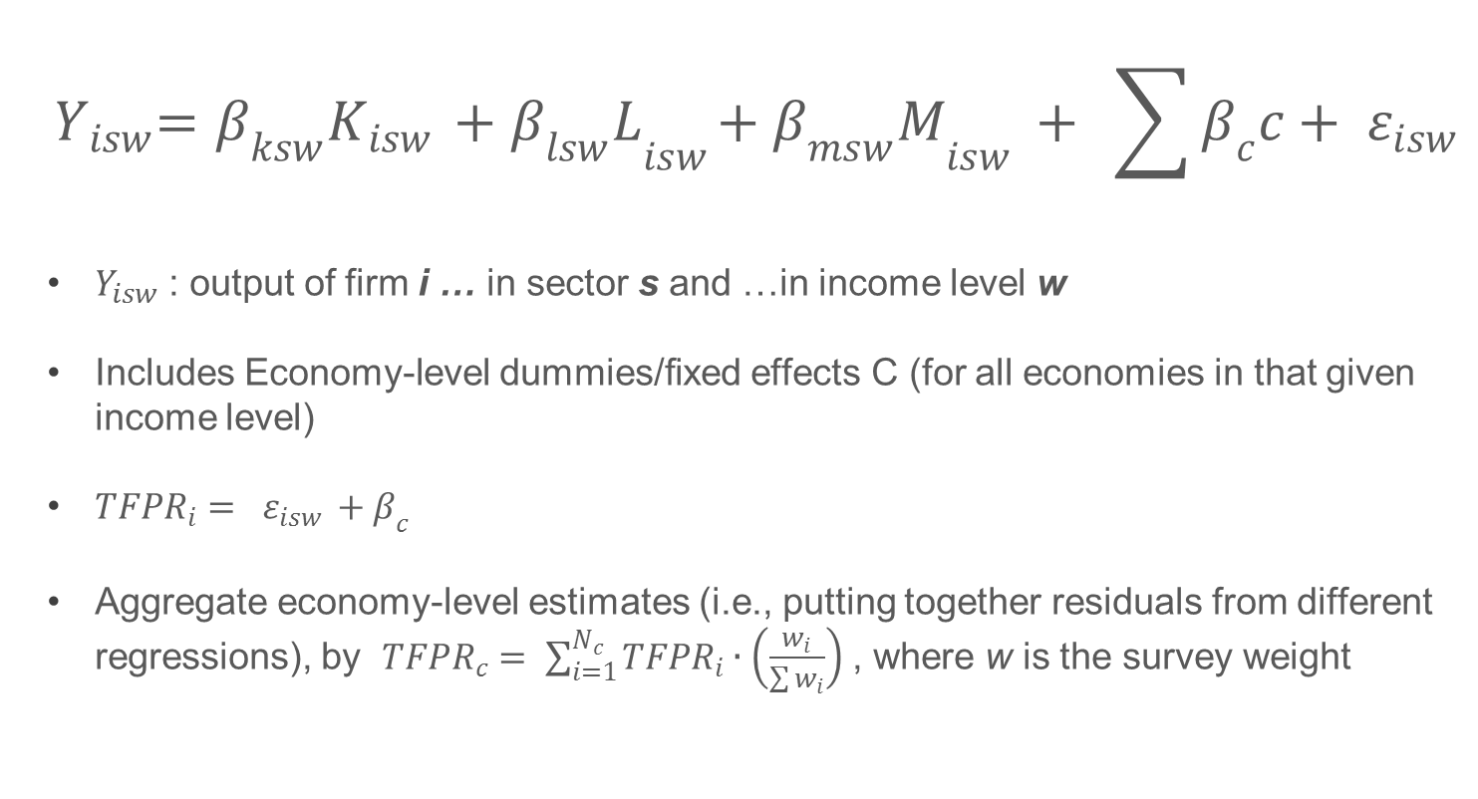
Econometrically…
$${ Y}_{isw}=β_{ksw}K_{isw}{ + β_{lsw}L}_{isw}{+ β_{msw}M}_{isw }+ \sum{β_{c}c}+ ε_{isw }$$
$Y_{isw}$ : output of firm i … in sector s and …in income level w
Includes Economy-level dummies/fixed effects C (for all economies in that given income level)
$TFPR_{i}= ε_{isw }+β_{c}$
Aggregate economy-level estimates (i.e., putting together residuals from different regressions), by $TFPR_{c}= \sum_{i=1}^{N_{c}}{TFPR_{i}∙\left(\frac{w_{i}}{\sum{w_{i}}}\right)}$ , where w is the survey weight

Slide 12
Issues not addressed
Estimations are based on reported data
No imputation…
…Nor allowance for non-response correlated with variables of interest
TFPR uses GDP-deflated data…not industry-specific deflators
Still uses the assumption that firms are alike within (2-digit) industries
Endogeneity…knowledge of productivity can affect input choices
ALLOW RESEARCHERS TO APPLY ADDITIONAL METHODS OR ASSUMPTIONS

Slide 13
Coverage
Argentina 2010 | 413 |  | Mexico 2010 | 965
Bahamas 2010 | 16 |  | Mongolia 2013 | 15
Bangladesh 2013 | 1031 |  | Morocco 2013 | 69
Belize 2010 | 25 |  | Mozambique 2007 | 286
Bhutan 2015 | 16 |  | Myanmar 2014 | 118
Bih 2013 | 16 |  | Nepal 2013 | 156
Brazil 2009 | 1022 |  | Nicaragua 2010 | 18
Burundi 2014 | 15 |  | Nigeria 2014 | 285
Cameroon 2009 | 15 |  | Pakistan 2013 | 109
Chile 2010 | 555 |  | Paraguay 2010 | 23
China 2012 | 1188 |  | Peru 2010 | 464
Colombia 2010 | 494 |  | Philippines 2009 | 286
Costarica 2010 | 109 |  | Romania 2013 | 17
Cote d'Ivoire 2009 | 26 |  | Russia 2012 | 333
Croatia 2013 | 18 |  | Senegal 2014 | 48
Dominican Republic 2010 | 17 |  | Slovenia 2013 | 15
Dom. Rep. Congo 2013 | 89 |  | South Africa 2007 | 634
Ecuador 2010 | 24 |  | South Sudan 2014 | 15
Egypt 2013 | 1377 |  | Sri Lanka 2011 | 207
Elsalvador 2010 | 26 |  | Stlucia 2010 | 18
Ethiopia 2015 | 188 |  | St Vincent and the Grenadines 2010 | 19
Fyrom 2013 | 20 |  | Suriname 2010 | 28
Georgia 2013 | 15 |  | Sweden 2014 | 175
Ghana 2013 | 169 |  | Tanzania 2013 | 52
Guatemala 2010 | 124 |  | Trinidad and Tobago 2010 | 15
Guinea 2006 | 107 |  | Tunisia 2013 | 170
Guinea Bissau 2006 | 19 |  | Turkey 2013 | 210
Guyana 2010 | 21 |  | Uganda 2013 | 25
Honduras 2010 | 17 |  | Ukraine 2013 | 125
India 2014 | 2849 |  | Uruguay 2010 | 122
Indonesia 2015 | 892 |  | Vietnam 2015 | 324
Iraq 2011 | 418 |  | West Bank And Gaza 2013 | 46
Israel 2013 | 60 |  | Yemen 2013 | 24
Jamaica 2010 | 49 |  | Zambia 2013 | 75
Jordan 2013 | 141
Kenya 2013 | 144
Lebanon 2013 | 43
Madagascar 2013 | 94
Mauritius 2009 | 72

Slide 14
What can be done: example from EAP
Food and Beverages
Garments
Minerals

