Slide 1
https://help.sap.com/viewer/65de2977205c403bbc107264b8eccf4b/Cloud/en-US/4902b6e66cbd42648b5d9eaddc6a363d.html?q=
https://qiita.com/ymaru/items/cf513ab05fe0ebac7d3b

Slide 2
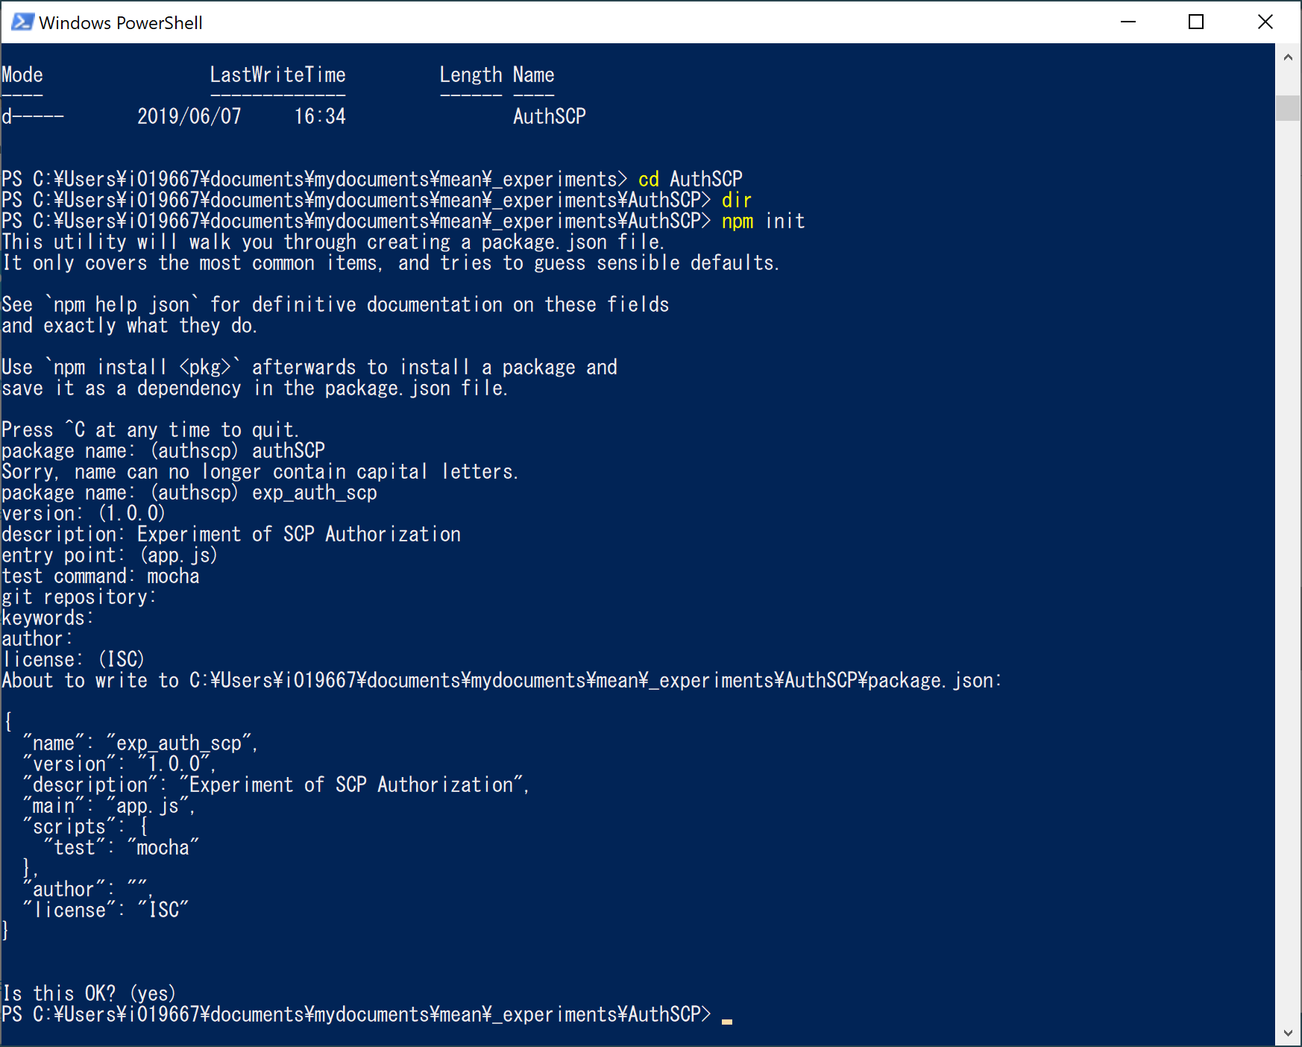

Slide 3
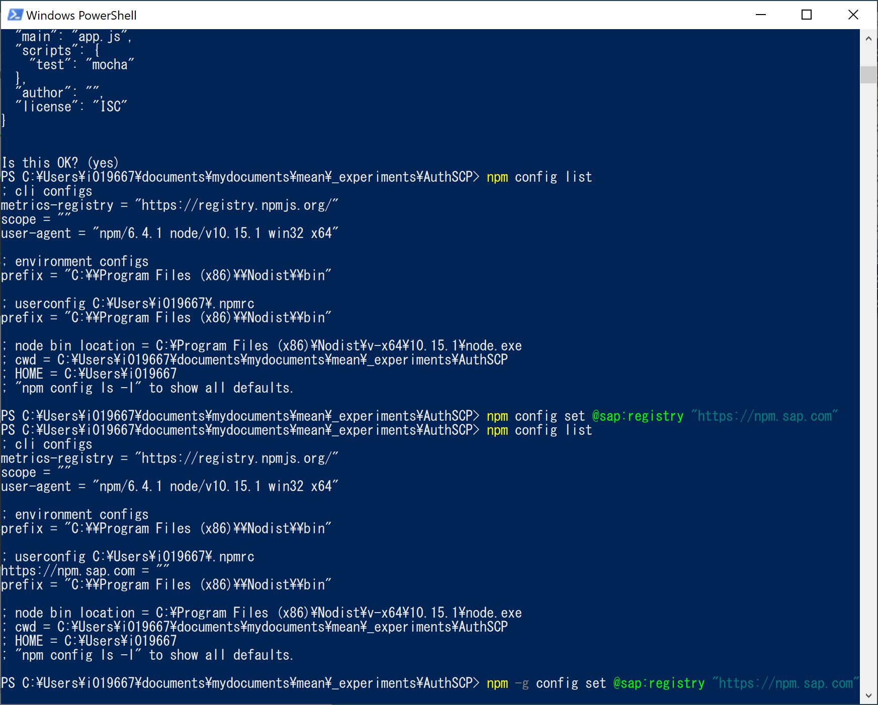
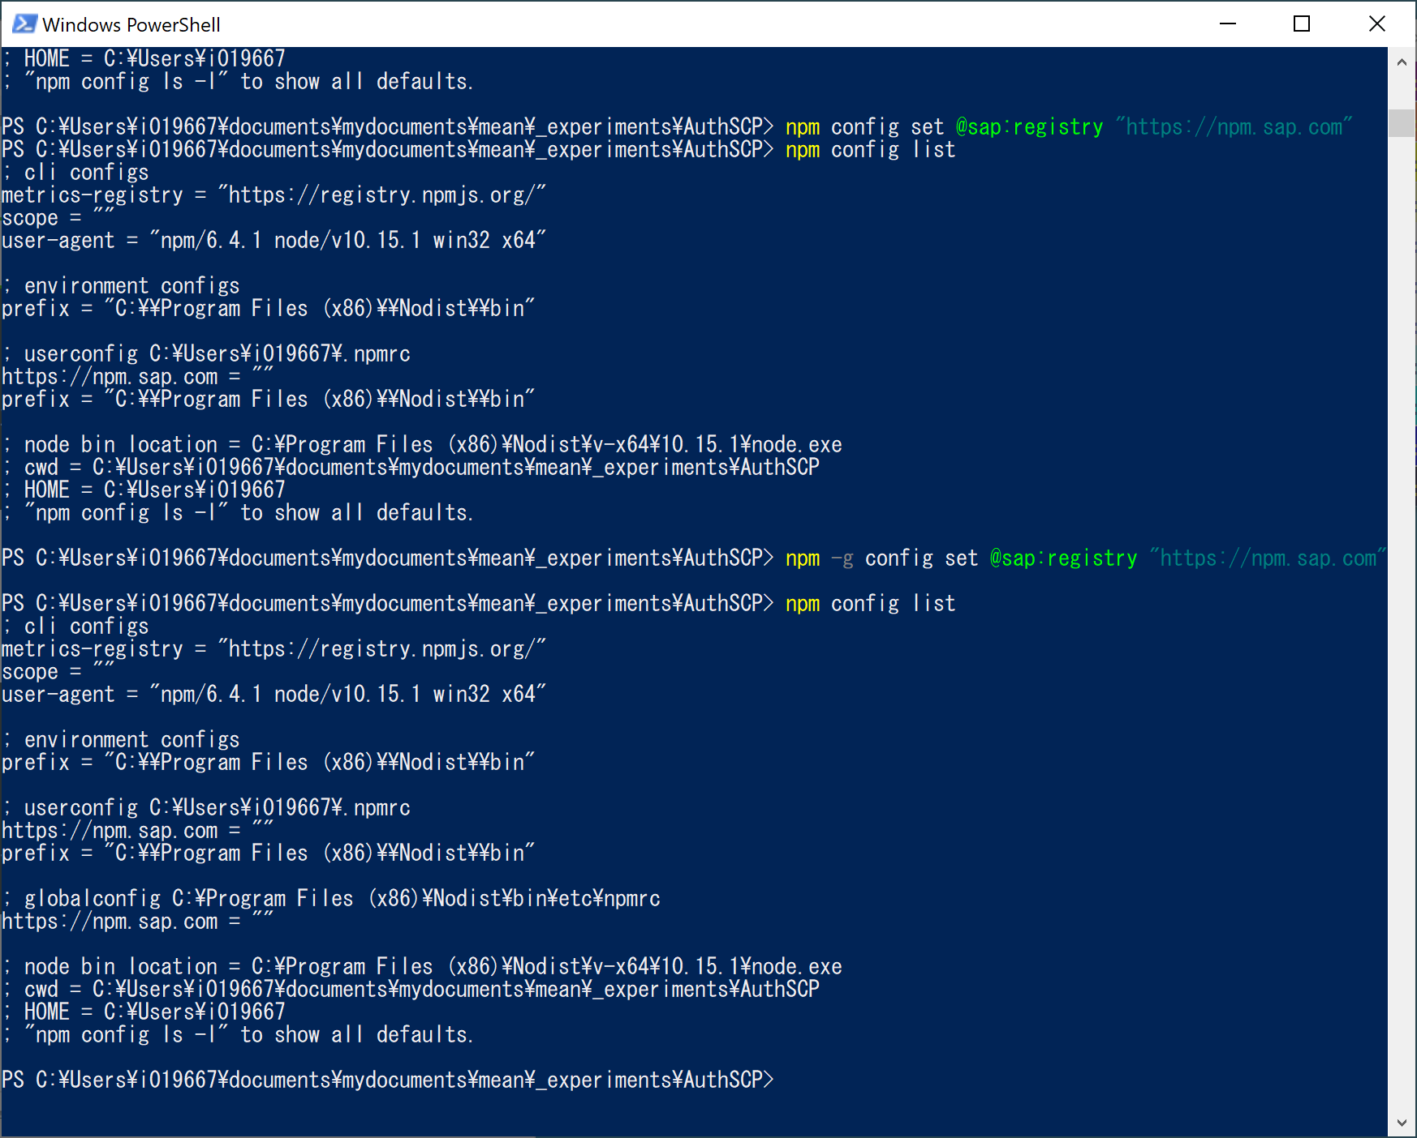

Slide 4
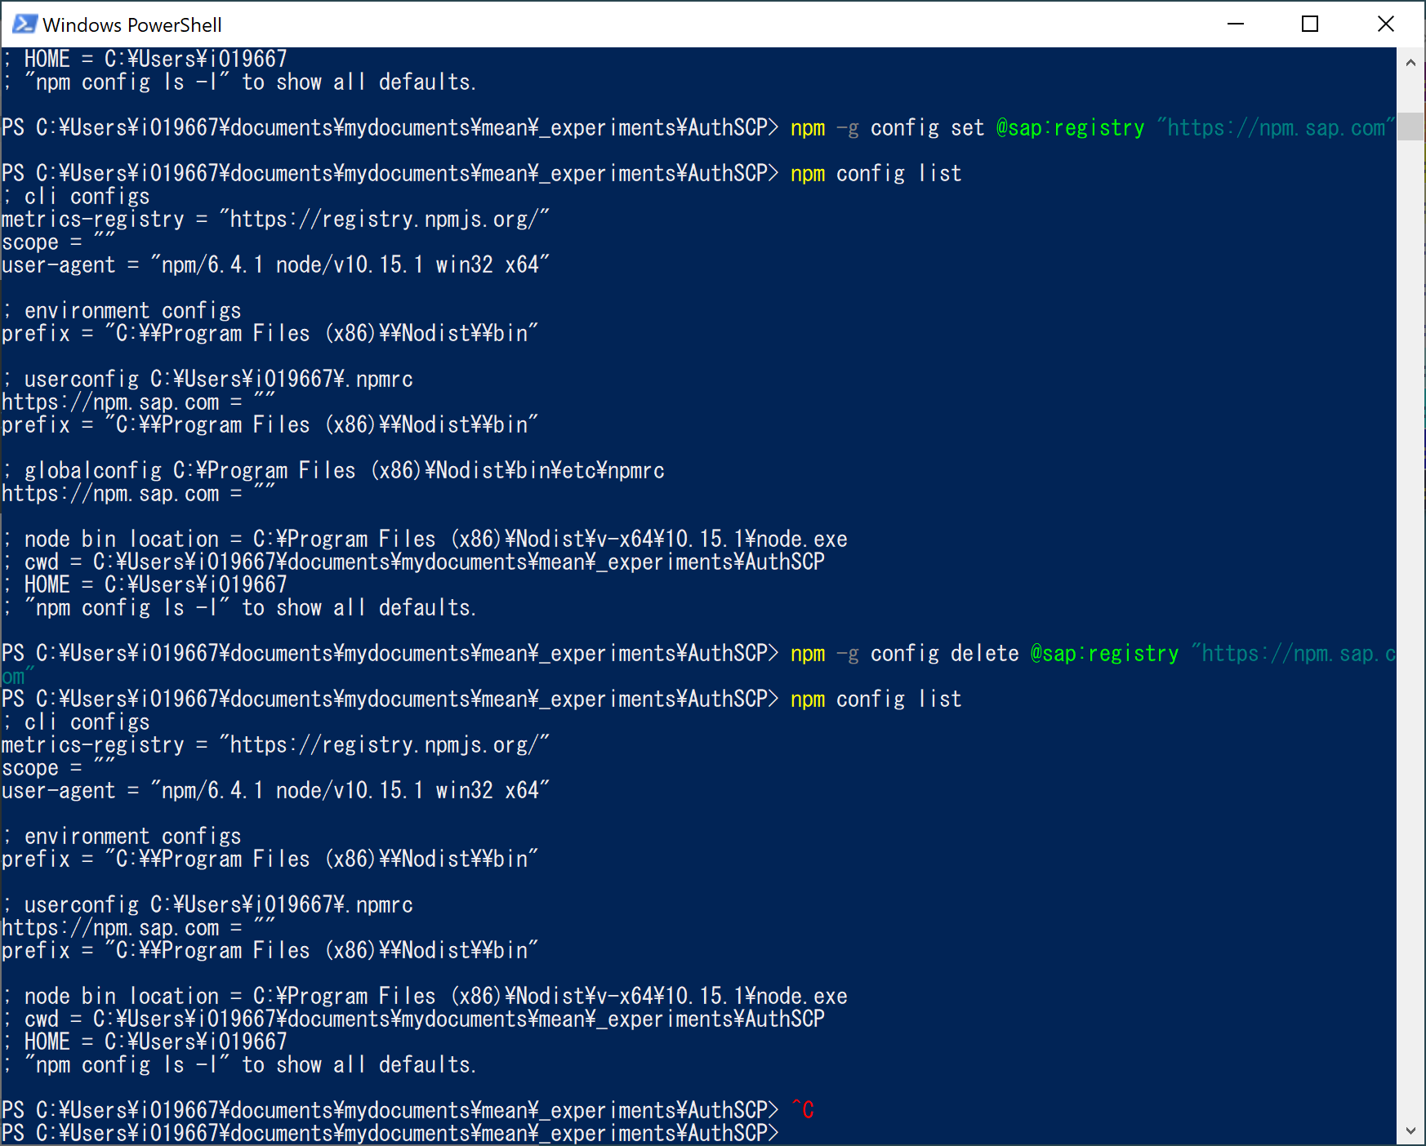
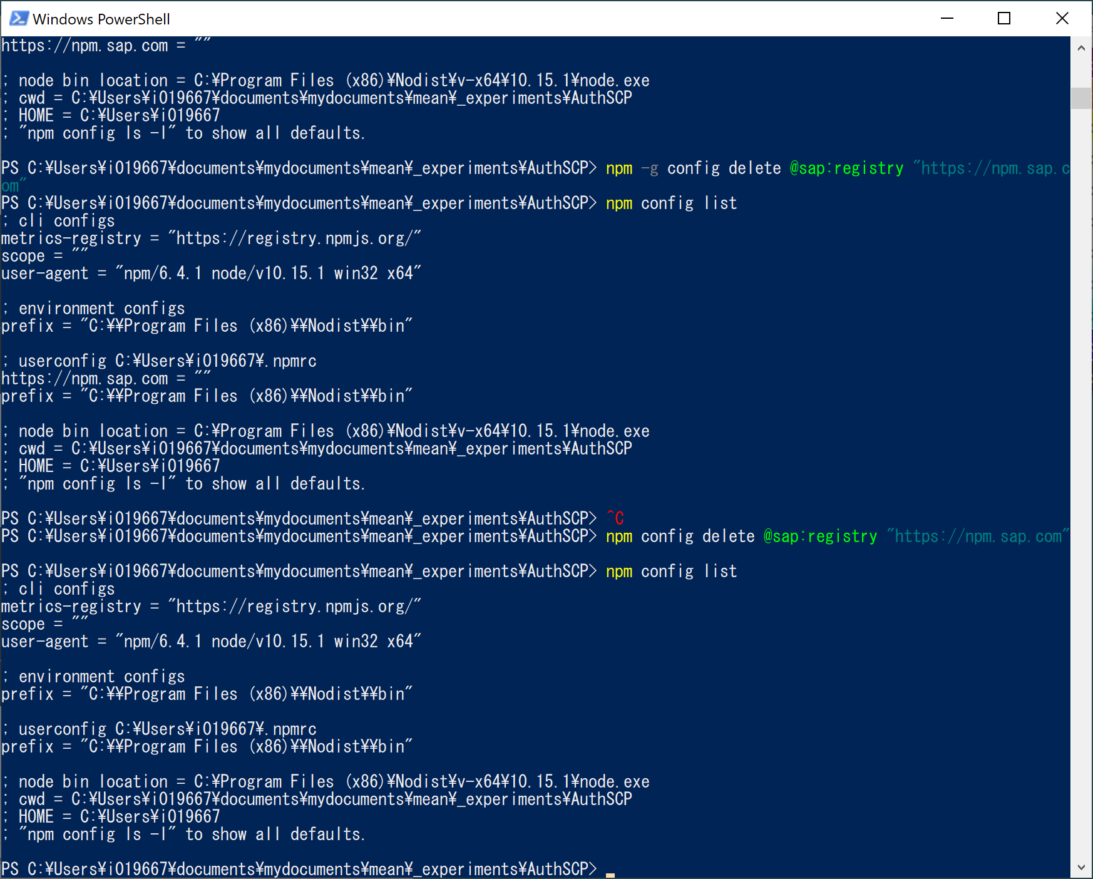

Slide 5
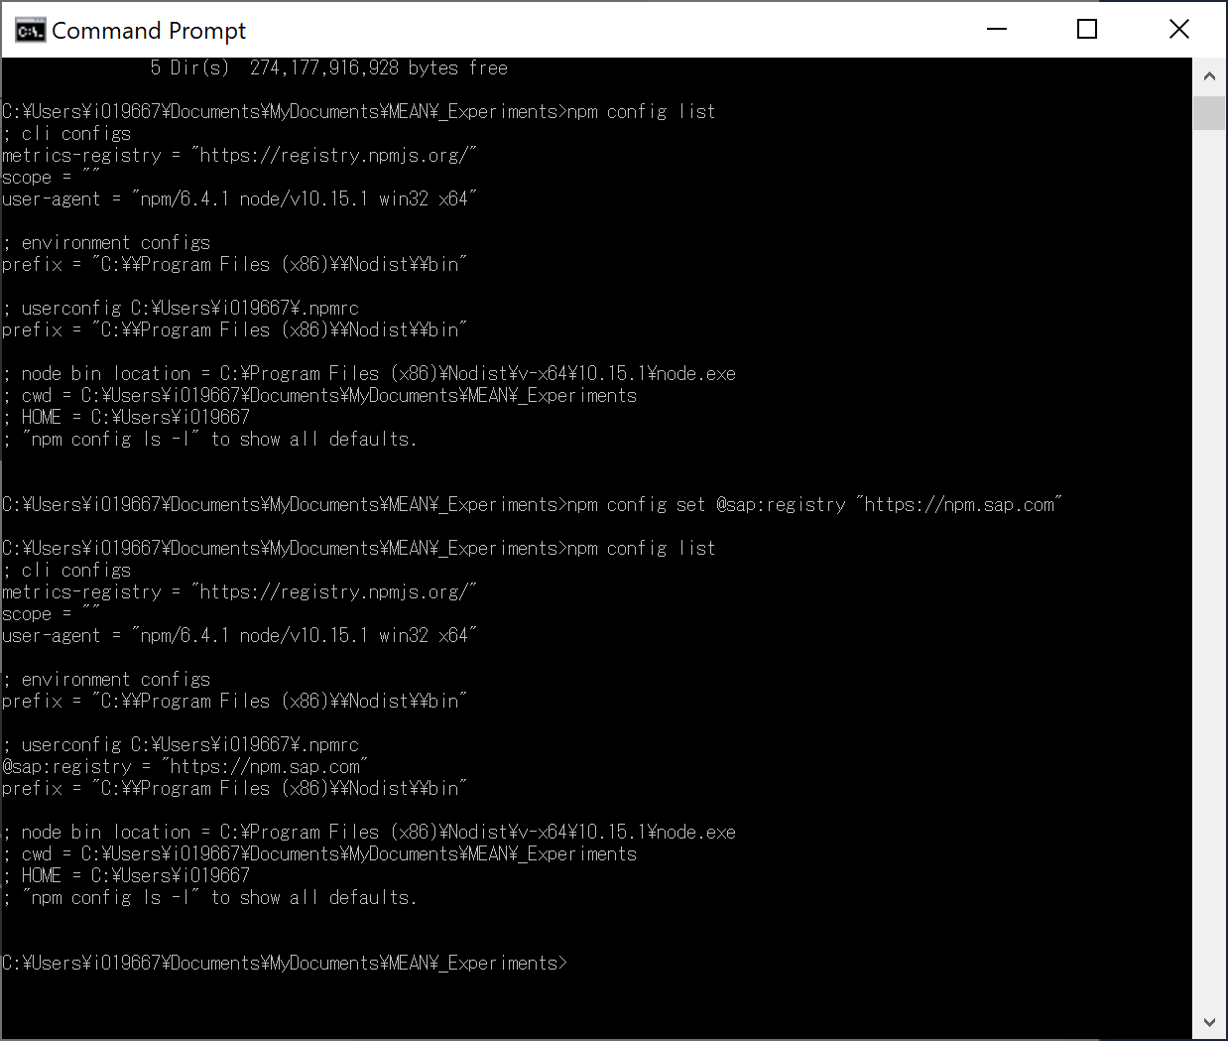
Windows Powershell does not work and “CMD” made it.

Slide 6
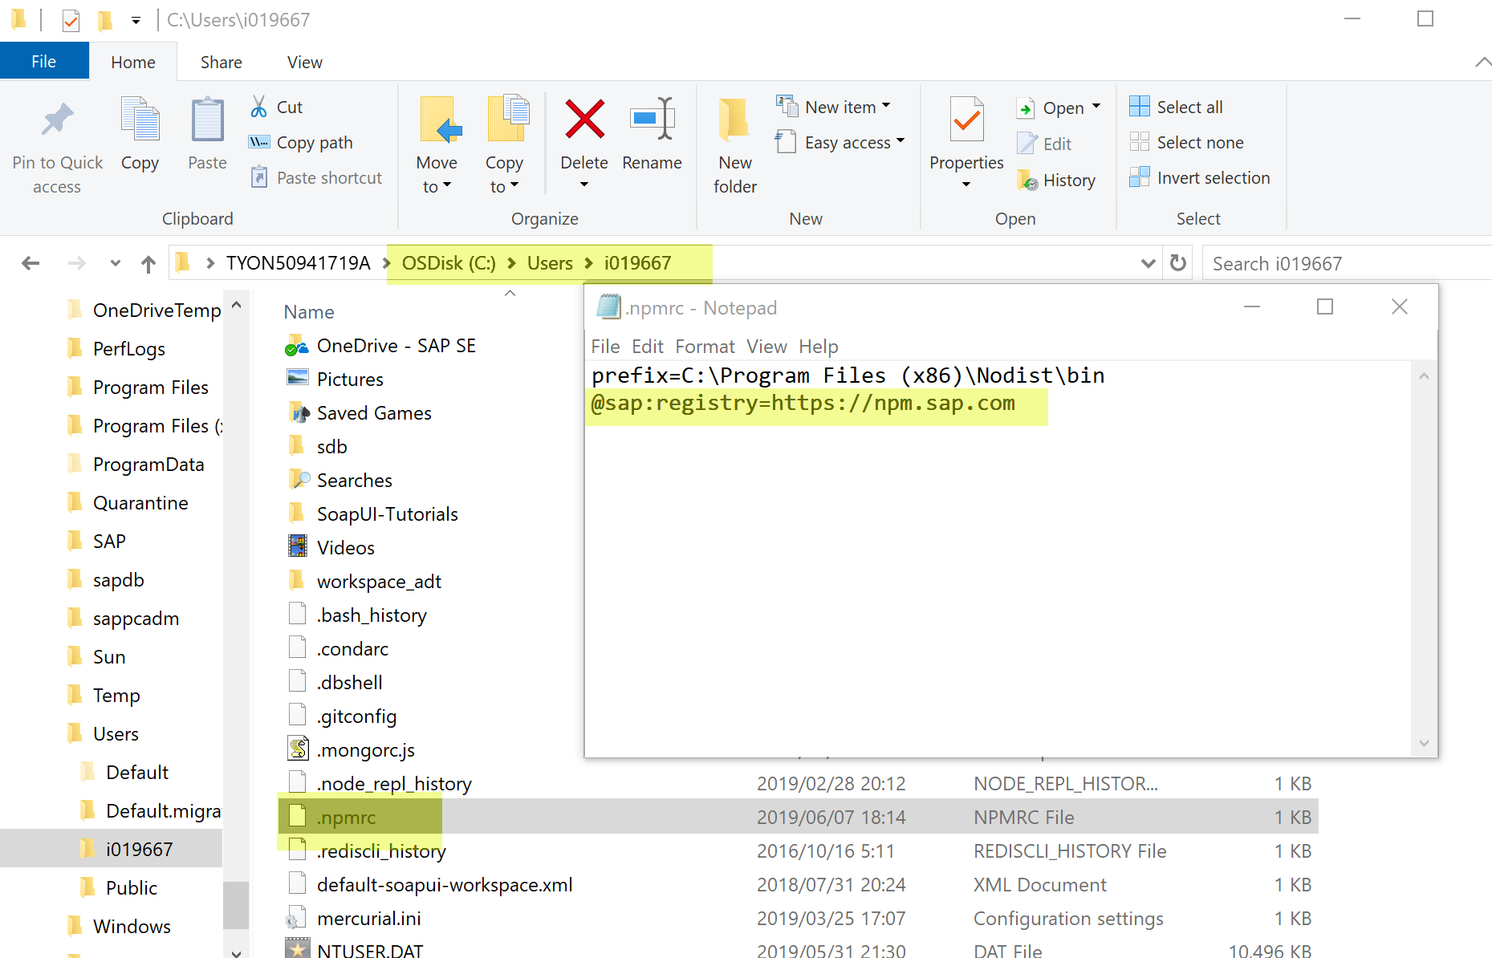

Slide 7
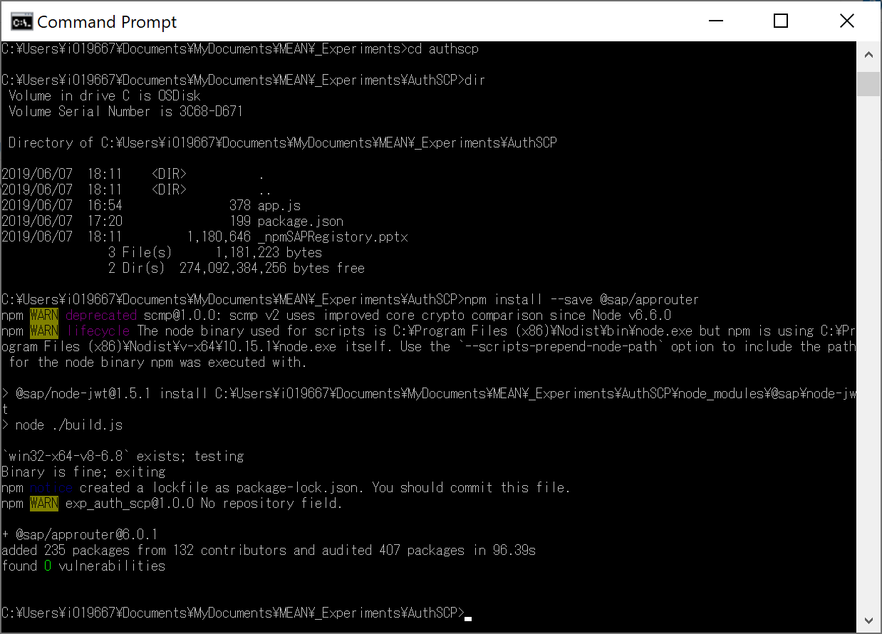
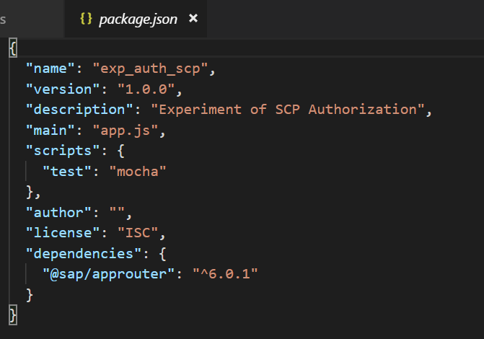
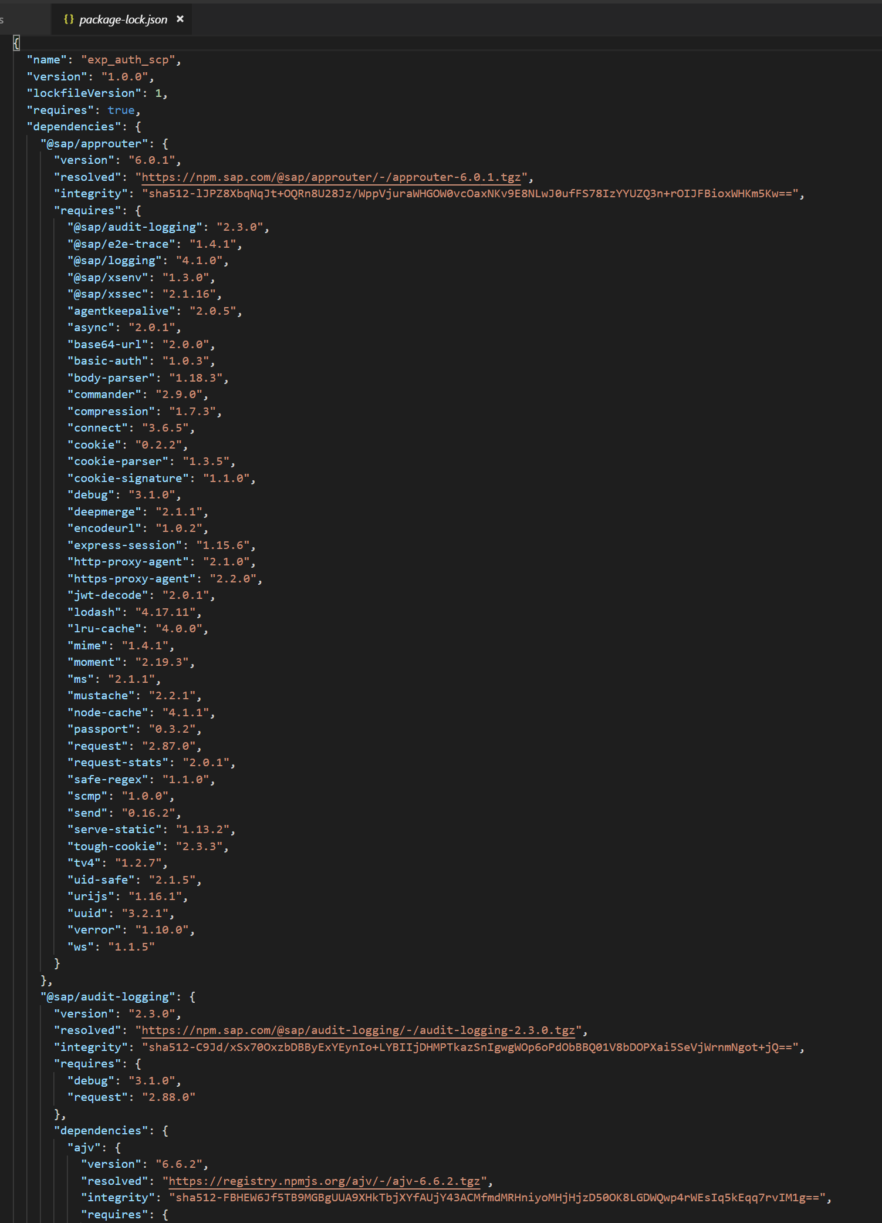

Slide 8
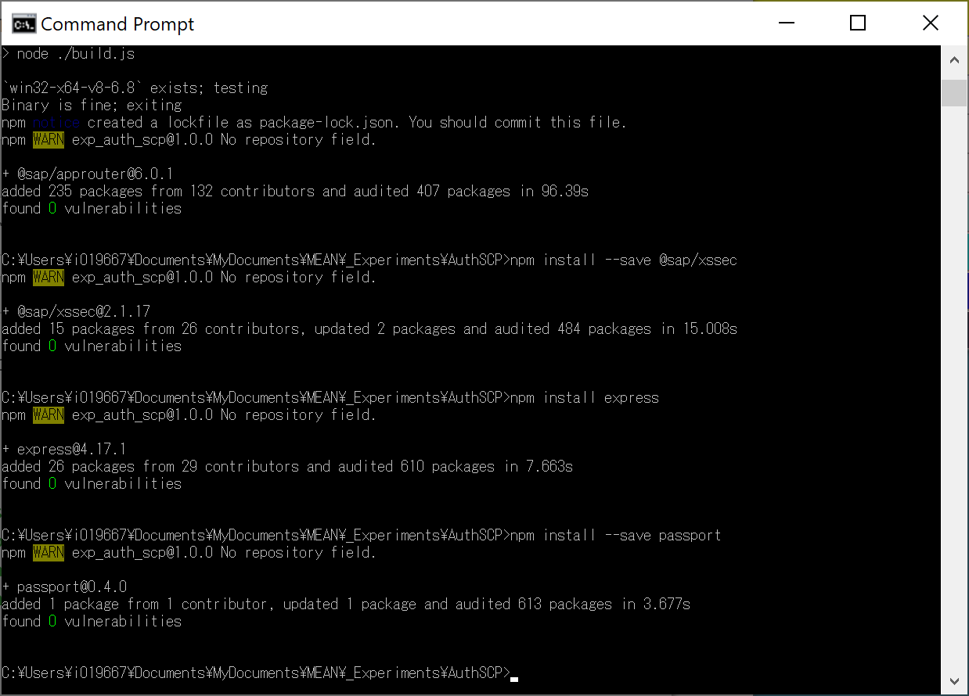
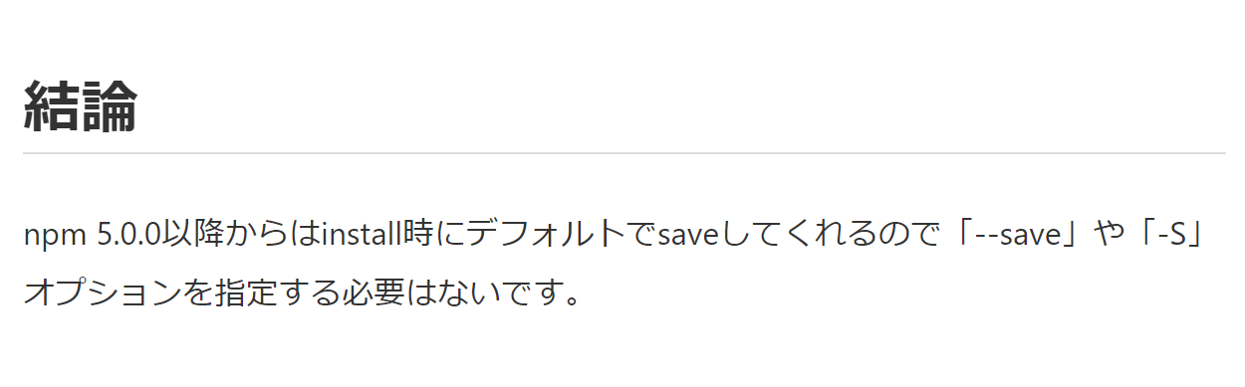
https://qiita.com/glhfdev/items/c5beda8572aa8c1e6be6

Slide 9
