Slide 1
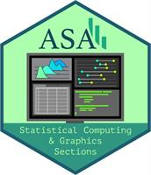
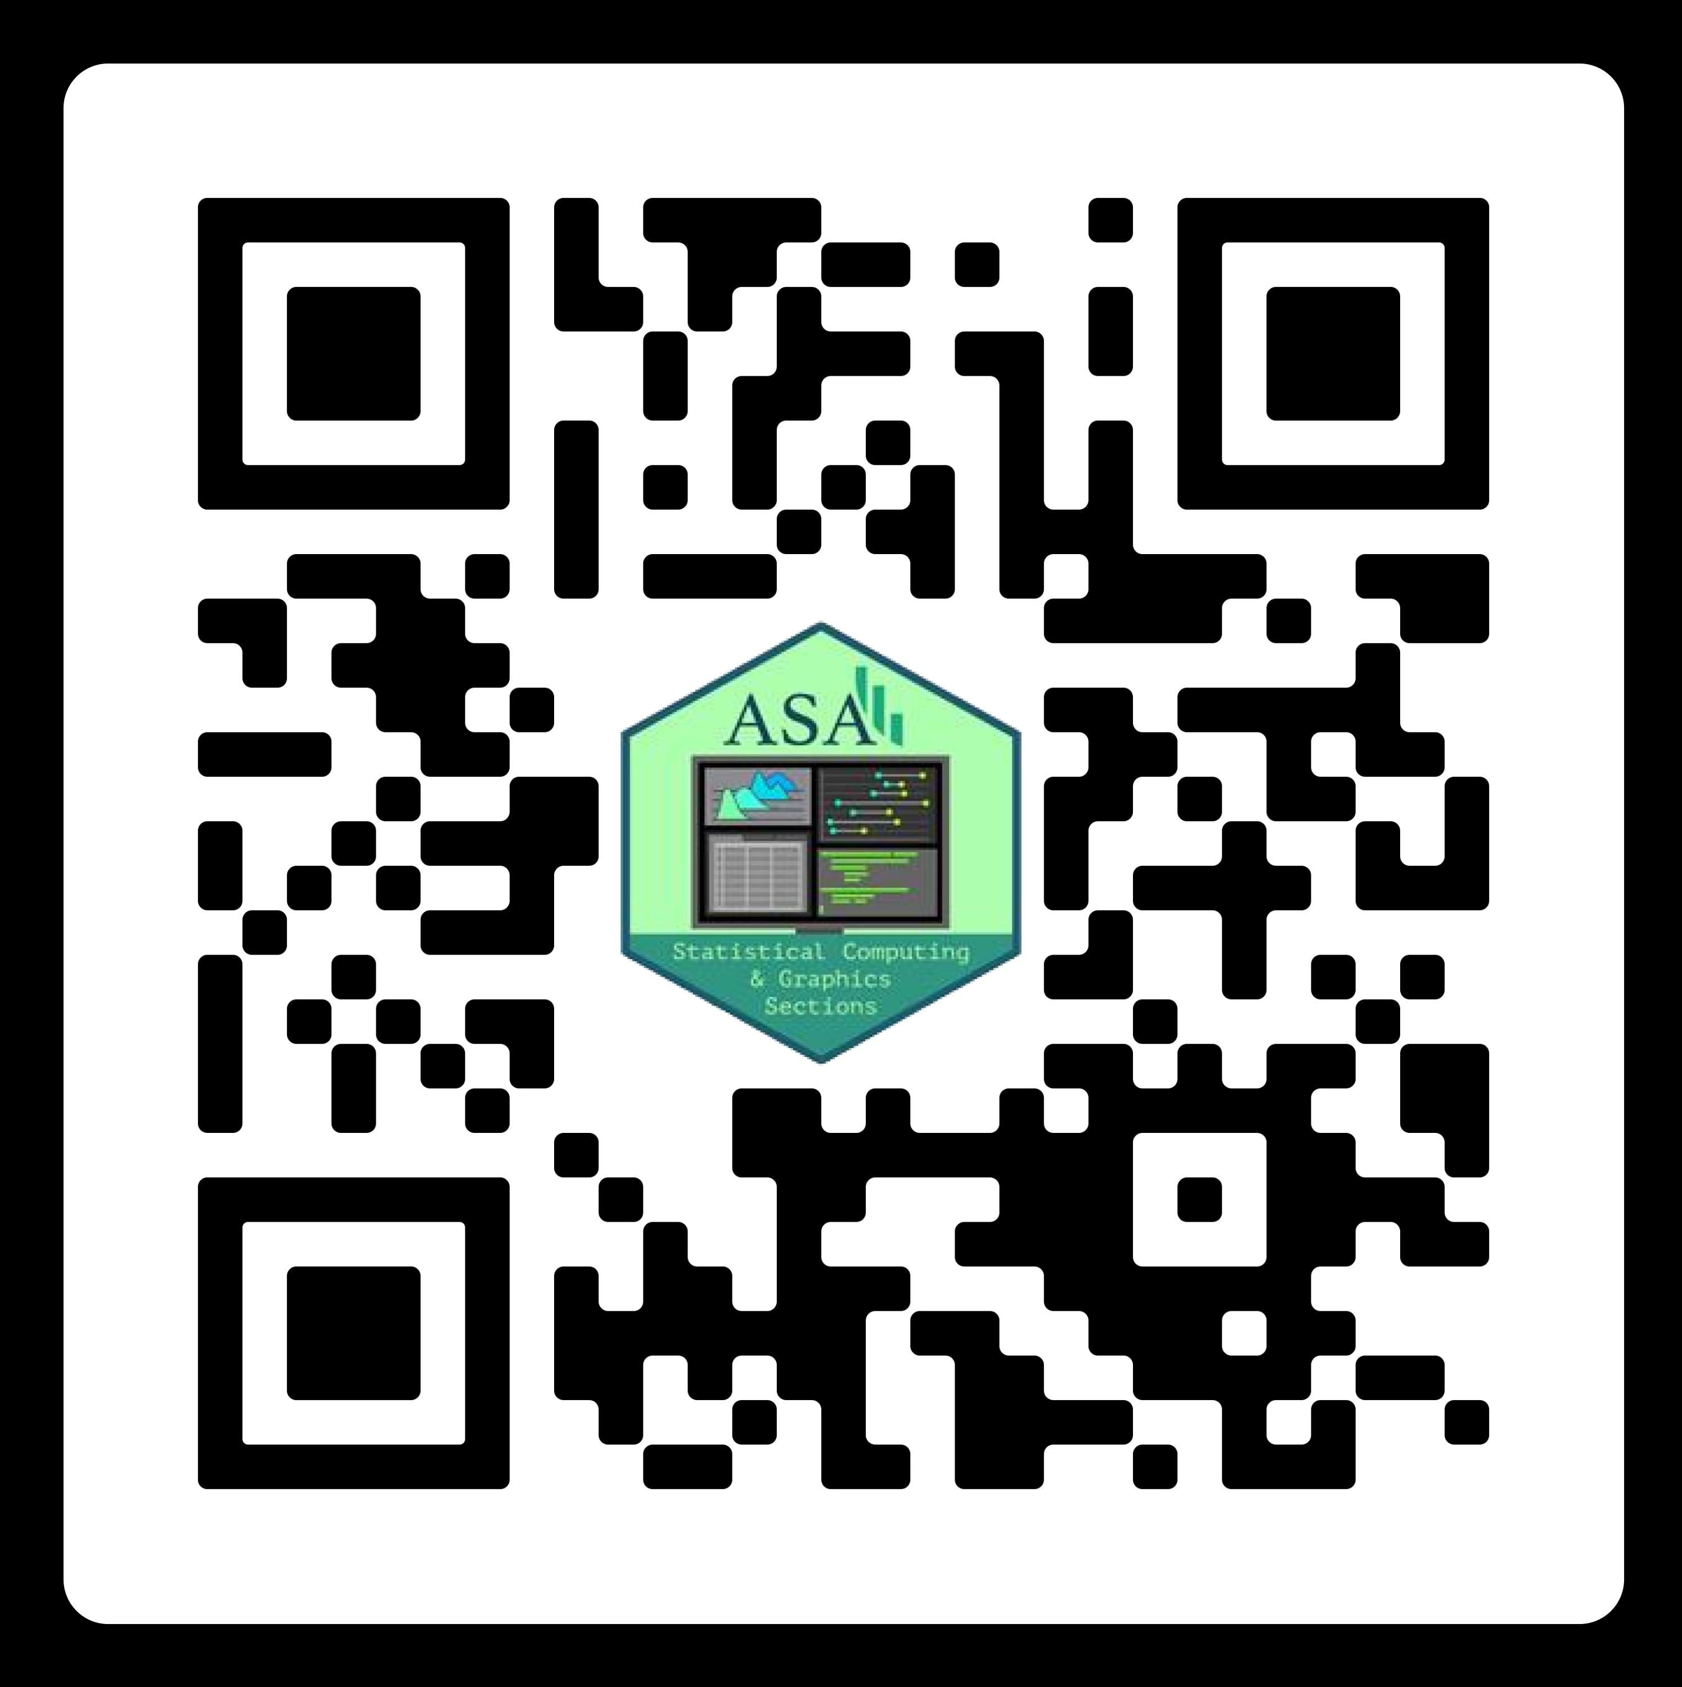
Statistical Computing in Action 2023
A Virtual Symposium by the
ASA Section on Statistical Computing
Saturday, November 4, 2023
11:00 – 15:30 Central Time
Keynote Speaker
Dr. Simon Urbanek
Executive Editor of R Journal
Senior Lecturer of Data Science, University of Auckland
Data Jamboree
Dataset: A subset of the NYC Open Data of 311 Service Requests
Contributed Speed Sessions
Abstract submission open until October 2
Panel Discussion
Topic:
Open-source software, open data, and open computing
Panelists:
Tracy Teal, Open Source Program Director, Posit PBC
Carol Willing, Python and Jupyter Core Developer, VP
of Engineering, Noteable
Achim Zeileis, Editor-in-Chief of Journal of Statistical
Software, Professor, Universität Innsbruck
The event aims to
showcase the power/beauty of statistical computing to students;
help practitioners sharpen their statistical computing skills; and
foster community across different computing
Registration starts on
August 15!
FREE for student members of SSC
Reduced fee for non-student members of SSC
Learn More
http://bit.ly/asa-ssc-symp23
Dr. Kun Chen
Co-Chair
University of Connecticut
kun.chen@uconn.edu • (860)486-4847
Dr. David Dahl
Co-Chair
Brigham Young University
dahl@stat.byu • ( 801) 422-9222
Organizing Committee: Jun Yan (University of Connecticut), Mingzhao Hu (Mayo Clinic)

