Slide 1

HR-Employee-Attrition Analysis
Done by:
Asaad Al Busaidi

Slide 2
Content
Case Study
1
Analysis
2
Conclusion
3
Recommendations
4

Slide 3
Case Study
- Data set created by IBM data scientists
- It has around 1470 employees. Every year around (15%-20%) of them need to be replaced
Bad for the company :
1- Projects get delayed.
2- The new employees have to be trained for the job.

Slide 4
Target audience?
Companies.
Company Question?
Factors they should focus on, in order to curb attrition.

Slide 5
Checklists
Inspecting
1407 rows
35 columns
01
Cleansing
(Missing values, Empty data, Incorrect Type, Incorrect values, Outliers and non relevant data)
846 Employees after deleting the outliers
02
Transforming
Reshaping, Transforming Structures, Indexing for quick access, Merging and Joining.
03
04
Modeling : (Visualization, Statical models, Correlation, Reporting).

Slide 6
Data Set Columns
'Age','Attrition','BusinessTravel','DailyRate', 'Department','DistanceFromHome','Education', 'EducationField', 'EmployeeCount', 'EmployeeNumber', 'EnvironmentSatisfaction', 'Gender', 'HourlyRate', 'JobInvolvement', 'JobLevel', 'JobRole', 'JobSatisfaction', 'MaritalStatus', 'MonthlyIncome', 'MonthlyRate', 'NumCompaniesWorked', 'Over18', 'OverTime', 'PercentSalaryHike', 'PerformanceRating', 'RelationshipSatisfaction', 'StandardHours', 'StockOptionLevel','TotalWorkingYears', 'TrainingTimesLastYear', 'WorkLifeBalance', 'YearsAtCompany', 'YearsInCurrentRole', 'YearsSinceLastPromotion', 'YearsWithCurrManager’

Slide 7
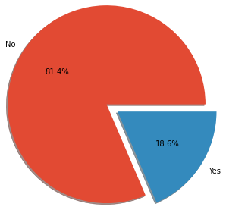
Attrition percentage

Slide 8
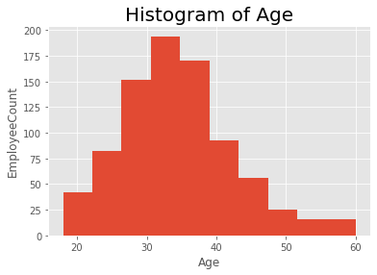
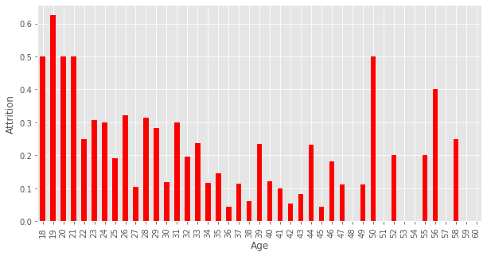
Age attrition
- Majority of employees aged 30 to 40
- Majority of employees who have higher attrition aged 18 to 21

Slide 9
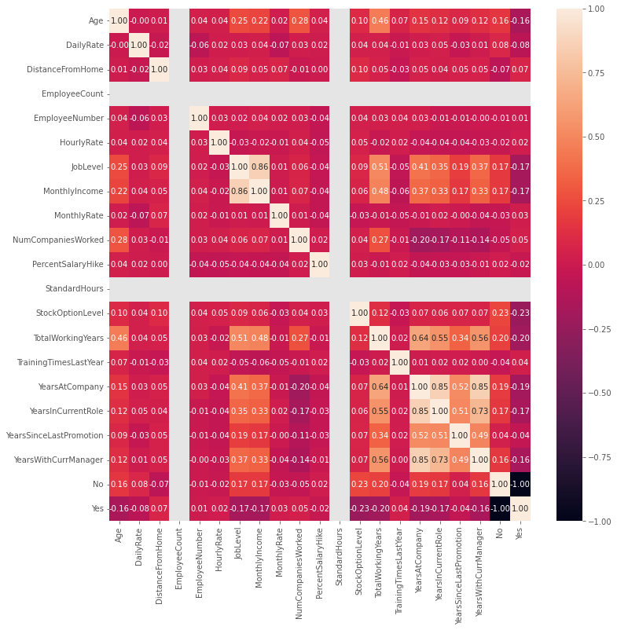
Correlation
- Heat map correlation

Slide 10
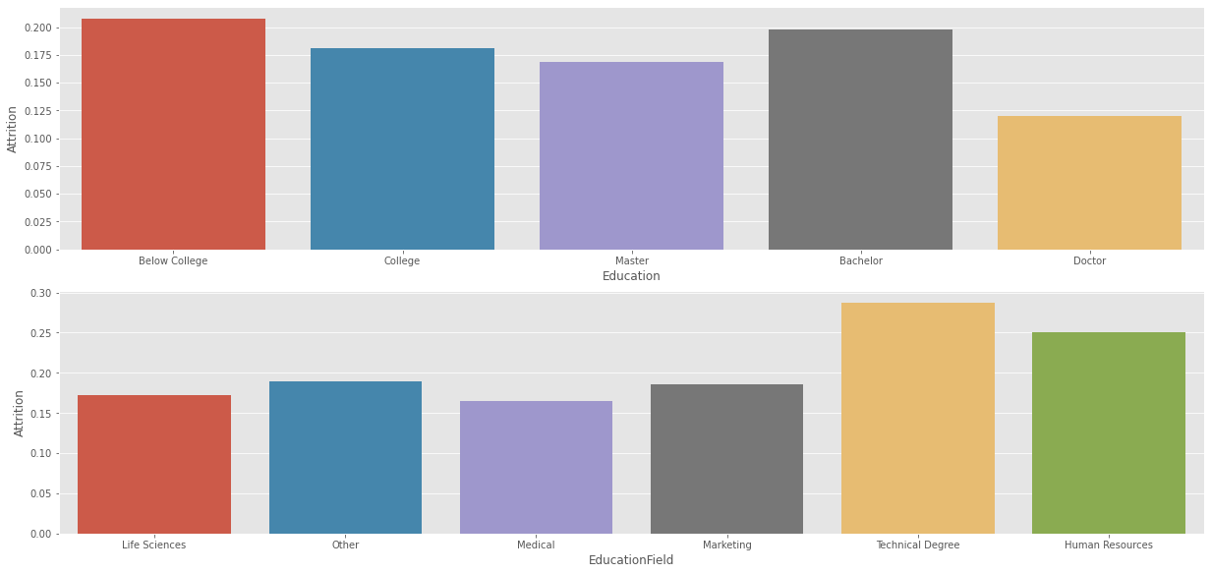
Education and Education Field
- Employees having (Below College, Bachelor ) Education , more attrition
- Employees having (Technical Degree, Human Resources) EducationField, more attrition

Slide 11
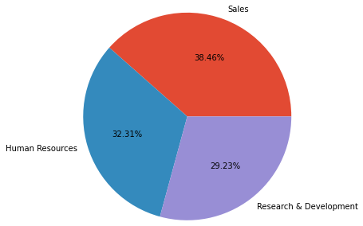
Department attrition
- Employees in Sales department have the higher attrition

Slide 12
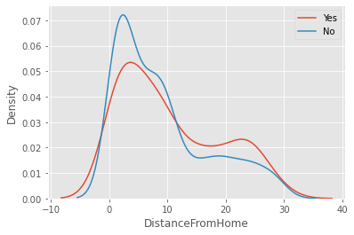
Distance From Home
- Higher attrition employees who stay far from the office (More than 10 KM)

Slide 13
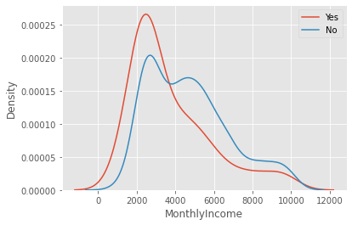
Monthly Income
- Employees with low income are more to attrite from the company

Slide 14
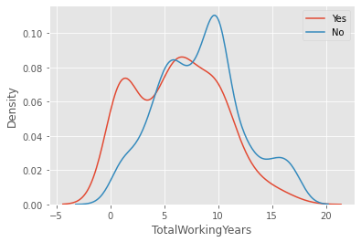
Total Working Years
- Employees with less total working years are more to attrite from the company

Slide 15
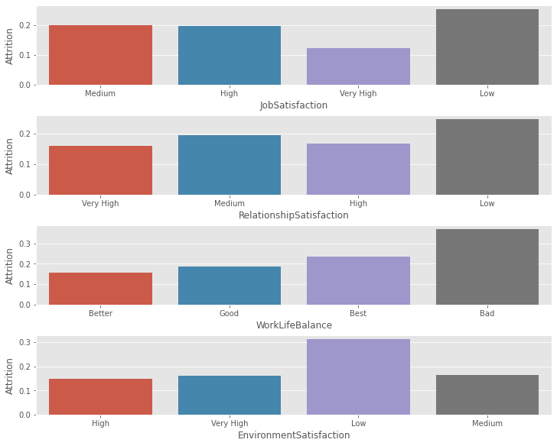
Employee satisfaction
- Employees with ,Low Job Satisfaction, Low Relation ship Satisfaction, Bad Work Life Balance, Low Environment Satisfaction have the higher attrition

Slide 16
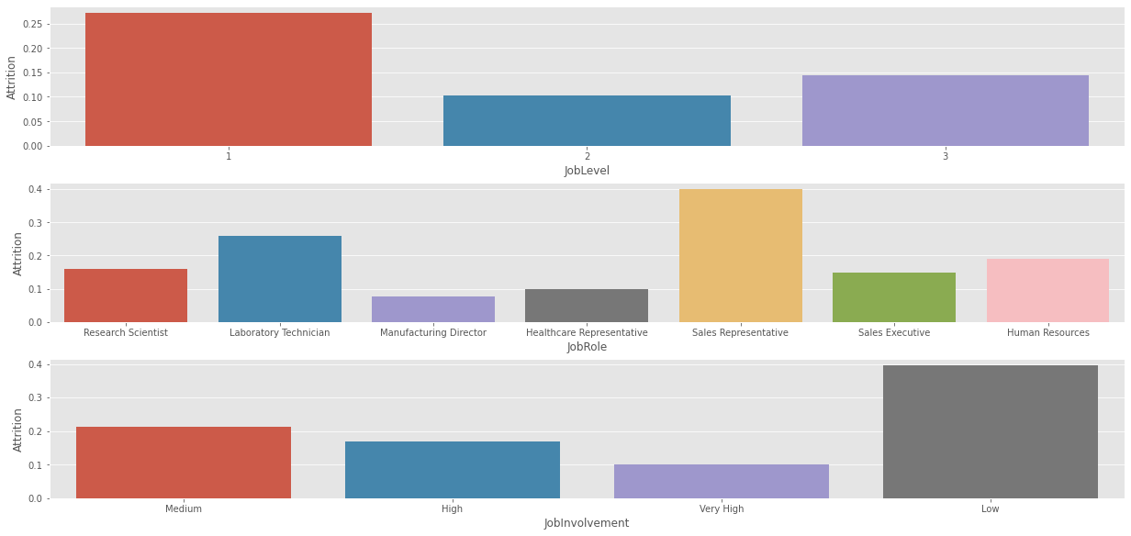
Employee job level and involvement
- Employees with job Level 1 ,Job Role(Sales Representative), low job Involvement have higher attrition

Slide 17







Conclusion
Monthly Income
Low monthly income
Sales Representative
Low Job Satisfaction
Low Relation ship Satisfaction, Bad Work Life Balance, Low Environment Satisfaction
Distance From Home
Long distance between employees home and the company location
Sales department
probably because of the pressure on the employees from the managers
Low job Involvement

Slide 18



Recommendations
Increase the monthly salary.
Changing the work environment and making it appropriate for achievement and improve the relationship between employees.
Reducing the pressure on the sales department and give them a bonus to encourage them.
Find accommodation for employees that is close to work
Increase the job Involvement for the employees.

