Slide 1
JobsCrawler project
Thanh Vu
Asaad
Yongliang
Luhua
Yang Lu

Slide 2
Outline
Approach
What we achieved ?
Parsing strategy
Design Architect
Limitations / Problems
What we learnt ?
Future Enhancements
Connecting to SCI

Slide 3
Approach
Parse Dice.com with Apply feature
Parse Cybercoders.com for Email sending
Apply Strategy pattern for each parsers
Open for extending new parsers

Slide 4
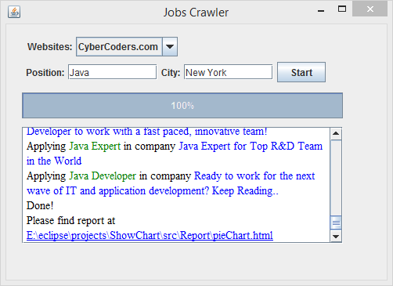
What we achieved ?
Simple UI for input search (Title and location)

Slide 5
What we achieved ?
Crawl Dice and Cybercoders site
Get JobVacancy with up to 12 fields
Support Apply and Email sending via 1 button
Show progress for crawling
Logging feature
Support analytics with interactive charts
statistics based on Location
based on Title

Slide 6
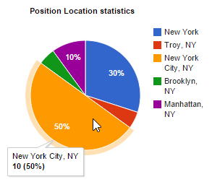
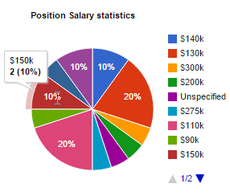
What we achieved ?
Support Analytics with interactive charts
statistics based on Location
based on Title

Slide 7
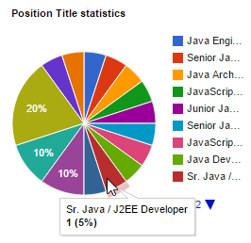
What we achieved ?
Support Analytics with interactive charts
statistics based on Location
based on Title

Slide 8
Parsing strategy
Dice.com
Get SessionId by hacking logging process
Get some info from search page : Title, Url, Location, Company
Navigate to Url : PositionId, Description, Employee Type, Contact Info
Cybercoders.com
Get cookies
Get some info from search page : title, url, location, company,empType, salary, postedTime
Navigate to Url : Description, Contact info, Email, PositionId, Skill sets

Slide 9
Design Architect
TO DO
(add UML diagrams)

Slide 10
Limitations / Problems
Very short time project
Some websites with Connection error
Solution : Increase Timeout value (5000ms)
Hard-parsing with non-uniform layout site
Dice.com : not well-formatted layout
Cybercoders.com : hide company info

Slide 11
What we learnt ?
Collaborations
NGU (Never Give Up) – choose best strategies

Slide 12
Future Enhancements
Support more sites
Use R for Analytics with many charts
Build rules for parser to get all data in many paths
Use MongoDB to store data and apply Data Analytics on it
Use K-Means for clustering to get similar Vacancies based on metrics for comparison

Slide 13
Connecting to SCI
Do less, accomplish more
Good design ensures 75% good product
Less efforts for maintenance
Life is structured in many forms
Good design ensure loose-coupling
Programs is divided into layers

