Slide 1
CS1675 Recitation #4: 9/21/18
These slides are available online:
https://github.com/kc13/CS1675
Agenda for today:
Linear regression exercises:
Closed form solution
Gradient descent

Slide 2
Dataset:
https://github.com/kc13/CS1675/houses.xlsx
Very small dataset of houses in Shadyside (from Trulia)
Four features (x1-x4) are available to predict the y variable (price, in thousand $)
You should add a bias feature, x0 (column of all 1’s – see slide 10 in Regression slides from lecture)
Use the first five houses as the training set
The final house will serve as the test set
We will perform three tasks with this dataset.
There will be some similarities to HW3, but you will be asked to do more by hand. You will not need to standardize any values (as in part III of HW3).

Slide 3
Tasks:
First, perform linear regression using the closed form least squares solution to solve for a weight vector w that predicts the y values (price) on the basis of the input features (formula copied below from the whiteboard notes from “Regression and Overfitting”):
where w* is a 5 x 1 weight vector, X is the 5 x 5 matrix of training features, and y is the 5 x 1 vector of training prices. You are allowed to use Matlab, but only the following basic operations: concatenation, matrix multiplication, concatenation, transpose and inv (but not pinv).
The idea is to get close experience with the formula without needing to be concerned with tedious calculations. If you are interested in reading about how to find a matrix inverse by hand, see here.

Slide 4
Tasks:
Once you have solved for w:
Inspect the sign and magnitude of the elements in the vector. Do they make sense?
Apply w to the final (6th) row of features, in order to predict this house’s price.

Slide 5
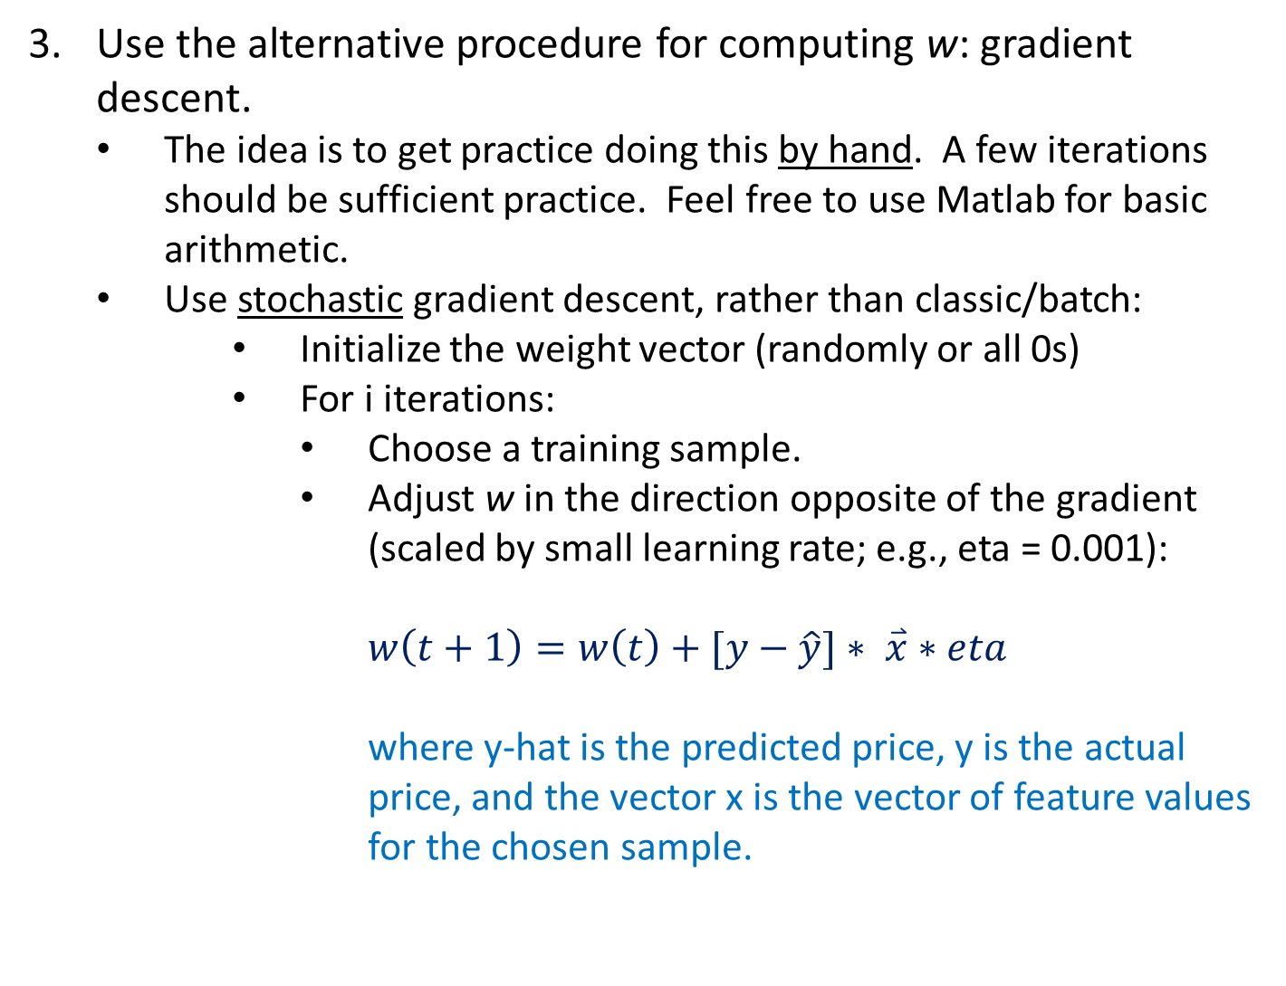
Tasks:
Use the alternative procedure for computing w: gradient descent.
The idea is to get practice doing this by hand. A few iterations should be sufficient practice. Feel free to use Matlab for basic arithmetic.
Use stochastic gradient descent, rather than classic/batch:
Initialize the weight vector (randomly or all 0s)
For i iterations:
Choose a training sample.
Adjust w in the direction opposite of the gradient (scaled by small learning rate; e.g., eta = 0.001):
$$w\left(t+1\right)=w\left(t\right)+[y−\hat{y}]∗ \overset{⃑}{x}∗eta$$
where y-hat is the predicted price, y is the actual price, and the vector x is the vector of feature values for the chosen sample.

Slide 6
Solutions:
Will be posted online on Friday afternoon.
Tasks 1-2 will be summarized in a .m file, and the gradient descent calculations will be shown in a .pptx file.

