Slide 1
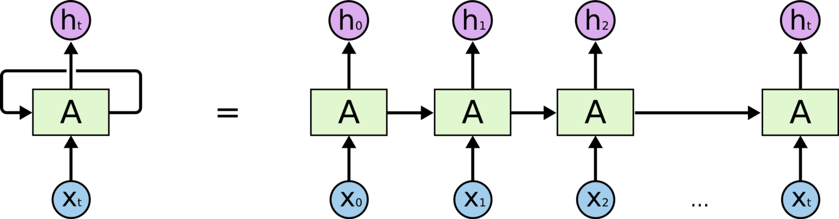
Machine learning for sequence data

Slide 2
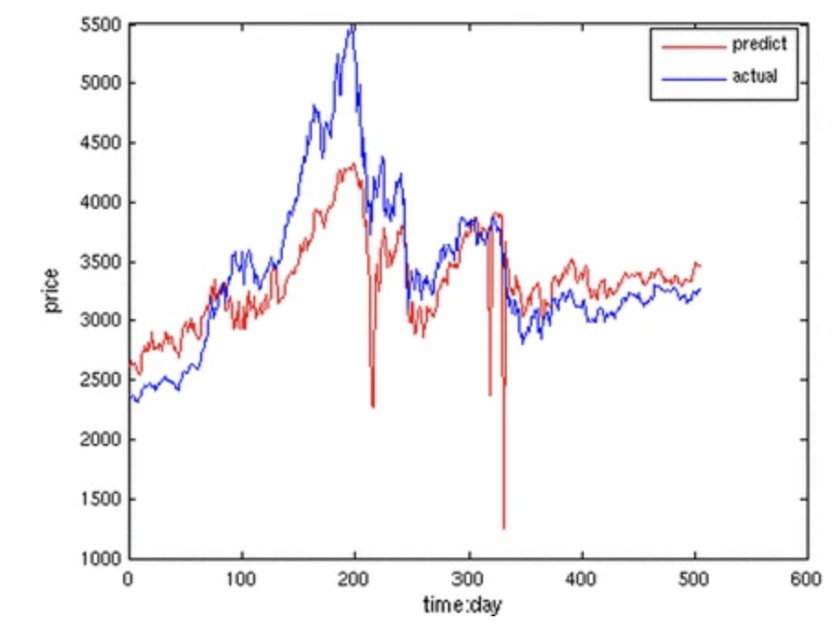
Sequence data
Consider the following examples:
A text document as a sequence of words (tokens)
Sequence representing the stay of a patient in a hospital
Stock market prediction

Slide 3
Sequence data
Prediction problems for sequence data (and let’s consider text data for concreteness):
Classify text (e.g. spam vs non-spam)
Translation, part of speech tagging (a sequence-to-sequence problem)
Text completion (this is what LLMs do!)

Slide 4
Text as a sequence of tokens
LLMs and other NLP methods break down text into smaller pieces called tokens.
Think of tokens as the fundamental LEGO bricks of language for an LLM.
Tokens can be:
Whole words (e.g., 'hello', 'world')
Parts of words (e.g., 'un-', '-ing', 'play-', '-able')
Punctuation (e.g., '.', '!', ‘?’)
Example: “Let’s learn about generative AI!” might be tokenized as: [“Let’s”, “learn”, “about”, “gener”, “ative”, “AI”, “!”]
https://gpt-tokenizer.dev
https://platform.openai.com/tokenizer

Slide 5
From tokens to token IDs
The list of tokens is converted into a list of token IDs:
[“Let”, “’s”, “learn”, “about”, “generat”, “ive”, “AI”, “!”]
[430, 126, 472, 3721, 2218, 21372, 28212, 9821]
When providing text as input to a neural network, we will then convert the tokens into vectors, called embeddings.

Slide 6
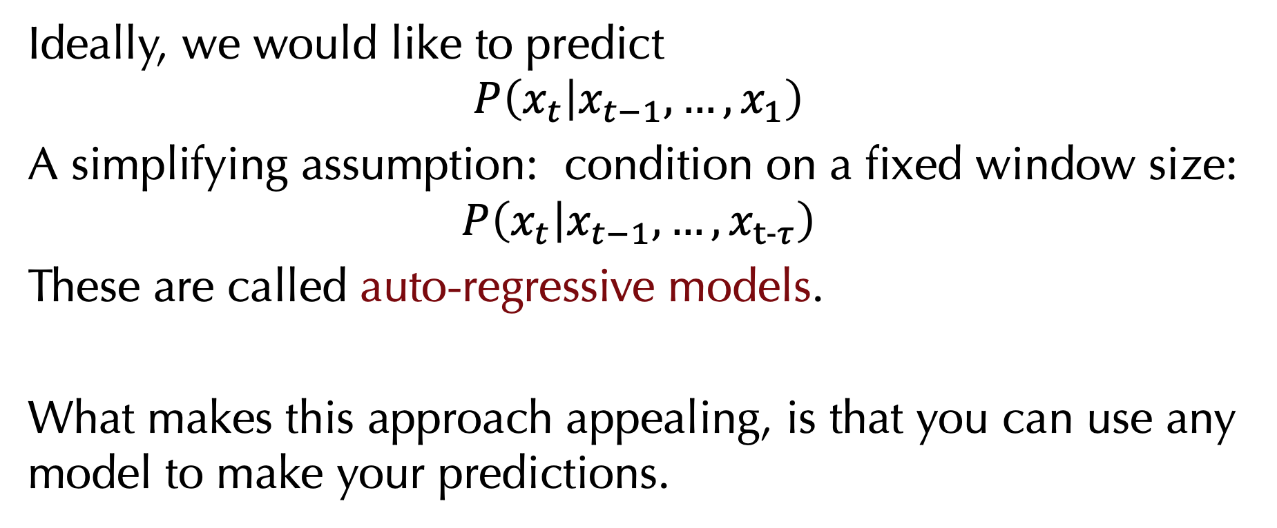
A naïve approach
Ideally, we would like to predict
$$P\left(x_{t} | x_{t−1},…,x_{1}\right)$$
A simplifying assumption: condition on a fixed window size:
$$P\left(x_{t} | x_{t−1},…,x_{t−τ}\right)$$
These are called auto-regressive models.
What makes this approach appealing, is that you can use any model to make your predictions.

Slide 7
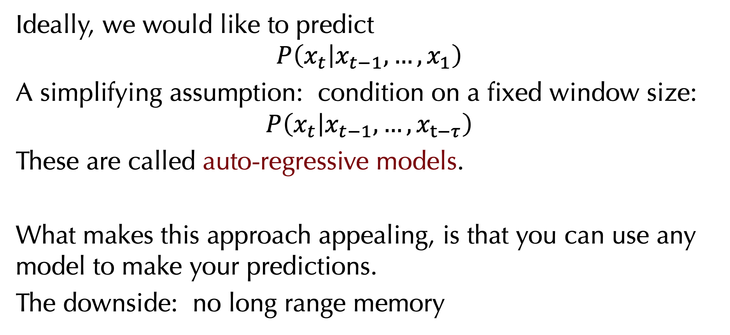
A naïve approach
Ideally, we would like to predict
$$P\left(x_{t} | x_{t−1},…,x_{1}\right)$$
A simplifying assumption: condition on a fixed window size:
$$P\left(x_{t} | x_{t−1},…,x_{t−τ}\right)$$
These are called auto-regressive models.
What makes this approach appealing, is that you can use any model to make your predictions.
The downside: no long range memory

Slide 8
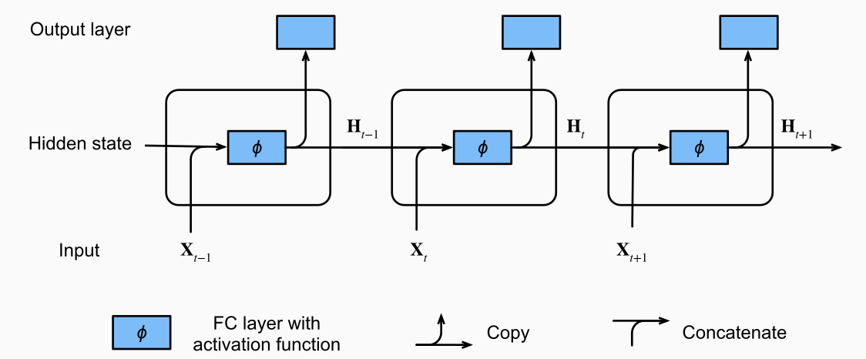
Recurrent networks
Recurrent networks maintain memory of previously seen inputs and can model relationships across a sequence.
The training algorithm: Back propagation through time
Williams, R. J., & Zipser, D. (1989). A learning algorithm for
continually running fully recurrent neural networks. Neural
Computation, 1(2), 270–280.
Notes:
The RNN encapsulates the previously seen elements of the sequence in its hidden state that is used to infer the next output

Slide 9
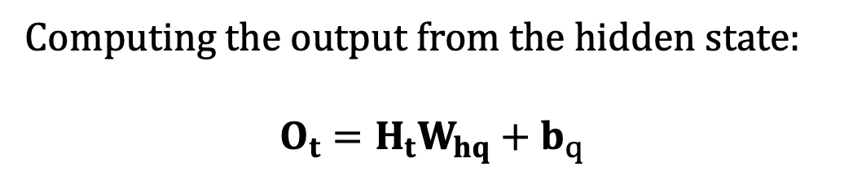
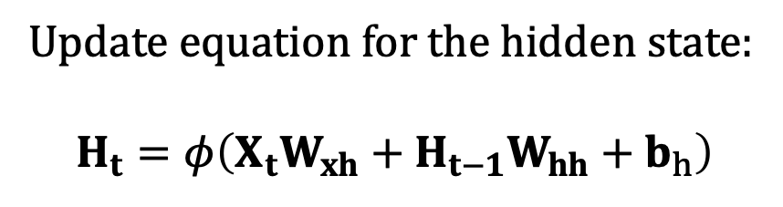
Recurrent networks
Update equation for the hidden state:
$$H_{t}=φ\left(X_{t}W_{xh}+H_{t−1}W_{hh}+b_{h}\right)$$
Computing the output from the hidden state:
$$O_{t}=H_{t}W_{hq}+b_{q}$$
Notes:
The RNN encapsulates the previously seen elements of the sequence in its hidden state that is used to infer the next output.
During the training process, we run a softmax operation on the output from the output layer for each time step, and then use the cross-entropy loss to compute the error between the model output and the target.

Slide 10
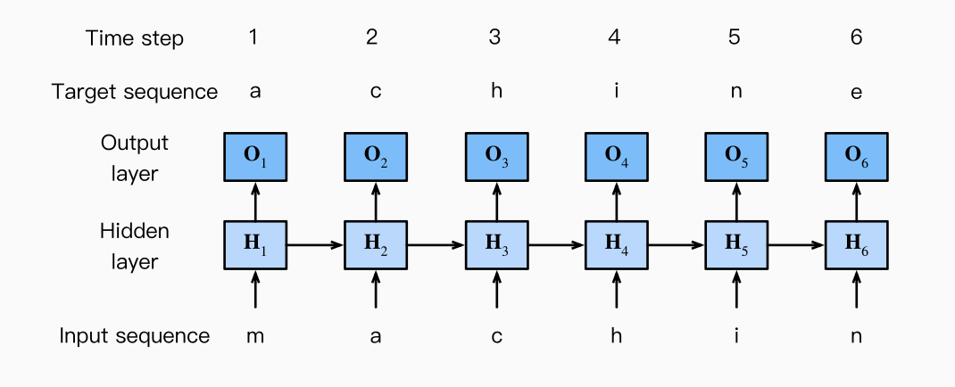
Recurrent networks
RNN applied to a hypothetical sequence of tokens:

Slide 11
The problems with recurrent networks
What happens to the gradient if you backpropagate through a long sequence?
Notes:
(“the vanishing / exploding gradient problem”). Part of the solution : gradient clipping

Slide 12
The problems with recurrent networks
After sufficiently many steps, the network “forgets” what it has seen earlier.
Notes:
as that gap grows, RNNs become unable to learn to connect the information between what it has seen and what is needed in a given position

Slide 13
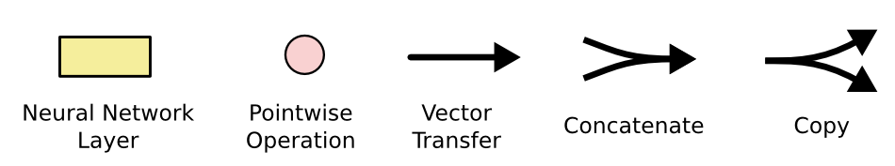
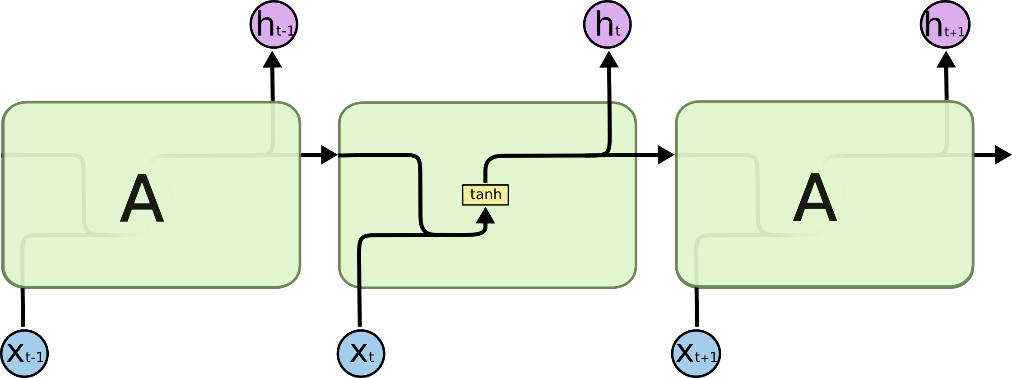
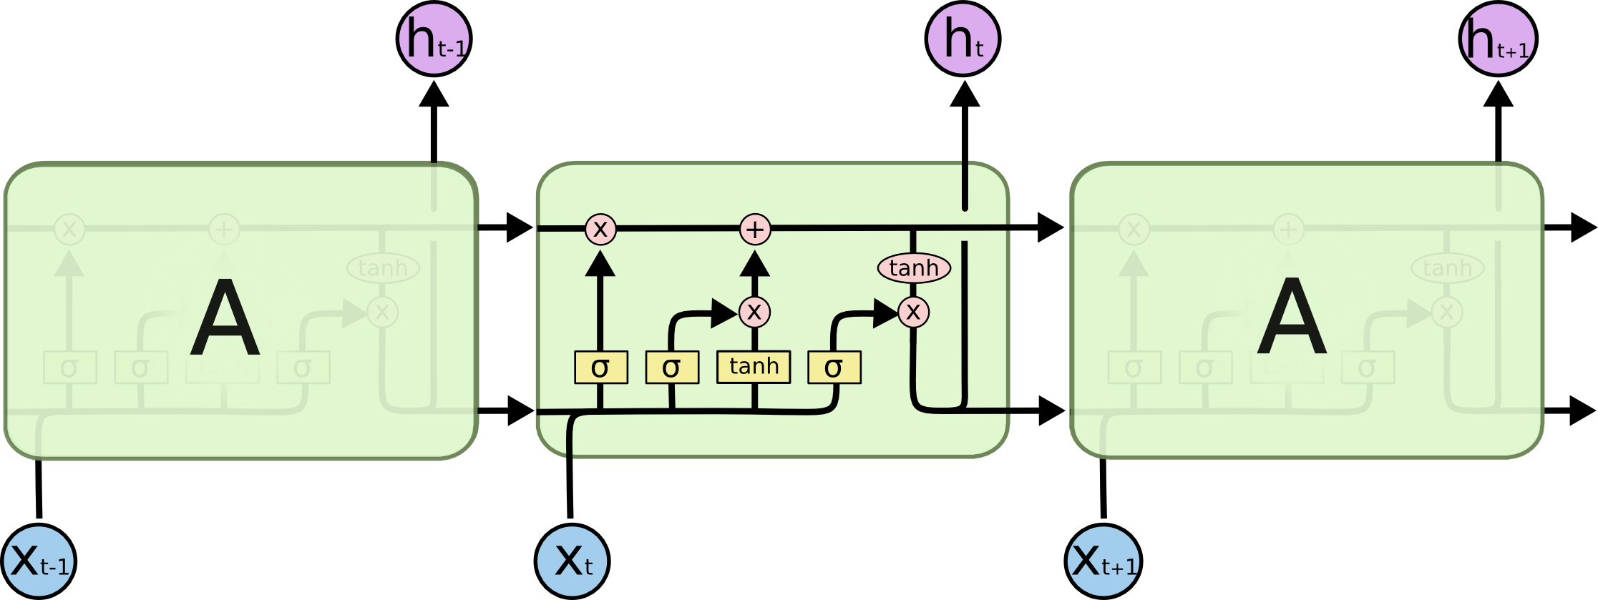
The solution: LSTMs / GRUs
Standard RNNs have a very simple structure:
LSTMs have more elaborate units:
Original paper:
Hochreiter, Sepp, and Jürgen Schmidhuber. "Long short-term memory." Neural computation 9.8 (1997): 1735-1780.
Presentation follows:
http://colah.github.io/posts/2015-08-Understanding-LSTMs/
Notes:
LSTMs are explicitly designed to avoid the long-term dependency problem. Remembering information for long periods of time is practically their default behavior, not something they struggle to learn!

Slide 14
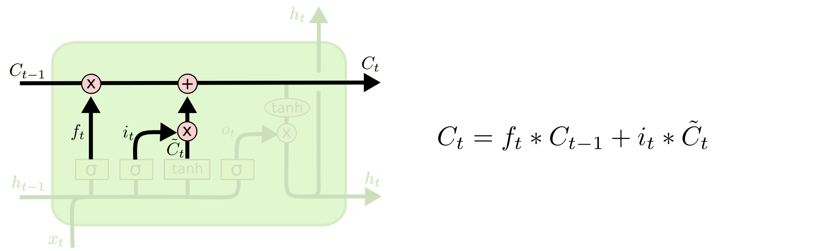
Updating the cell state
Forget gate
Input gate
Notes:
The cell state provides longer term memory
The next step is to decide what new information we’re going to store in the cell state. This has two parts. First, a sigmoid layer called the “input gate layer” decides which values we’ll update. Next, a tanh layer creates a vector of new candidate values, C̃ tC~t, that could be added to the state. In the next step, we’ll combine these two to create an update to the state.

Slide 15
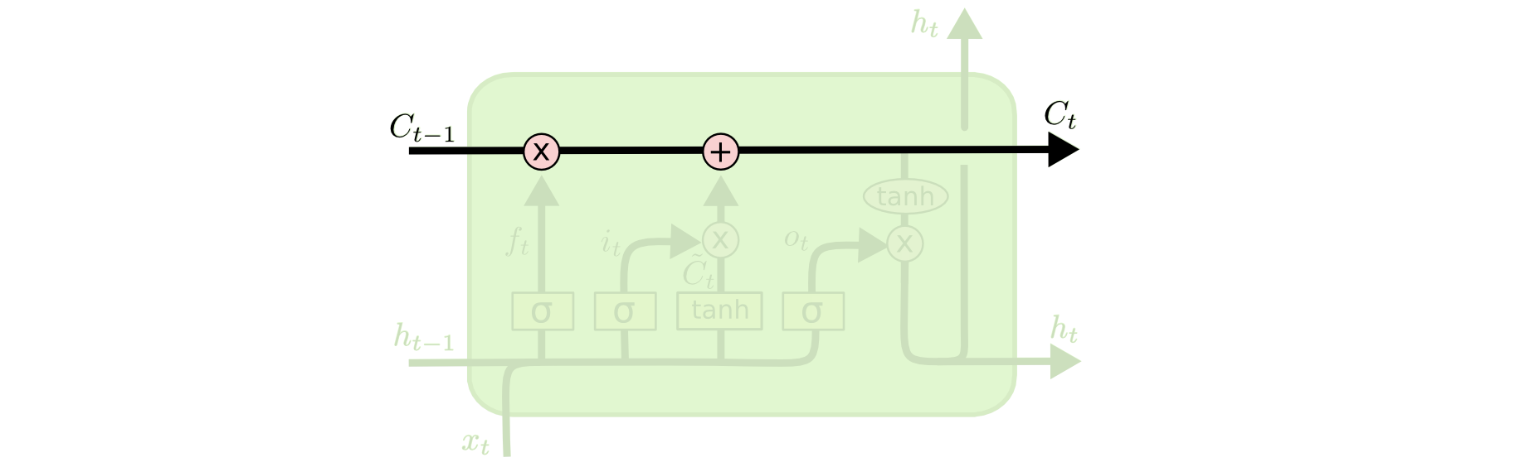
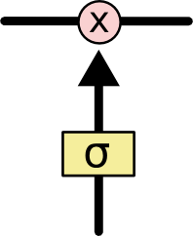
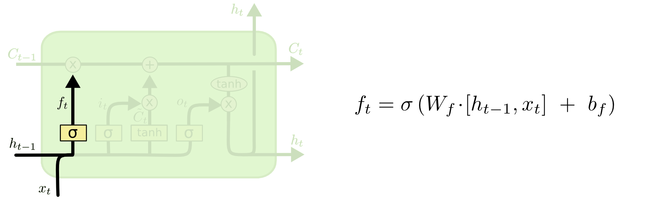
Updating the cell state
C_{t} – the cell state
At each step the LSTM has the ability to modify the cell state using gates
The “forget gate” – controls what information to keep in the cell state
Notes:
The cell state is kind of like a conveyor belt. It runs straight down the entire chain, with only some minor linear interactions. It’s very easy for information to just flow along it unchanged.
The first step in our LSTM is to decide what information we’re going to throw away from the cell state. This decision is made by a sigmoid layer called the “forget gate layer.” It looks at ht−1 and xt, and outputs a number between 0 and 1 for each number in the cell state Ct−1. A 1 represents “completely keep this” while a 0 represents “completely get rid of this.”

Slide 16
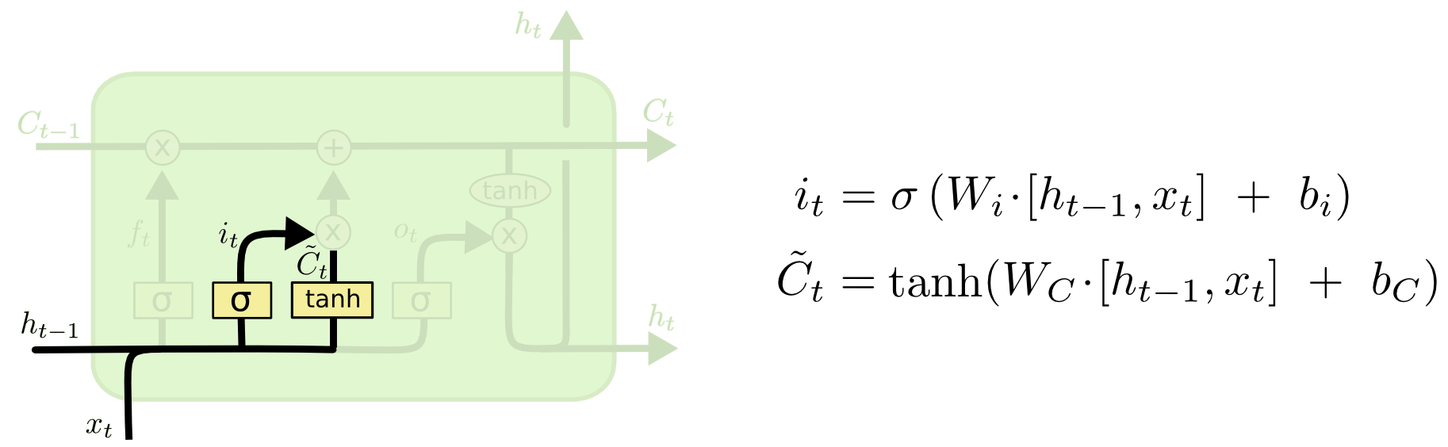
Updating the cell state
Deciding what new information to add to the cell state:
Notes:
The next step is to decide what new information we’re going to store in the cell state. This has two parts. First, a sigmoid layer called the “input gate layer” decides which values we’ll update. Next, a tanh layer creates a vector of new candidate values, C̃ t, that could be added to the state. In the next step, we’ll combine these two to create an update to the state.

Slide 17
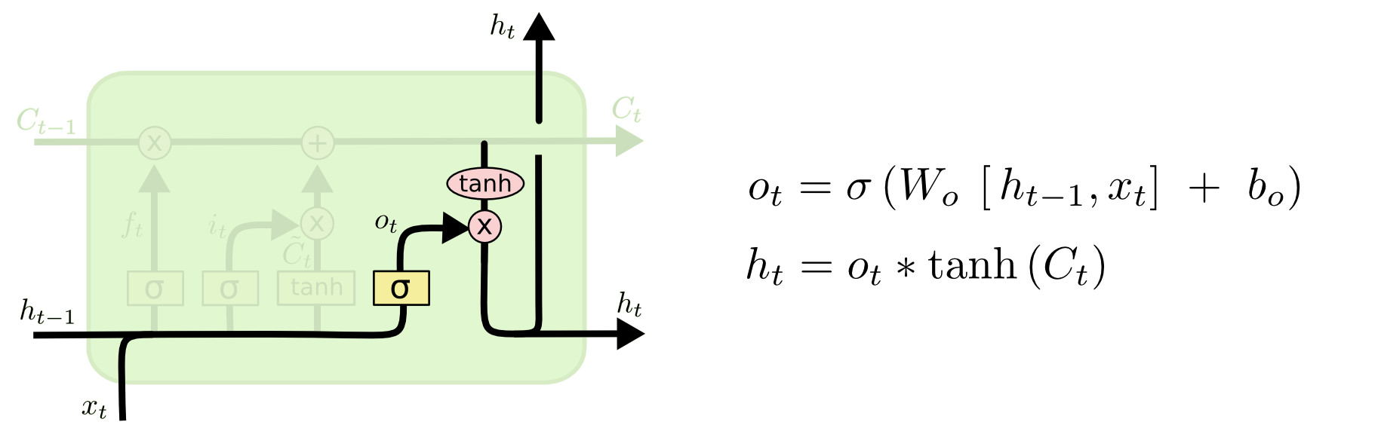
The output
The output is based on the cell state and the previous hidden state:

Slide 18
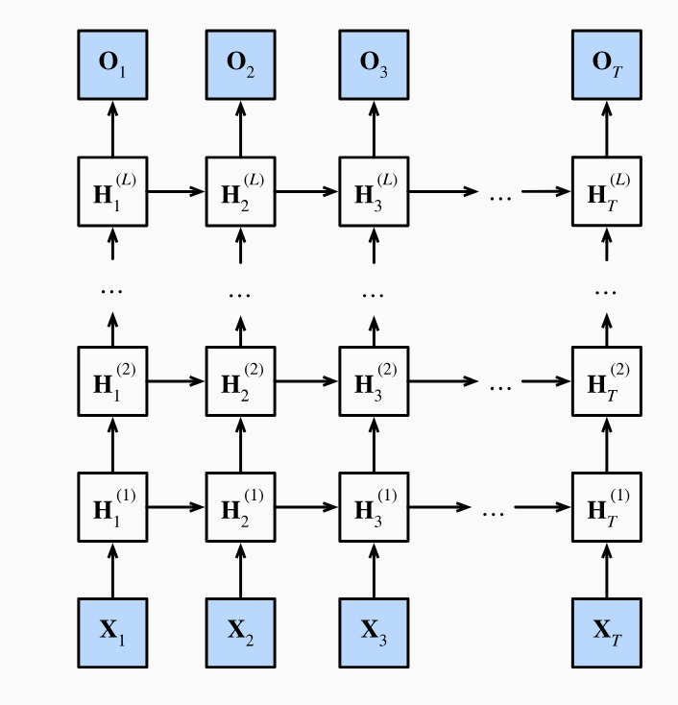
Deep recurrent networks
Like MLPs and CNNs, you can stack multiple RNN layers:

Slide 19
Improving recurrent networks
Prediction of masked tokens is a common application of RNNs. Depending on what comes after the masked token, the likely value of the missing token changes dramatically:
I am ___.
I am ___ hungry.
I am ___ hungry, and I can eat half a pig.
There is a simple tweak that will allow the network to do better in this task.
Notes:
In the first sentence “happy” seems to be a likely candidate. The words “not” and “very” seem plausible in the second sentence, but “not” seems incompatible with the third sentences.

Slide 20
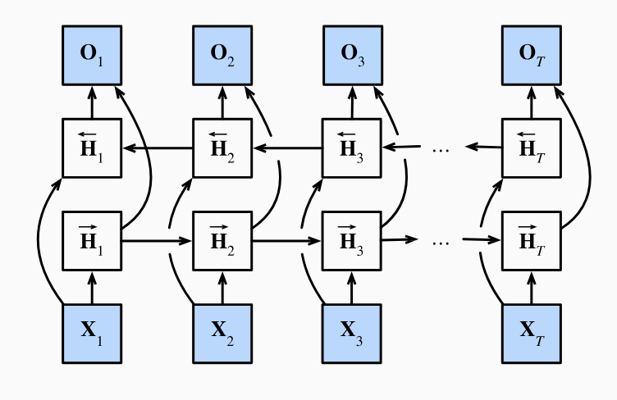
Bidirectional recurrent networks
Idea: chain two unidirectional RNN layers in opposite directions and acting on the same input
Schuster, M., & Paliwal, K. K. (1997). Bidirectional recurrent neural networks.
IEEE Transactions on Signal Processing, 45(11), 2673–2681.

Slide 21
Applications of LSTMs
Time series prediction
Speech recognition (2004; in conjunction with the CTC loss; incorporated in google voice in 2015)
Handwriting recognition
NLP
Image captioning
Translation
Variants: Gated Recurrent Units (GRUs)

Slide 22
What’s next: LSTMs for document classification

