Slide 1

COMP410 Project
WebGL Shooting Game
Alpay Sabuncuoglu

Slide 2

WebGL Program Structure
1. Create a canvas element.
2. Obtain a drawing context for the canvas.
3. Initialize the viewport.
4. Create one or more buffers containing the data to be rendered (typically vertices).
5. Create one or more matrices to define the transformation from vertex buffers to screen space.
6. Create one or more shaders to implement the drawing algorithm.
7. Initialize the shaders with parameters.
8. Draw

Slide 3
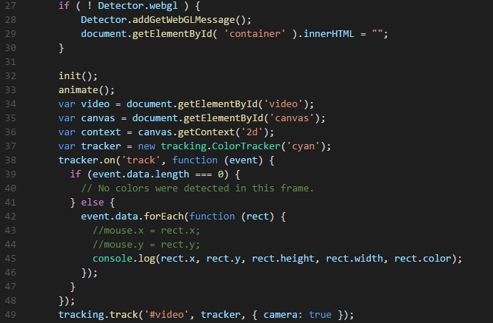
Figure 1. index.html script element

Slide 4
Main Points:
Creating Scene, Camera and Renderer
Creating Tunnel Object
Creating Monster
Creating Laser
Moving Ball with Ammo.js
Tracking object
Intersecting Ball/Laser with Monster object

