Slide 1
DEEP LEARNING | SEMESTER PROJECT
FloraScan AI
Smart Phytopathology System
Dual-engine tomato leaf disease classification using a custom CNN and a transfer-learned ResNet-18
5 classes
5,000 images
96.53% test accuracy
PRESENTED BY
SUBMITTED TO
Asad Ali Sajjad
Dr. Munir Ahmad
SU92-BSCSM-F23-167 | BSCS-7A | 7th Semester
Course: Deep Learning
Notes:
Introduce yourself and the project. FloraScan AI classifies tomato leaf health using two deep learning models and a Streamlit app. Headline result: 96.53% test accuracy.

Slide 2






Agenda
OVERVIEW
01
02
03
The Problem
Data
Models
Why leaf disease matters
Curation and preprocessing
Custom CNN vs ResNet-18
04
05
06
Results
Application
Outlook
Training and evaluation
Streamlit system and safety
Limits and future work
Click any card to jump to that section.
Notes:
Walk through the six parts. Cards are clickable during slideshow mode.

Slide 3



Crop disease is costly, and diagnosis is slow
THE PROBLEM
Heavy yield loss
THE FLORASCAN AI SOLUTION
Pests and diseases are estimated by the FAO to cost agriculture roughly 20 to 40 percent of potential yield.
An end-to-end pipeline: curate data, train two models, deploy a guarded web app.
Slow, subjective diagnosis
96.53%
94.13%
Expert inspection does not scale, and early symptoms are easy to miss.
Custom CNN
ResNet-18
Need for accessible AI
5,000
65%
A phone photo of one leaf can carry enough signal for instant, low-cost screening.
Curated images
Safety threshold
Agenda
Notes:
Frame the problem: disease is costly and diagnosis does not scale. FloraScan AI is the answer; the four numbers on the right preview the project.

Slide 4
A balanced five-class dataset
DATA
Tomato Healthy
Even green tissue, no lesions
Bacterial Spot
Dark water-soaked spots, yellow halos
Early Blight
Target-like concentric rings
Late Blight
Grey-green water-mold lesions
Not Leaf
1,000 synthetic images: noise, shapes, gradients
Seeded random split (seed 42)
1,000 images per class: four from PlantVillage (20,638 raw images), one synthetic
Agenda
Notes:
Explain class balance and why 1,000 per class. Mention that Not Leaf is synthetic, created programmatically.

Slide 5
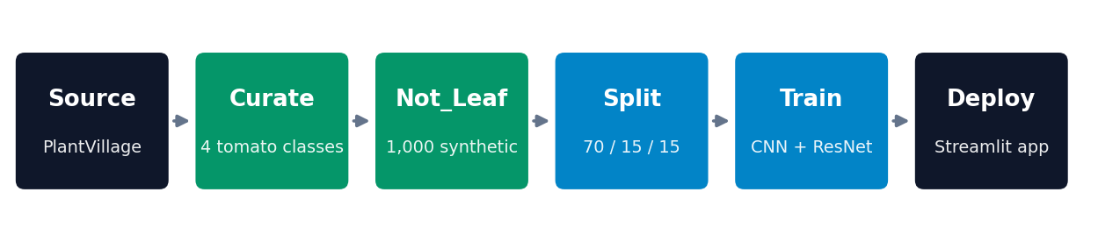


From raw images to model input
DATA
Preprocessing
Why a synthetic Not Leaf class?
Resize to 224 x 224 RGB
Train: random flip and rotation up to 15 degrees
Val and test: resize only, fully deterministic
ImageNet mean and standard deviation normalisation
A leaf-only classifier must always pick a leaf label, even for a wall or a hand. Not Leaf teaches the model that none of the above is a valid answer, and works with the 65% confidence guardrail to avoid meaningless diagnoses.
Agenda
Notes:
Show the full workflow, then explain preprocessing and the reasoning behind the synthetic class. Be candid that the synthetic images are simple.

Slide 6
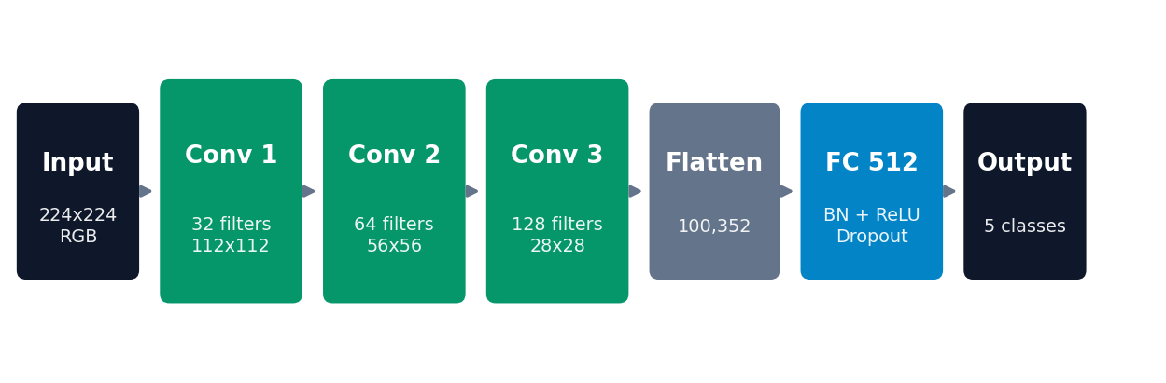
Two engines, two approaches
MODELS
Custom 3-block CNN
ResNet-18 transfer learning
Trained from scratch, every layer updated
Conv + BatchNorm + ReLU + MaxPool, then FC 512
About 51.5 M trainable parameters
ImageNet weights, backbone frozen
New 512 to 5 linear layer is the only trained part
Only 2,565 trainable parameters
Agenda
Notes:
Contrast the two. The custom CNN is shallow but has a big fully connected layer, so it is not parameter-light. ResNet-18 trains only its last layer.

Slide 7
Identical training for a fair comparison
TRAINING
10
Adam
Epochs
LR 0.001
32
T4 GPU
Batch size
Colab
CE
42
Cross-entropy loss
Random seed
Best checkpoint kept by validation accuracy
Agenda
Notes:
Custom CNN peaks at 97.33% validation at epoch 7. ResNet-18 improves steadily and peaks at 96.27% at epoch 10.

Slide 8
The custom CNN reaches 96.53% on unseen data
RESULTS
724 / 750
706 / 750
Custom CNN correct
ResNet-18 correct
26 errors
44 errors
TAKEAWAY
About 41% fewer mistakes than the frozen ResNet-18, because every layer of the custom model adapts to leaf texture and lesion shape.
Agenda
Notes:
26 errors versus 44, about a 41% reduction. Be clear that this is one random split; no confusion matrix was computed.

Slide 9


What the results tell us
ANALYSIS
Specialised features win
Healthy generalisation
Two engines are safer
Disease cues are local: lesion edges, rings, colour shifts. Full training lets filters specialise, while frozen ImageNet features only get re-weighted.
Validation tracks training closely. Augmentation and dropout explain why validation can exceed training, with no strong overfitting in ten epochs.
When both agree, trust rises. When they disagree, the app asks for manual review rather than guessing.
Fairness note: ResNet-18 was frozen, so this compares a fully trained custom model against a feature-extraction baseline, not a fine-tuned ResNet.
Agenda
Notes:
Offer the interpretation, and be upfront that fine-tuning ResNet is a natural follow-up experiment.

Slide 10



A guarded, easy-to-use Streamlit app
APPLICATION
Dual benchmark
65% safety threshold
Probability bars
Both engines on one leaf, with an agreement banner
Low confidence shows Unrecognized, never a guess
Full distribution across all five classes
Disease library
Scan history
Downloadable reports
Signs, severity, and care for each class
Session log of every analysis, one-click clear
Text report for any confident diagnosis
app.py (UI) | config.py (classes, threshold, guide) | model.py (PyTorch) | ui.py | styles.css | two .pth checkpoints
Agenda
Notes:
Demo tip: upload a leaf, switch between the three engine modes, then try a non-leaf image to show the Unrecognized path.

Slide 11

Limitations and next steps
OUTLOOK
Limitations
Future work
Lab-style PlantVillage images; field photos may score lower
Synthetic Not Leaf is simple, so real clutter may slip through
One crop, three diseases
One split, accuracy only: no confusion matrix yet
Fine-tune ResNet-18 for a fairer comparison
Per-class precision, recall, and cross-validation
Field images and realistic negatives
Multi-crop expansion: potato, pepper, corn, apple, grape
ONNX or mobile export for offline use, plus outbreak mapping
Agenda
Notes:
Show you understand the limits. This strengthens the project rather than weakening it.

Slide 12
SUMMARY
Thank you
Questions and discussion welcome
96.53%
94.13%
5
65%
Custom CNN test accuracy
ResNet-18 test accuracy
Health states recognised
Confidence guardrail
Asad Ali Sajjad
Deep Learning | Dr. Munir Ahmad
SU92-BSCSM-F23-167 | BSCS-7A | 7th Semester
Notes:
Close by restating the result, then invite questions.

