Slide 1
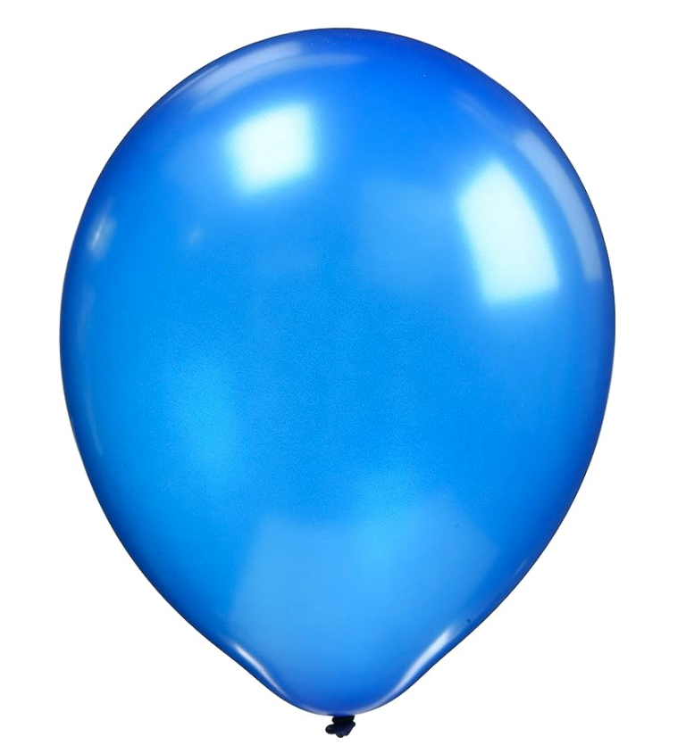
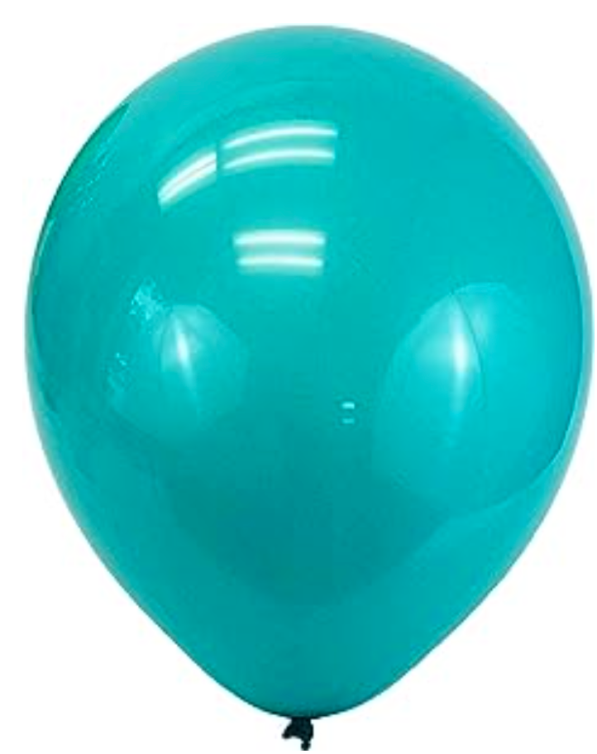


GET
READY

Slide 2
3

Slide 3
2

Slide 4
1

Slide 5
HAPPY
BIRTHDAY
MEERAL

