Slide 1

What Is a Database System?
Database: a very large, integrated collection of data.
Models a real-world enterprise
  Entities (e.g., teams, games)
  Relationships (e.g., The Forty-Niners are playing in The Superbowl)
  More recently, also includes active components , often called “business logic”. (e.g., the BCS ranking system)
A Database Management System (DBMS) is a software system designed to store, manage, and facilitate access to databases.

Slide 2
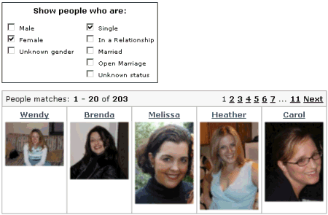
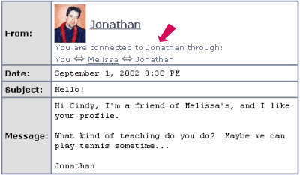
Database Systems: Today
From Friendster.com on-line tour

Slide 3






Other databases you may use

Slide 4


Is the WWW a DBMS?
=
Fairly sophisticated search available
  crawler indexes pages on the web
  Keyword-based search for pages
But, currently
  data is mostly unstructured and untyped
  search only:
    can’t modify the data
    can’t get summaries, complex combinations of data
  few guarantees provided for freshness of data, consistency across data items, fault tolerance, …
  Web sites typically have a DBMS in the background to provide these functions.
The picture is changing
  New standards e.g., XML, Semantic Web can help data modeling
  Research groups (e.g., at Berkeley) are working on providing some of this functionality across multiple web sites.

Slide 5
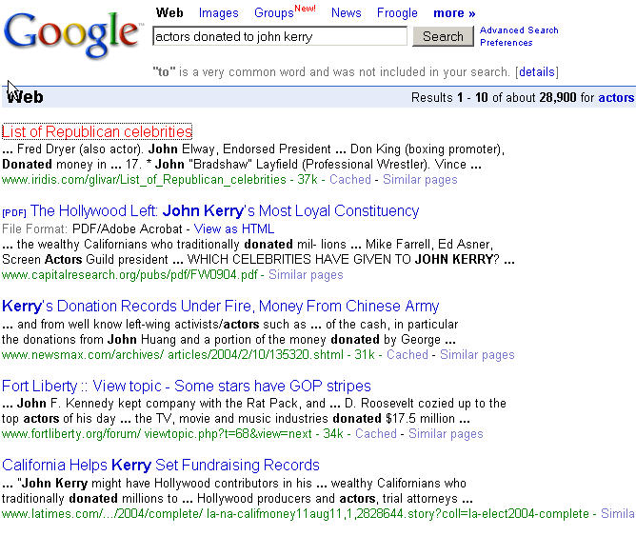
“Search” vs. Query
What if you wanted to find out which actors donated to John Kerry’s presidential campaign?
Try “actors donated to john kerry” in your favorite search engine.

Slide 6
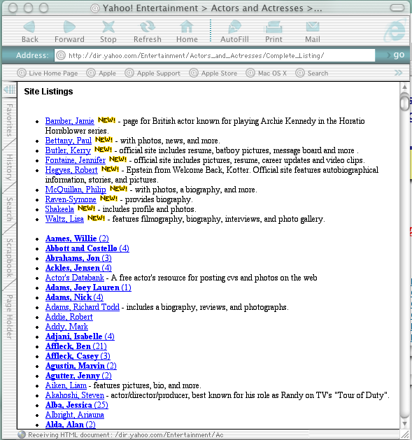
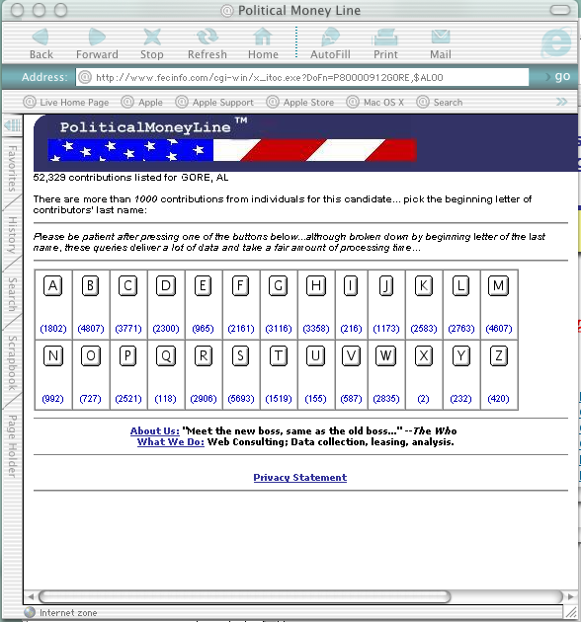

A “Database Query” Approach

Slide 7

Is a File System a DBMS?
=
Thought Experiment 1:
  You and your project partner are editing the same file.
  You both save it at the same time.
  Whose changes survive?
A) Yours
B) Partner’s
C) Both
D) Neither
E) ???
Thought Experiment 2:
  You’re updating a file.
  The power goes out.
  Which of your changes survive?
Q: How do you write
programs over a
subsystem when it
promises you only “???” ?
A: Very, very carefully!!
A) All
B) None
C) All Since Last Save
D) ???

Slide 8
Current Commercial Outlook
A major part of the software industry:
  Oracle, IBM, Microsoft, Sybase
  also Informix (now IBM), Teradata
  smaller players: java-based dbms, devices, OO, …
Well-known benchmarks (esp. TPC)
Lots of related industries
  data warehouse, document management, storage, backup, reporting, business intelligence, app integration
Relational products dominant and evolving
  adapting for extensibility (user-defined types), adding native XML support.
Open Source coming on strong
  MySQL, PostgreSQL, BerkeleyDB

Slide 9

Why Study Databases??
?
Shift from computation to information
  always true for corporate computing
  Web made this point for personal computing
  more and more true for scientific computing
Need for DBMS has exploded in the last years
  Corporate: retail swipe/clickstreams, “customer relationship mgmt”, “supply chain mgmt”, “data warehouses”, etc.
  Scientific: digital libraries, Human Genome project, NASA Mission to Planet Earth, physical sensors, grid physics network
DBMS encompasses much of CS in a practical discipline
  OS, languages, theory, AI, multimedia, logic
  Yet traditional focus on real-world apps

Slide 10

What’s the intellectual content?
representing information
  data modeling
languages and systems for querying data
  complex queries with real semantics*
  over massive data sets
concurrency control for data manipulation
  controlling concurrent access
  ensuring transactional semantics
reliable data storage
  maintain data semantics even if you pull the plug
  * semantics: the meaning or relationship of meanings of a sign or set of signs
Notes:
1. Representing info: both critically useful and profound.
where bits and bytes meet “reality” – computational models of reality
where bits and bytes meet mental models of reality: thought
(because who/what are we modeling for? for other people, who will ask questions to learn more)
not unlike data structures, but imagine a 20-year data structure!
Correctness, evolution, communication
2. Languages: deeply tied to models
for non-programmers, and must support evolution of models.
So: declarative, not imperative
Query processing: data access and operations for things MUCH bigger than memory. Must generate correct answers!
3. CC:: ensuring correctness in the face of concurrent update. First question: WHAT IS CORRECT? Second: how to ensure that without one-at-a-time operation?
4. Reliability: in the face of user error, software error, hardware failure, catastrophe!

Slide 11
Describing Data: Data Models
A data model is a collection of concepts for describing data.
A schema is a description of a particular collection of data, using a given data model.
The relational model of data is the most widely used model today.
  Main concept: relation, basically a table with rows and columns.
  Every relation has a schema, which describes the columns, or fields.
Notes:
5

Slide 12



Levels of Abstraction
Users
Views describe how users see the data.
Conceptual schema defines logical structure
Physical schema describes the files and indexes used.
(sometimes called the ANSI/SPARC model)
View 1
View 2
View 3
Conceptual Schema
Physical Schema
DB
Notes:
6

Slide 13
Example: University Database
View 1
View 2
View 3
Conceptual schema:
  Students(sid: string, name: string, login: string, age: integer, gpa:real)
  Courses(cid: string, cname:string, credits:integer)
  Enrolled(sid:string, cid:string, grade:string)
External Schema (View):
  Course_info(cid:string,enrollment:integer)
Physical schema:
  Relations stored as unordered files.
  Index on first column of Students.
Conceptual Schema
Physical Schema
DB
Notes:
7

Slide 14
Data Independence
Applications insulated from how data is structured and stored.
Logical data independence: Protection from changes in logical structure of data.
Physical data independence: Protection from changes in physical structure of data.
Q: Why are these particularly important for DBMS?
View 1
View 2
View 3
Conceptual Schema
Physical Schema
DB

Slide 15
Queries, Query Plans, and Operators
Count distinct
Having
SELECT eid, ename, title
FROM Emp E
WHERE E.sal > $50K
SELECT
COUNT DISTINCT (E.eid)
FROM Emp E, Proj P, Asgn A
WHERE E.eid = A.eid
AND P.pid = A.pid
AND E.loc <> P.loc
SELECT E.loc, AVG(E.sal)
FROM Emp E
GROUP BY E.loc
HAVING Count(*) > 5
π
π
Group(agg)
Join
Select
π
Join
Proj
Emp
Emp
Emp
Asgn
System handles query plan generation & optimization; ensures correct execution.
Employees
Projects
Assignments
Issues: view reconciliation, operator ordering, physical operator choice, memory management, access path (index) use, …

Slide 16
Concurrency Control
Concurrent execution of user programs: key to good DBMS performance.
  Disk accesses frequent, pretty slow
  Keep the CPU working on several programs concurrently.
Interleaving actions of different programs: trouble!
  e.g., account-transfer & print statement at same time
DBMS ensures such problems don’t arise.
  Users/programmers can pretend they are using a single-user system. (called “Isolation”)
  Thank goodness! Don’t have to program “very, very carefully”.

Slide 17
Transactions: ACID Properties
Key concept is a transaction: a sequence of database actions (reads/writes).
DBMS ensures atomicity (all-or-nothing property) even if system crashes in the middle of a Xact.
Each transaction, executed completely, must take the DB between consistent states or must not run at all.
DBMS ensures that concurrent transactions appear to run in isolation.
DBMS ensures durability of committed Xacts even if system crashes.
Note: can specify simple integrity constraints on the data. The DBMS enforces these.
  Beyond this, the DBMS does not understand the semantics of the data.
  Ensuring that a single transaction (run alone) preserves consistency is largely the user’s responsibility!

Slide 18
Ensuring Transaction Properites
DBMS ensures atomicity (all-or-nothing property) even if system crashes in the middle of a Xact.
DBMS ensures durability of committed Xacts even if system crashes.
Idea: Keep a log (history) of all actions carried out by the DBMS while executing a set of Xacts:
  Before a change is made to the database, the corresponding log entry is forced to a safe location.
  After a crash, the effects of partially executed transactions are undone using the log. Effects of committed transactions are redone using the log.
  trickier than it sounds!

Slide 19

The Log
The following actions are recorded in the log:
  Ti writes an object: the old value and the new value.
    Log record must go to disk before the changed page!
  Ti commits/aborts: a log record indicating this action.
Log is often duplexed and archived on “stable” storage.
All log related activities (and in fact, all concurrency control related activities such as lock/unlock, dealing with deadlocks etc.) are handled transparently by the DBMS.
Notes:
20

Slide 20
Structure of a DBMS
These layers
must consider
concurrency
control and
recovery
A typical DBMS has a layered architecture.
The figure does not show the concurrency control and recovery components.
Each database system has its own variations.
Query Optimization
and Execution
Relational Operators
Files and Access Methods
Buffer Management
Disk Space Management
DB
Notes:
22

Slide 21
Advantages of a DBMS
Data independence
Efficient data access
Data integrity & security
Data administration
Concurrent access, crash recovery
Reduced application development time
So why not use them always?
  Expensive/complicated to set up & maintain
  This cost & complexity must be offset by need
  General-purpose, not suited for special-purpose tasks (e.g. text search!)

Slide 22

Databases make these folks happy ...
DBMS vendors, programmers
  Oracle, IBM, MS, Sybase, …
End users in many fields
  Business, education, science, …
DB application programmers
  Build enterprise applications on top of DBMSs
  Build web services that run off DBMSs
Database administrators (DBAs)
  Design logical/physical schemas
  Handle security and authorization
  Data availability, crash recovery
  Database tuning as needs evolve
…must understand how a DBMS works
Notes:
21

Slide 23
Summary (part 1)
DBMS used to maintain, query large datasets.
  can manipulate data and exploit semantics
Other benefits include:
  recovery from system crashes,
  concurrent access,
  quick application development,
  data integrity and security.
Levels of abstraction provide data independence
  Key when dapp/dt << dplatform/dt

Slide 24


Summary, cont.
DBAs, DB developers the
bedrock of the information
economy
DBMS R&D represents a broad,
fundamental branch of the science
of computation

