Slide 1
Data Modeling : ER Model

Slide 2
Why We use Model
We build models of complex systems because we cannot comprehend any such system in its entirety
Need to develop a common understanding of the problem and the solution
Cannot afford a trial-and-error approach
to communicate the desired structure and behavior of our systems

Slide 3
Why We Model…
to visualize and control system’s architecture
to understand the system we are building, often exposing opportunities for simplification and reuse
to manage risk

Slide 4
How We Model
The choice of which model we use has a profound influence on how a problem is attacked and how a solution is shaped
No single model is sufficient; every complex system is best approached through a set of independent models
Every model may be expressed at different levels of fidelity
The best models are connected to reality

Slide 5
OUTLINE
Data model
Concepts of entity and relationships
E-R diagramming
Keys
Weak entities
Extended E-R model

Slide 6
DATA MODEL
for representation of a part of a real world
it is an abstraction of the reality: ignores unnecessary details
represents operational data about real world events, entities, activities, etc.
model may be at various levels depending of requirements :
  logical or physical
  external, conceptual, internal

Slide 7
Data Model……
a good model
  is easy to understand
  has a few concepts
  permits top-down specifications
model offers concepts, constructs and operations
must capture meaning of data (data semantics) which help us in interpreting and manipulating data

Slide 8
Data Model……
semantics captured through data types, inter-relationships and data integrity constraints
  uniqueness
  existence dependence
  restrictions on some operations such as insertions, deletions

Slide 9
Example : Data Model in a PL
data structuring concepts
  data field/variable
  data groups and arrays
  Record/structure : unit of file i/o
  file : collection of records

Slide 10
Example : Data Model in a PL …
Operations
  file level : open, close
  record level :
    read next/random
    write next/random
  field level : computations
no inter-file and inter-record relationships
no constraints except primary key for indexed files

Slide 11
ENTITY-RELATIONSHIP (ER) MODEL
for representation of real-world
represents overall logical structure of information
  grouping of data elements
  inter-relationships between groups

Slide 12
ER MODEL….
a few concepts
simple and easy-to-use
permits top-down approach for controlling details
useful as a tool for communication between designer and user during requirements analysis and conceptual design

Slide 13
ENTITY
an object that exists
distinguishable from other objects
could be concrete or abstract
Examples : a book, an item, a student, a purchase order
(a/an above indicates that we are referring to one of these)

Slide 14
ENTITY SET
a set of similar entities
need not be disjoint with other entity sets
  e.g., supplier and customer may have common entities
Example : set of all books in a library
  set of all customers
entity set also called entity type or entity class
entity considered as an occurrence of entity type

Slide 15
ENTITY SET……
we often use the words ‘entity’ to mean ‘entity-set’
entity sets are named using singular common nouns :
  Book
  Student
  Course

Slide 16
ATTRIBUTE
an entity has a set of attributes
attribute defines property of an entity
it is given a name
attribute has value for each entity
value may change over time
same set of attributes are defined for entities in an entity set

Slide 17
ATTRIBUTE….
Example : entity set BOOK has the following attributes
  TITLE ISBN
  ACC-NO AUTHOR
  PUBLISHER YEAR
  PRICE
a particular book has value for each of the above attributes

Slide 18
ATTRIBUTE….
an attribute may be multi-valued, i.e., it has more than one value for a given entity; e.g., a book may have many authors
an attribute which uniquely identifies entities of a set is called primary key attribute of that entity set
composite attribute : date, address, etc

Slide 19
DOMAIN
gives set of permitted values for an attribute
all values may not be present at all times in database
may be defined by type : integer, string
attributes are ‘roles’ played by domains
  domain ‘personname’ can be used for attribute ‘name’ for teacher and student entities

Slide 20
EXAMPLE : A COLLEGE
STUDENT : rollno, name, hostel-no., date-of-birth
COURSE : courseno, name, credits
TEACHER : empno, name, rank, room-no., tel-phone
DEPT : name, tel-phone

Slide 21
EXAMPLE : A COLLEGE…
this example will be refined further
perception of reality and focus of design could have indicated more entities
  HOSTEL SEMESTER
  Or, teacher could only be an attribute
EXERCISE : identify entities in a hospital and
give a few instances of each

Slide 22
RELATIONSHIP
represents association among entities
e.g., a particular book is a text for particular course
  book ‘Database Systems’ by C.J. Date is text for course identified by code ‘CS644’
e.g., student GANESH has enrolled for course CS644

Slide 23
RELATIONSHIP SET
set of relationships of same type
words ‘relationship’ and ‘relationship set’ often used interchangeably
between certain entity sets
  binary relationship : between two entity sets
  ternary relationship : among three entity sets

Slide 24
RELATIONSHIP SET….
e.g., binary relationship set STUDY between STUDENT and COURSE
relationship STUDY could be ternary among STUDENT, COURSE and TEACHER
What is the difference ?
a relationship may have attributes
  e.g., attribute GRADE and SEMESTER for STUDY

Slide 25
RELATIONSHIP SET….
relationships named using verbs or nouns
    Study
    Enroll
    Order
EXERCISE : identify relationships and their attributes in the hospital example and give a few instances of each

Slide 26
DEPICTING A RELATIONSHIP
entity sets as a collection
entity instances by small circles
relationship instances by small rectangle with connections to involved entities

Slide 27
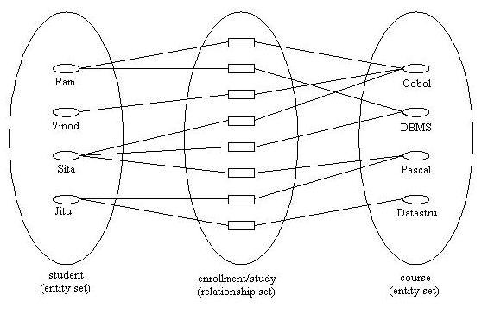

Slide 28
RELATIONSHIP CARDINALITY
is a constraint on a relationship
it characterizes relationships further
given as (mapping) cardinality : how many entities of an entity set participate in a relationship
especially useful for binary relationships

Slide 29
RELATIONSHIP CARDINALITY…
a relationship set R between entity sets A and B may be one of the following
  one-to-one : one entity in A associated with at most one entity in B
  one-to-many : one entity in A may be associated with zero/more number of entities in B. However, one entity in B can be associated with at most one entity from A.
  many-to-one : reverse of above definition (like a mathematical function)

Slide 30
RELATIONSHIP CARDINALITY…
  many-to-many : one entity in A may be associated with any number of entities in B, and vice-versa.
EXAMPLES :
  relationship set TEACHES from TEACHER to COURSE is one-to-many
  (TAUGHT-BY from COURSE to TEACHER is many-to-one)
  relationship STUDY between STUDENT and COURSE is many-to-many

Slide 31
EXISTENCE DEPENDENCE
existence dependency : another important constraint
  existence of entity ‘a’ may depend on existence of another entity ‘b’:
  ‘b’ is called dominant entity and ‘a’ is called subordinate entity

Slide 32
EXISTENCE DEPENDENCE…
there exists existence dependency of
  TEACHER on DEPT as no teacher can be appointed without fixing her department
Subordinate entity has its own key and may
participate in more relationship
Whenever the existence of an entity depends on the existence of another entity, that relationship is described as an existence dependency (ED)

Slide 33
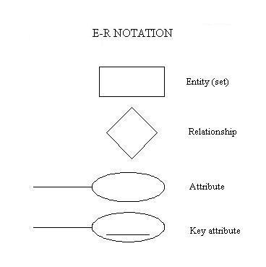

Slide 34
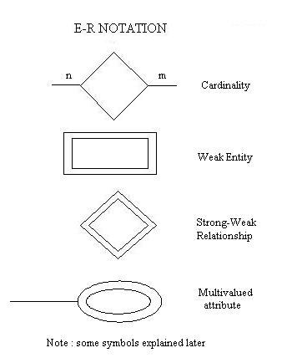

Slide 35
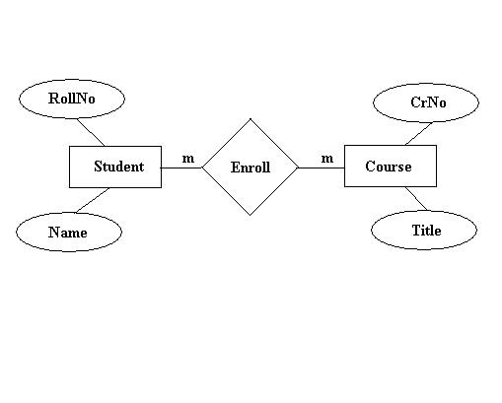
E-R Diagram : Examples

Slide 36
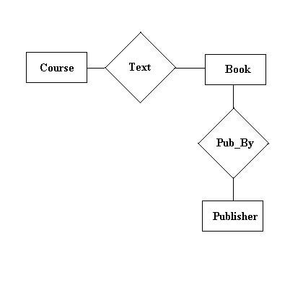
Add some attributes to entities here
Courses may have another course as pre-requisite

Slide 37
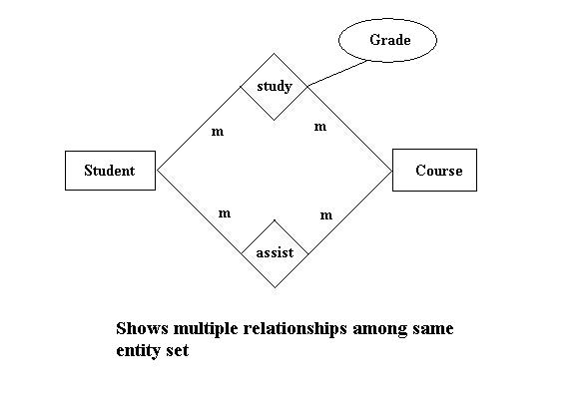

Slide 38
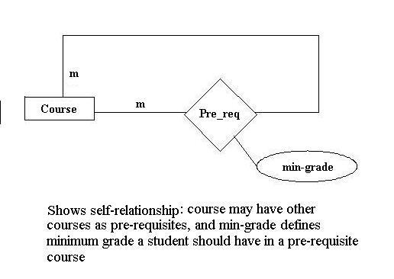

Slide 39
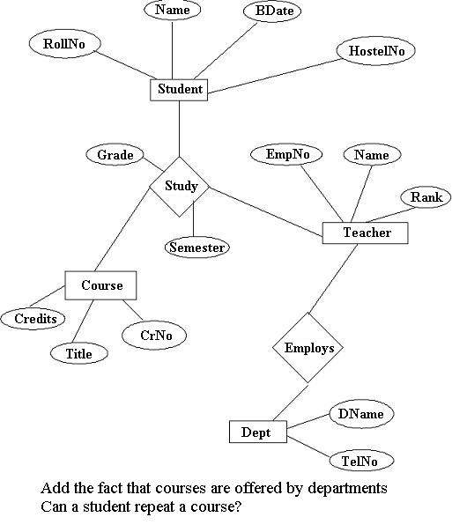

Slide 40
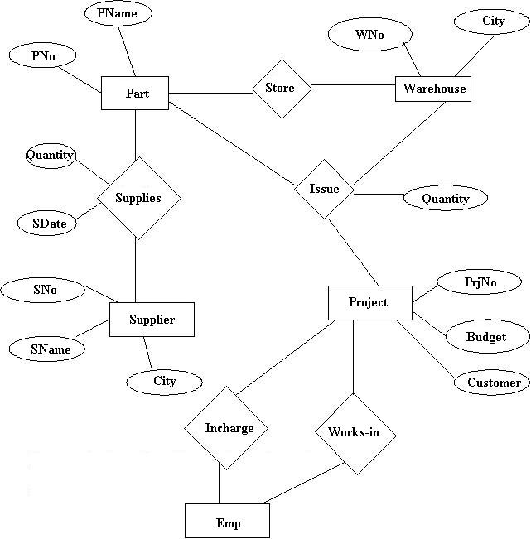
  Describe the real-world mapped above in words.
  Can you represents this : a supplier may supply same part many times
Note : Relationship ‘supplies’ could also be ternary
(by involving warehouse)

Slide 41
TERNARY RELATIONSHIPS
be sure that your model reflects real-world correctly
ternary (or, of higher order) relationships are harder to understand
is a ternary equivalent to two binary? if not, which one is correct in a given situation?

Slide 42
TERNARY RELATIONSHIPS…
consider shipments data where parts are supplied to projects by suppliers in certain quantities; given :
    S1 supplies 40 number of P1 to J1
  we lose context if we replace it by
    S1 supplies 40 of P1
    S1 supplies to J1
  thus, ternary relationship is not same as two binary relationships

Slide 43
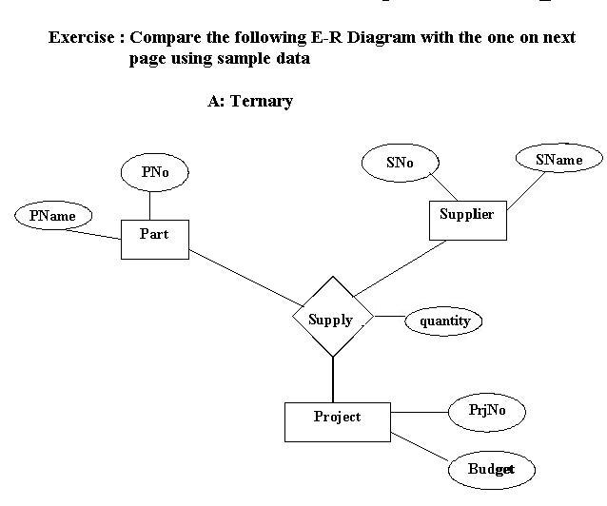

Slide 44
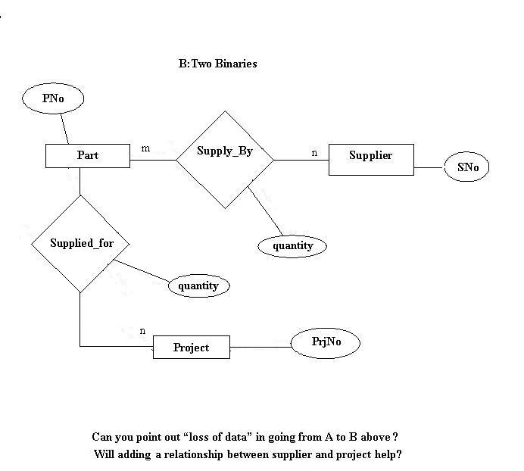

Slide 45
PRIMARY KEYS
to distinguish occurrences of entities and relationships
distinction made using values of some attributes
superkey : set of one/more attributes which, taken collectively, uniquely identify an entity in an entity set
superkey may contain extraneous attributes

Slide 46
PRIMARY KEYS…..
e.g., rollno is sufficient to identify students
  it is a primary key
  combination (rollno, name) is a superkey
  name itself may not be sufficient as key
candidate key is minimal superkey. No subset of it is a superkey
an entity may have multiple candidate keys
primary key is a candidate key chosen by designer as the principal means of identification

Slide 47
PRIMARY KEY FOR REPATIONSHIPS
made of primary keys of all participating entities e.g., primary key of STUDY is
(rollno, courseno)

Slide 48
WEAK ENTITY
does not have a primary key on its own
they are related to one/more ‘strong’ entities
they often can be visualized as multivalued attribute or group of attributes
they either have a ‘partial’ key or we add one to distinguish between those which are related to same strong entity

Slide 49
WEAK ENTITY…
examples:
  branches of a bank
  interviews between candidates and companies viewed as entities (not relationships) so that they can participate further in relationships
  E-R diagrams follow

Slide 50
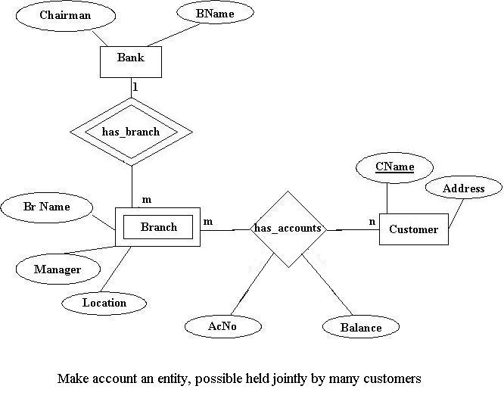

Slide 51
WEAK ENTITY…
partial key (BrName in example) also called discriminatory attribute
a weak entity can participate further in relationships with other entities
a weak entity can also have weak entities dependent on in
primary key of weak entity = primary key of its strong entity + discriminating attribute of weak entity within the context of strong entity

Slide 52
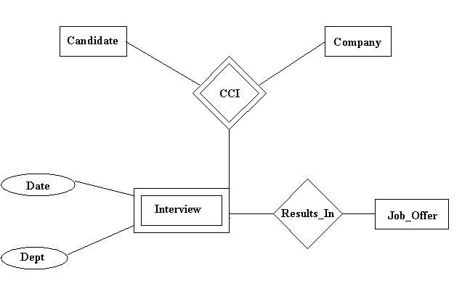
shows weak entity depending on two strong entities.
Taken from Elmasri/Navathe’s book

Slide 53
EXERCISE (Post-Graduate studies)
Students join a particular specialization offered by a department. A specialization with same title (e.g., MICROCOMPUTER) may be offered by one/more depts independently. Teachers are appointed to a specific dept, and given a room and telephone. Depts have some teacher as its head. Courses are offered under various specializations. A teacher may teach many courses and a course may be taught by many. A student studies a course under a teacher during some semester (e.g., semester 1 of 1989), and is awarded a grade. A teacher’s research interest may lie in one/more specializations. Courses have one/more/zero prerequisites

Slide 54
EXTENDED E-R MODEL
extensions to capture more meaning
concepts of generalization, aggregation and sub-set hierarchies added
  Similar to OO concepts : inheritance, composite objects

Slide 55
Generalization
to generalize from two or more entity sets and factor out commonality
entity E is generalization of entities E1, E2, E3 … if each instance of E is also an instance of one and only one of E1, E2, etc.; E called superclass of E1, E2, …
represented by IS-A relationship

Slide 56
Generalization…
Example : given two entities Faculty and Non-faculty,we can define a ‘general’ entity called Employee
Common attributes are factored out to define ‘Employee’ entity; specific (non-common) attributes incorporated in ‘Faculty’ and ‘Non-faculty’ entities

Slide 57
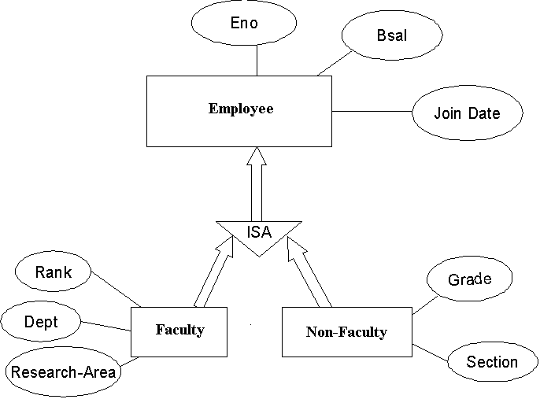

Slide 58
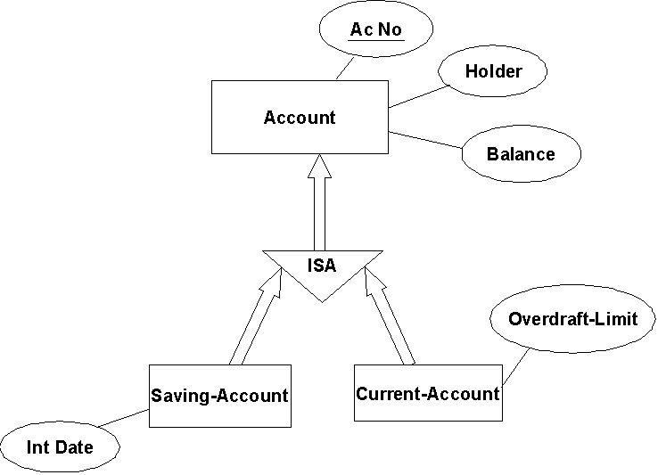
Another example :

Slide 59
Specialization
also called subset hierarchy
entity E1 is subset of E if every instance of E1 is also an instance of E; this is also IS-A relationship
E called superset and E1 as subset (or sub-class); E may have multiple and possibly over-lapping subsets
every instance in E need not be present in subsets of E

Slide 60
Specialization…..
specialization allows classification of an entity in subsets based on some distinguishing attribute/property
we may have several specialization of same entity
the subsets may have additional attributes

Slide 61
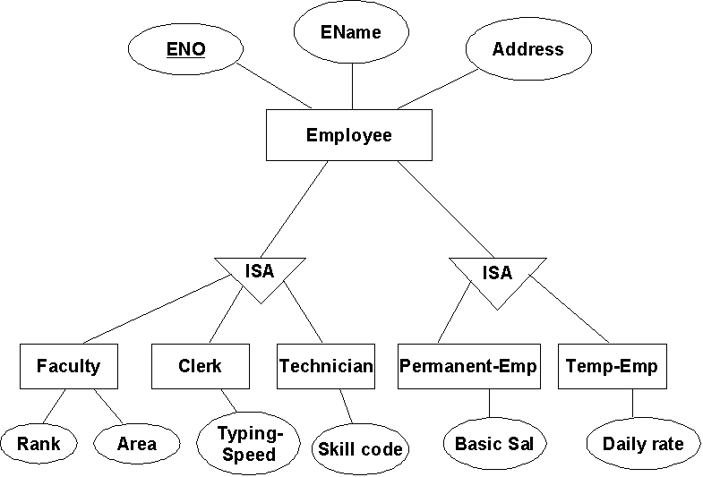

Slide 62
Inheritance
there is inheritance of attributes from superclass or superset
the subclass/subset automatically inherits attributes defined at superclass/superset level
thus, inheritance present in both Generalization and specialization
  Direction important : bottom-up in generalization, top-down in Specialization
  Important to distinguish the two cases

Slide 63
Aggregation
for building complex entity from existing entities (or existing entities and relationships)
two ways of defining complex entities :
  create an attribute whose value is another entity
  define an entity as containing a group of related entities

Slide 64
Examples :
Work-order object (entity) defined as consisting of entities Raw-material, Tools and Workers;
Work-order itself related with Customer entity
Aggregation notation not explicitly provided in Extended E-R model

Slide 65
Work-order
Raw Material
Tools
Worker
Customer
JobNo
Quantity

Slide 66
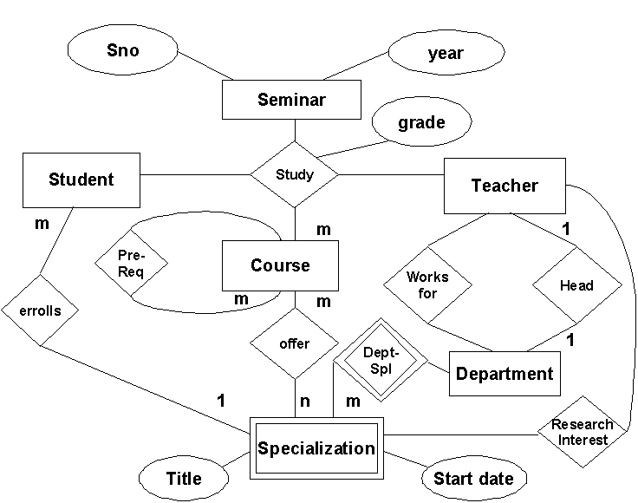
(ANSWER TO EXERCISE)

Slide 67
Going from E-R to Relational Data Model
Need to match
ER model concepts : entity, relationship, attribute
with
Relational model concepts : relation, attribute
entity
Student
Student ( rollno, name, …. )
rollno
name
….

Slide 68
E-R to Relational …
Dept
1
1
Mgr
1:1
DNo
……
MName
……
DEPT (DNo , ………. , MName )
MGR (MName , ……, DNo )
also keys; in one or both

Slide 69
E-R to Relational …
Bank Branch
1
m
Client
ACno
Name
……
BName
Loc
……
BKBranch (BName , Loc , ………. )
Client (Name , ……, BName , Loc , ACno )
The relationship is included in the entity on ‘many’ side;
It includes primary key of entity on ‘one’ side and
Relationship attributes, if any

Slide 70
E-R to Relational …
Std
m
Reg
m
Course
R#
……
Grade
C#
……
STD (R# , ………. )
COURSE (C# , …… )
REG (R# , C# , Grade)

Slide 71
Exercise: Airport database
  keeps track of airplanes, their owners, airport employees and pilots
  Each airplane has a registration number, is of a particular plane type and is stored in a particular hanger. Each plane type has a model number, capacity and weight. Each hanger has a number, capacity and location. The database also keeps track of who owns which plane. Persons have name, address and phones. A person buys a plane on a particular date and cost.

Slide 72
Airport database….
  Each plane undergoes service many times. A service information contains date of work, nature, hours spent, cost, etc. Pilots and employees are persons. Pilots have a license number with validity and salary. Employees have a number, rank and salary. Each pilot is authorized to fly certain types of planes. Employees are involved in servicing of planes.
prepare E-R model
convert to the relational model

Slide 73
Exercises
Prepare E-R models and convert to relational schema
Railway Reservation
  30 days in advance
  trains, stations, quotas, coaches
  passengers, tickets, wait-list, etc.

Slide 74
Exercises…
Old Car Mart
  buying and selling of old cars
  cars, purchases, sales – direct or installment-wise
  service to sold cars, pre-sale repairs
  agents
Cricket Database
  countries, players, teams
  matches, results, scores
  Prepare sample data

Slide 75
Exercise : Portfolio Management
for individual investors
investments are made in shares, debentures, bonds, National saving certificates, various schemes like PPF, ELSS, mutual funds, etc.
these may be acquired at public issue time, purchased from market, obtained as bonus (free), on ‘rights-basis’, etc.

Slide 76
Portfolio …
some investments have regular returns; e.g., yearly, 6-monthly, etc. at fixed or announced rates
these will be sold in market or re-deemed, converted, etc.
how, when and how much invested, what returns already obtained are important for the investor to know how good are his investments. At year end, he may wants to know the market value of his investments

Slide 77
Portfolio …
Exercise :
  Draw E-R diagram
  convert to relational scheme
  check if all relations are in 3NF

Slide 78
QUALITY AND COMPLETENESS CHECKS
ENTITIES
  are they really entities? i.e., things of real significance about which information needs to be held
Checklist
  singular meaningful name
  mutual exclusivity
  at least 2 attributes ( and < 8 )
  synonyms/homonyms
  full definition

Slide 79
QUALITY AND COMPLETENESS CHECKS…
ENTITIES (Checklist…)
  volumetric information
  a unique identifier
  at least one relationship
  at least one business function to create, update, delete, archieve and use the entity
  changes over time
  it (functionally) determines its attributes
  is it too generic ?
  is it sufficiently generic ?

Slide 80
QUALITY AND COMPLETENESS CHECKS…
ATTRIBUTES
  do they really describe the particular entity ?
Checklist
  singular meaningful name
  name not to include entity name
  only one value : no repeating / group value
  complete metadata (format, allowed values, etc.)
  is it really an entity
  value depends only on the entity (not on part of identifier or some other attribute)

Slide 81
QUALITY AND COMPLETENESS CHECKS…
Relationships
  are they really significant associations ?
Checklist
  each end named and capable of being read accurately and sensibly
  each end has a degree and optionality
  is it redundant
  does it cater for time
  check arity
Try populating the E-R model

Slide 82
Entity/Process Matrix
after building data model and defining elementary processes, create a matrix with entities along columns, processes along rows
fill entries indicating which processes create entities, and which read, update and delete the entities
Also called CRUD (Create, Read, Update and Delete) matrix

Slide 83
Relationships between diagrams
FDD identifies processes
These processes shown in DFDs
  DFDs give process dependencies with data interactions added
Data stores in DFDs are basis for E-R diagram
These three diagrams should be consistent

Slide 84
ENTITY LIFE HISTORY (ELH)
depicts pictorially the events affecting life of an entity from creation to deletion
dynamic history : state changes over time are depicted
events may be triggered by input or time
possible effects of events : creation, deletion, modify attributes of entities, relationships or both
ELH Notation

Slide 85
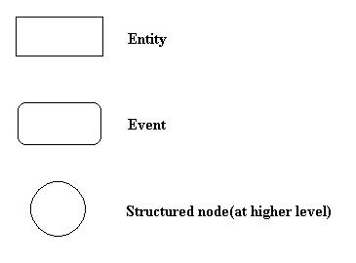
ENTITY LIFE HISTORY (ELH)..
ELH Notation

Slide 86
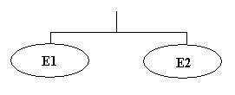
ENTITY LIFE HISTORY (ELH)..
ELH is a tree with an entity type as its root
Event compositions
  sequence of E1 and E2

Slide 87
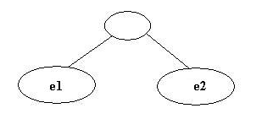

ENTITY LIFE HISTORY (ELH)..
  Selection : e1 or e2 ( one-of )
  iteration :

Slide 88
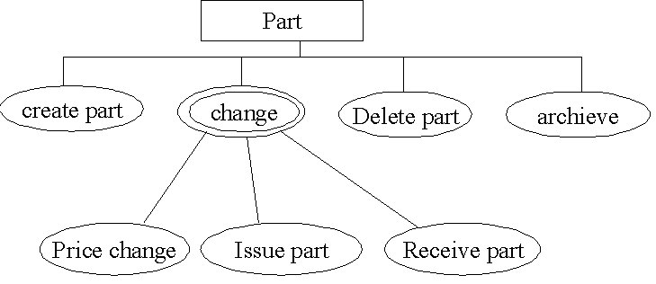
ENTITY LIFE HISTORY (ELH)..
example

Slide 89
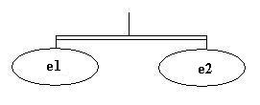
ENTITY LIFE HISTORY (ELH)..
Parallelism between events may be shown :

