Slide 1


Final Project Introduction to Data Science - Semester 1 - 2020 Asad Abid – 102446428

Slide 2




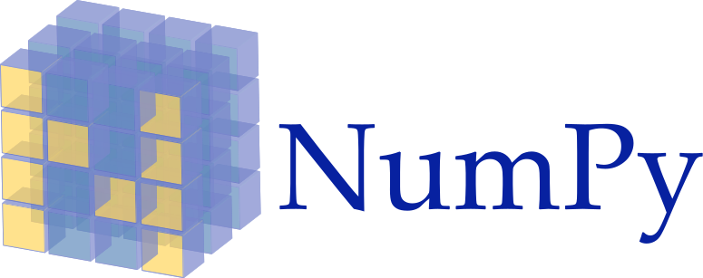
Tools and Libraries

Slide 3

Chocolate Rating Dataset
9 attributes including target variable (rating)
1500 records

Slide 4
Data Pre-Processing
Raw file loaded in a dataframe with encoding “utf-8”
Check for Duplicates if present then drop
Check and drop if any row has more than 50% missing data
Removing all leading and trailing whitespaces
Renaming Columns
Checking Null Values

Slide 5

Interpreting Null and Missing Values
For Column BeanType one ‘Null’ value and 750 'Â' values
For Column BroadBeanOrigin one ‘Null’ value and 61 'Â' values
'Â’ → missing values
Converting all ‘Â’ values → NULL
BeanType → 751 missing values
BroadBeanOrigin → 62 missing values

Slide 6
Filling Missing Values
Calculating Correlation Coefficient for BeanType and BroadBeanOrigin
Using highly predictive columns, calculated mode incorporating group by method
Created Key:Value pairs for results by using dictionary
Filled level by level until all values are filled
Example:
BeanType = ["BroadBeanOrigin"],["Rating"],["SpecificBeanOrigin"]
One level down:
BeanType = ["BroadBeanOrigin"],["Rating"]
One level further down:
BeanType = ["BroadBeanOrigin"]

Slide 7

Handling Other Data Issues
CocoaPercent: Removed ‘%’ symbol and divided by 100, hence converting it to float
Example: 64% → 0.64
CompanyLocation: Removed ‘.’ (full stops) from locations
Example: U.S.A→ USA
Company(Maker-if-known): Replaced Melters names with Makers name. Replacing the cell values with values inside bracket.
Example: Original Beans (Felchlin) → Felchlin Tablette (aka Vanillabeans) → Vanillabeans

Slide 8
Feature Engineering (BeanTypeVariety)
Forastero if exact matches ‘Amazon’; is ‘Beniano’, ‘Nacional’; or ‘Nacional (Arriba)’ or specifies the subspecies ‘Amelonado’, ‘Arriba’, ‘Catongo’, ‘Nacional’, or ‘Parazinho’.
Example: 'Amazon’ : 'Forastero'
Criollo if exact specifies the subspecies ‘Amarru’, ‘Porcelana’ or ‘Wild’.
Example: 'Criollo (Amarru)’ : 'Criollo'
Trinatario if exact is ‘Trinitario, TCGA’; or specifies the subspecies ‘Amelonado’ or ‘Scavina’.
Example: 'Trinitario (Scavina)':'Trinitario'
Blend if matches ‘blend’; or mixes any of the three main varieties.
Example: 'Blend-Forastero,Criollo’ : 'blend'
Hybrid if is ‘Matina’ or EET’; or matches ‘CCN’ or ‘Ocumare’
Example: 'EET’ : 'hybrid'

Slide 9
Feature Engineering…
BroadBeanOriginModified
If BroadBeanOrigin has more than one country it will be replaced by Multiple.
Identifying data by symbols and keywords like ( ‘,’ 'and’ ‘&’ ‘/’ ‘-’ )
Example: Peru, Mad., Dom. Rep. = Multiple
Central and S. America = Multiple
SpecificBeanOriginCleaned
If SpecificBeanOrigin has, stripping any symbols using Regex (r"[^a-zA-Z ]+", " ")
Removing the information after first Comma ( , )
Example: Matagalpa, Cacao Bisiesto = Matagalpa
Cuba, Batch 59/100 = Cuba

Slide 10

Learning Type of Problem
Supervised Learning
Classification Problem

Slide 11
Binning Target Variable
Solving this as a classification problem so using Cut( ) for ‘Rating’ Column
Example:
Cut_bins | Cut_Labels
[0-1.99] | 1
[3.999 – 4.999] | 4

Slide 12
Creating Dummy Variables
By Using Correlation Coefficient, all highly predictable columns are selected for model development.
Some columns are not used because of the multicollinearity.
Example: The correlation coefficient between SpecificBeanOrigin and SpecificBeanOriginCleaned is 99% so using modified one
ReviewDate and REF has 98% so using REF.
Dummy variables are created for important selected features which are categorical.
Total columns afterwards 762.

Slide 13
Data Partitioning
Train
Test
Train_Test Split

Slide 14
Learning Algorithms
Decision Tree
K - Nearest Neighbors
Random Forest

Slide 15

Hyperparameter Tuning - GridSearchCV
DecisionTreeClassifier
min_samples_split = [2,5,7]
min_samples_leaf = [10,20,30]
KNeighborsClassifier
leaf_size = [1,3,5]
p = [1,2]
RandomForestClassifier
max_depth =[1,3,5,7,9]
min_samples_split = [2, 5,7,9]
min_samples_leaf = [1, 2, 4]
max_depth = [1,3,5]
n_neighbors = [25,27,29,30]
n_estimators = [1,3,5,7,10]

Slide 16

Assessing Validation Performance – Cross Validation Score
 | DecisionTreeClassifier | KNeighborsClassifier | RandomForestClassifier
Mean Validation Performance - 3 folds | 0.6838152296605019 | 0.6838152296605019 | 0.6847621993574716
Mean Validation Performance - 4 folds | 0.6772220861614056 | 0.6809741487196952 | 0.6819246091137657
Mean Validation Performance - 5 folds | 0.6838207782489399 | 0.6809771763532052 | 0.685702841683136

Slide 17
RandomForestClassifier - Performance Assessment on Test Data
Accuracy
71.33%

Slide 18





Visualisation Libraries
Bonus Section
Bar Chart
Regression Plot
Treemap
Geographical map

Slide 19
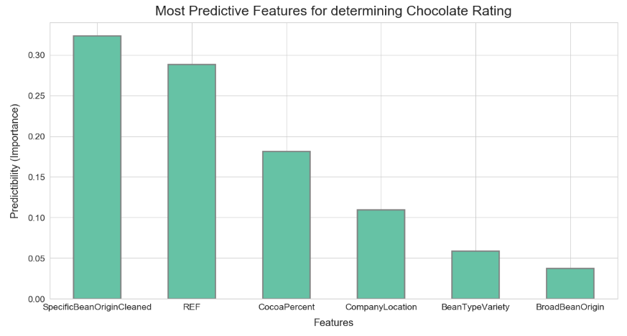
Bar Chart of most predictive attributes using RandomForest Feature_Importance

Slide 20

Thank you

