Slide 1
Lascon 2022 badge game
(Blockchain CTF Solution)

Slide 2
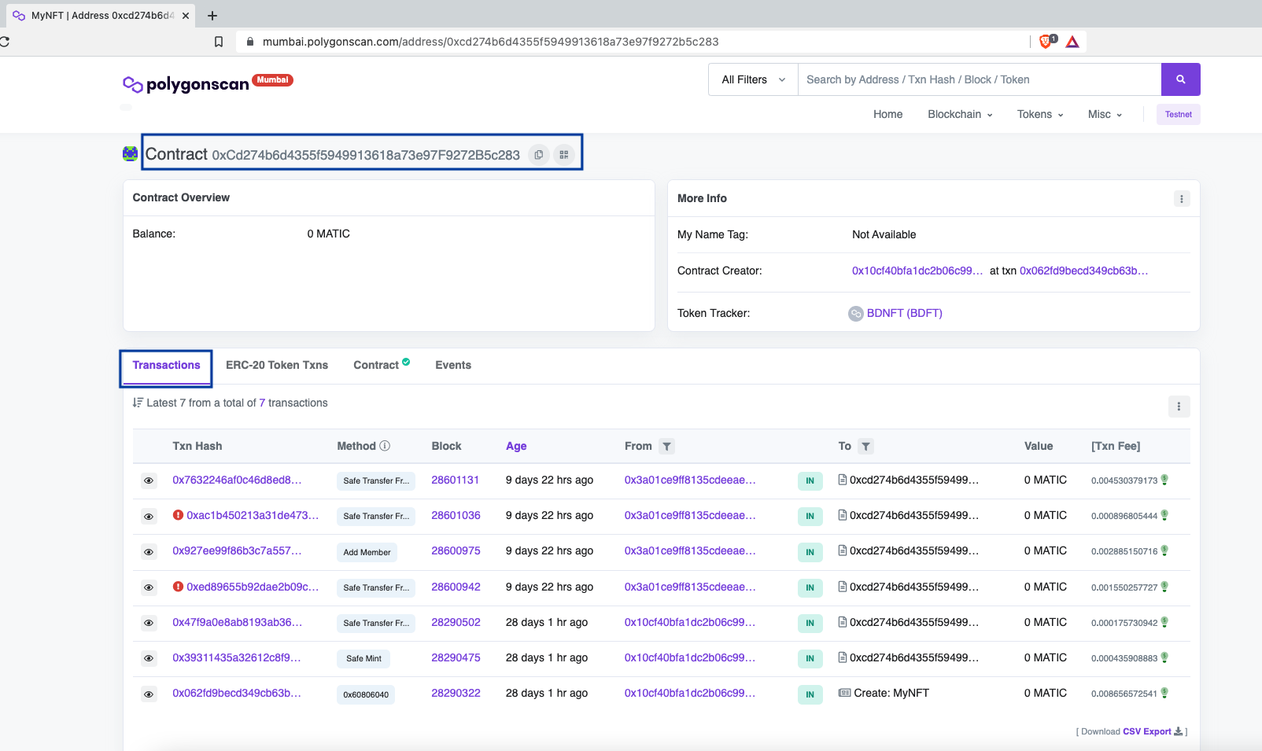
SmartContract - Polygon Test Network

Slide 3
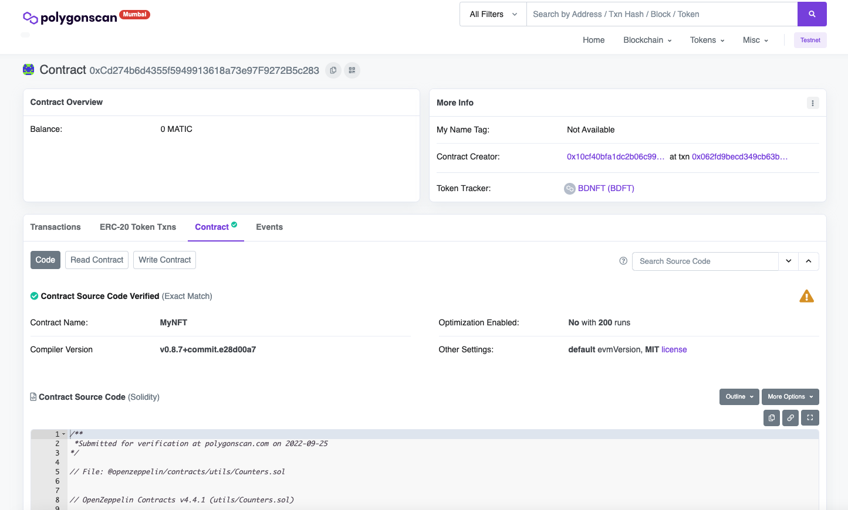
Go to Contract Tab

Slide 4
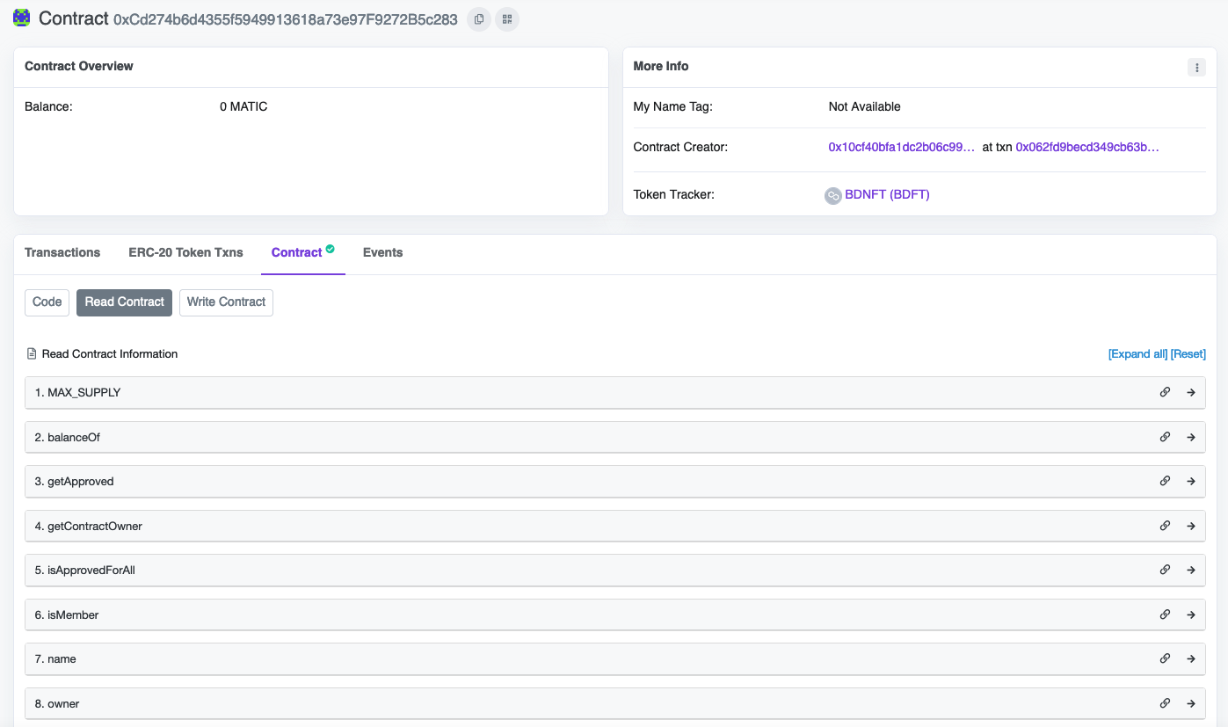
Get familiar with all functions available in the smart contract

Slide 5
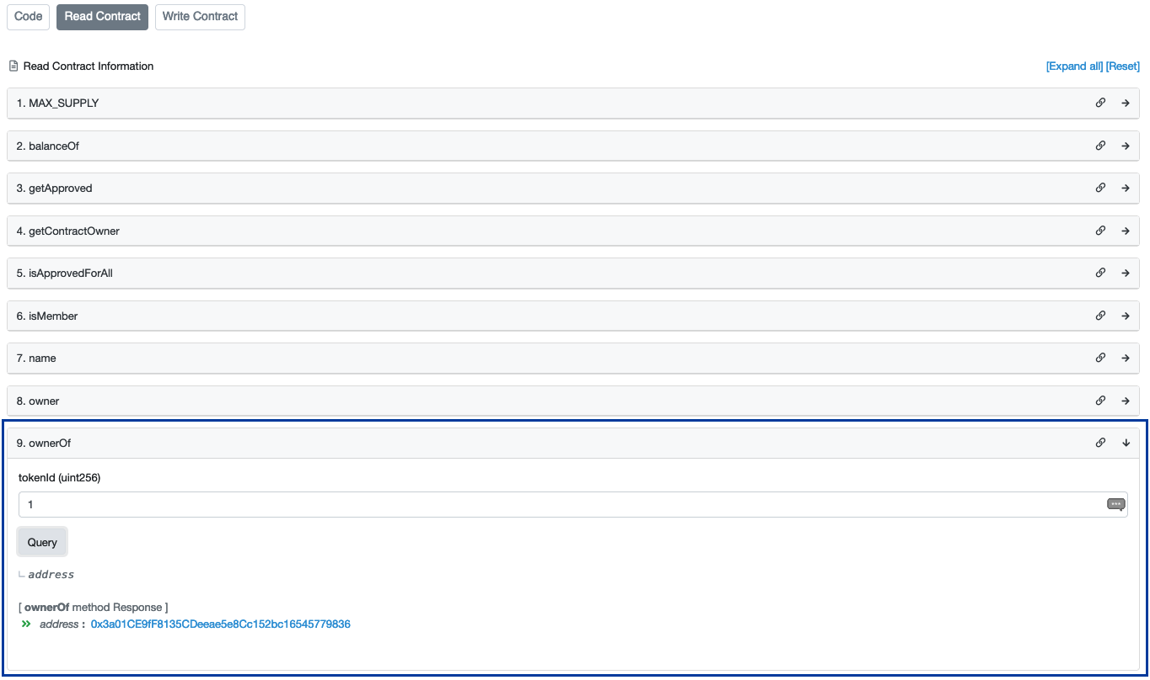
Find Owner of NFT token

Slide 6
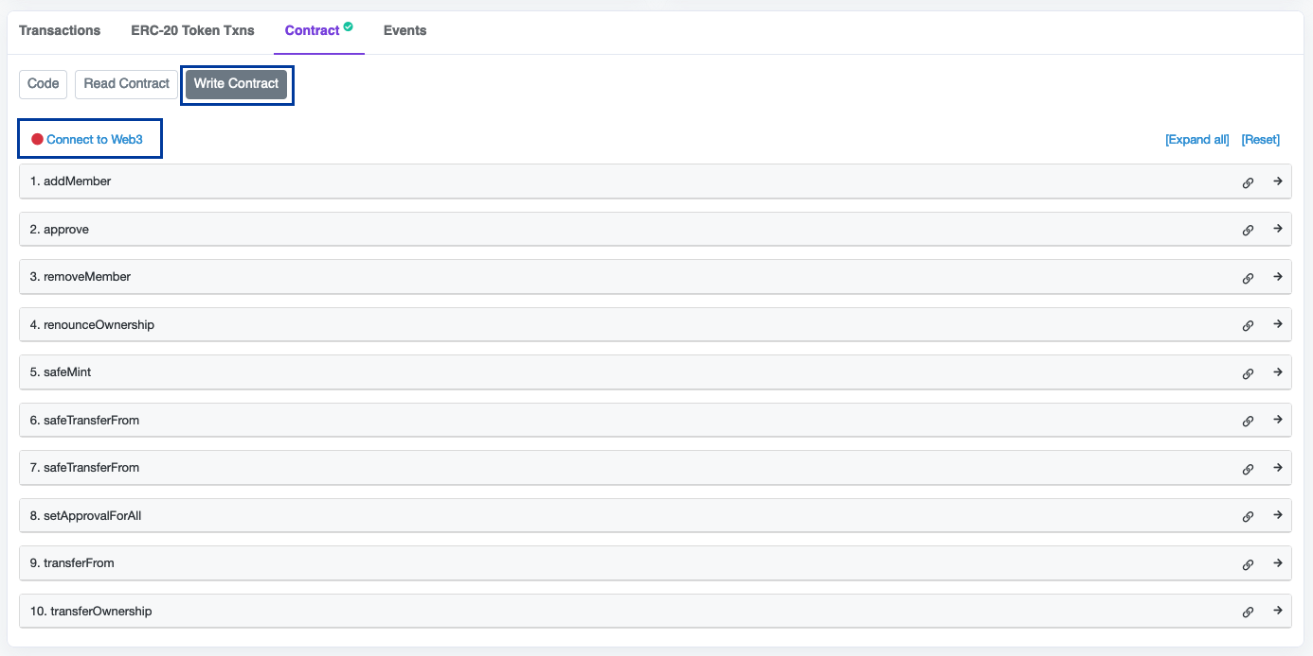
Connect to Web3 provider like Metamask

Slide 7
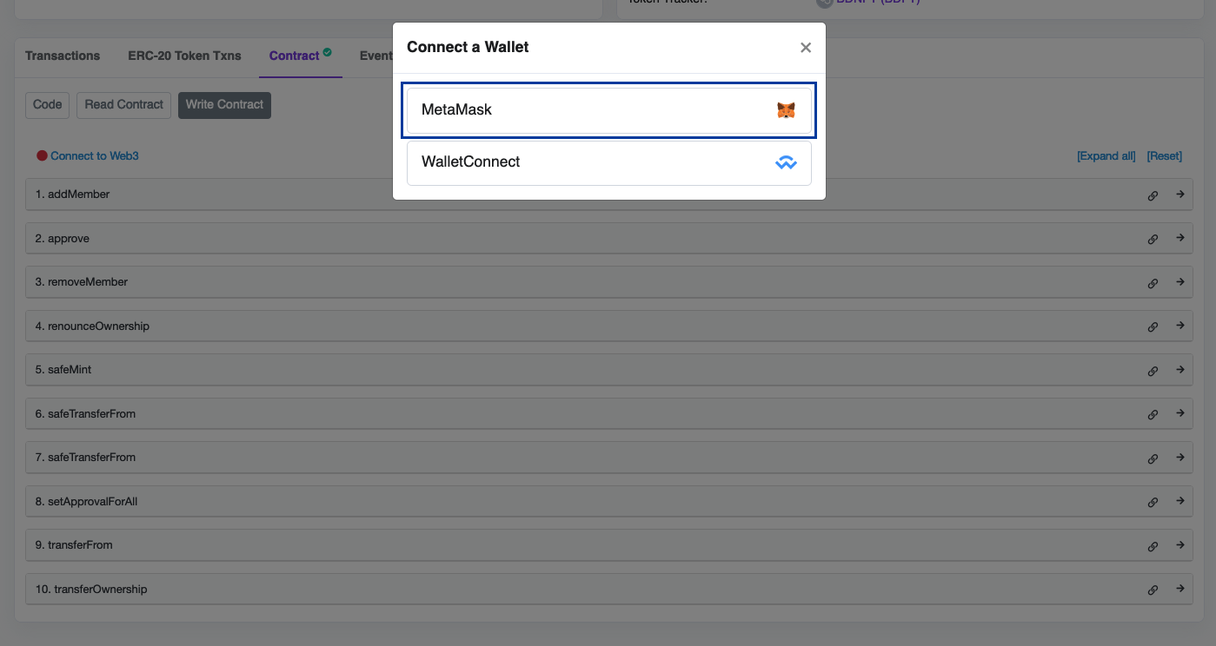
Metamask

Slide 8
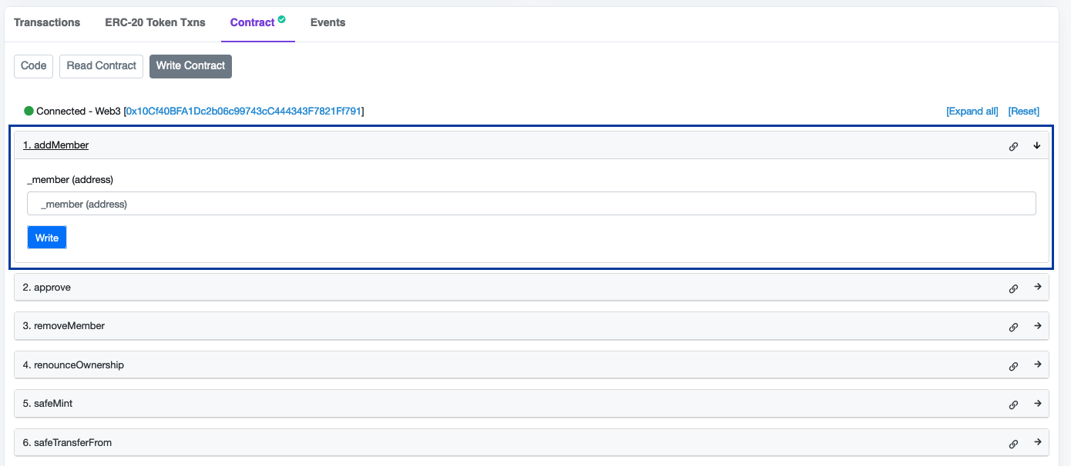
Add Wallet Address to whitelist

Slide 9
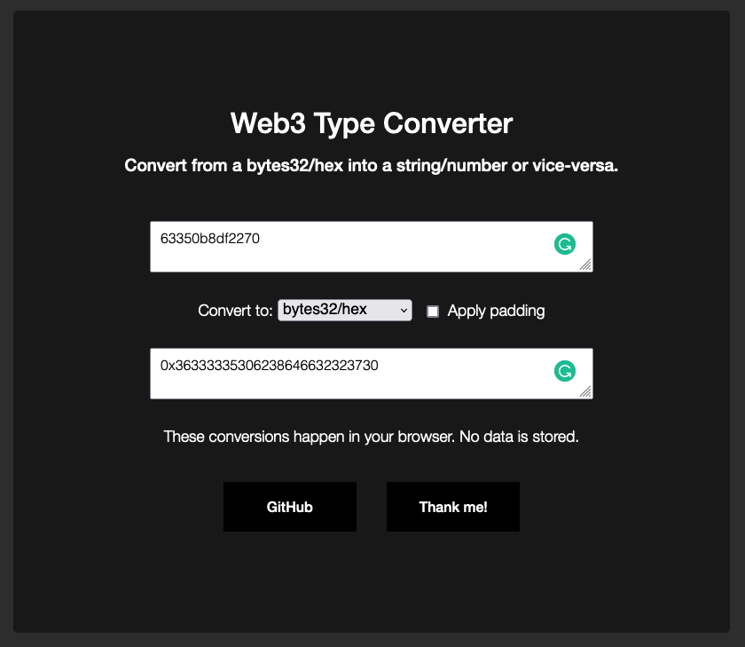
Convert code to bytes
URL: https://web3-type-converter.onbrn.com/

Slide 10
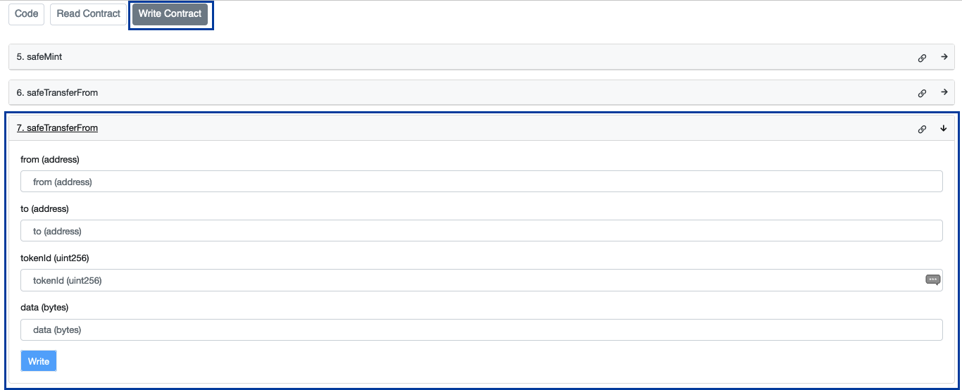
Transfer ownership of NFT token to your wallet address

Slide 11
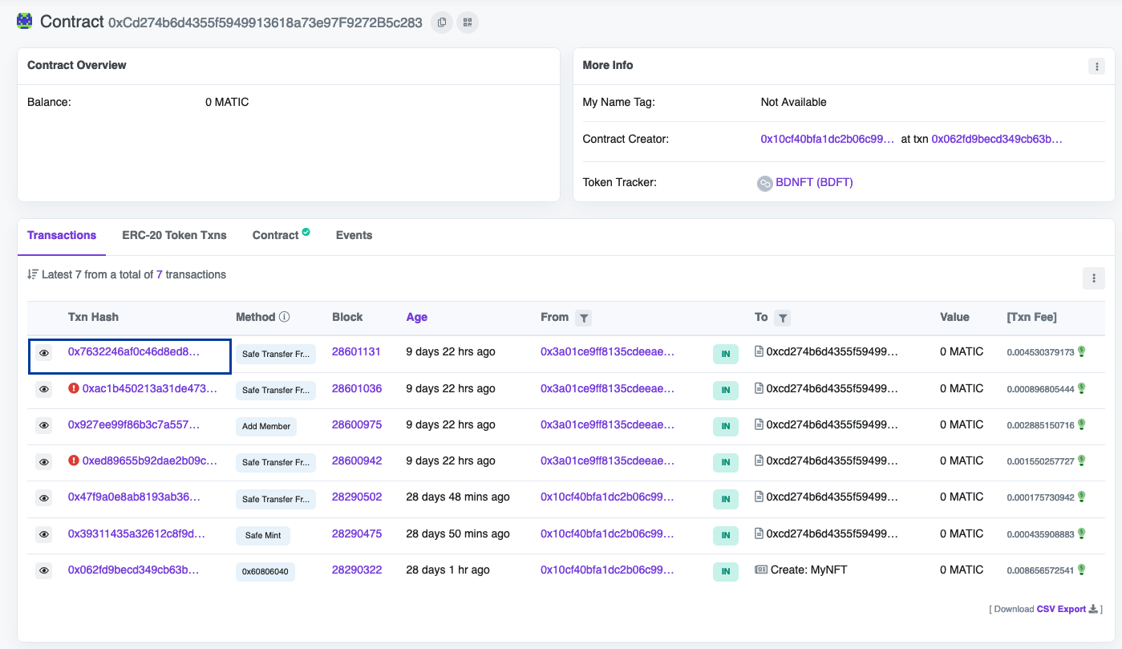
Verify transaction

Slide 12
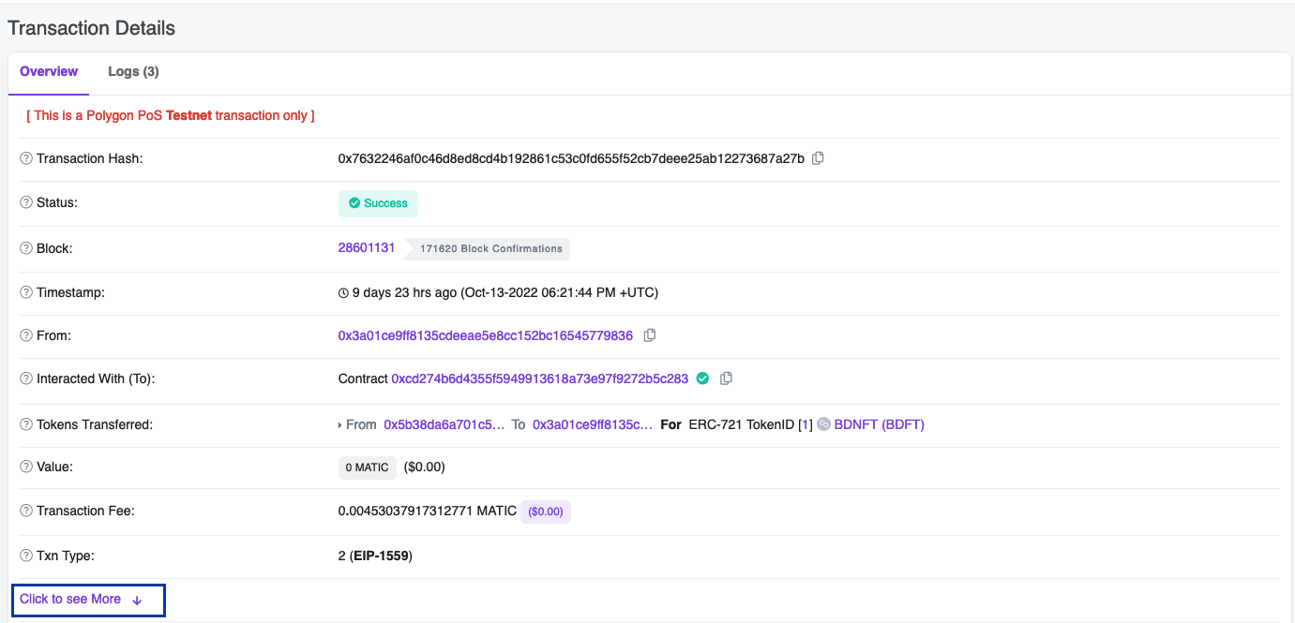
Verification (cont’d)

Slide 13
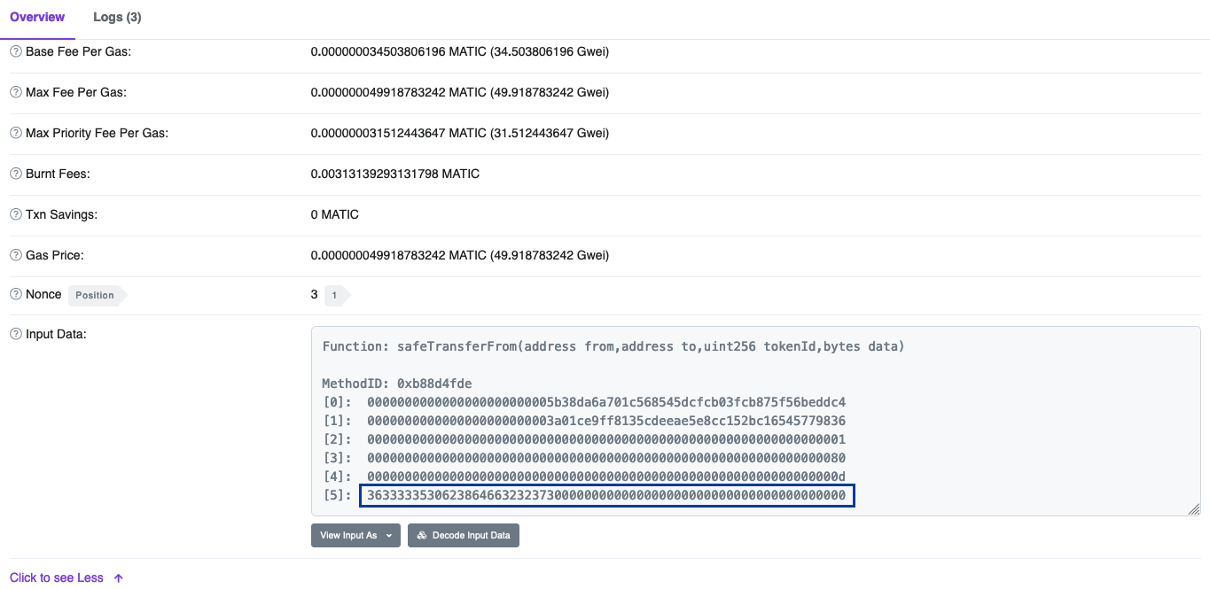
Copy bytes data
Source: https://stackoverflow.com

Slide 14
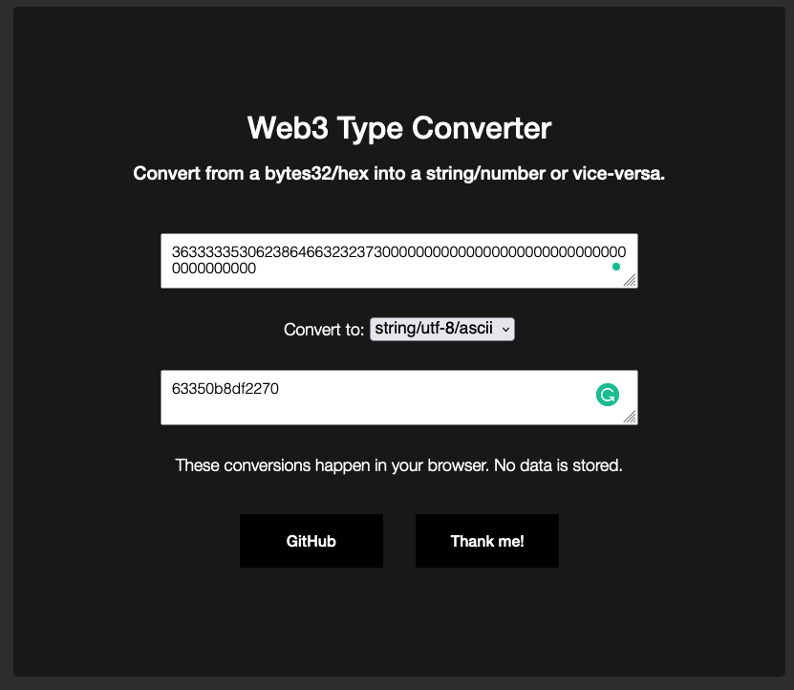
Ensure code is same
Source: https://stackoverflow.com

Slide 15
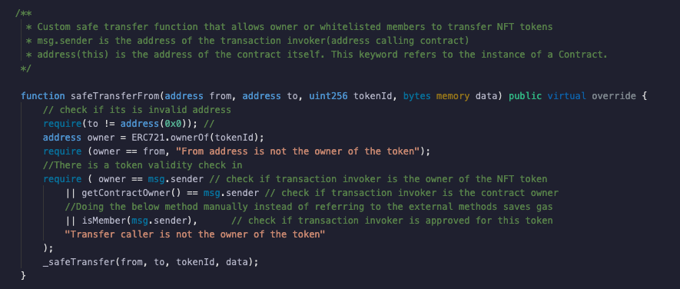
Safe Code

Slide 16
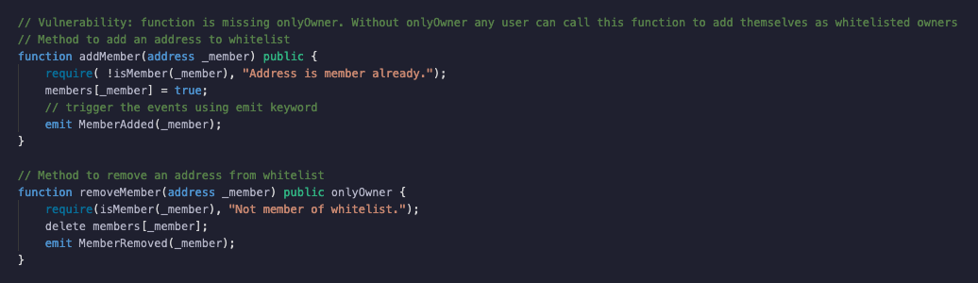
Vulnerable Code

Slide 17
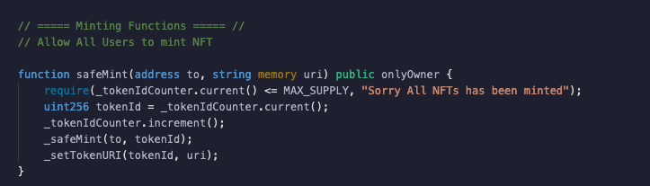
Example: Safe Code

Slide 18
THANKS!
Any questions?
You can find me at
@asadasivan & contact.arunsec@gmail.com

