Slide 1
Fan: Matematika Sing: 5
Mavzu: To‘g‘ri to‘rtburchak va uchburchaklardan tuzilgan murakkab shakllarning yuzi

Slide 2
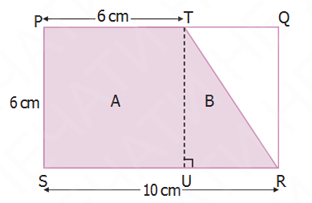
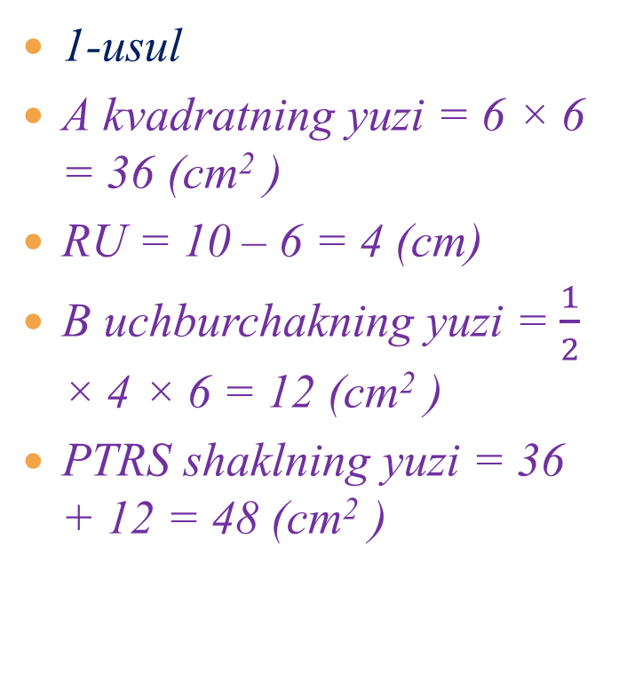
PQRS – to‘g‘ri to‘rtburchak, PTUS esa kvadrat. Bo‘yalgan shaklning yuzini toping.
1-usul
A kvadratning yuzi = 6 × 6 = 36 (cm² )
RU = 10 – 6 = 4 (cm)
B uchburchakning yuzi = $\frac{1}{2}$ × 4 × 6 = 12 (cm² )
PTRS shaklning yuzi = 36 + 12 = 48 (cm² )

Slide 3
PQRS – to‘g‘ri to‘rtburchak, PTUS esa kvadrat. Bo‘yalgan shaklning yuzini toping.
1-usul:
A kvadratning yuzi = 6 × 6 = 36 (cm² )
RU = 10 – 6 = 4 (cm)
B uchburchakning yuzi = × 4 × 6 = 12 (cm² )
PTRS shaklning yuzi = 36 + 12 = 48 (cm² )
2-usul:
PQRS to‘g‘ri to‘rtburchakning yuzi = 10 × 6 = 60 (cm² )
TQ = 10 – 6 = 4 (cm)
TQR uchburchakning yuzi = × 4 × 6 = 12 (cm² )
PTRS shaklning yuzi = 60 – 12 = 48 (cm² )

Slide 4
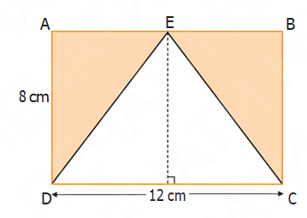
ABCD to‘g‘ri to‘rtburchakning bo‘yalgan qismi yuzini toping
ABCD to‘g‘ri to‘rtburchakning yuzi = 12 × 8 = 96 (cm²)
DEC uchburchakning yuzi = 1 2 × 12 × 8 = 48 (cm²)
Bo‘yalgan qismning yuzi = 96 – 48 =48 (cm²)

Slide 5
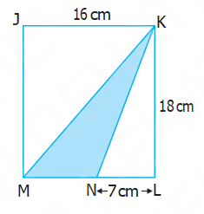
JKLM to‘g‘ri to‘rtburchak berilgan. Bo‘yalgan uchburchak yuzini toping.
MN kesma KMN uchburchakning asosidir. MN = 16 – 7 = 9 (cm²)
Bo‘yalgan uchburchak yuzi = 1 2 × 9 × 18 = 81 (cm²)

Slide 6
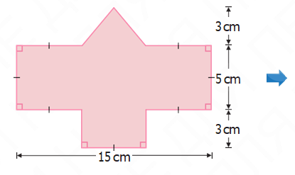
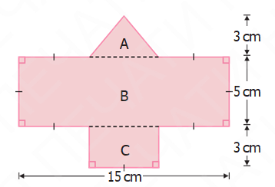
Quyidagi rasmda keltirilgan shakl nimalardan tashkil topganini aniqlang va uning yuzini toping.
.

Slide 7
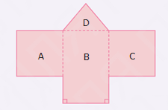
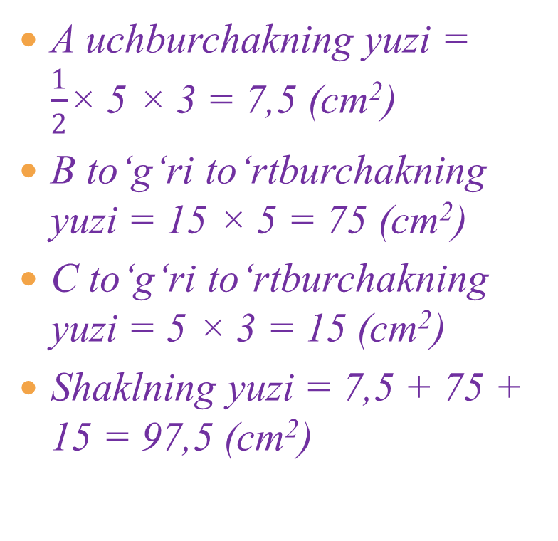
Men A, B, C va D shakllarning yuzini qo‘shib, umumiy shaklning yuzini topa olaman.
A uchburchakning yuzi = $\frac{1}{2}$× 5 × 3 = 7,5 (cm²)
B to‘g‘ri to‘rtburchakning yuzi = 15 × 5 = 75 (cm²)
C to‘g‘ri to‘rtburchakning yuzi = 5 × 3 = 15 (cm²)
Shaklning yuzi = 7,5 + 75 + 15 = 97,5 (cm²)

Slide 8
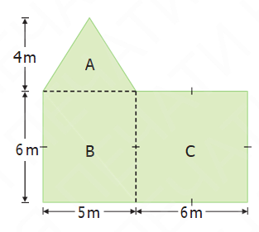
Uchburchak, to‘g‘ri to‘rtburchak va kvadratdan tashkil topgan shaklning yuzini toping.
A uchburchakning yuzi = 1 2 × 5 × 4 = 10 (m²)
B to‘g‘ri to‘rtburchakning yuzi = 6 × 5 = 30 (m²)
C kvadratning yuzi = 6 × 6 = 36 (m²)
Shaklning yuzi = 10 + 30 + 36 = 76 (m²)

Slide 9
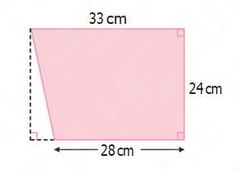
Juftlikda ishlang
Quyidagi rasmda keltirilgan shakllar nimalardan tashkil topganini aniqlang va ularning yuzini toping. Javobingizni sinfdoshlaringiz bilan o‘rtoqlashing.

Slide 10
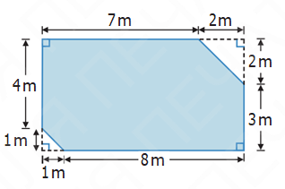
Juftlikda ishlang

Slide 11
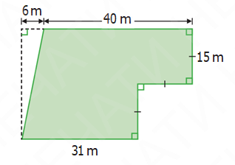
Juftlikda ishlang

Slide 12
Uyga vazifa:
Mashq daftari 123-128-betlar

