Slide 1
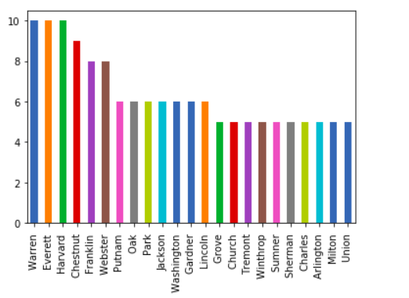
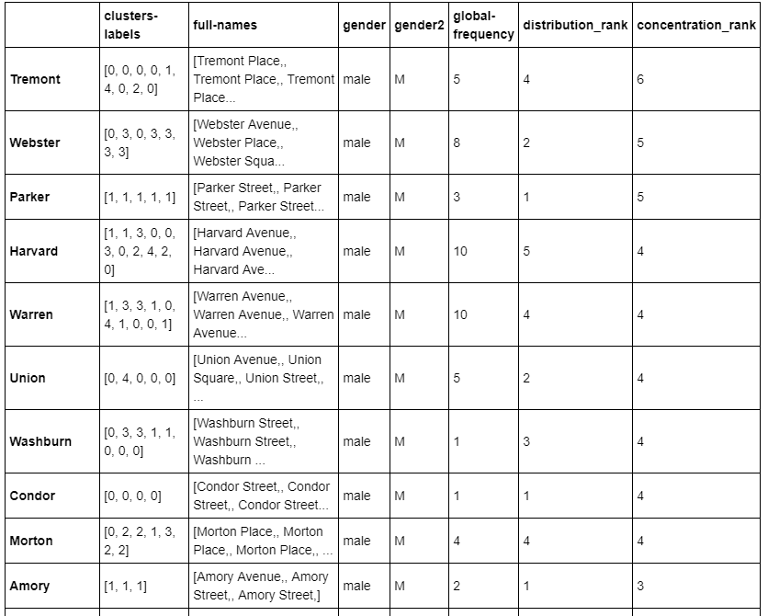
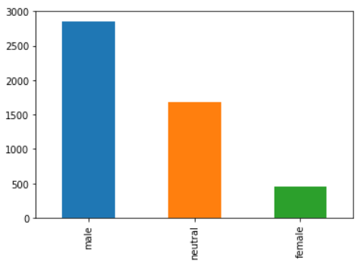
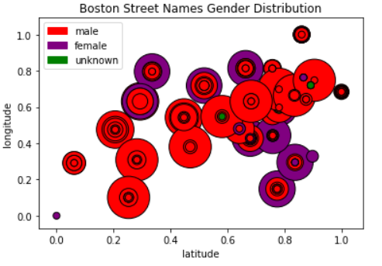
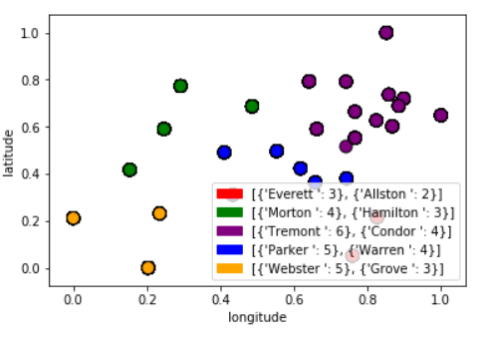
Taking Gender Equity to the Streets
bu.edu/cs
Our Goal:
Understand Boston's street names from a gender perspective. Given Boston's parochial history, the city of Boston is concerned with representing its current demographic of 52% women. As such, by classifying street names as female, male, or neutral, we are able to gain insight into their characteristics, repetitiveness, and determine which are candidates for renaming.
Renaming Criteria:
Global Frequency - Frequency of the name in the original data set
Distribution Rank - The number of clusters that the name appears in. The more clusters it appears in, the better the distrubtion, the higher the rank.
Concentration Rank - Local frequency of the name in each cluster
Datasets:
CityofBoston.gov contains a word document of all the streets in the Boston area. We also used another dataset containing the zip codes, longitude, and latitude from a GitHub repository to produce more meaningful data when applying the K Means Clustering technique.
Clustering Analysis:
Obtain names with highest concentration ranks and compare their global frequencies and distribution ranks.
Gender Classification:
We used a popular gender classifier API called Namsor which is capable of classifying names of varying ethnic backgrounds. We also used an additional python library for gender classification called Gender Predictor in order to compare the gender results. This helps us produce a more accurate classification of the data.
Challenges:
The Boston street book did not contain GEO locations. We needed to clean and combine datasets to get associated longitude and latitudes
Large data sets led to longer processing times, especially when using an API
Deciding the renaming criteria and producing the metrics to do so

