Slide 1


NYC Airbnb
Market Trends
& Insights
MGG 633
Group 10
GROUP 10
Asad Firoz · Riya Gupta · Kinjal Goyal · Daniel Charles

Slide 2

Why Airbnb?
THE NYC SHORT TERM RENTAL MARKET IS BOOMING
Airbnb has changed the landscape of renting (particularly short-term rental markets) in major cities such as NYC, being one of the more active cities for Airbnb rental listings. It’s become a supplement to household income for landlords and alternative to hotels for consumers.
Quick Facts:
100,000+ Listings spread across the five boroughs
Several hundred neighborhoods
Listing ranges from $100 per night (outer borough) to exceeding $1,000 per night (central manhattan)

Slide 3




01
02
03
04
PRICING ANALYSIS
HOSTS & BOOKING
REVIEWS & RATINGS
AVAILABILITY TRENDS
How does price vary across NYC boroughs and room types? How is the overall price distribution shaped?
What proportion of hosts on the platform are identity-verified, and how does verification vary geographically?
How has review activity evolve and what drives rating? Track platform growth, COVID impact, and factors behind higher guest ratings.
Which boroughs are most and least booked up? Identify high-demand areas and availability trends across neighborhoods.
What's the Story?
This report is intended to serve two audiences. The academic audience is evaluating the analytical and modeling work. Second, the hypothetical business-focused audience (short-term rental operators, real estate analysts, or city policy researchers), who could use the dashboard and findings to understand pricing, investment strategies, or regulatory decisions.

Slide 4
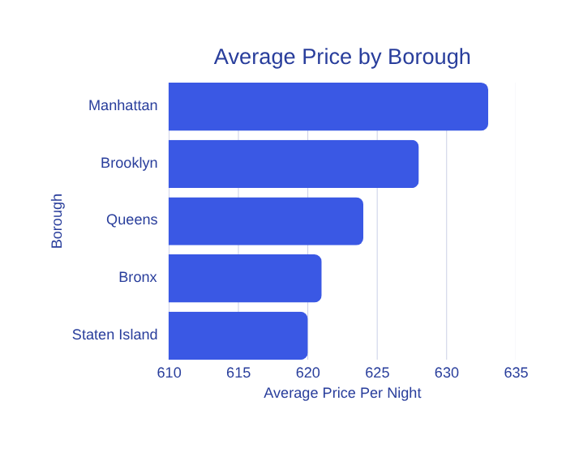
Pricing
Analysis
HOW DOES PRICE VARY ACROSS NYC BOROUGHS AND ROOM TYPES?
$625
Key Points:
Overall avg price/night: $625
Price gap: $13 gap (Manhattan vs. Staten Island)
Price Distribution: $200-$1,000/night
Borough matters less than the room type. A well-crafted listing in Queens is worth as much as a listing in Manhattan.
Overall avg price per night

Slide 5
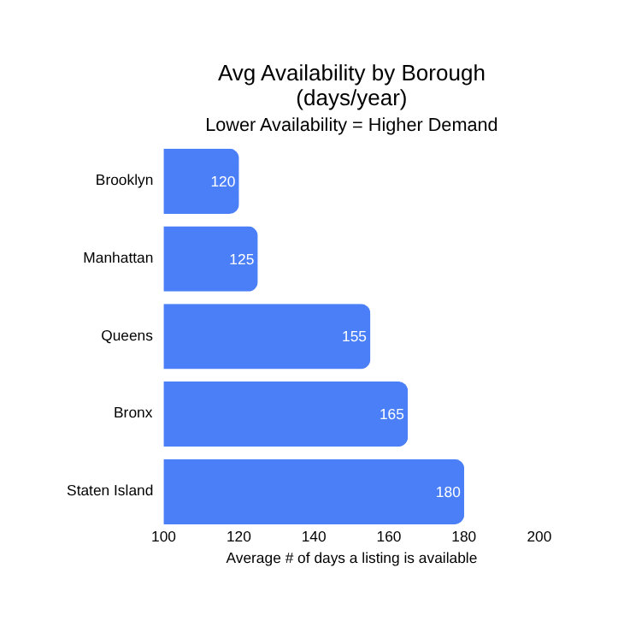


Host Behavior & Availability
HOST VERIFICATION ANALYSIS
49.8%
Only 49.8% of NYC Airbnb hosts have completed identity verification. This 50/50 split is consistent across all five boroughs; verification is a platform-wide behavior, not a geographic indicator of trustworthiness. Getting verified represents an immediate competitive advantage.
HOSTS IDENTITY-VERIFIED
VERIFICATION RATE
Half of NYC Airbnb hosts are verified. No 'trustworthy borough' pattern found.
AVAILABILITY GAP
Manhattan & Brooklyn show lowest availability, indicating highest demand.
KEY INSIGHT
Lower availability = higher demand. Location drives booking pressure.

Slide 6
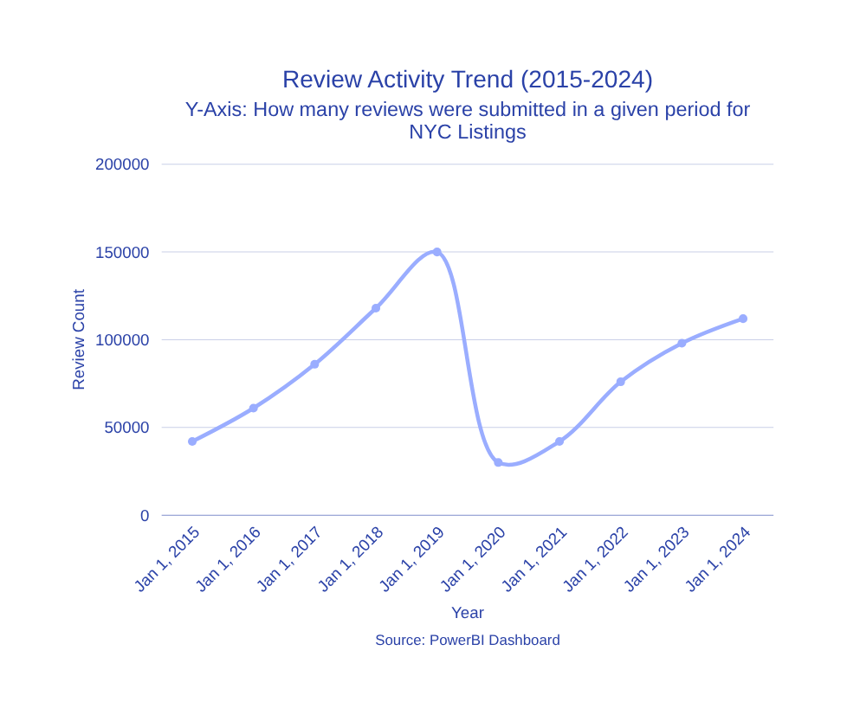
Reviews & Recency
HOW HAS PLATFORM ACTIVITY EVOLVED, AND WHAT DRIVES HIGHER RATINGS?
Review Activity Trend (2015–2024):
• Growth (2015–2019): Platform scales to 150K monthly reviews as NYC short-term rentals boom
• COVID Collapse (2020): Reviews drop ~80% as travel halts globally
• Recovery (2022–2024): Gradual rebound underway, but activity has not yet returned to pre-pandemic peaks
Key Insight: Since the COVID-19 collapse (2020), the Airbnb market in NYC has only been rising in demand and could eventually reach the market's peak (2019) or surpass it moving forward.
150K
PEAK MONTHLY REVIEWS PRE-COVID

Slide 7
01
Borough ≠ Price
4 Things the Data Told Us
Average nightly prices nearly identical across boroughs (~$620–$633). Room type and quality matter more.
02
Verification Gap
Only 49.8% of hosts are verified. There is an immediate competitive advantage for those who verify.
ACROSS 102,000 LISTINGS, FOUR PATTERNS STAND OUT CLEARLY
Room type and quality of listing is doing the real work
Since half the platform in NYC is unverified, getting verified is one of the EASIEST competitive edges a host can have
COVID has made the NYC market drop. NOW would be the best time to get into the airbnb market in NYC before it resurges like it did in 2019
COVID Left a Mark
03
Review activity collapsed ~80% in 2020; recovery has been gradual and slow. Strong resurge from 2024 to current.
04
Professionalism Pays
Listings that are well-maintained, proper pictures, and attentive hosts typically have higher $ per night.

Slide 8


Implications & Recommendations
ACTIONABLE INSIGHTS FOR HOSTS, OPERATORS & POLICYMAKERS
Get verified. Only half of the hosts are. It's a free competitive edge that builds guest trust.
Operate more like a hotel. Consistent standards and professional hospitality lead to better ratings.
Don't overfocus on borough. A well-run Queens listing competes effectively with Manhattan.
For policymakers: Monitor host concentration, pair with NYC tourism data, note gradual recovery.

Slide 9


Thank You!
Any Questions?
MGG 633
Group 10

