Slide 1
AI – RAG & Chatbots
Notes:
Imagine asking a chatbot a question—and it answers like a subject-matter expert. Not because it memorized the answer… but because it retrieved the right knowledge in real time and generated a response just for you. That’s the magic of RAG—Retrieval-Augmented Generation—and it’s changing how we interact with AI
Given the diverse backgrounds of our audience, we'll keep the session simple and conversational.
Your participation is highly encouraged!
AI is a rapidly evolving field — none of us know everything, but together, we can explore, learn, and grow from each other’s insights.
Session Flow: We'll begin with the basics to establish a common foundation, followed by a couple of demos to bring the concepts to life.

Slide 2



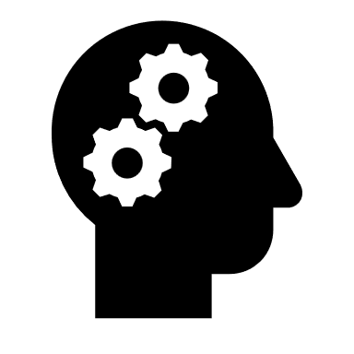

You
Query
Prompt
LLM
Output
Notes:
Let’s walk through how a typical interaction with an AI model works:
It starts with You — the user.
You have a query in mind — something you want to ask or know.
That query is converted into a prompt — a more natural or instructive form.
The prompt is then sent to the LLM — the large language model, like GPT.
The LLM processes the prompt and generates a meaningful response — your final output.
A prompt is the input or instruction you give to the model. It’s how you tell the AI what you want it to do.
Example:
Query: weather in Paris
Prompt: What's the weather like in Paris today?
In traditional search engines, the query might work fine. But for AI models, a prompt helps provide better context and generates richer, more accurate responses.

Slide 3

What if we want to augment the output with our own data?
Notes:
Let’s say the language model gives great responses—but it doesn’t know anything about your company, your domain-specific knowledge, or your internal documents.
So what if you want the model to go beyond its training and include your own data in the response?
For Bentley wiki documents?

Slide 4

Retrieval-Augmented Generation in Action
Notes:
That’s where RAG — Retrieval-Augmented Generation — comes in action!
Instead of relying only on what the model knows, we can retrieve relevant information from our own data sources and feed it into the model at runtime.
This way, the output becomes more accurate, domain-specific, and grounded in your data—without needing to retrain the model.

Slide 5

Any thoughts on how we should handle it?
Context
You
Query
Prompt
LLM
Output
This is what’s known as RAG
Notes:
Context = All the relevant information (past and present) that an AI uses to interpret, reason, and respond correctly.
Response from the DB is used as context for the prompt.
We are searching data based on natural language ? Current traditional Database can support it?
Our data is not structured?

Slide 6

Is a traditional database sufficient?
Notes:
Let’s pause and ask ourselves: Can we rely on a traditional database for our current needs—especially when working with modern AI systems like RAG?
Traditional relational databases like MySQL or PostgreSQL are great for structured data — things like customer records, transactions, or inventory tables. They're optimized for exact matching, filtering, and relational queries using SQL.
But when we move into the world of semantic search and unstructured data — such as documents, PDFs, articles, or natural language queries — these databases begin to fall short.
They can’t:
Understand meaning or context
Lets try to understand with the help of example

Slide 7

Unstructured Data
Structured Data
Id | Country | Capital
1 | France | Paris
2 | Italy | Rome
Documents
Emails
Chat Messages
Notes:
Let’s understand the two main types of data we deal with: structured and unstructured
Structured Data
This is the data that fits neatly into tables, rows, and columns.
It has a defined schema and is easy to query using tools like SQL.
Examples include:
Customer databases
Order records
Sensor readings in tabular format
It's great for traditional systems and analytics. Unstructured Data This type of data doesn’t follow a fixed format.
It includes text, audio, video, images, PDFs, emails, and more. Most real-world knowledge is unstructured.
To build smart systems — like RAG (Retrieval-Augmented Generation) — we need to process and search unstructured data effectively.
Structured data is easy to store. Unstructured data is rich in meaning — and harder to unlock

Slide 8
Unstructured Data
Id | Text | Keywords
1 | Capital of France | Capital, France
2 | Paris is the capital of France | Capital, France, Paris
“Which city is capital of France?”
SELECT * FROM data
WHERE Text LIKE ‘%Which city is capital of France%’ AND Keywords LIKE '%capital%';
Result: Both rows with get selected
Notes:
At first glance, this might seem fine — we’re trying to find rows that mention something about the capital of France.
But here’s the problem:
This query is doing a keyword match.
It will only return results if the keywords appear exactly as written.

Slide 9

Id | Text | Keywords
1 | Capital of France | Capital, France
2 | Paris is the capital of France | Capital, France, Paris
“What is the capital city of France?”
SELECT * FROM data
WHERE Text LIKE ‘%Whats is the Capital of France%’ AND Keywords LIKE '%capital%';
Notes:
If the phrasing is slightly different — like “What is the capital city of France?” or “Which city is the head of France?” — the query fails to match.
It doesn't understand meaning, just words.
This won’t match either row—because none of the exact keywords ("head", "city") are there, even though the meaning is similar to “capital of France.”

Slide 10
Do We Need Semantic Search?
Meaning?
Notes:
Semantic search is a method of searching that focuses on the meaning (semantics) of a query rather than just matching keywords.
Do you agree Computers are great with numbers?

Slide 11
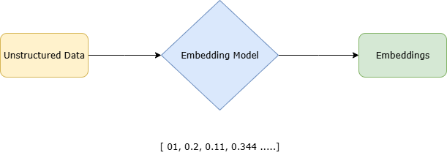
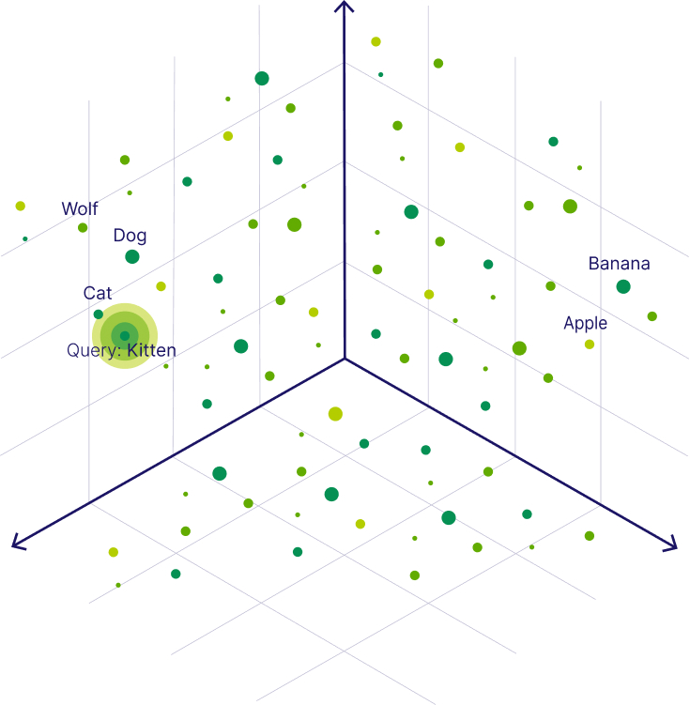
Notes:
Computers are great with numbers, but language is not numbers — it’s full of nuance, ambiguity, and context.
That’s why we use embeddings: they convert language into numbers so computers can understand and work with it.
Embeddings are numerical representations of data (like text, images, or code) that capture their meaning, context, or similarity in a form a machine can understand.
semantic search focuses on “what you mean,” not just “what you typed.”
Imagine embeddings as coordinates on a map of meaning. Words or phrases with similar meaning are located closer together.
For example:
The sentences:
"How are you?"
"What's up?“ may look different, but their embeddings will be very close — because they have similar meaning.
Whereas:
"How are you?" and "Banana split." will have very different embeddings.
How Does It Work?
Text chunks from documents are converted into embeddings — mathematical representations of meaning.
Your query is also converted into an embedding.

Slide 12
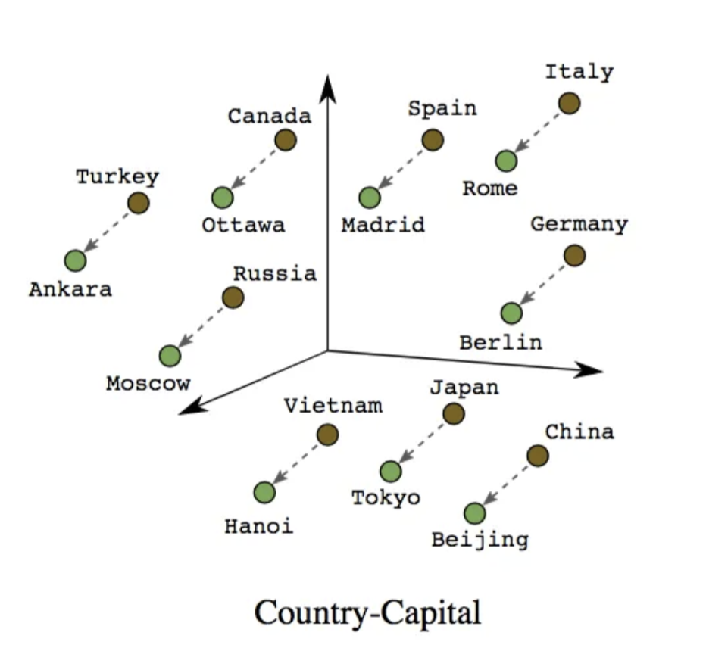

Overly simplified version for just explanation
Notes:
Based on all the unstructured data
What if we place similar words occurring together in similar context. close to each other and assign them a numerical value?

Slide 13
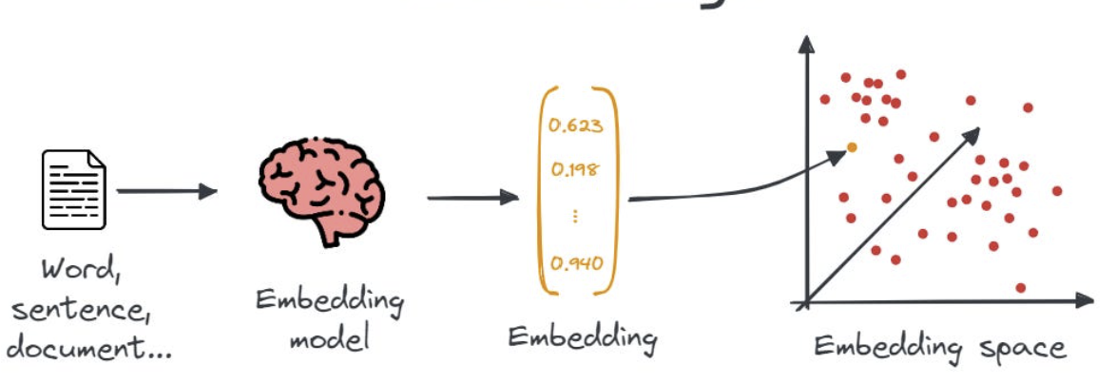
Notes:
Structured:
UserID Name City Age
101 Alice New York 28
Unstructured
Alice, a 28-year-old software engineer from New York, loves working with AI and spends her weekends hiking.“

Slide 14
Can embeddings help?
YES!
Notes:
So now we have numbers – the embeddings can we use computers to perform some similarity search?
The answer is YES.

Slide 15
We’ve Got Embeddings — So Where Do We Store Them?
Notes:
At this point, we’ve generated embeddings — vectors that capture the meaning of our data.
But now the question is: Where do we store them so we can search and retrieve them efficiently? Any guess?

Slide 16
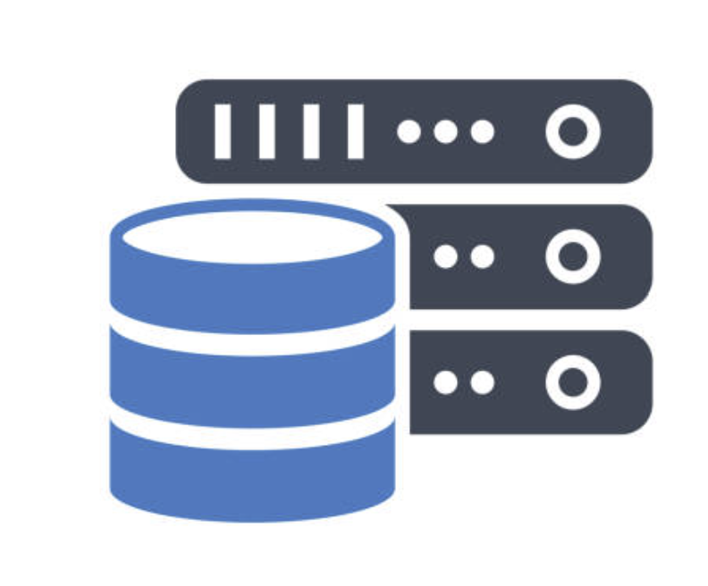
VECTOR DATABASE
A vector database indexes and stores vector embeddings for fast retrieval and similarity search
Notes:
Vector databases are designed to store embeddings and retrieve the most semantically similar results quickly.
They power applications like semantic search by organizing and indexing embeddings for high-speed vector comparison.
https://www.trychroma.com/ Pinecone, Milvus, Qdrant, Weaviate, Chroma, Faiss, and pgvector

Slide 17
Feature | Relational DB (SQL) | Vector DB (Semantic Search)
Search Type | Keyword-based | Meaning-based
Data Format | Tables with exact values | Embeddings/vectors
Handles Synonyms? | No | Yes
Understands Context? | No | Yes
Best for | Structured, exact queries | Natural language, fuzzy or open-ended questions
Example Tech | MySQL, PostgreSQL, SQLite | Pinecone, Chroma, Weaviate, FAISS
Notes:
Relational DBs are like asking a robot to find exact words. Vector DBs are like asking a smart assistant who understands what you mean.

Slide 18
Vector Database
Context
You
Query
Prompt
LLM
Output
This is what’s known as RAG
Notes:
By using a vector database with RAG, we’re able to tap into our internal data, give the model the right context, and generate responses that are more accurate and relevant to our domain.

Slide 19
LLM – OLLAMA MISTRAL
Notes:
Ollama - Local LLM Runner & Manage

Slide 20
Demo: RAG LLM: Mistral EMBEDDING MODEL: jina-embeddings-v2-base-en Vector DB: ChromA
Notes:
Other Bentley Examples: includes Regie PT

Slide 21
Demo: ITWIN.JS API Assistant

