Slide 1



CSS
Tip
:last-child
:last-child selector is used match element which is last child of its parent.
Let’s try it, with our circle and square example
Follow
me for more tips

Slide 2
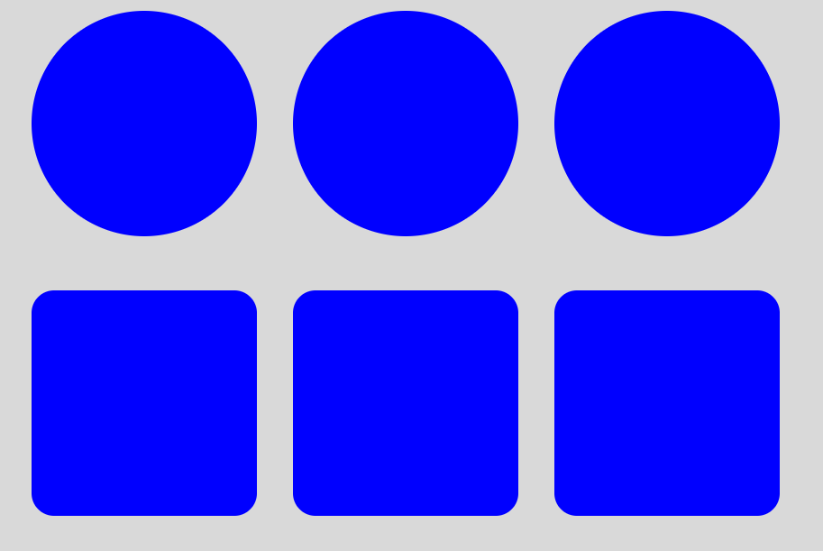
CSS
Tip
:last-child
Let’s create 3 circles and squares:
<div class="row">
<div class="circle"></div>
<div class="circle"></div>
<div class="circle"></div>
<div class="row">
<div class="square"></div>
<div class="square"></div>
<div class="square"></div>
</div>
.circle {
width: 250px;
height: 250px;
border-radius: 50%;
background-color: blue;
}
.square {
width: 250px;
height: 250px;
border-radius: 10%;
background-color: blue;
}
Output:
Follow
me for more tips

Slide 3
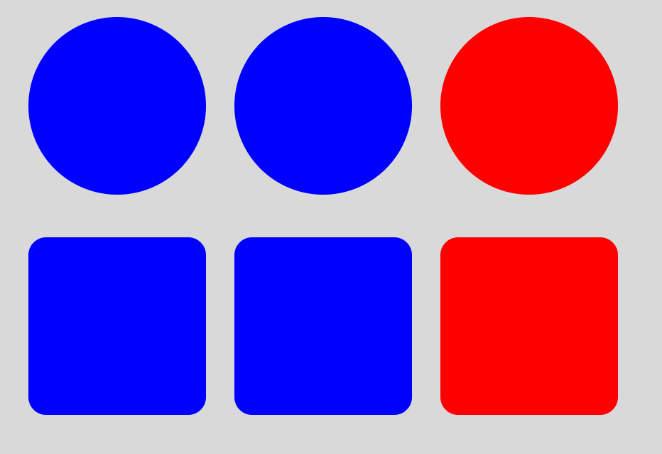
CSS
Tip
:last-child
Change the color of last circle and square
.circle:last-child {
background-color:red;
} .square:last-child {
background-color:red;
}
Output:
Follow
me for more tips

Slide 4
CSS
Tip
:last-child
For complete sample:
https://github.com/asadhasnain/tips/tree/master/CSS/Tip4-last-child
Follow
me for more tips

