Slide 1


VSCode
Tip
Top 5 - VS Code
Must try Extensions to
Review, visualize and present code state
Follow
me for more tips

Slide 2
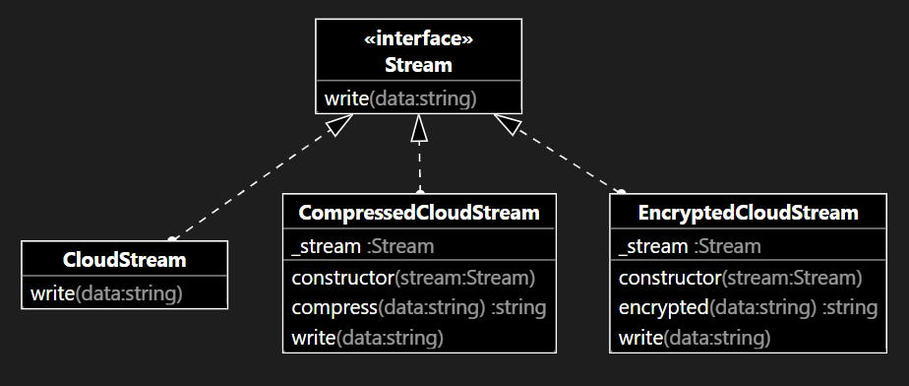
VSCode
Tip
UML Class Diagram
classdiagram-ts to generate UML Class diagram based on typescript source files
Follow
me for more tips

Slide 3
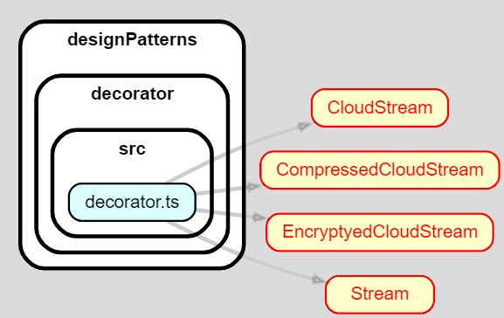
VSCode
Tip
Dependency Graphs
Dependency Cruiser helps to quickly check dependencies of any files
Follow
me for more tips

Slide 4
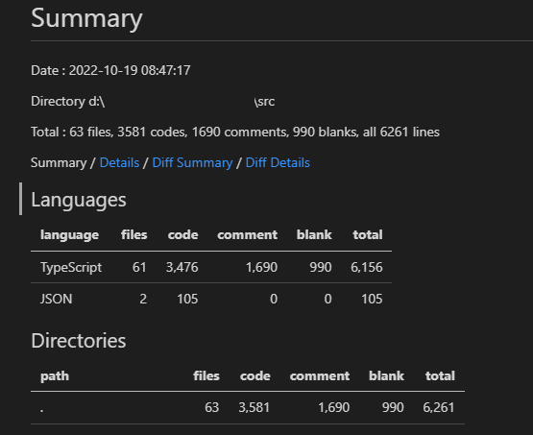
VSCode
Tip
Line of Code
VS Code Counter helps to count line of code and identify files that require attention
Follow
me for more tips

Slide 5
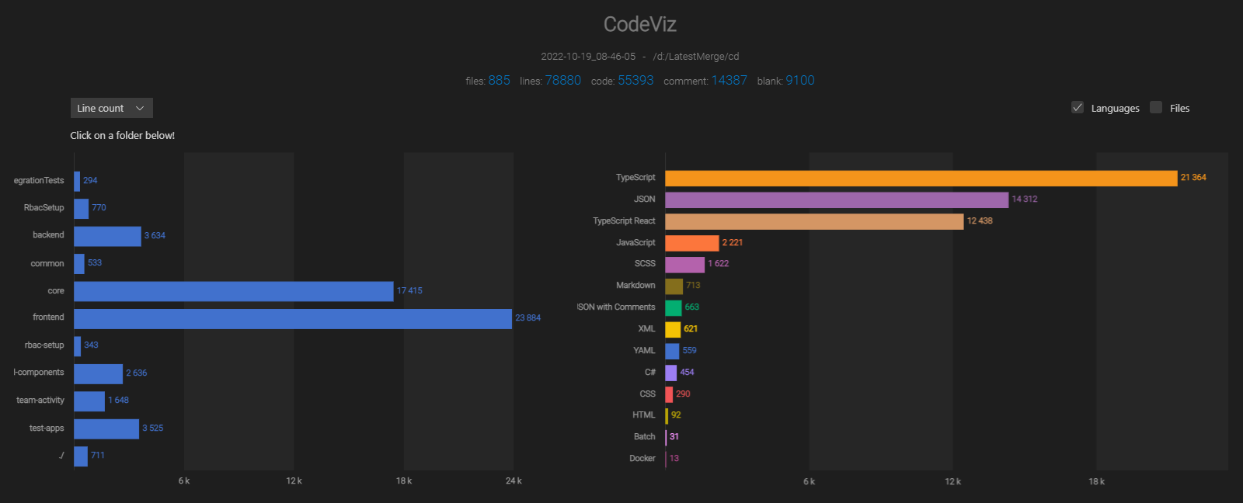
VSCode
Tip
Code Stats Visualization
CodeViz Stat provides source code statistics with animated visualization
Follow
me for more tips

Slide 6
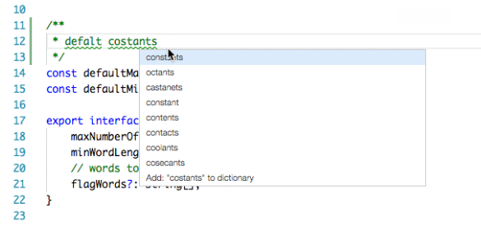
VSCode
Tip
Spelling Checker
Code Spell Checker helps to minimize spelling mistakes in source code and comments
Follow
me for more tips

Slide 7

Tip
VS Code Extension you are using, share in comment
Follow
me for more tips

