Slide 1
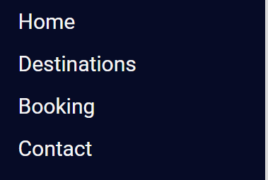
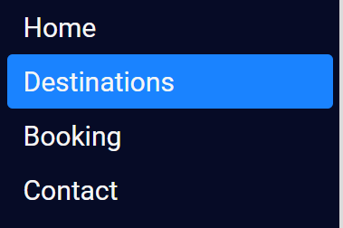




React
Tip
Side Nav bar
Side Nav bar – is used to show navigation option on the side of the page, mostly left side.
Hover
Click leads to respective element/page
Follow
me for more tips

Slide 2
React
Tip
Side Nav bar
Step 1: Create a Side Nav Bar Component
/* Sidebar.tsx */
import React from "react";
import { Link } from "react-router-dom";
import "./Sidebar.css";
export const Sidebar = () => {
const menuItem = (to: string, title: string) => {
return (
<li className="nav-text">
<Link to={to}><span>{title}</span></Link>
</li>);
} return (
<><nav className ="sidebar-menu">
<ul>
{menuItem("/", "Home")}
{menuItem("/destinations", "Destinations")}
{menuItem("/booking", "Booking")}
{menuItem("/contact", "Contact")}
</ul>
</nav></>);
};
Follow
me for more tips

Slide 3
React
Tip
Side Nav bar
Step 2: Style Side Nav Bar
/* Sidebar.css */
.sidebar-menu {
background-color: #060b26;
width: 250px;
height: 100vh;
}
span {
margin-left: 12px;
}
.nav-text {
list-style: none;
padding: 0px 5px;
height: 2rem;
}
Follow
me for more tips

Slide 4
React
Tip
Side Nav bar
Step 3: Style Nav text
/* Sidebar.css */
.nav-text a {
text-decoration: none;
color: #f5f5f5;
font-size: 18px;
height: 100%;
display: flex;
align-items: center;
border-radius: 4px;
}
.nav-text a:hover {
background-color: #1a83ff;
}
Follow
me for more tips

Slide 5
React
Tip
Side Nav bar
Step 4: Use the component
/* App.tsx */
import React from "react";
import { BrowserRouter } from "react-router-dom";
import "./App.css";
import { Sidebar } from "./sideBar/Sidebar";
export default function App() {
return (
<div>
<BrowserRouter>
<Sidebar />
</BrowserRouter>
</div>
);
}
Follow
me for more tips

Slide 6

React
Tip
Side Nav bar
Your Side Nav bar is ready
Hover
Click leads to respective element/page
Follow
me for more tips

Slide 7
React
Tip
Side Nav bar
For complete sample:
https://github.com/asadhasnain/tips/tree/master/React/side-bar
Follow
me for more tips

