Slide 1
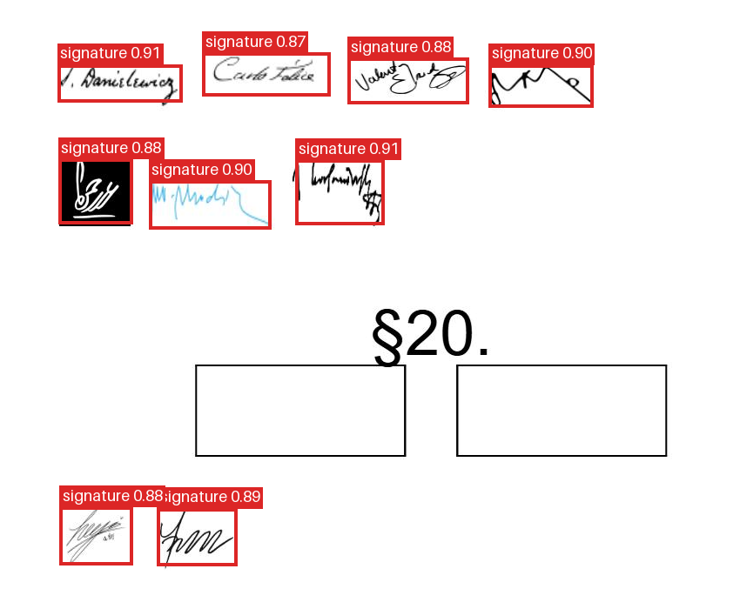
SIGNATURE IDENTIFIER / YOLOX-TINY
Signature detection in documents
Upload a document image. Receive a PNG with signature boxes and confidence scores.
Local data, cleaned and grouped
3 datasets · 3,970 images · 7,859 boxes
RGB conversion, box validation and repair
Related images grouped before splitting
Train 3,176 / Validation 397 / Test 397
Training on the laptop GPU
COCO transfer learning · 416 × 416 input
30 epochs · batch 8 · mixed precision
RTX 3060 Laptop GPU, 6 GB
Held-out example: 9 detections
Signature location; signer identity is not inferred.
1/2
Notes:
Sources: docs/README.md (dataset audit, grouped split, training settings); Signature_Detection_YOLOX_Tiny.ipynb saved outputs; .artifacts/docker-prediction.png and .artifacts/docker-smoke-result.json (API verification, 2026-11-05). Prepared 2026-11-09. Data: bondaruk 810 images/4148 boxes; tech 2819/3252; rf100 341/459. Total 316 negative pages retained. Grouped 80:10:10 split, seed 42, no detected group crossing. Thirty total epochs included a resumed run; EMA and AMP enabled; best saved epoch 26. Crop is for slide visibility and retains all nine detected signatures; API returns the full page. Detection locates signatures and does not authenticate signers.

Slide 2
RESULTS / DEPLOYMENT
Evaluation and serving architecture
Held-out test: 397 images, 784 signatures
Metric | Result
mAP @ IoU 0.50 | 95.03%
mAP @ IoU 0.50–0.95 | 65.51%
Precision | 92.81%
Recall | 93.88%
F1 score | 93.34%
Swagger UI / HTTP client
FastAPI POST /predict
YOLOX-Tiny + NMS
Annotated PNG response
Docker · CPU inference
Bundled 20.3 MB model
One worker · two PyTorch CPU threads
Precision / recall / F1: confidence 0.25, IoU 0.50.
736 true positives · 57 false positives · 48 missed boxes.
Performance on new document collections requires validation.
2/2
Notes:
Sources: signature_yolox/reports/evaluation_test/metrics.json (saved test evaluation), docs/README.md, app/main.py, app/detector.py, Dockerfile and compose.yaml. Prepared 2026-11-09. Exact metrics: mAP50 .9502923526790285; mAP50_95 .6550610933055143; precision .9281210592686002; recall .9387755102040817; F1 .9334178820545338. AP score floor .001, NMS .65, max detections 100. AP integrates the precision-recall curve; precision/recall/F1 use confidence .25 and matching IoU .5. Single-class signature detector: CSPDarknet backbone -> PAFPN -> decoupled anchor-free head. Model exported as tensor-only model.pth, 20,320,443 bytes. Startup verifies SHA-256 and loads once. Runtime uses image validation, EXIF orientation, BGR top-left letterbox to 416, YOLOX, class/objectness score filtering, NMS and rescaled boxes. A serial lock protects request processing. API returns original oriented image size PNG. GET /health and GET /docs are also available. CPU runtime and GPU training are separate. Prior API verification was on 2026-11-05; no new latency benchmark is claimed.

