Slide 1

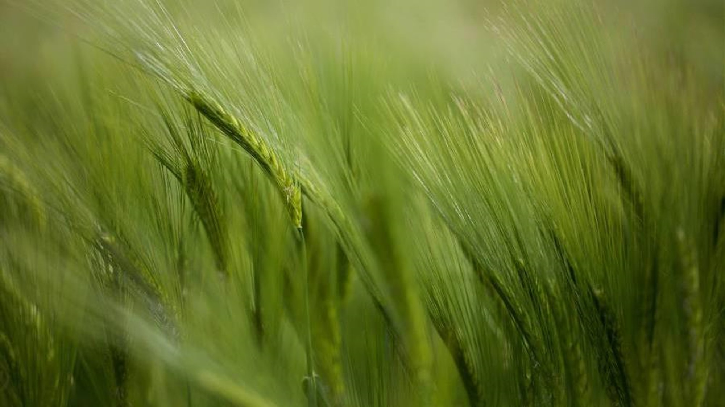
Welcome to my presentation

Slide 2
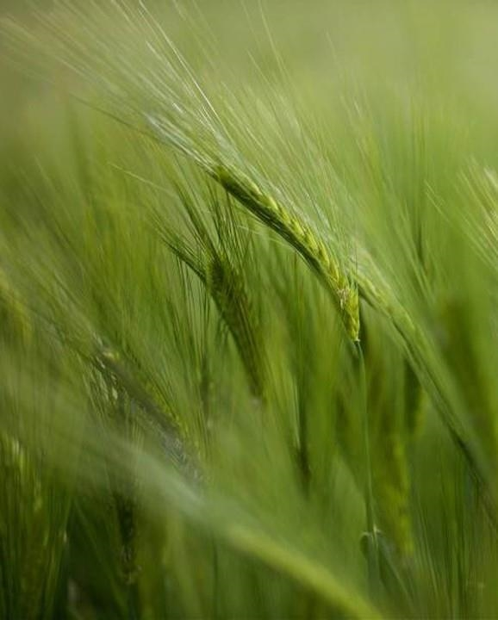
Experimental design and treatments
Scenario 1: Business as usual Farmers’ practice
Scenario 2: Best management practices with conventional tillage
Scenario 3: Best management practices with reduced tillage.
Scenario 4: Crop diversification with best management practices and reduced to zero tillage

Slide 3
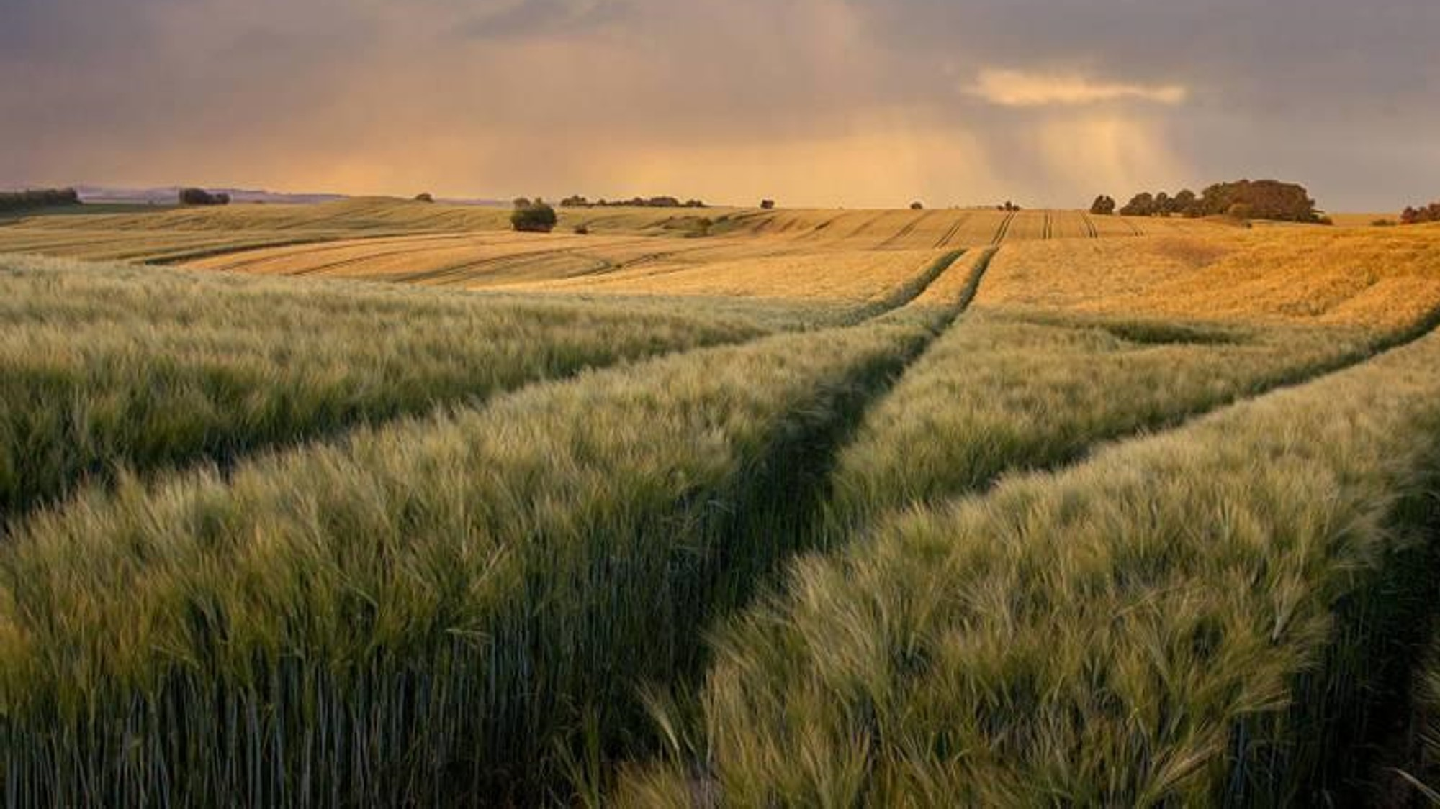
Soil sampling and analysis

Slide 4
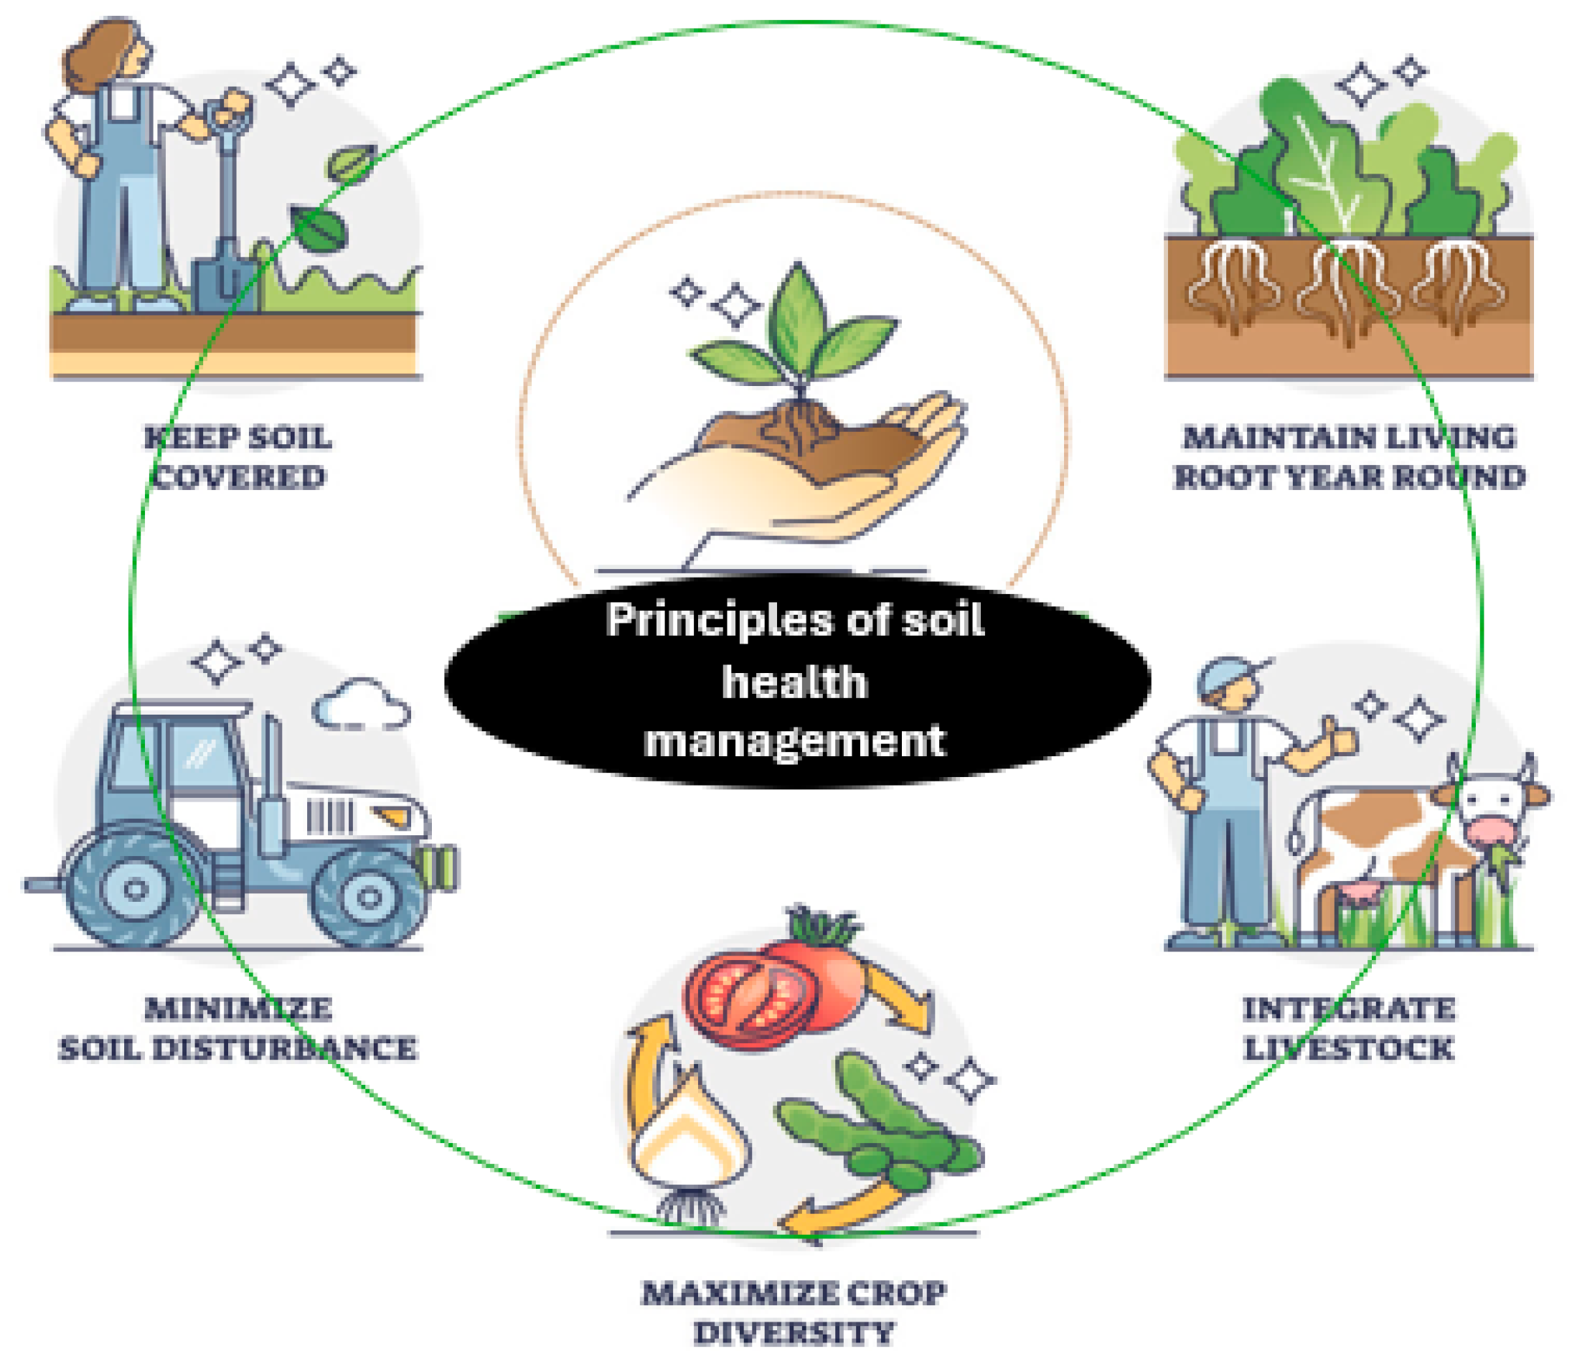
Data measurement and calculation
The human labor used in all operations and management practices, amounts of all inputs and outputs, electrical energy used for irrigation, input–output prices, wage rate for labor and machinery rent were recorded for each plot.

Slide 5
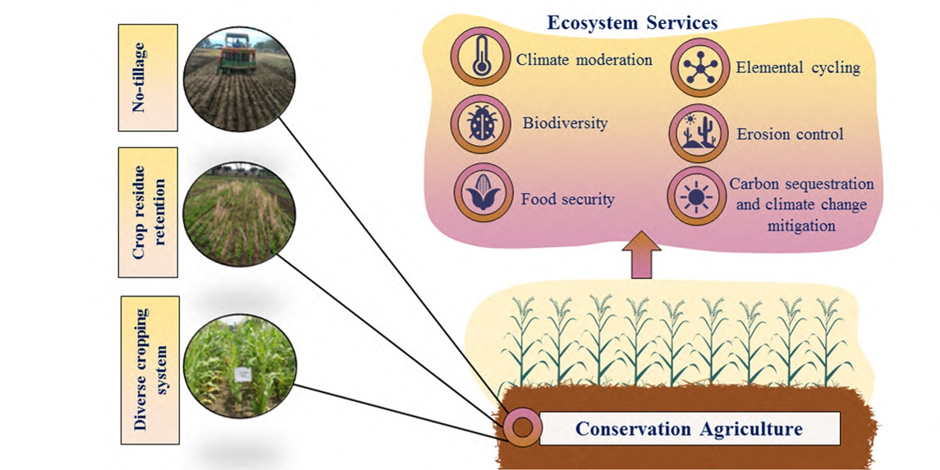
Experimental design and treatments
Four cropping system treatments referred to as scenarios (S) were designed based on different drivers of agricultural change. The scenarios varied from each other in tillage, crop establishment, residue management, crop rotation and other management practices.

Slide 6
Table-1 : Monthly Total rainfall and monthly average maximum and minimum temperatures during cropping years, 2009–2010
Name of Month | Cropping Year 2009-2010
 | Temperature |  | Rainfall
 | Max | Min
January | 220 | 213 | 225
February | 325 | 319 | 250
March | 330 | 325 | 350
April | 435 | 429 | 450
May | 540 | 535 | 550
June | 637 | 632 | 350
July | 533 | 527 | 320
August | 431 | 422 | 220
September | 329 | 321 | 330
October | 225 | 219 | 220
November | 223 | 217 | 250
December | 321 | 215 | 360
Maize is mainly a feed crop but it is also a food crop in many poverty-stricken areas, especially in the hilly areas. These crops greatly influence the livelihoods and health of the urban and rural poor in these regions

Slide 7
Monthly Total rainfall and monthly average maximum and minimum

Slide 8
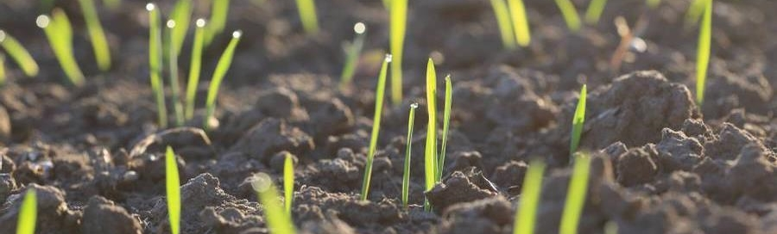
References
Acemoglu, M., Aksoy, A.S., 2005. The cultivation and energy balance of Miscanthus giganteus production in Turkey. Biomass Bioenergy 29, 42–48.
Argiro, V., Stamatas, A., George, D., Nanos, A., Constantinos, A., 2006. Energy flow for integrated apple production in Greece. Agric. Ecosystem. Environ.
Bala, B.K., Hussain, M.D., 1992. Energy use pattern for crop production in Bangladesh.
J. Eng. Int. Dev. 1, 41–47.
BRRI, 2010. Annual Internal Review Report for 2009–10. Bangladesh Rice Research Institute, Gazipur, Bangladesh.
BRRI, 2007. Aphonic Daner Chas (A Bengali Publication). Bangladesh Rice Research Institute, Gazipur, Bangladesh.
BARI, 2004. Krishi Prajakta Harbai (A Bengali Publication). Bangladesh Agricultural Research Institute, Gazipur, Bangladesh.

Slide 9

Thank you
Name : MD. Asadujjaman
Roll : 14-65
Batch No.: 65
​

