Slide 1
A LECTURE FOR COMPUTER SCIENCE STUDENTS
Linear Algebra
in Computer Science
Designed by
Dr. M. Asad Iqbal
How matrices, vectors, and dot products quietly power images, recommendation engines, and every neural network you'll ever train.
Data • Vectors • Matrices • Classifiers • Neural Networks

Slide 2
INTRODUCTION
Why Does Computer Science Need Linear Algebra?
Linear Algebra is the backbone of computer science — especially AI and Machine Learning. It is the tool that lets a computer process, analyze, or compress numbers at massive scale.
1
2
3
4
5
Representation of Data
Dimensionality Reduction
Optimization
Feature Engineering
Similarity Measures
Images, text, and audio are stored as matrices — grids of numbers a computer can understand.
Techniques like PCA and SVD shrink huge feature sets while keeping the important information.
ML models use linear algebra to find the minimum error — the core engine of machine learning.
Linear transformations combine existing data into new, more meaningful features.
Embeddings turn words and sentences into vectors so machines can compare meaning.
LINEAR ALGEBRA IN CS
2

Slide 3
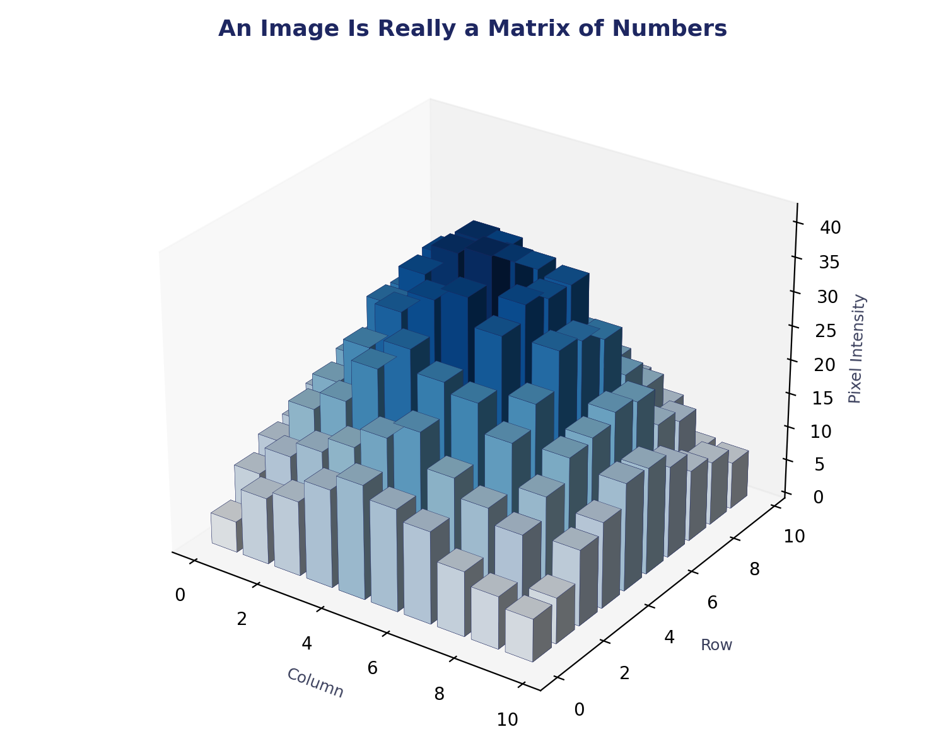
REASON 1
Representation of Data
Complex datasets — images, text, audio — are stored in matrices (grids of numbers). That's how a computer “learns” and understands them.
No data or image is represented as a single line. Instead, matrices organize data into rows and columns, so each value knows its neighbours — essential when a filter needs nearby pixels to detect an edge.
EXAMPLES
A 100×100 pixel image → becomes a 100×100 matrix
A WhatsApp photo → is internally a matrix
Netflix recommendations → matrix of user ratings
LINEAR ALGEBRA IN CS
3

Slide 4
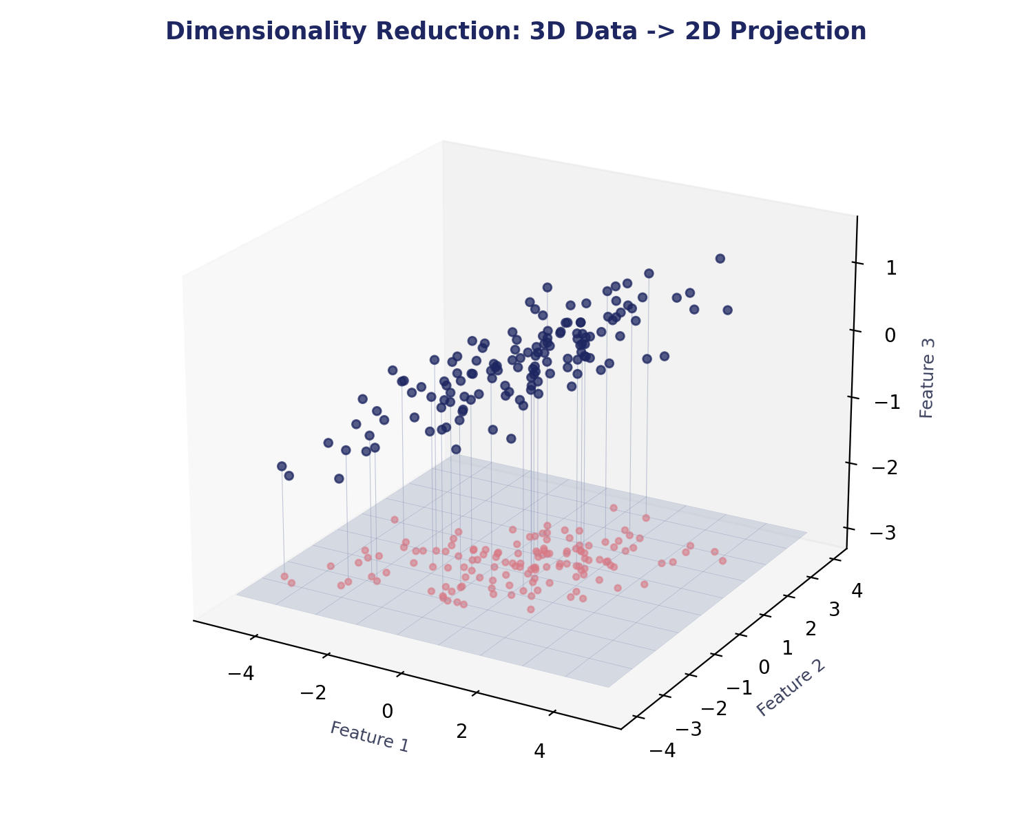
REASON 2
Dimensionality Reduction
Too many variables slow models down and cause two big problems: duplication of information, and models that can't find a clear pattern. Linear Algebra (SVD, PCA) reduces variables while keeping the important information — boosting model efficiency.
1,000 features → reduced to 10 → model becomes faster
Used in PCA (Principal Component Analysis) for ML: less variation, easier to solve; more information, more useful.
WHY IT MATTERS
More dimensions → more duplication and no clear pattern. Fewer, well-chosen dimensions → the model recognizes patterns easily and generalizes better.
LINEAR ALGEBRA IN CS
4

Slide 5
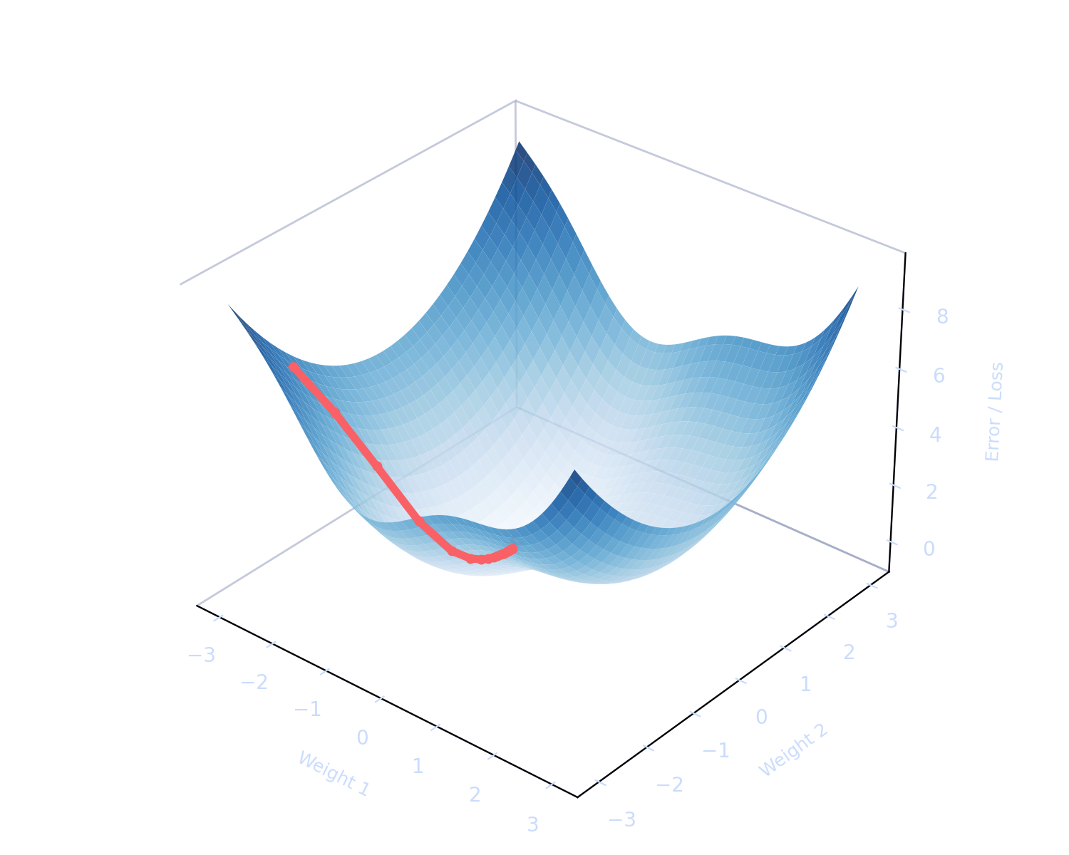
REASON 3
Optimization — The Core Engine of ML
ML models use linear algebra to find the minimum of a function — the lowest possible error. Minimizing cost/error or maximizing accuracy/marks are the same idea: find the best option.
How training works:
1. Model starts with random weights (millions of numbers)
2. It makes a prediction and measures the error
3. Gradient descent updates the weights, step by step
4. Repeat until the error is minimized
Google Translate and ChatGPT run this same optimization loop at enormous scale.
LINEAR ALGEBRA IN CS
5

Slide 6
REASON 4
Feature Engineering
Mixing different features creates new features, through linear transformations and matrix operations. New, meaningful data emerges from existing data.
Linear
Transform
Height
Weight
BMI
Example
Height + Weight → BMI (Body Mass Index)
a brand-new feature built from existing data.
LINEAR TRANSFORMATIONS (3D → 2D, 2D → 3D)
Image resizing, rotating, blurring, and zooming are all matrix multiplications — producing new information from existing data.
IMAGE OPERATIONS AS MATRIX MULTIPLICATION
Rotate · Blur · Zoom · Resize
Every visual effect you apply to a photo is a matrix acting on a matrix.
LINEAR ALGEBRA IN CS
6

Slide 7
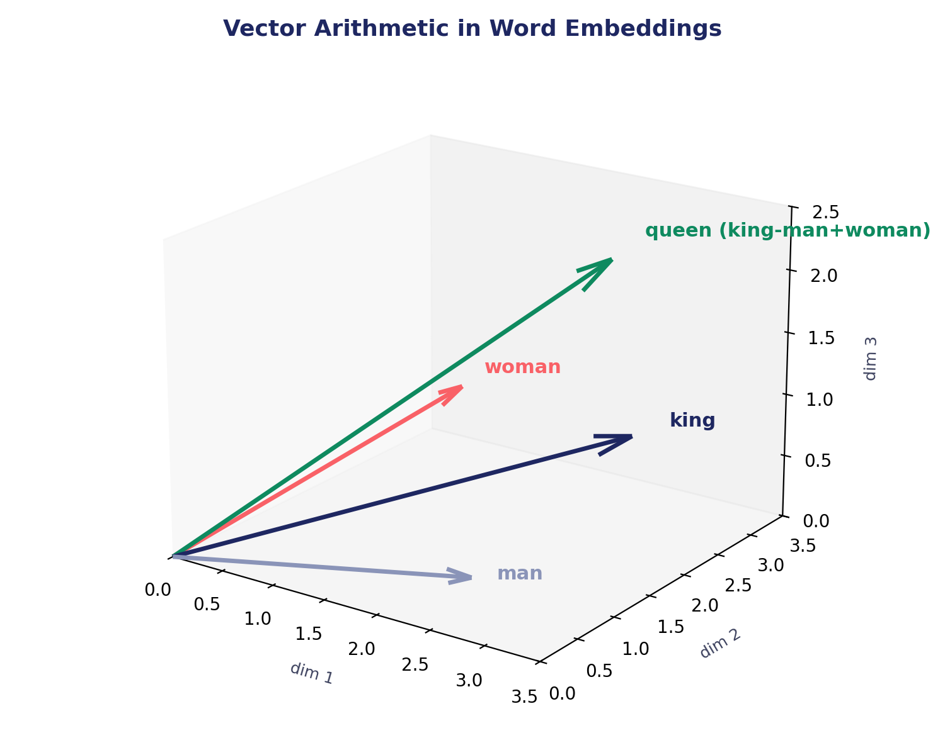
REASON 5
Similarity Measures & Embeddings
Embeddings turn words or sentences into a list of numbers (a vector) whose properties represent the meaning of that thing. This is how recommendation systems and AI chatbots compare meaning.
Vector Arithmetic
king − man + woman = queen
ChatGPT's word vectors encode relationships like this directly.
Spotify → compares song vectors to find similar songs
Similarity = dot product between two vectors
LINEAR ALGEBRA IN CS
7

Slide 8
TAKEAWAYS
Remember Me
Linear Algebra = The Language of Machine Learning. Without it, there is no AI.
Data
Training
Compression
Similarity
Prediction
= matrix
= matrix operations
= matrix decomposition
= dot product
= matrix multiplication
THE AI PIPELINE, IN ONE LINE
Data in → find patterns → make predictions.
Every one of those steps is vectors and matrices at work. No linear algebra, no AI.
LINEAR ALGEBRA IN CS
15

Slide 9
Scalar, Vector, and Matrix
Scalar
Vector
Matrix
A single number
A list of numbers
A table of numbers
No direction — just magnitude
CS type: int, float, double
e.g. age = 20
C++: float salary = 50000;
Has both magnitude & direction
CS type: array of floats
e.g. [2, -8, 7] (Row 1)
float emp[2] = {5, 50000};
Organized in rows + columns
e.g. [ -6 -4 27 ]
3D data → [3, 1, 2] as a vector
Vectors stack to form a matrix
LINEAR ALGEBRA IN CS
8

Slide 10
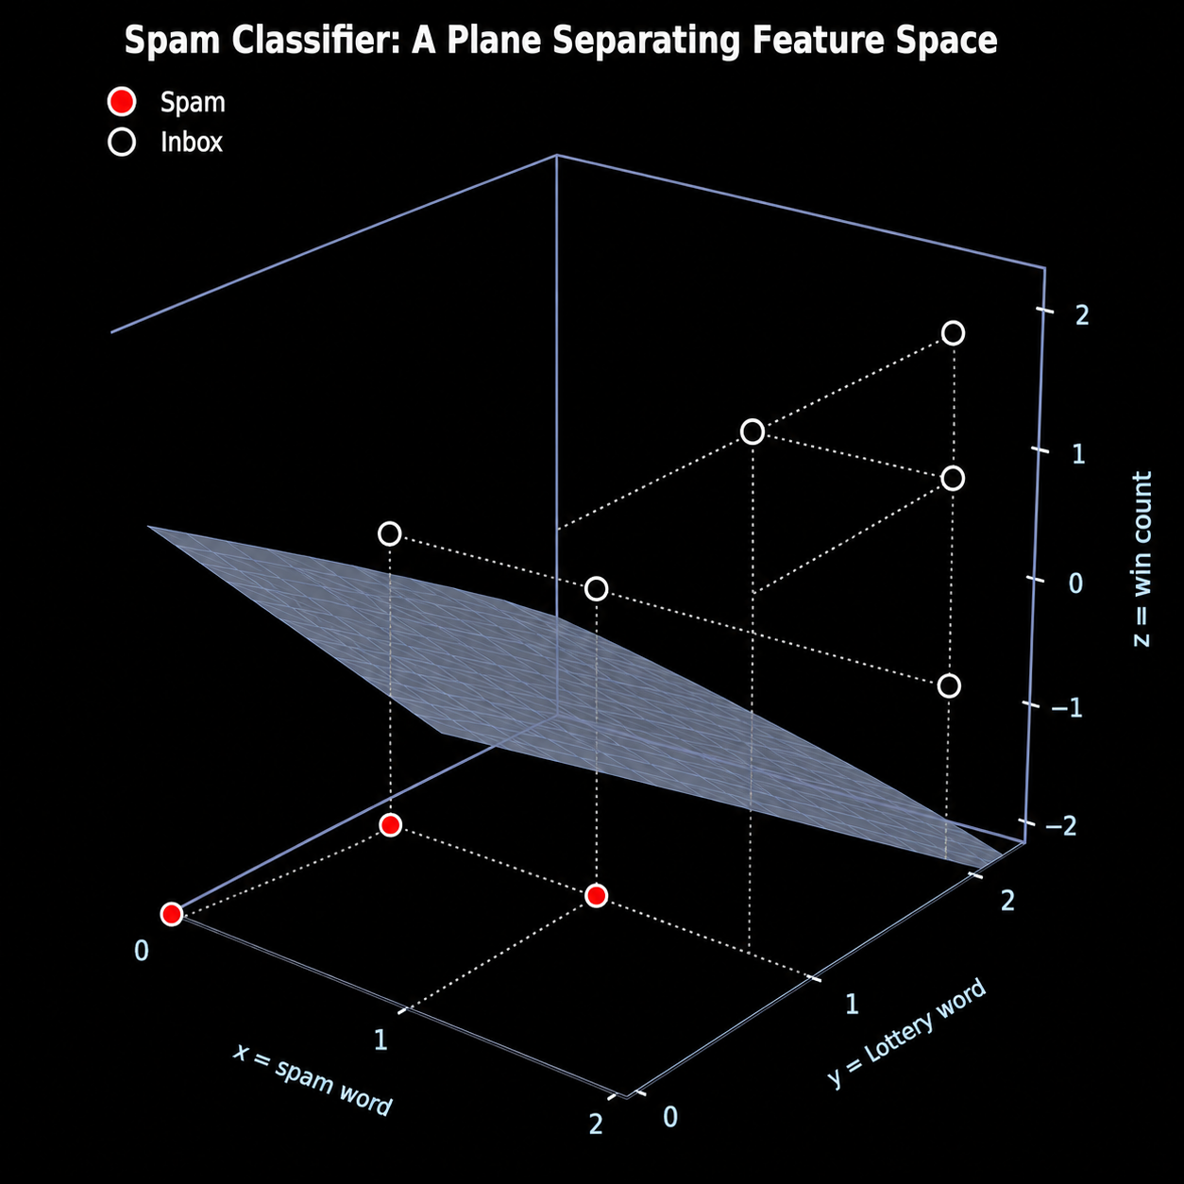
Case Study: How Does an Email Spam Filter Work?
x
Spam word present?
Yes or No
y
“Lottery” word value
0, 1, or 2
z
“Win” word value
0, 1, or 2
Rule (classifier): Lottery + Win > Threshold
LINEAR ALGEBRA IN CS
9

Slide 11
Spam | Lottery (x) | Win (y)
Yes | 1 | 1
Yes | 2 | 1
No | 0 | 0
Yes | 0 | 2
No | 0 | 1
No | 1 | 0
Yes | 2 | 2
Yes | 2 | 0
Yes | 1 | 2

Slide 12
CORE MECHANIC
The Dot Product — How a Classifier Decides
Multiply each pair of corresponding numbers, then add the results.
A · B = (a₁×b₁) + (a₂×b₂) + …
Same idea, different model
The weight vector V is fully customizable — change it and the classifier's behavior changes:
[1,0] → only x matters
[0,1] → only y matters
[0,0] → no input matters
Any spam filter you can build, an inbox filter can be built the same way.
Worked example — Spam Model
Model (weight vector) V = [1, 1] — both inputs matter equally.
Rule: if email · V > 1.5 → SPAM, otherwise → INBOX
[1, 1] · [1, 1] = 2
SPAM
[0, 0] · [1, 1] = 0
INBOX
[2, 2] · [1, 1] = 4
SPAM
[0, 1] · [1, 1] = 1
INBOX
LINEAR ALGEBRA IN CS
10

Slide 13
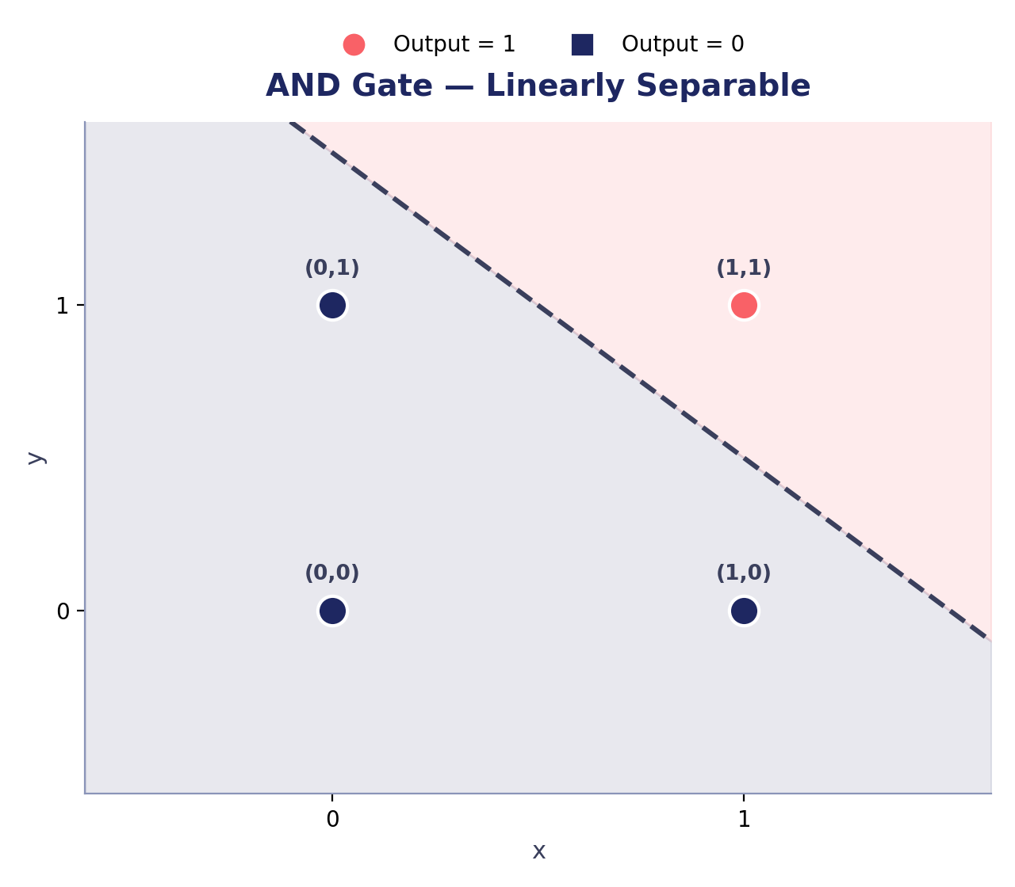
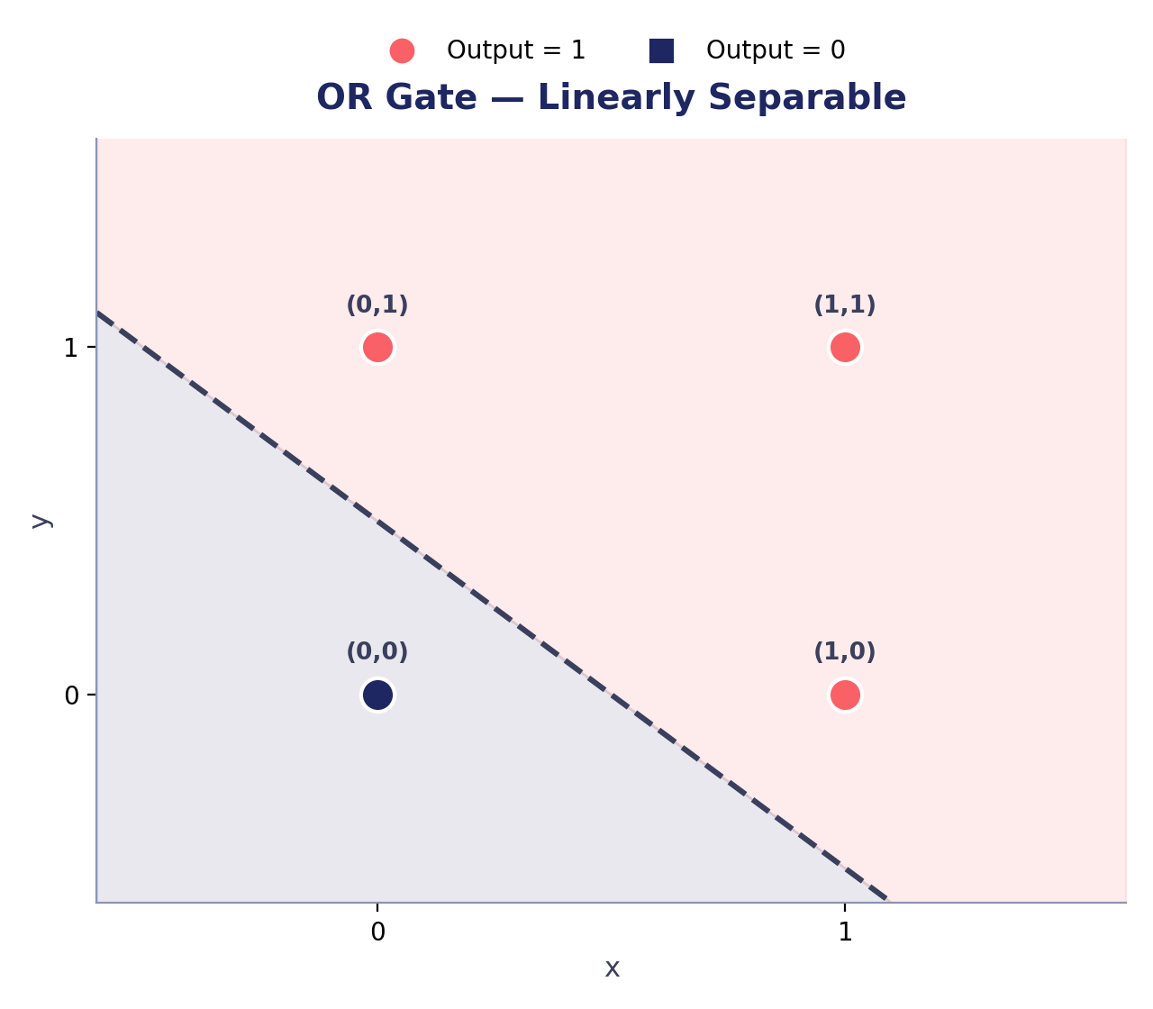
GEOMETRY OF CLASSIFIERS
Logic Gates Are Linear Classifiers & and have one layer neural network
Every truth table can be checked: can a straight line (a hyperplane) separate the outputs? If yes → one layer is enough. If no → we need more.
LINEAR ALGEBRA IN CS
11

Slide 14
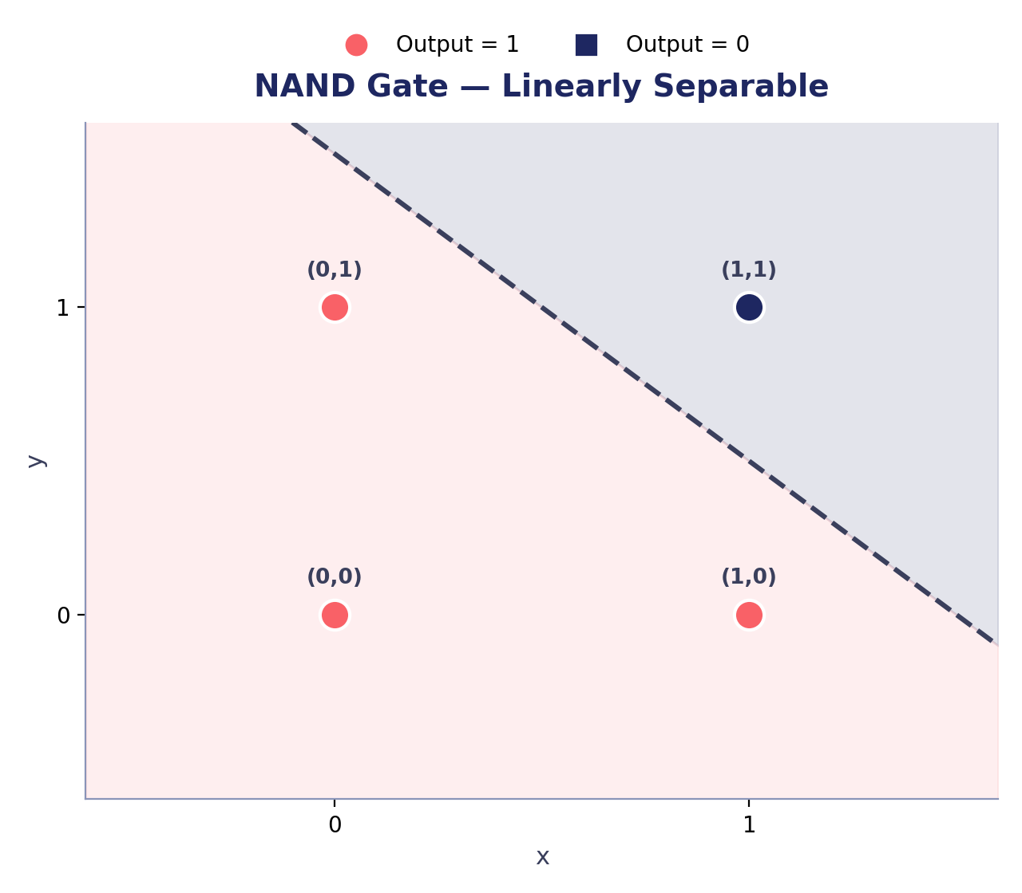
GEOMETRY OF CLASSIFIERS
Flipping the Rule: NAND, NOR, and NOT
Changing the weight vector or the threshold reshapes the decision boundary — the same one-layer model can implement many different gates.
LINEAR ALGEBRA IN CS
12

Slide 15
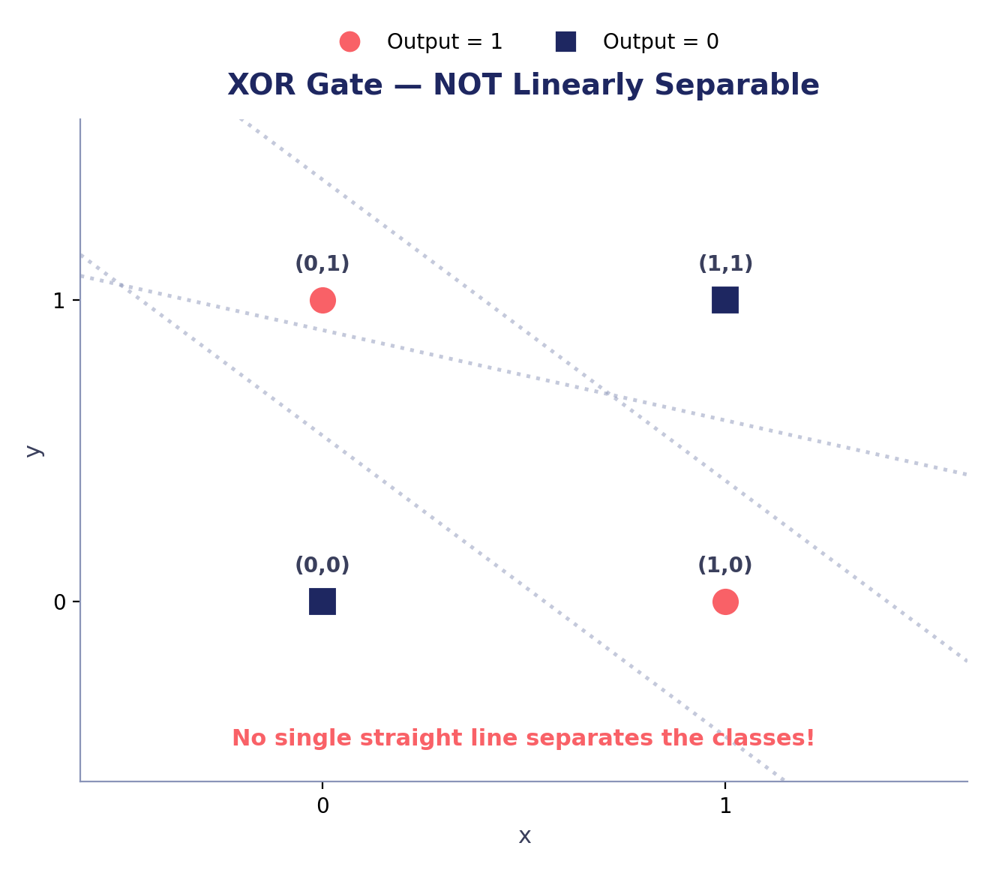
THE LIMIT OF LINEAR MODELS
The XOR Problem
XOR is NOT linearly separable — a single-layer classifier cannot solve it, no matter how the weight vector is chosen.
XOR TRUTH TABLE
x | y | Output
0 | 0 | 0 (No)
0 | 1 | 1 (Yes)
1 | 0 | 1 (Yes)
1 | 1 | 0 (No)
Condition-based rule instead:
If x = y → Output = 0
If x ≠ y → Output = 1
This condition can't be written as one straight boundary — we need to combine multiple lines.
LINEAR ALGEBRA IN CS
13

Slide 16
THE SOLUTION
Solving XOR: Stack the Layers
A single line can't separate XOR — but two lines, combined, can. This is exactly what a hidden layer in a neural network does.
h1
Key idea
Hidden layer:
draws linear boundaries
Output layer:
combines those boundaries
Threshold:
acts as the activation step
Result: a perfect mapping that matches the XOR truth table.
x
h2
z
y
h3
Input
Layer
Hidden Layer
(linear boundaries)
Output Layer
(combines boundaries)
LINEAR ALGEBRA IN CS
14

