Slide 1
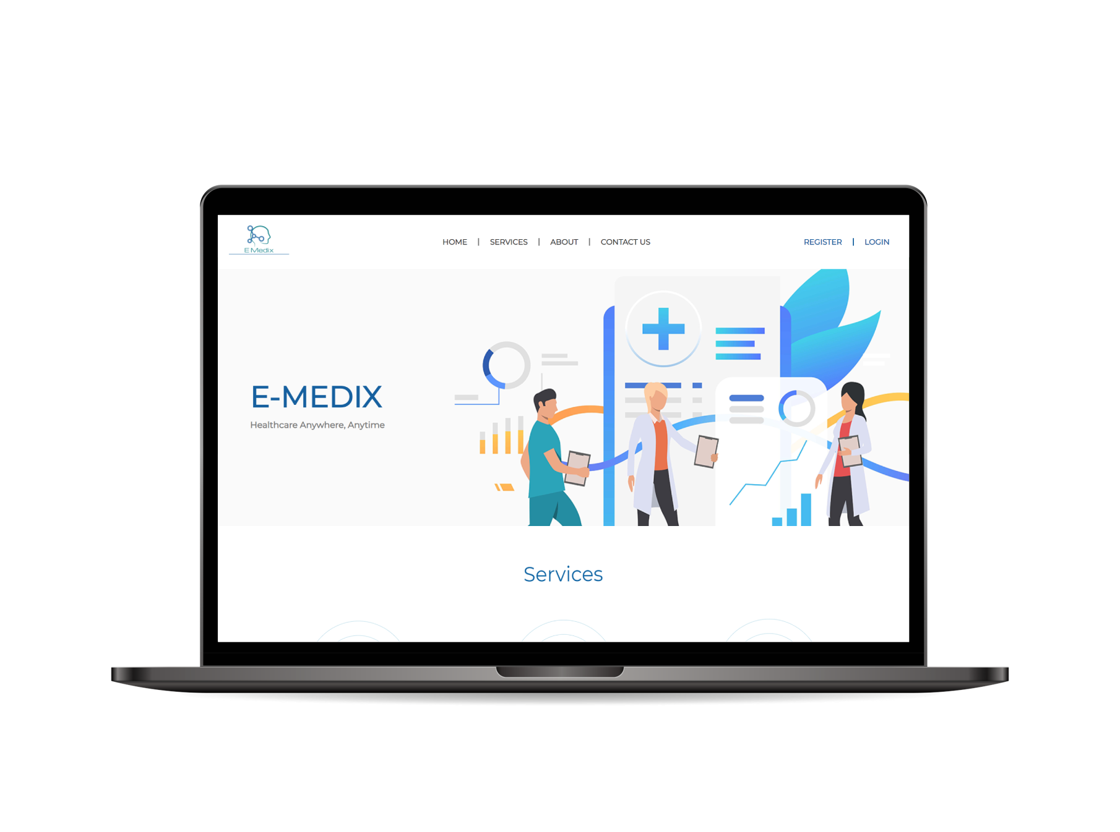
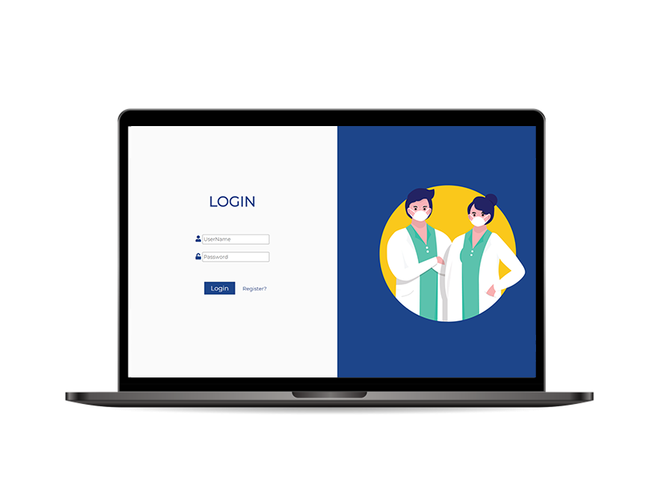
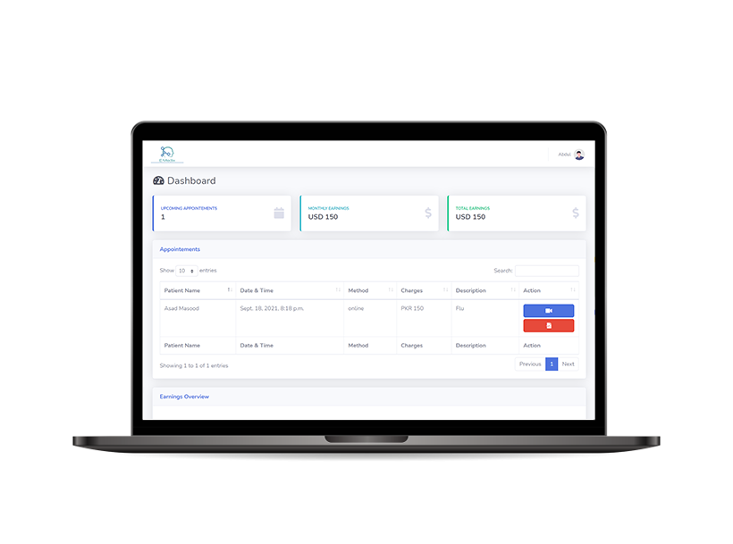
E-MEDIX
Healthcare Anywhere, Anytime

Slide 2
Advisor
Mr.Yahya Khurram
Presented By
Asad Masood Chaudhary (0224-BSCS-17)
Hafiz Abdul Sattar Butt (0249-BSCS-17)

Slide 3

Contents
01
02
03
04
05
06
Introduction
Technologies
About E-Medix
Scope of the Project
Languages
Tools
Framework
Functionalities
Django
Why Use Django?
Key Functionalities
User Interface
Conclusion
E-Medix User Interface
Future Work

Slide 4
01.
INTRODUCTION

Slide 5
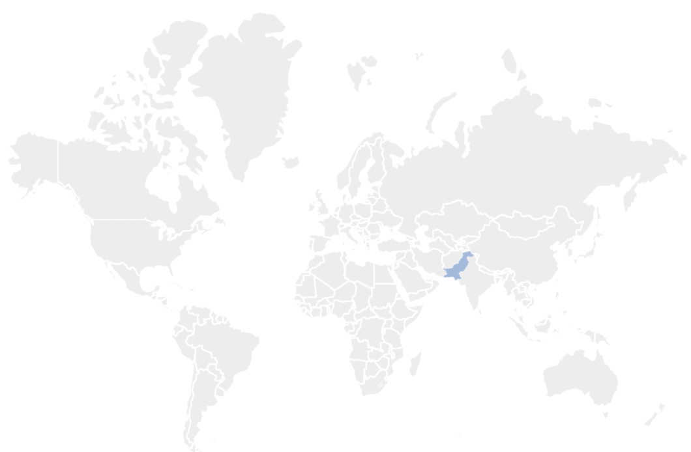





About E-Medix
WHO PERFORMANCE REPORT
[Reference]
=
190
=
1st
=
122nd
=
37th
=
18th

Slide 6
About E-Medix
Unavailability of healthcare facilities is one of the most salient factors for the increased death rate in Pakistan.
A Platform built to bridge the gap between a patient and top quality healthcare facilities.
Focuses on improving the quality of the healthcare ecosystem.
Making Healthcare facilities accessible anywhere at anytime.
Aim to gather the complete healthcare ecosystem under one platform

Slide 7
Scope of the Project
The Scope of this project is to make healthcare accessible anywhere, anytime.
Appointment booking
Online consultancy
Writing and Viewing Prescriptions
Maintain Appointments Record
Upload Medical Record
View Medical Record
Financial Analytics

Slide 8
02.
TECHNOLOGIES

Slide 9





Languages
HTML 5
CSS 3
JAVASCRIPT
BOOTSTRAP 4
PYTHON

Slide 10




Tools
VISUAL STUDIO CODE
ADOBE PHOTOSHOP
GIT
GITHUB

Slide 11
03.
FRAMEWORK

Slide 12
Django
High level Python Web Framework
Encourages Rapid Development
Encourages Clean and Pragmatic Design
Free and Open Source
Based on MVT Model
Models: Interface of Data
Views: Takes a web request and returns a Web Response
Templates: Consists of HTML, CSS, Bootstrap, JavaScript, etc.

Slide 13






Why Django?
Ridiculously Fast
Fully Loaded
Reassuringly Secure
Scalable
Incredibly Versatile
User Friendly

Slide 14
04.
FUNCTIONALITIES

Slide 15






Key Functionalities
Online Appointment Booking
Video Consultancy
Medical Record Management
Appointments Management
Prescription Management
Ordering Medicine

Slide 16
05.
USER INTERFACE

Slide 17
E-Medix User Interface
MAIN PAGE

Slide 18
E-Medix User Interface
LOGIN

Slide 19
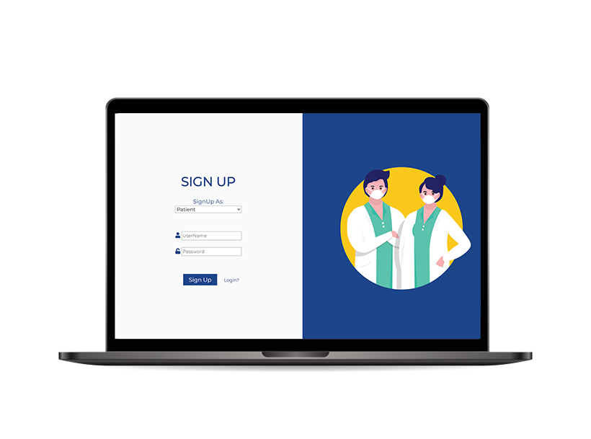
E-Medix User Interface
SIGN UP

Slide 20
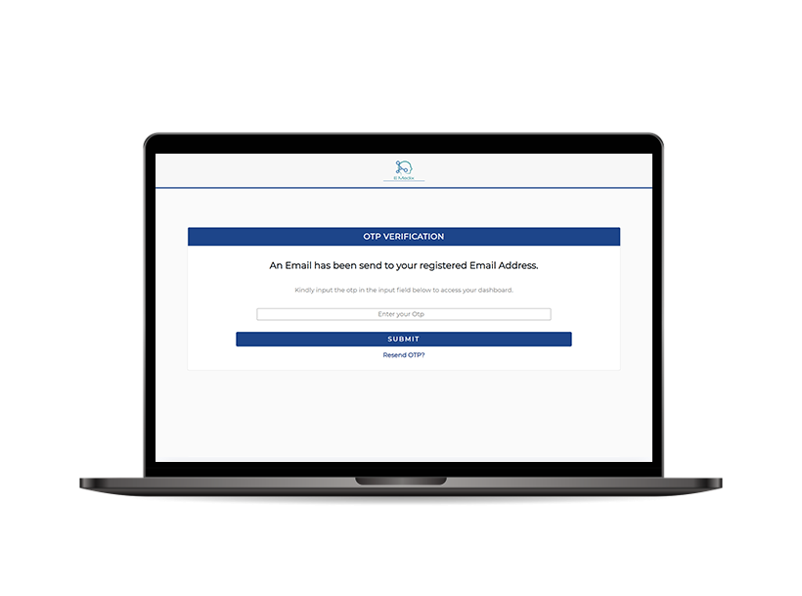
E-Medix User Interface
TWO FACTOR VERIFICATION
(OTP)

Slide 21
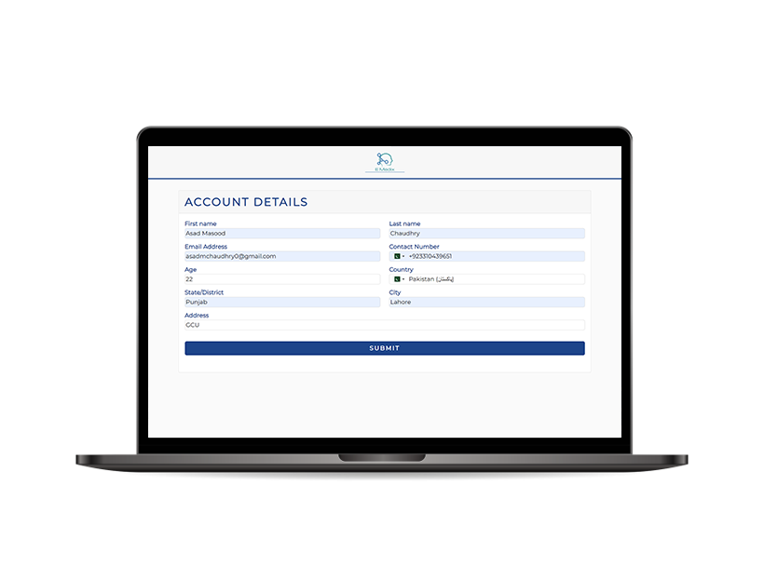
E-Medix User Interface
ACCOUNT DETAILS

Slide 22
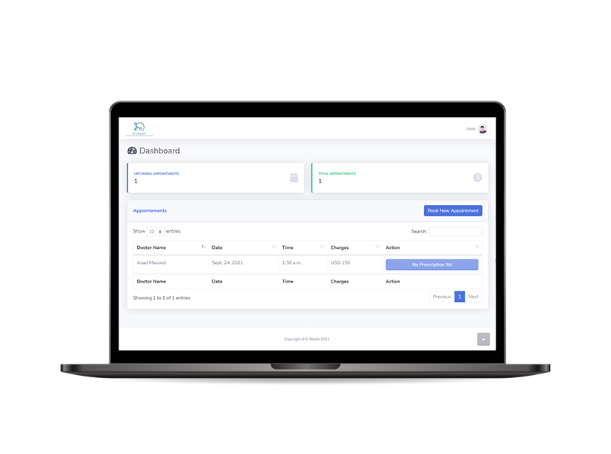
E-Medix User Interface
PATIENT DASHBOARD

Slide 23
E-Medix User Interface
DOCTOR DASHBOARD

Slide 24
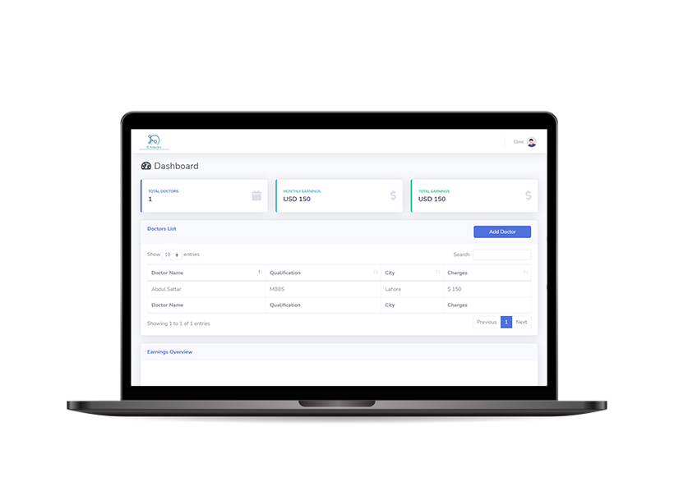
E-Medix User Interface
CLINIC DASHBOARD

Slide 25
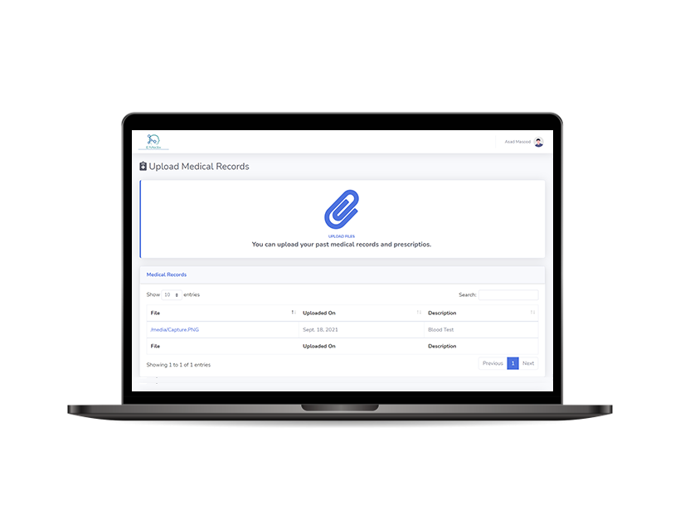
E-Medix User Interface
UPLOAD MEDICAL RECORD

Slide 26
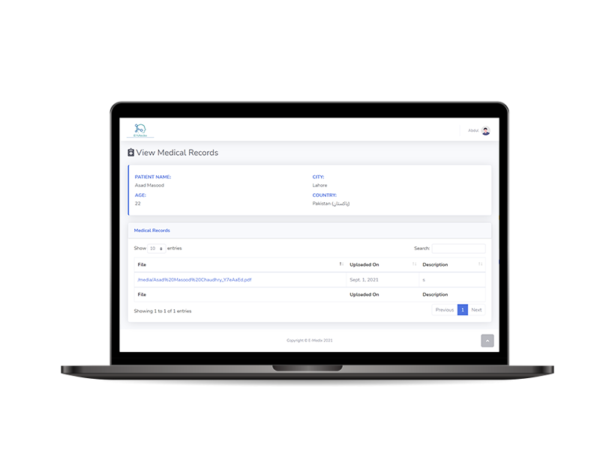
E-Medix User Interface
VIEW MEDICAL RECORD

Slide 27
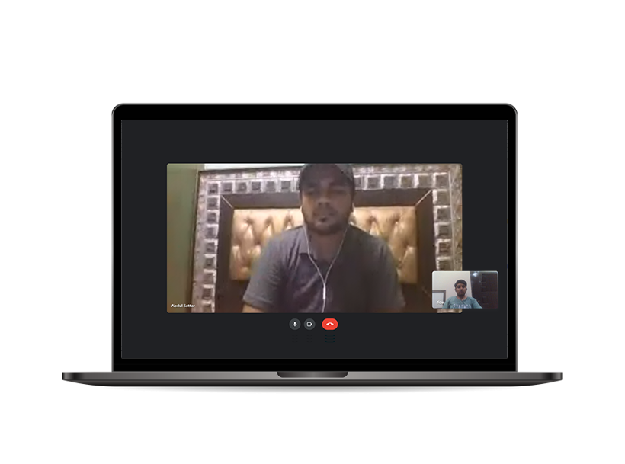
E-Medix User Interface
ONLINE CONSULTATION

Slide 28
06.
CONCLUSION

Slide 29
Future Work
Adding an intelligent chat bot to the web application to enhance it’s productivity.
Ordering the prescribed Medicine directly with the click of a button.
Booking home sample collection for the prescribed lab tests with the click of a button.
Onboarding worldwide users to add versatility and further improving the facilities provided through E-Medix.
Developing a mobile application to make healthcare more accessible for the users.

Slide 30
Thank You!

