Slide 1
CNN ON Fruits-360 Dataset
Lecturer: Dr Umair

Slide 2
01
02
About Dataset
Libraries Used
What the dataset contatins
What libraries have been used
CONTENTS
03
04
CNN Model
Prediction
What CNN Model we have created
Loss, Accuracy and Predictions

Slide 3
01
About Dataset

Slide 4
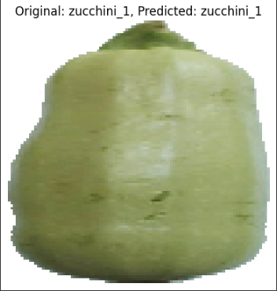
CNN On Moltean Fruits
About Our Dataset
What images look like
Dataset properties
The total number of images: 11475.
Training set size: 6231 images
Test set size: 3110 images
Validation set size : 2134 images
The number of classes: 24.
Image size: Resized 100x100 pixels.
3

Slide 5
02
Libraries Used

Slide 6
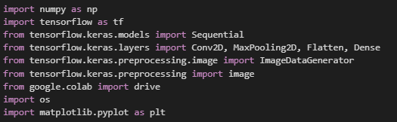
CNN On Moltean Fruits
Libraries:
Numpy
OS
Matplotlib
TensorFlow:
Sequential
Conv2D(keras)
MaxPooling2D(keras)
Flatten(keras)
Dense(keras)
Image (keras)
3

Slide 7
03
CNN Model

Slide 8
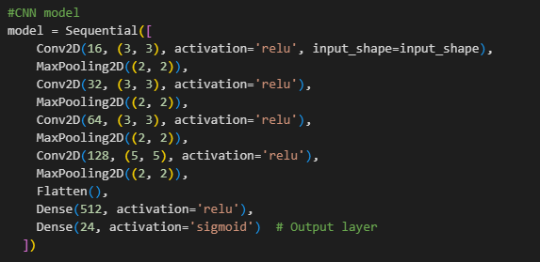


YOUR TITLE HERE

Slide 9
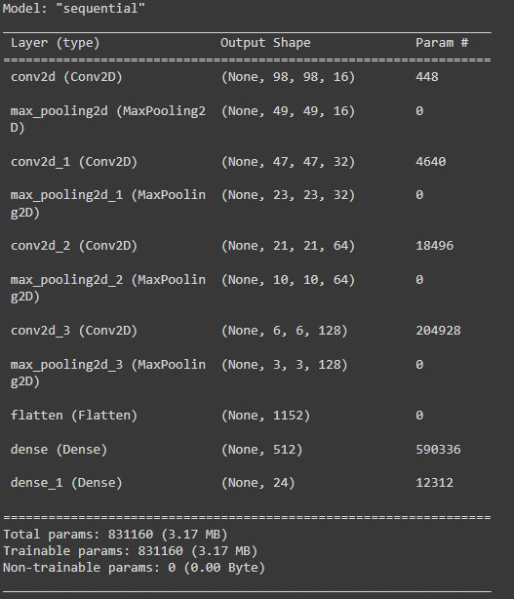
Model Summary

Slide 10
04
Predictions and Graphs

Slide 11
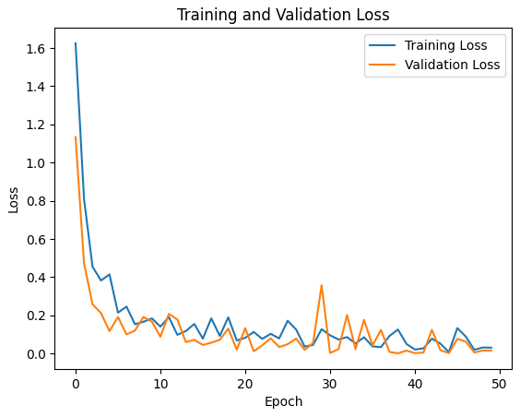
Training and Validation loss

Slide 12
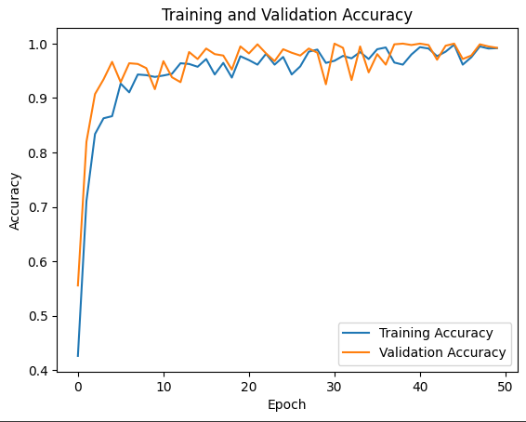
Training and Validation Accuracy

Slide 13
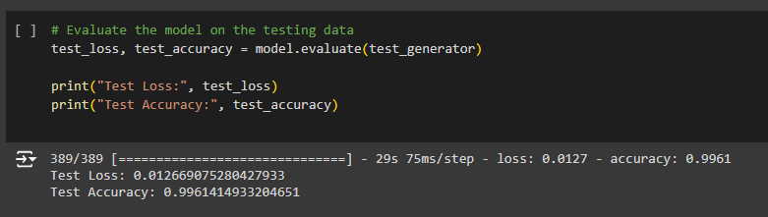
Test Loss and Test Accuracy

Slide 14
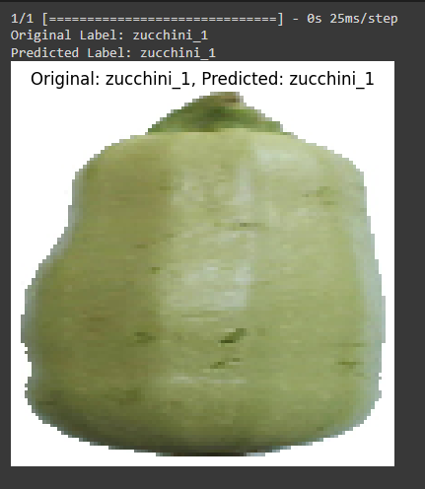
Predicted Label and Original Label
Image was taken from Validation Set of the Dataset and model was able to predict it correctly.

Slide 15
THANKS

