Slide 1
Stored Function

Slide 2
What is a Stored Function?
A stored function, also known as a user-defined function (UDF), is a named and pre-compiled block of code stored in a database that can be called and used within SQL statements. Similar to a stored procedure, a stored function encapsulates a specific task or calculation and returns a value or a result set.
Stored functions are typically written in a programming language specific to the database system, such as PL/SQL (Oracle), T-SQL (Microsoft SQL Server), or PL/pgSQL (PostgreSQL). They can accept input parameters, perform computations, and return a single value or a result set based on the defined logic.

Slide 3
Stored functions can be used in various scenarios, such as performing complex calculations, data transformations, string manipulations, or custom aggregations. They provide a way to extend the functionality of the database system and enable developers to create custom logic that can be reused across different applications or database interactions.
Overall, stored functions offer a powerful mechanism for implementing custom logic within the database and enhancing the capabilities of SQL statements by providing reusable, deterministic code blocks that return values or result sets.

Slide 4
Definition:
A stored function is a named block of code stored in a database that performs specific computations or tasks. It accepts input parameters, executes logic, and returns a single value or result set, which can be used within SQL statements. Stored functions enhance the capabilities of the database by providing reusable code that can be called repeatedly.

Slide 5
Deterministic:
A deterministic function will always produce the same result for the same set of input parameters. It means that if you invoke the function multiple times with identical input values, it will consistently return the same output. Deterministic functions do not rely on external factors or data, and their behavior is entirely determined by the input provided.
Examples of deterministic functions include mathematical operations like addition or subtraction, string manipulations, or simple lookup functions.

Slide 6
Non-Deterministic:
A non-deterministic function, on the other hand, may produce different results for the same set of input parameters. The output of a non-deterministic function can vary based on external factors, system state, or data changes that are not explicitly part of the input parameters. Non-deterministic functions can include those that generate random numbers, current timestamps, or functions that rely on system configurations or external data sources.

Slide 7
Definition:
A stored function is a named block of code stored in a database that performs specific computations or tasks. It accepts input parameters, executes logic, and returns a single value or result set, which can be used within SQL statements. Stored functions enhance the capabilities of the database by providing reusable code that can be called repeatedly.

Slide 8
Syntax:
Create function function_name(func_parm1, func_parm2,…)
Return datatype[characteristics]
Func_body

Slide 9
Execute a Stored Function:
select function_name(param1);
Drop a Stored Function:
Drop function function_name;

Slide 10
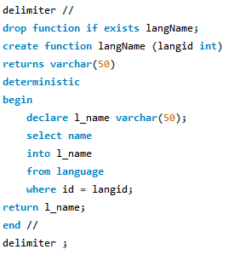
Example:

