Slide 1
Normalization

Slide 2
What is Database Normalization?
Normalization is a database design technique that reduces data redundancy and eliminates undesirable characteristics like Insertion, Update and Deletion Anomalies. Normalization rules divides larger tables into smaller tables and links them using relationships. The purpose of Normalisation in SQL is to eliminate redundant (repetitive) data and ensure data is stored logically.

Slide 3
Database Normal Forms
Here is a list of Normal Forms in SQL:
1NF (First Normal Form)
2NF (Second Normal Form)
3NF (Third Normal Form)

Slide 4
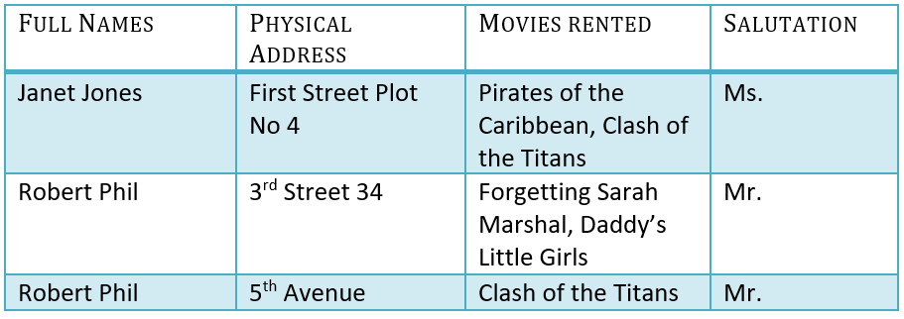
Normalization Example

Slide 5
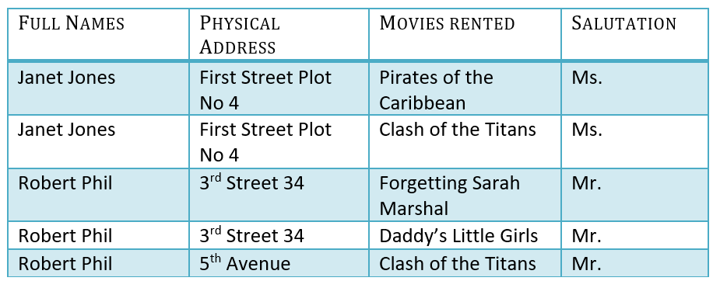
1NF (First Normal Form) Rules
Each table cell should contain a single value.
Each record needs to be unique.

Slide 6


2NF (Second Normal Form) Rules
Rule 1- Be in 1NF
Rule 2- Single Column Primary Key that does not functionally dependent on any subset of candidate key relation

Slide 7

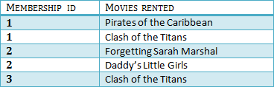

3NF (Third Normal Form) Rules
Rule 1- Be in 2NF
Rule 2- Has no transitive functional dependencies

