Slide 1
Stored Procedure

Slide 2
What is a Stored Procedure?
A stored procedure is a prepared SQL code that you can save, so the code can be reused over and over again.
So if you have an SQL query that you write over and over again, save it as a stored procedure, and then just call it to execute it.
You can also pass parameters to a stored procedure, so that the stored procedure can act based on the parameter value(s) that is passed

Slide 3
Definition:
A stored procedure is a named and pre-compiled set of SQL statements or procedural code stored in a database. It is designed to perform specific tasks and can be repeatedly executed for improved efficiency and modularity.

Slide 4
Syntax:
CREATE PROCEDURE procedure_name
AS
sql_statement
GO;

Slide 5
Execute a Stored Function:
Call procedure_name();
Drop a Stored Function:
Drop procedure procedure_name;

Slide 6
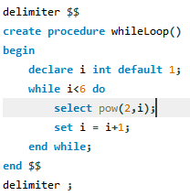
Example:

Slide 7
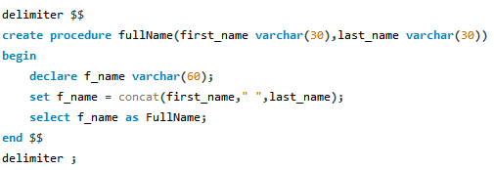
Example:

