Slide 1
Trigger

Slide 2
Introduction:
A trigger is a stored procedure in a database that automatically invokes whenever a special event in the database occurs.
For example, a trigger can be invoked when a row is inserted into a specified table or when specific table columns are updated in simple words a trigger is a collection of SQL statements with particular names that are stored in system memory.
It belongs to a specific class of stored procedures that are automatically invoked in response to database server events.
Every trigger has a table attached to it.

Slide 3
Because a trigger cannot be called directly, unlike a stored procedure, it is referred to as a special procedure.
A trigger is automatically called whenever a data modification event against a table takes place, which is the main distinction between a trigger and a procedure.
On the other hand, a stored procedure must be called directly.

Slide 4
Definition:
A trigger in the context of databases is a special type of code or stored procedure that automatically executes in response to specific events or actions on a table. It is used to enforce rules, maintain data integrity, and perform automated actions in the database.

Slide 5
Syntax:
create trigger [trigger_name]
[before | after]
{insert | update | delete}
on [table_name]
[for each row]
[trigger_body]

Slide 6
Delimiter:
In SQL, the delimiter is a special character or sequence of characters that marks the end of a SQL statement or a block of code. It is used to separate multiple SQL statements within a single query or to define the boundaries of stored procedures, functions, triggers, or other database objects.
The default delimiter in SQL statements is usually a semicolon (;). After each complete SQL statement, a semicolon is placed to indicate the end of that statement.

Slide 7
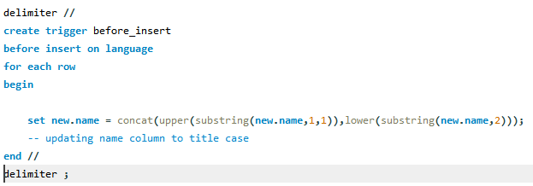
Before insert Example:

Slide 8
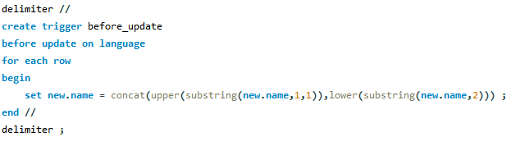
Before Update Example:

Slide 9
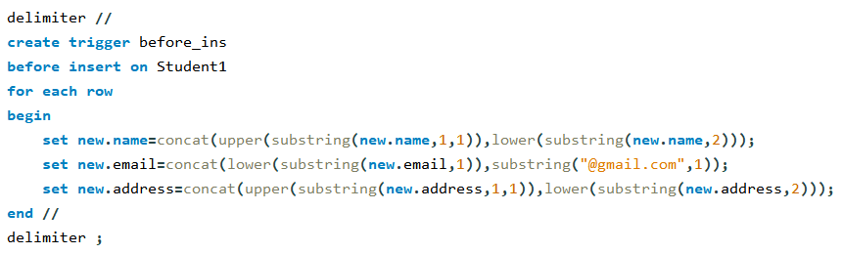
Example:

