Slide 1
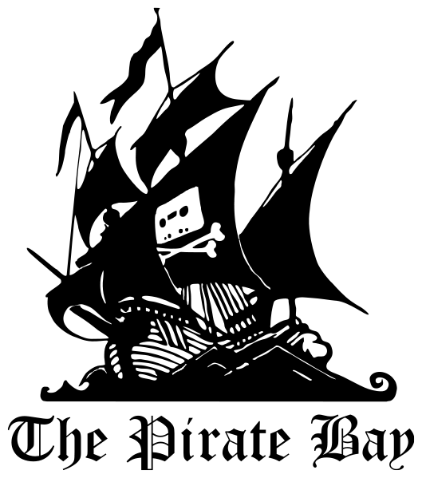
Software Piracy
Scholarly article vs. Popular article
By Adam Darrah

Slide 2
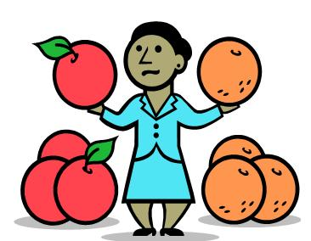
Differences
Scholarly
3 authors
Audience is more educated
Contained interview
Contained data tables
Popular:
No clear author
Audience is less educated

Slide 3
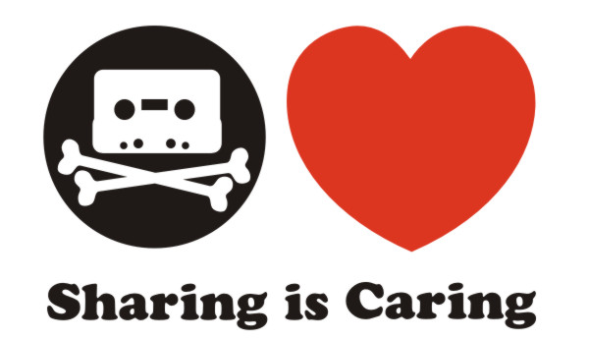
Similarities
Plain formatting
Both use statistics
Both included history of piracy
No advertisements

Slide 4

Questions
Popular article was a basic summary of scholarly article
Popular article was aimed at a less educated audience
Popular article was mostly accurate:
Statistical inaccuracy
Popular article claimed 10% drop in piracy would create 500,000 jobs

Slide 5
Final Thoughts
“By compromising intellectual property, pirates inhibit innovation and remove any financial incentive to develop a new product or work of art. The interesting thing, however, is that pirates probably see themselves as the innovators, using technology to spread information more widely and effectively than ever before.” -Mikhail Atallah
Popular article:"Software Piracy On The Rise, Study Finds; Rates of pirated software ranged from a high of 93% in Armenia to a low of 20% in the United States, according to the 2007 BSA and IDC Global Software Piracy study. " InformationWeek. (May 14, 2008): NA. Expanded Academic ASAP. Gale. UNIV LIBRARY AT IUPUI. 6 Aug. 2008 <http://find.galegroup.com/itx/infomark.do?&contentSet=IAC-Documents&type=retrieve&tabID=T003&prodId=EAIM&docId=A179009613&source=gale&userGroupName=iulib_iupui&version=1.0>.
Scholarly article:
Wade, Jared.Steal this article.(Cover story). ." Risk Management. 55.5 (May 2008): 25(10). Expanded Academic ASAP. Gale. UNIV LIBRARY AT IUPUI. 6 Aug. 2008 <http://find.galegroup.com/itx/infomark.do?&contentSet=IAC-Documents&type=retrieve&tabID=T002&prodId=EAIM&docId=A179160582&source=gale&userGroupName=iulib_iupui&version=1.0>.

