Slide 1




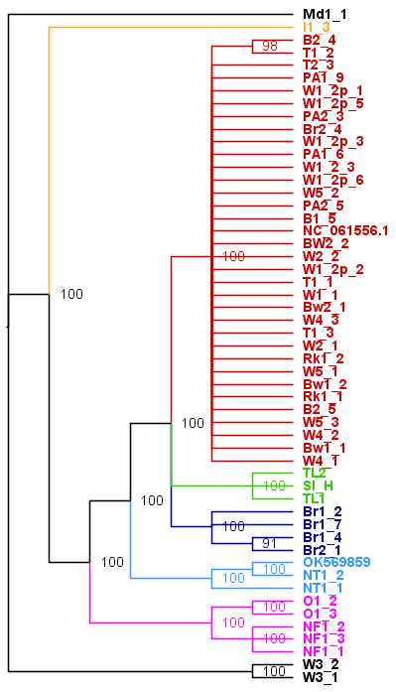
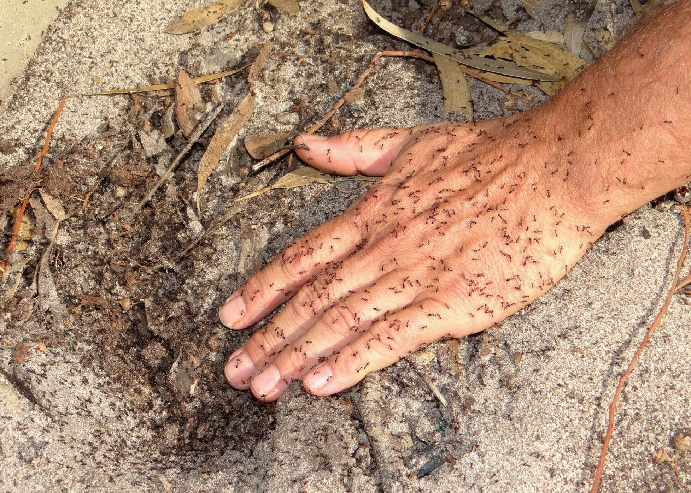
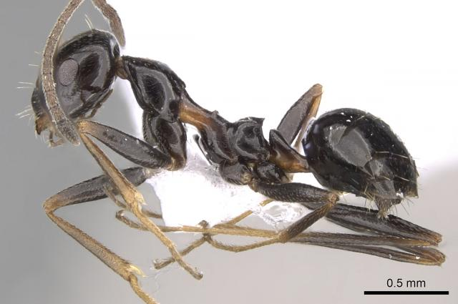
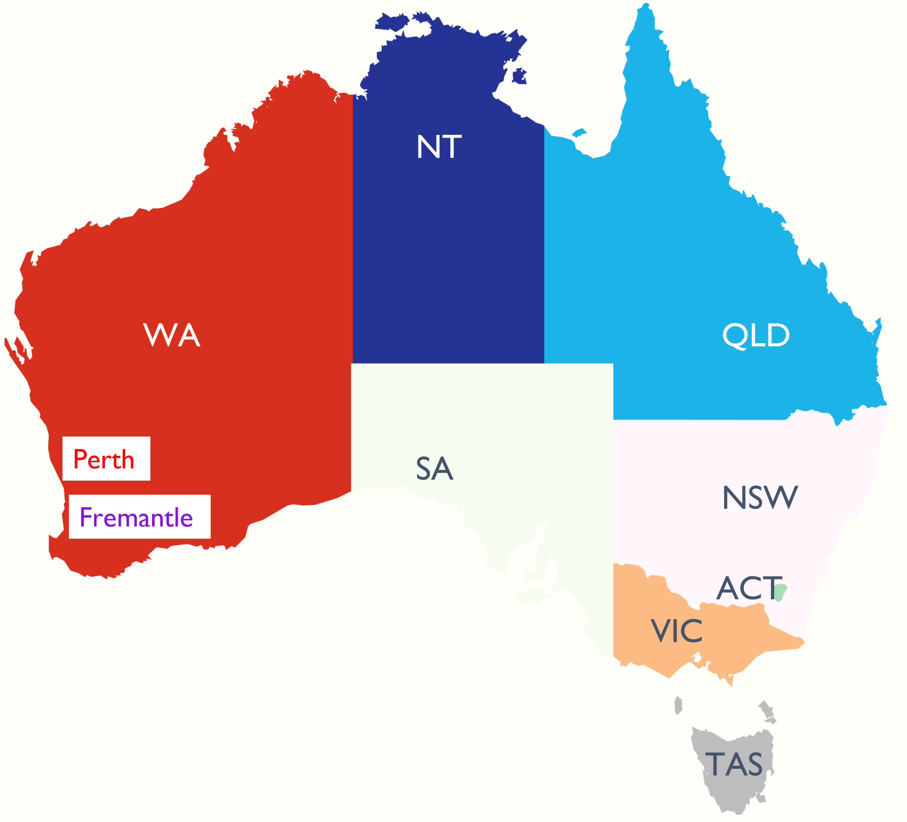
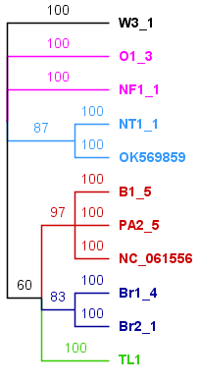
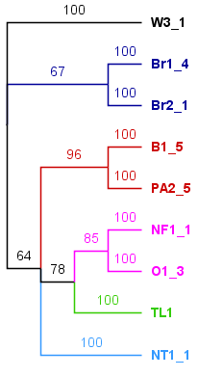
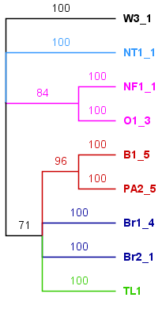
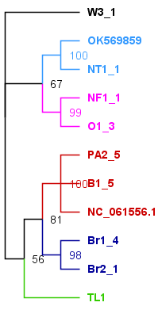
Application of nanopore sequencing in
Biosecurity surveillance
M. Asaduzzaman Prodhan*¹
Marc Widmer¹, Tonny Kinene¹ and Monica Kehoe¹
QR code
Introduction
Results
Browsing ant (Lepisiota frauenfeldi) is an exotic pest in Australia (Fig. 1), a national biosecurity risk.
It is a potential threat to agriculture, environment, and households.
Thirty-four incursions have been detected in Australia since 2013 (Fig. 2).
Are these incursions from a same origin? Or multiple?
This information is key to taking effective biosecurity measures and keep the pest at bay
QLD, NT and WA incursions are separate (Fig. 3)
Within WA, possibly two incursions: Perth & Fremantle
Perth incursions could be a spread of an incursion or multiple incursions from the same source/origin
Among the 13 mitochondrial protein coding genes, only cox1, nad5 and cob (Fig. 4A-C, respectively) showed a topology
However, none could not reveal the relatedness like the whole mitogenome-based tree (Figs. 3 and 4D).
Outgroup
Overseas
WA Perth
Photo: Pia Scanlon and Marc Widmer
Overseas
Fig 1. Browsing ant incursion in Australia
NT
QLD
WA Fremantle
Outgroup
Fig 3. Phylogenetic tree based on Bayesian Inference
A (cox1)
B (nad5)
C (cob)
D (whole mitogenome)
Legends:
WA Perth
WA Fremantle
NT
QLD
Overseas
Outgroup
Fig 2. Browsing ant detected in WA, NT, and QLD.
Fig 4. (A) cox1, (B) nad5, (C) cob, and (D) whole mitogenome based Bayesian Inference trees
Methods
Take-home message
48 L. frauenfeldi and 3 L. incisa mitogenomes
L. incisa as outgroup
SQK-LSK109, MinION sequencing
Reference based assembly, 17 kb mitogenome
Phylogenetic analysis
Australian browsing ant incursions are not from a single overseas origin suggesting to scrutinise all possible avenues
However, only whole mitochondrial genome analysis could reveal the above resolution; not by a single gene analysis
*Correspondence: Asad.Prodhan@dpird.wa.gov.au; ¹Department of Primary Industries and Regional Development, 3 Baron-Hay Court, South Perth WA 6151, Australia

