Slide 1
An introduction to Nanopore DNA sequencing and data analysis
Asad Prodhan

Slide 2
Aims
DNA extraction to Data generation
Some key points in each step
Now I have my data, how do I get started?
Some resources

Slide 3
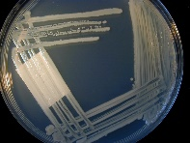
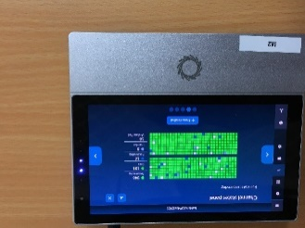
DNA extraction to Nanopore sequencing: an example
MinION
Hight Throughput Sequencing
Bacterial IDs

Slide 4
DNA extraction to Nanopore sequencing: an example
DNA Extraction
Library Preparation
Sequencing Reads
Read 1: ATGCCGGTATTAA …
Read 2: CGGATTAACGAGTAT …
hundreds of thousands of reads
100-500 GB per run
MinION
Hight Throughput Sequencing
Bioinformatics analysis
Bacterial IDs

Slide 5
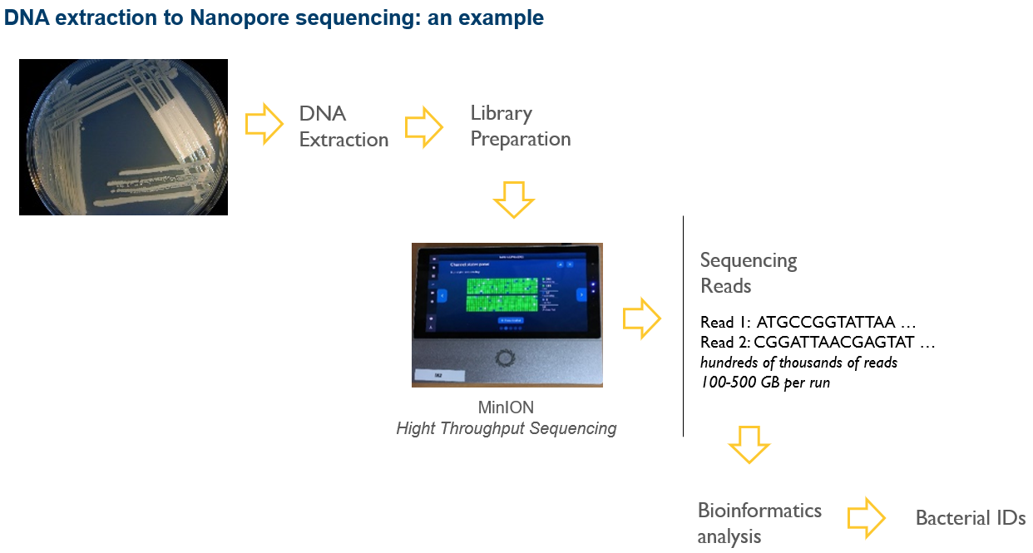
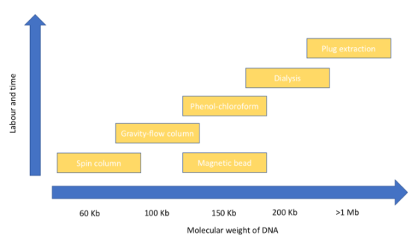
Dissecting Each Step
DNA Extraction
https://lab.loman.net/2018/05/25/dna-extraction-book-chapter/#__RefHeading___Toc505877552
High Molecular Weight (HMW) DNA = ~ 20-100 Kb
longer fragments = longer reads
longer reads are suitable for De novo assembly and structural variations (deletion, insertion, duplication, inversion, SNP, translocation)
Pipet slowly to minimise shearing DNA
QC is required
DNA fragment size selection is possible.

Slide 6
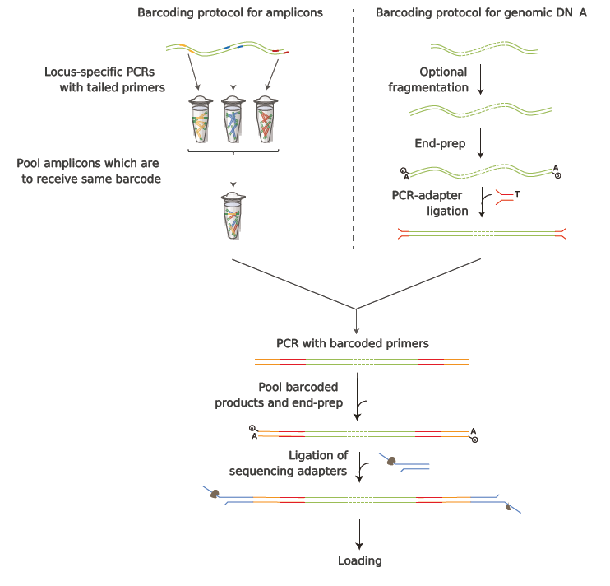
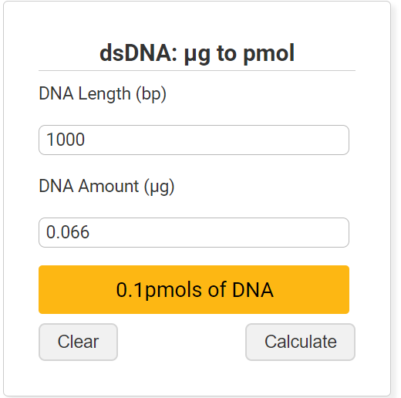

Dissecting Each Step
Library Preparation
Take the recommended amount of input DNA
How do we calculate fmol?
https://www.promega.com.au/resources/tools/biomath/
1 pmol = 1000 fmol
100 fmol = 1 Kb X 66 ng
Prepare the ends of the DNA fragments
Attach the barcodes and adapter sequences (need to be trimmed)

Slide 7
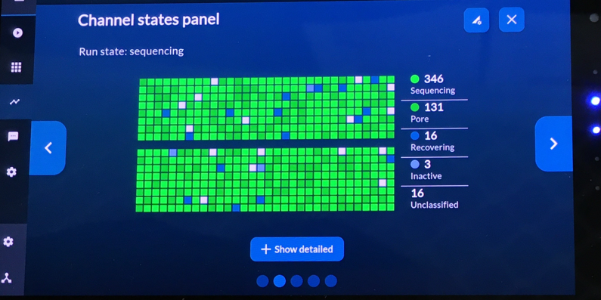
Dissecting Each Step
MinION
Fig. MinION Mk1C
Run time parameters
Basecalling mode: fast, hac (high accuracy) or sup (supper accuracy)
Min qscore = quality threshold for the reads to pass
Minimum length filter = length threshold for the reads to pass
Data output format: fast5 or pod5 (before basecalling), fastq (after basecalling)

Slide 8
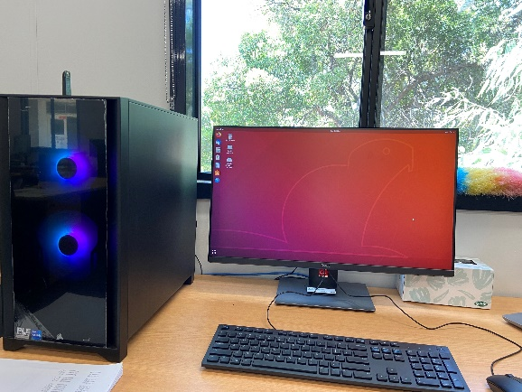
Dissecting Each Step
Sequencing Reads
fast5 & fastq format
SFTP
Transfer data from MinION to your Linux computer
sftp minit@MinION_Number.local:/data; then get -r *
fast5 will allow you to basecall again later if needed
(https://github.com/asadprodhan/GPU-accelerated-guppy-basecalling)
fast5 takes a lot of storage space
storage space can be reduced by converting fast5 to slow5
(https://github.com/asadprodhan/Reducing-storage-space-by-converting-Nanopore-fast5-to-slow5-using-slow5tools)

Slide 9
Dissecting Each Step
Bioinformatics Analysis
Read relevant papers
Identify bioinformatics tools
How to install the tools?
you get an answer

Slide 10
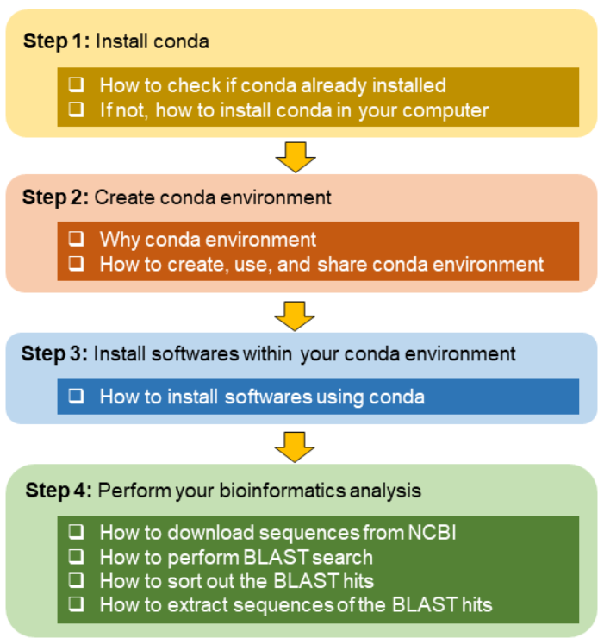
Dissecting Each Step
Bioinformatics Analysis
https://github.com/asadprodhan/A-beginner-s-guide-to-Bioinformatics
you get an answer

Slide 11
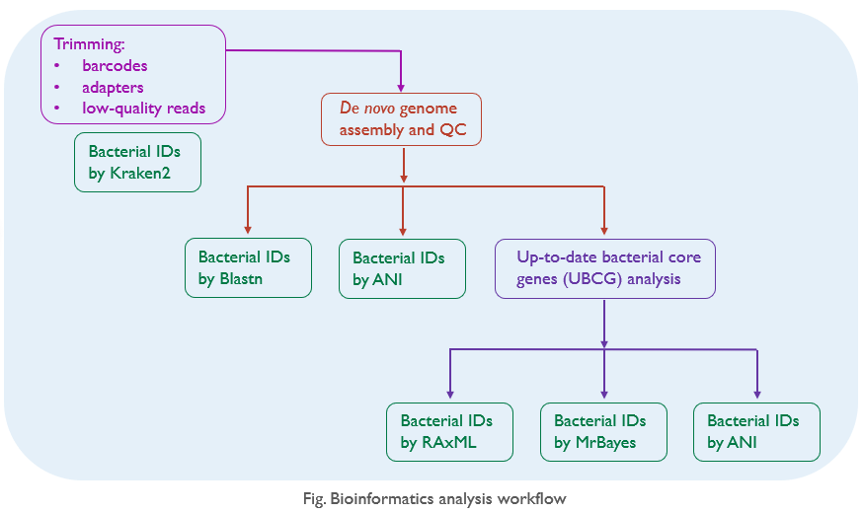
Dissecting Each Step
Bioinformatics Analysis
you get an answer

Slide 12
Dissecting Each Step
Bioinformatics Analysis
Genome assembly
(https://github.com/asadprodhan/Setting-up-and-running-Miniasm-assembler)
Blastn
(https://github.com/asadprodhan/A-beginner-s-guide-to-Bioinformatics)
Kraken2
(https://github.com/asadprodhan/How-to-run-Kraken2-on-HPC-using-Singularity-container-and-Nextflow)
ANI
(https://github.com/asadprodhan/Average-Nucleotide-Identity-ANI-analysis)
UBCG & Phylogeny
(https://github.com/asadprodhan/Bacterial-phylogenetic-tree-reconstruction-using-UBCG-pipeline)
you get an answer

Slide 13
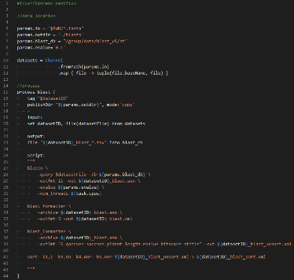
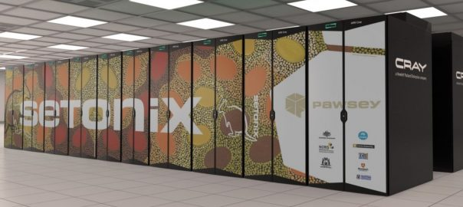
Dissecting Each Step
Bioinformatics Analysis
HPC Cluster
Nextflow & Singularity container
A collection of tutorials to learn coding from basics to bioinformatics.
(https://www.linkedin.com/in/asadprodhan/)

Slide 14
Summary
Analysis Steps
Example tools
Check the sequence quality
NanoPlot
Remove artificial sequences & low-quality reads
NanoFilt
Check the sequence quality
NanoPlot
Assemble the reads
- De novo?
- Reference-guided?
Miniasm, Flye, Canu, Spades etc
Polishing the assembly
Medaka, NanoPolish
Check assembly quality
Quast
Target-specific analysis
Blastn, Kraken2, ANI, Phylogeny etc

Slide 15


Acknowledgements
Monica Kehoe
Tonny Kinene
Dominie Wright
Cuiping Wang

Slide 16


