Slide 1
PharmaPedia Match
A 2D pharmacy learning game (Demonstration)
Student name: ____________________
Student ID: ____________________
Class / Section: Pharm-D ________
Pharm-D IT Lab – Assignment 2
Student project for the Pharm-D, IT lab. Not medical advice.

Slide 2
What the project is for
• A browser game that teaches 15 common medicines and their drug classes
• Players match a medicine to its class, or a class to its medicine
• For Pharm-D students revising pharmacology before quizzes and exams
• Works on laptop and mobile, online or offline, with no login
Student project for the Pharm-D, IT lab. Not medical advice.
2

Slide 3
Objectives
• Recognise the drug class of 15 commonly used medicines
• Link each medicine to its main use (indication)
• Learn from mistakes through instant feedback and an end-of-game review
• Make revision fun with points, streaks and a star rating
Student project for the Pharm-D, IT lab. Not medical advice.
3

Slide 4
AI tools used and how they helped
• Claude (Anthropic) – AI coding assistant: wrote the HTML, CSS and JavaScript, the screens, scoring and feedback logic
• AI also helped test the game by playing it start to finish 3 times on laptop and mobile sizes
• The pharmacy content was written and checked by me against my notes and references – not invented by AI
• AI declaration: AI arranged the content; I supplied and verified every medicine fact
Student project for the Pharm-D, IT lab. Not medical advice.
4

Slide 5
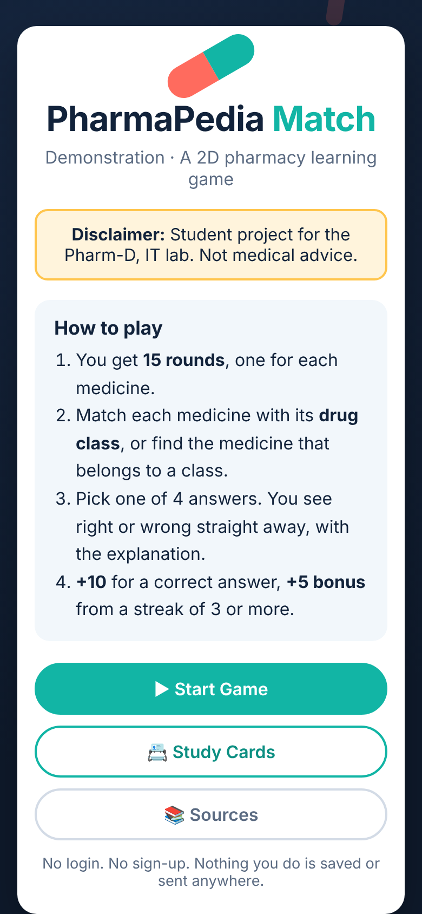
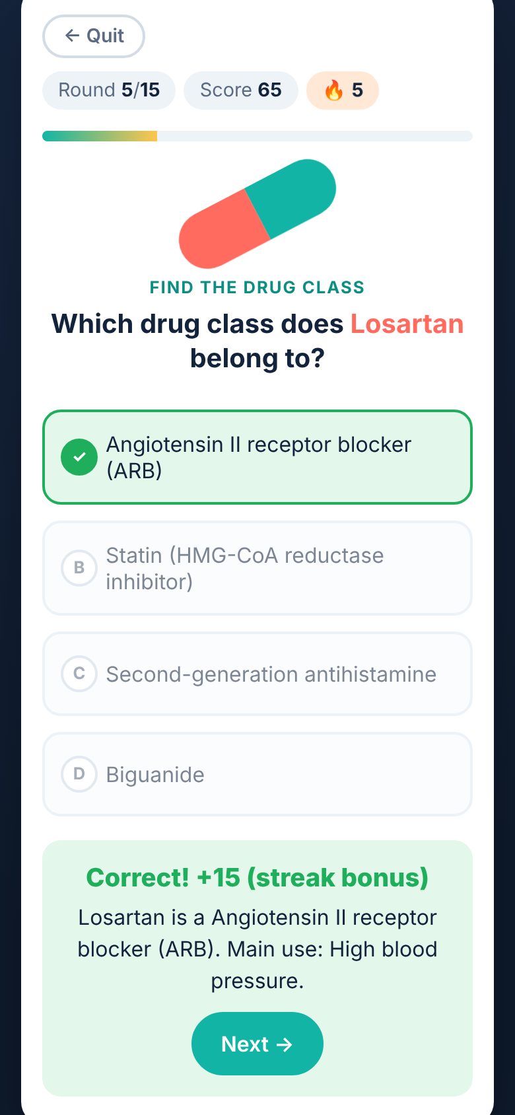
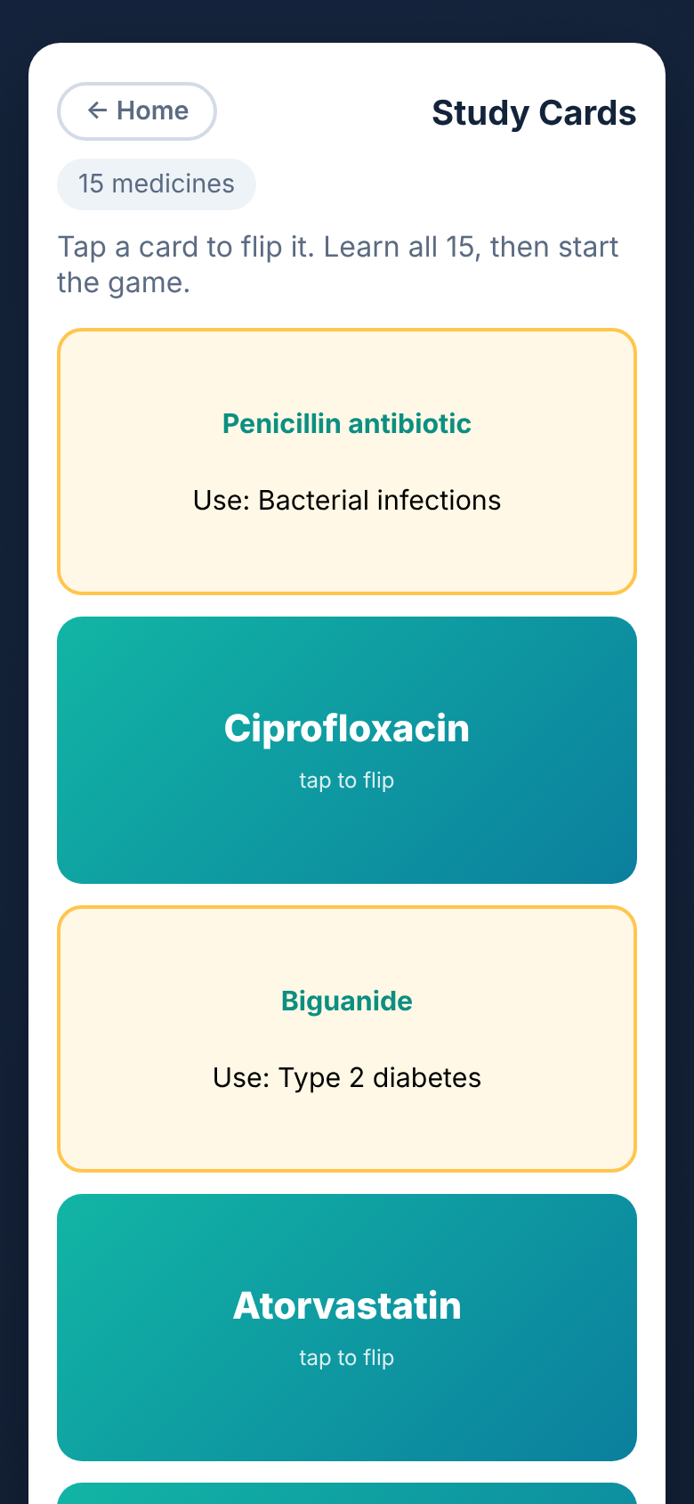
Main features
1. Start screen + disclaimer
2. Instant feedback + scoring
3. Study cards (flip to learn)
Student project for the Pharm-D, IT lab. Not medical advice.
5

Slide 6
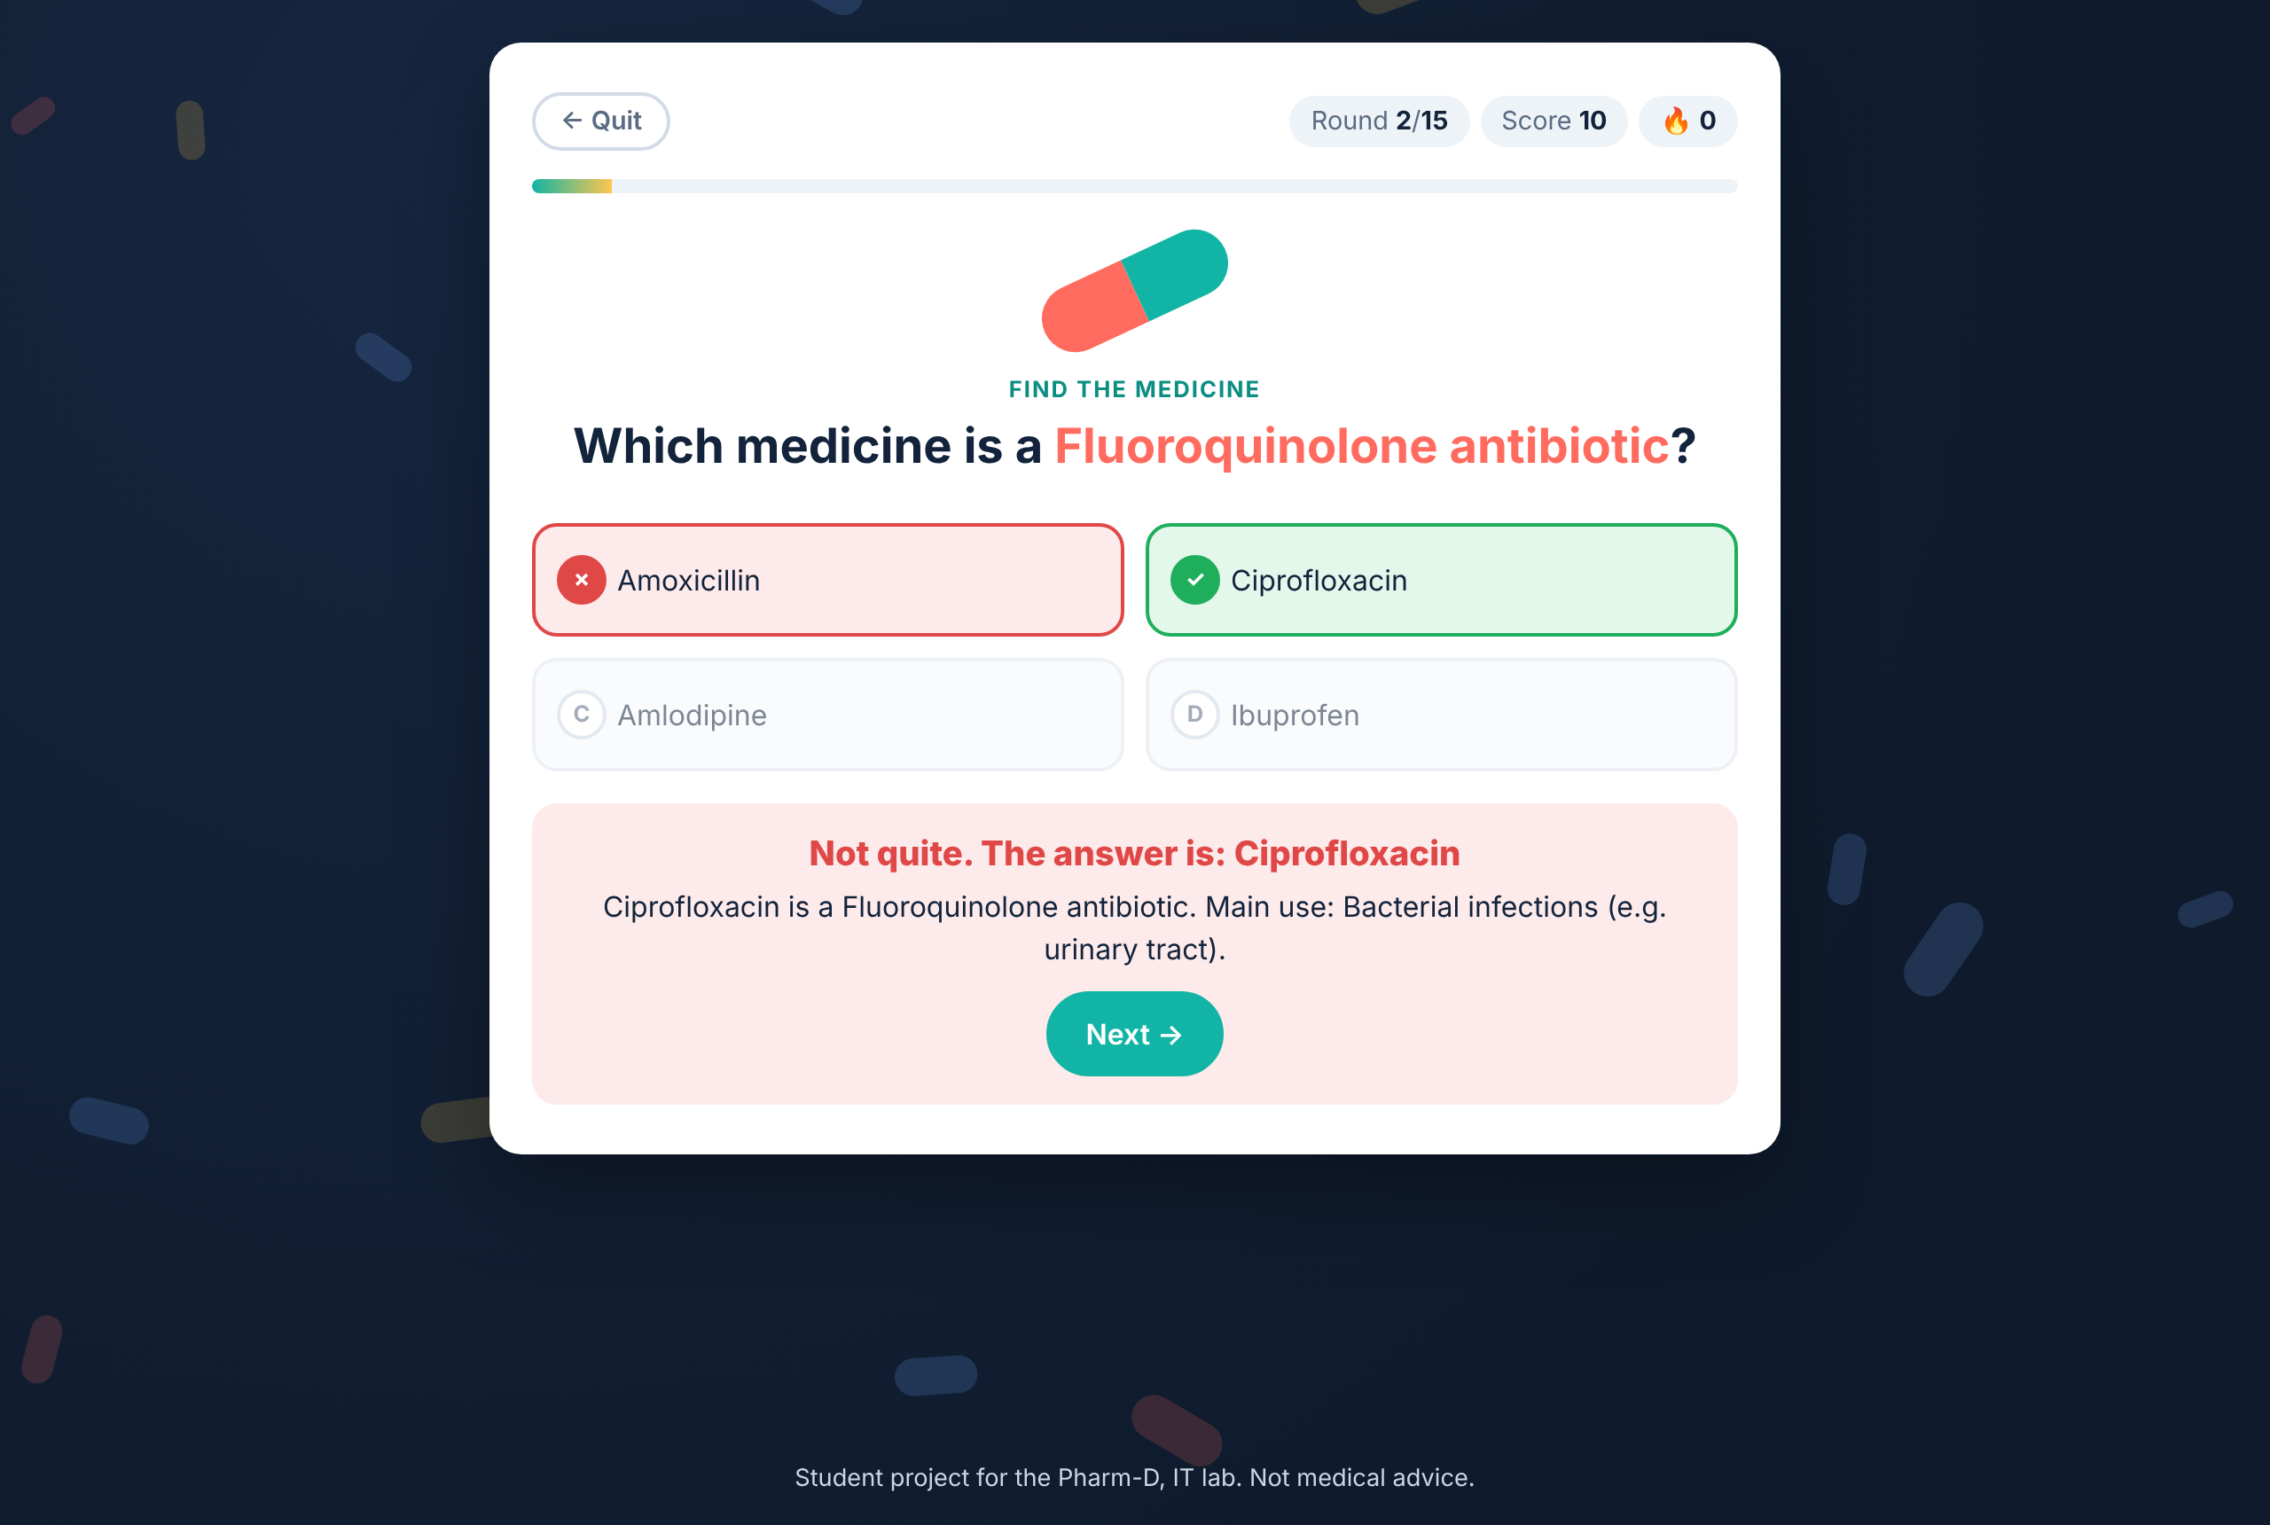
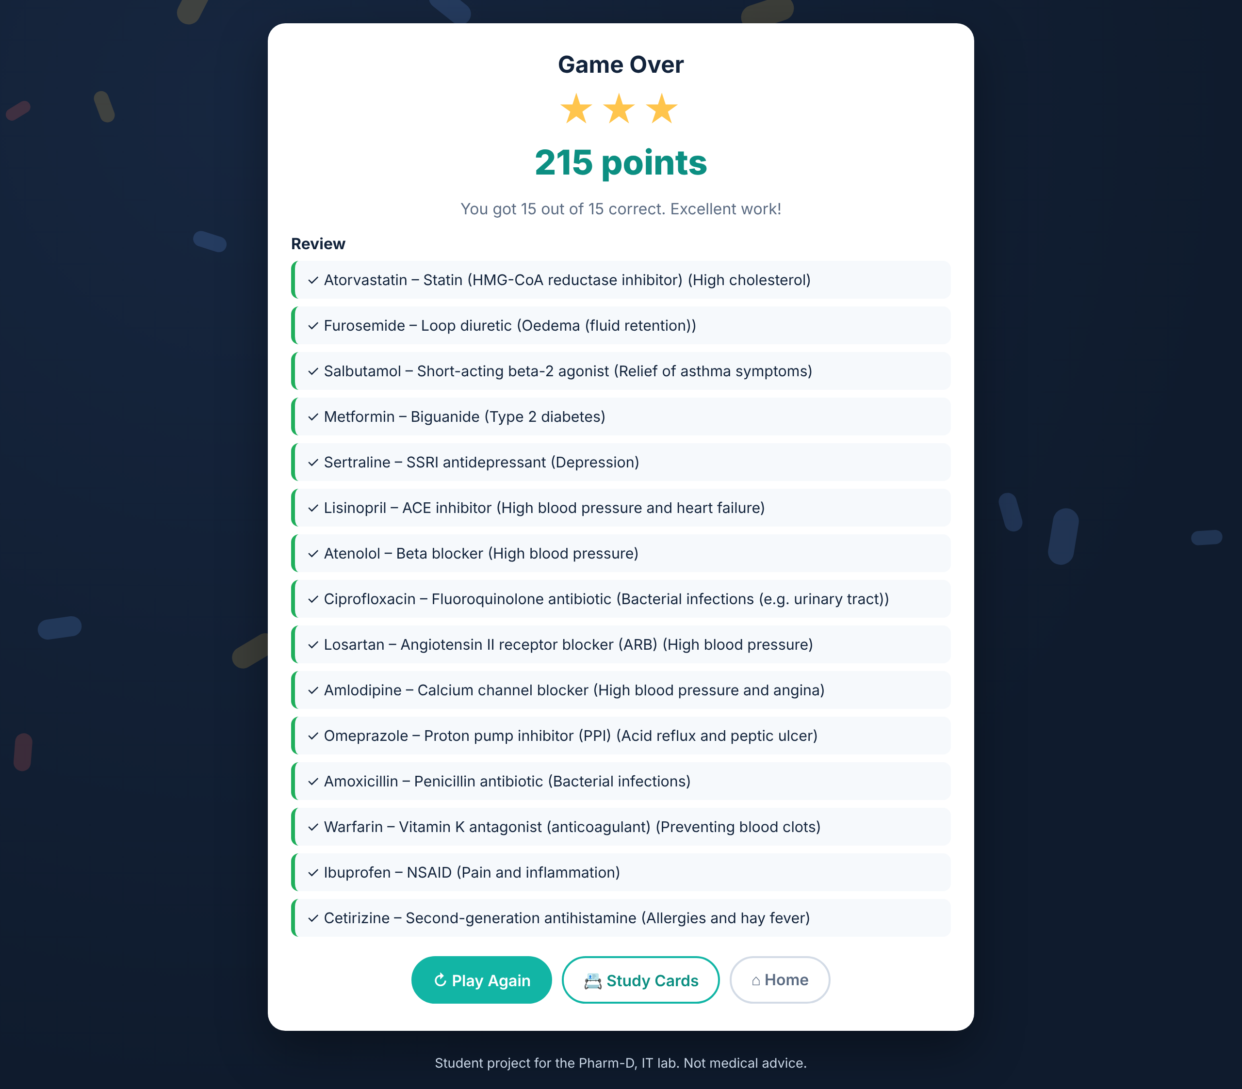
The game in play and the score screen
Wrong answer: shows the correct answer + explanation
Results: score, stars and a review of all 15
Student project for the Pharm-D, IT lab. Not medical advice.
6

Slide 7
Sources and AI declaration
• Pharmacology lecture notes – __________ (course / topic)
• British National Formulary (BNF) – edition ____
• Katzung, Basic & Clinical Pharmacology – edition ____, chapters ____
• AI: Claude was used for code only. All medicine facts were checked by me.
Student project for the Pharm-D, IT lab. Not medical advice.
7

Slide 8
What worked, what did not, what next
• Worked: all screens, scoring, feedback and study cards run on laptop and mobile
• Challenge: keeping every answer unique so there is only one correct option
• Next: add more medicines and a timed mode
• Next: a second round type matching medicines to their main use
Student project for the Pharm-D, IT lab. Not medical advice.
8

