Slide 1
King county housing project
Asad Rahman

Slide 2
Problem Statement
What are the most important features in housing prices
What can residents hoping to buy or sell a house focus on to get the best value
King County, Washington
21597 data sets
Collected between May 2014 and May 2015

Slide 3
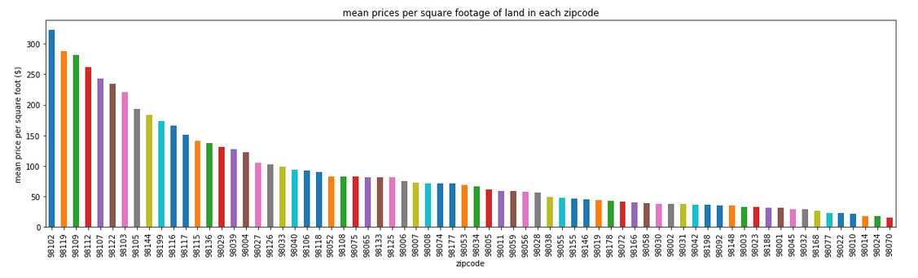
Affluent Areas

Slide 4
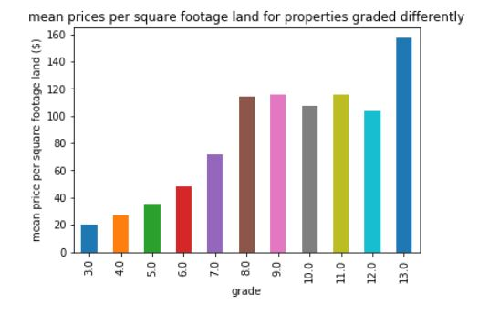
Grading influence

Slide 5
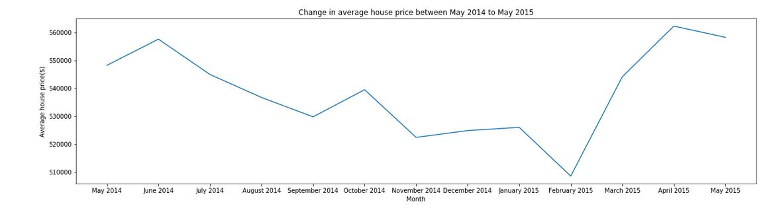
Price over time

Slide 6
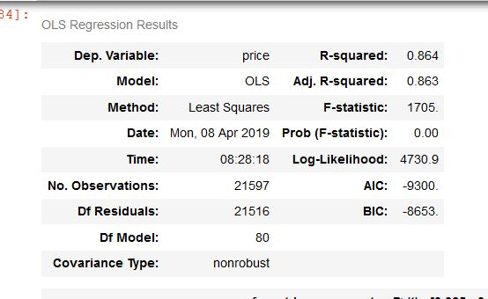
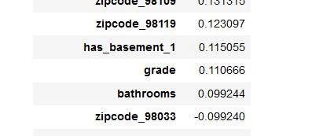
Interpretation

Slide 7
QUESTIONS?

