Slide 1
Representing Tribolium Nuclei
with 3D Gaussian Splatting
Real light-sheet microscopy data, fitted with compact anisotropic Gaussians
MLCV Seminar · Team Project
Notes:
We asked one question: can a few hundred 3D blobs describe real microscope images of embryos well enough to be useful? And we checked the answer honestly, including where it does not hold.

Slide 2
The Goal
Replace a microscopy volume — millions of voxels — with a compact set of 3D Gaussian blobs.
Each Gaussian carries a position, a size, a shape, and a brightness.
Hypothesis tested: if each Gaussian settles on one nucleus, one fit is both a compact model and a nucleus list. A detector already seeds and scores the fit, so this had to be tested, not assumed.
a few hundred Gaussians
millions of voxels
Tribolium nuclei · 3D Gaussian splatting
2
Notes:
A microscope volume is millions of brightness numbers. We replace it with a few hundred blobs; each blob has a position, a size, a shape and a brightness. The hope is one blob per nucleus, so one fit gives a small model and a list of nuclei at the same time. We treated that as a hypothesis, not a given: a detector already places the starting blobs and scores the result, so the list of nuclei is not free.

Slide 3
Built on Prior Work
Items 1-4 are from [colleague name]’s archive (“runs 2”, frozen 18 July 2026). The re-analysis and validation after it are ours.
1
57 experiments, 399 fits
A systematic sweep across parameterization, initialization, and budget — the largest single body of work behind this project.
2
Four-way parameterization sweep
Established full-anisotropic Gaussians (11 stored numbers, 10 degrees of freedom) as the strongest representation, ahead of axis-aligned, learned-isotropic, and fixed-isotropic.
3
Minimum peak spacing at init: +9.21 dB
The largest single lever in the archive. Found later: the spacing is in voxels, and on stretched voxels it does not transfer (Drosophila: 5/29 vs 22/29 human-labelled nuclei found).
4
Best observed real-data PSNR: 25.93 dB
750 Gaussians, full 37M-voxel volume. The best value in the archive, not a proven limit, and not like-for-like with our small crops.
A related archive idea, an anisotropy regularizer, was dropped for costing −1.15 dB PSNR. Our size cap is a different mechanism (a hard limit on nucleus-seeded Gaussians only); the two were never compared head to head.
Tribolium nuclei · 3D Gaussian splatting
3
Notes:
This builds on my teammate's archive of 399 fits. Their main findings: freely stretched and rotated blobs work best; spreading the starting points apart was the biggest single improvement; and the best image quality they saw was 25.93 dB. Two things we found later. First, that spacing was measured in voxels, and on data whose voxels are five times longer in depth it stops working. Second, the regularizer they dropped is a different thing from our size cap, so I do not claim one grew out of the other.

Slide 4
The Recipe
Each step was tested on its own. Steps 3 and 4 together were tested once, on Drosophila (slide 9).
1
Full anisotropic Gaussians
Colleague
Position + 3 independent scales + rotation + brightness. Not spheres.
2
Seed on detected nuclei first
Both
One Gaussian per detected nucleus before spending any budget on background.
3
Raise the position learning rate, only for poor seeds
This work
Lets badly placed blobs travel to a nucleus. With good seeds it hurt (Drosophila: 21 → 18.3 of 29 in the top 200).
4
Cap nucleus-Gaussian size
This work
Tested alone, default learning rate: +6 faint Tribolium nuclei (4 regions, 1 seed). On Drosophila it touched 2% of blobs and changed nothing.
5
250 Gaussians, 3000 steps
Colleague
No need for thousands — this budget is enough for a ~24-nucleus region.
Tribolium nuclei · 3D Gaussian splatting
4
Notes:
Five steps. Two came from my teammate, two from us, one is shared, and each was tested on its own. The learning rate: raising it lets badly placed blobs move to a nucleus, but when the starting points are already good it makes things worse. The size cap helped faint nuclei on Tribolium; on the Drosophila data it hardly touched any blob. Steps 3 and 4 together were tested once, on the next-to-last results slide.

Slide 5
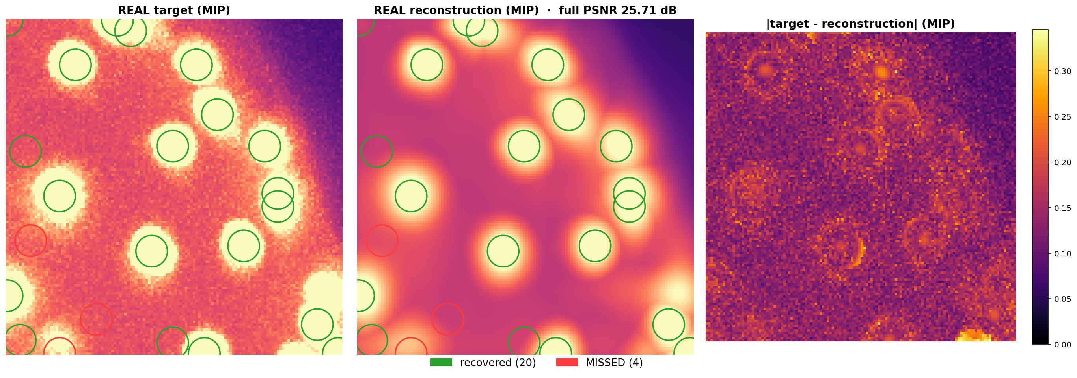
Real Data, Real Reconstruction
Real Tribolium crop (Lund, 64×128×128), 24 detector-found reference nuclei · PSNR 25.71 dB · 20/24 recovered · green = recovered, red = missed
References come from a peak detector, not from a human. Voxels 3.0 × 0.69 × 0.69 µm (z, y, x); a match is within 9.9 voxels (≈6.9 µm in xy, ≈30 µm in z). The reconstruction is visibly smoother than the real tissue.
Tribolium nuclei · 3D Gaussian splatting
5
Notes:
Here is one real Tribolium crop. Left is the data, middle is our blobs, right is the error. Of the 24 nuclei a detector finds in the data, 20 are also found in the reconstruction. Important: those 24 come from a detector, not from a person, so this is agreement between two detectors. Smooth-looking reconstruction is a real limitation.

Slide 6
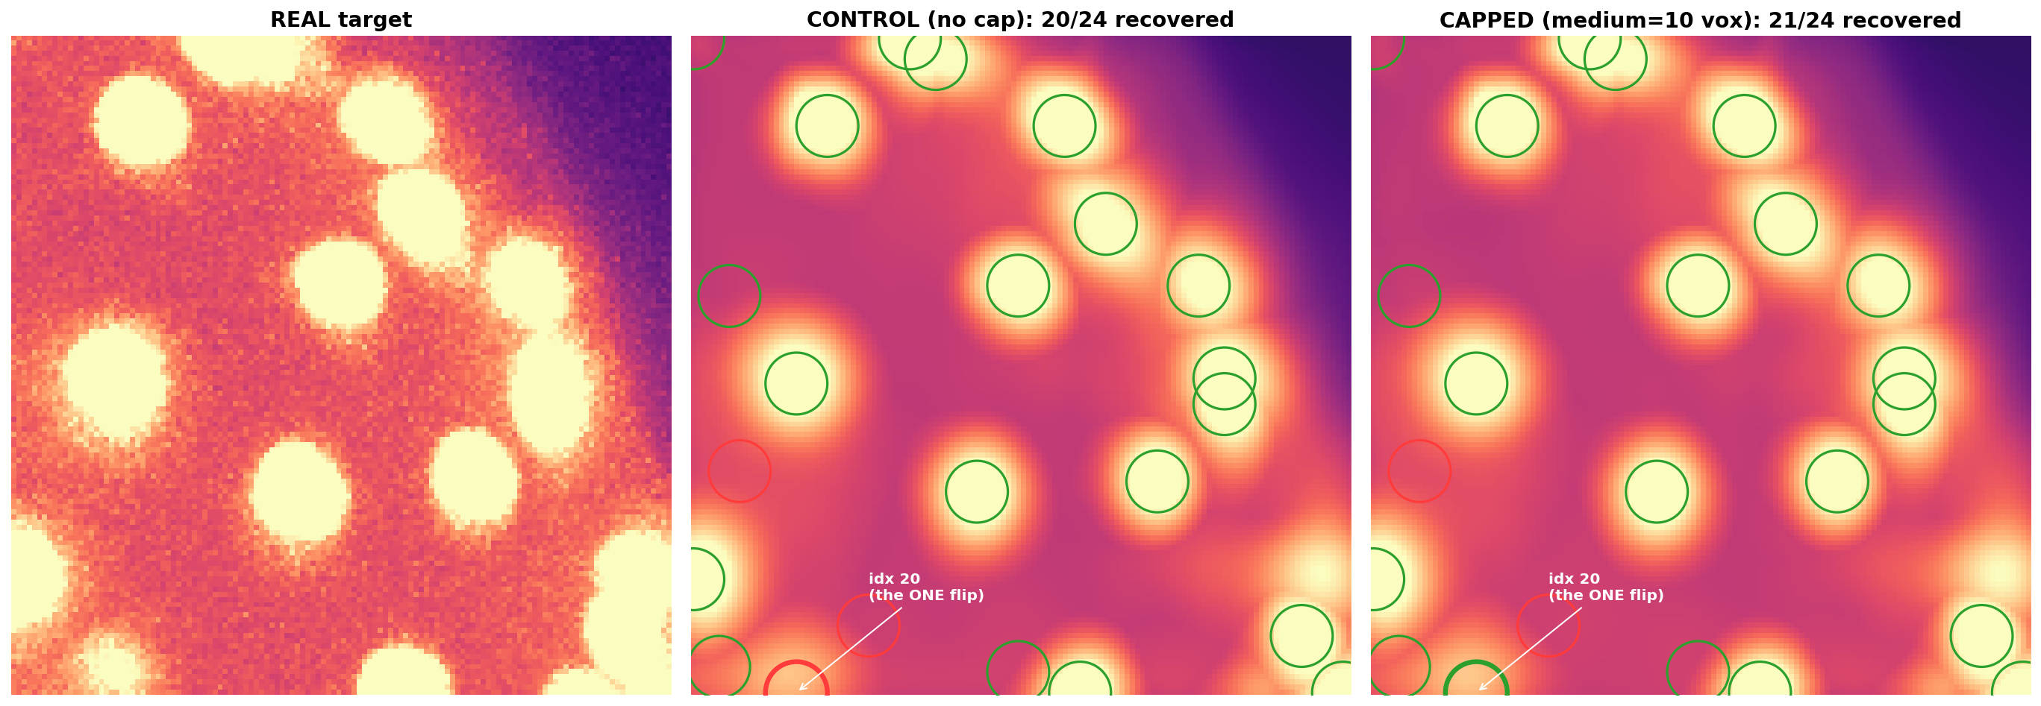
Capping Gaussian Size — Tested on the Same Data
Same 24 nuclei, same volume, one fit (seed 0) · 20/24 → 21/24 recovered · PSNR 25.71 → 25.70 dB
The one nucleus that flipped sits at the crop edge. Across 4 regions (seed 0, corrected matcher), faint-group survival S_B — the share of the faint reference nuclei still found — went 13/31 → 19/31 (+6): 4/9→5/9, 5/13→9/13, 3/4→2/4 (worse), 1/5→3/5. Recall 0.73 → 0.80; PSNR −0.01 dB.
Tribolium nuclei · 3D Gaussian splatting
6
Notes:
The main thing we changed: we limit how wide a nucleus blob may grow. We found that the nuclei we lose are the faint ones, and their blobs spread out until there is no peak left. On this crop the cap recovers one more nucleus, and that one sits at the edge, so on its own it is weak. Over four regions: 13 of 31 faint nuclei kept without the cap, 19 of 31 with it, and the image quality does not change. One region got worse. These numbers are after we fixed a scoring bug, which shrank the effect from +7 to +6 nuclei.

Slide 7
Tested Settings
What was used for the Tribolium crops, and where each choice came from. Rows were measured one at a time unless noted.
Parameter | Value | Source
Parameterization | Full anisotropic (11 stored numbers, 10 degrees of freedom) | Colleague's archive
Initialization | Coverage: one Gaussian per detected nucleus, then intensity-weighted support | Colleague's auto-tuner + this work
Candidate spacing (NMS) | Set in microns for each dataset (≈ nucleus spacing); a fixed voxel window fails on stretched voxels | Colleague’s auto-tuner; unit fix this work
Position learning rate | 0.05–0.1 when seeds are poor; the default (0.0016) when seeds are good | This work
Nucleus-Gaussian scale cap | 10 voxels (6.9 µm in xy), nucleus-seeded Gaussians only; tested at the default learning rate | This work
Gaussian budget K | ≈ 1 per nucleus + support (≈250 for 24 nuclei) | Colleague's budget sweep
Training iterations | 3000 | Colleague's archive
Batch sampling | 70% intensity-weighted / 30% uniform (no importance correction) | Colleague's archive
Tribolium nuclei · 3D Gaussian splatting
7
Notes:
The settings we used, and who found each one. Two notes: spacing must be set in microns for each dataset, and every row was measured on its own, not all together.

Slide 8
Results Summary
25.7 dB
20→21/24
381× fewer
14 vs 10
PSNR on one Tribolium crop (64×128×128), seed 0
detector-found nuclei recovered on that crop, no cap → cap (PSNR 25.71 → 25.70)
stored numbers: 250 Gaussians = 2,750 values vs 1,048,576 voxels (not a file-size ratio)
human-labelled Drosophila nuclei in the top 100 detections: fit vs raw image (mean of 3 seeds)
Tribolium cards: full-anisotropic · coverage init · default position LR (0.0016) · K=250 · 3000 iterations · seed 0 · references from a detector. Drosophila card: 29 human-labelled nuclei · K=500 · 3000 iterations.
Tribolium nuclei · 3D Gaussian splatting
8
Notes:
Four numbers, each with exactly what it was measured on. The first three come from one Tribolium crop, and the reference nuclei there come from a detector. 381 times fewer is a count of stored numbers, not a file size. The last number is the only one checked against nuclei that a person marked.

Slide 9
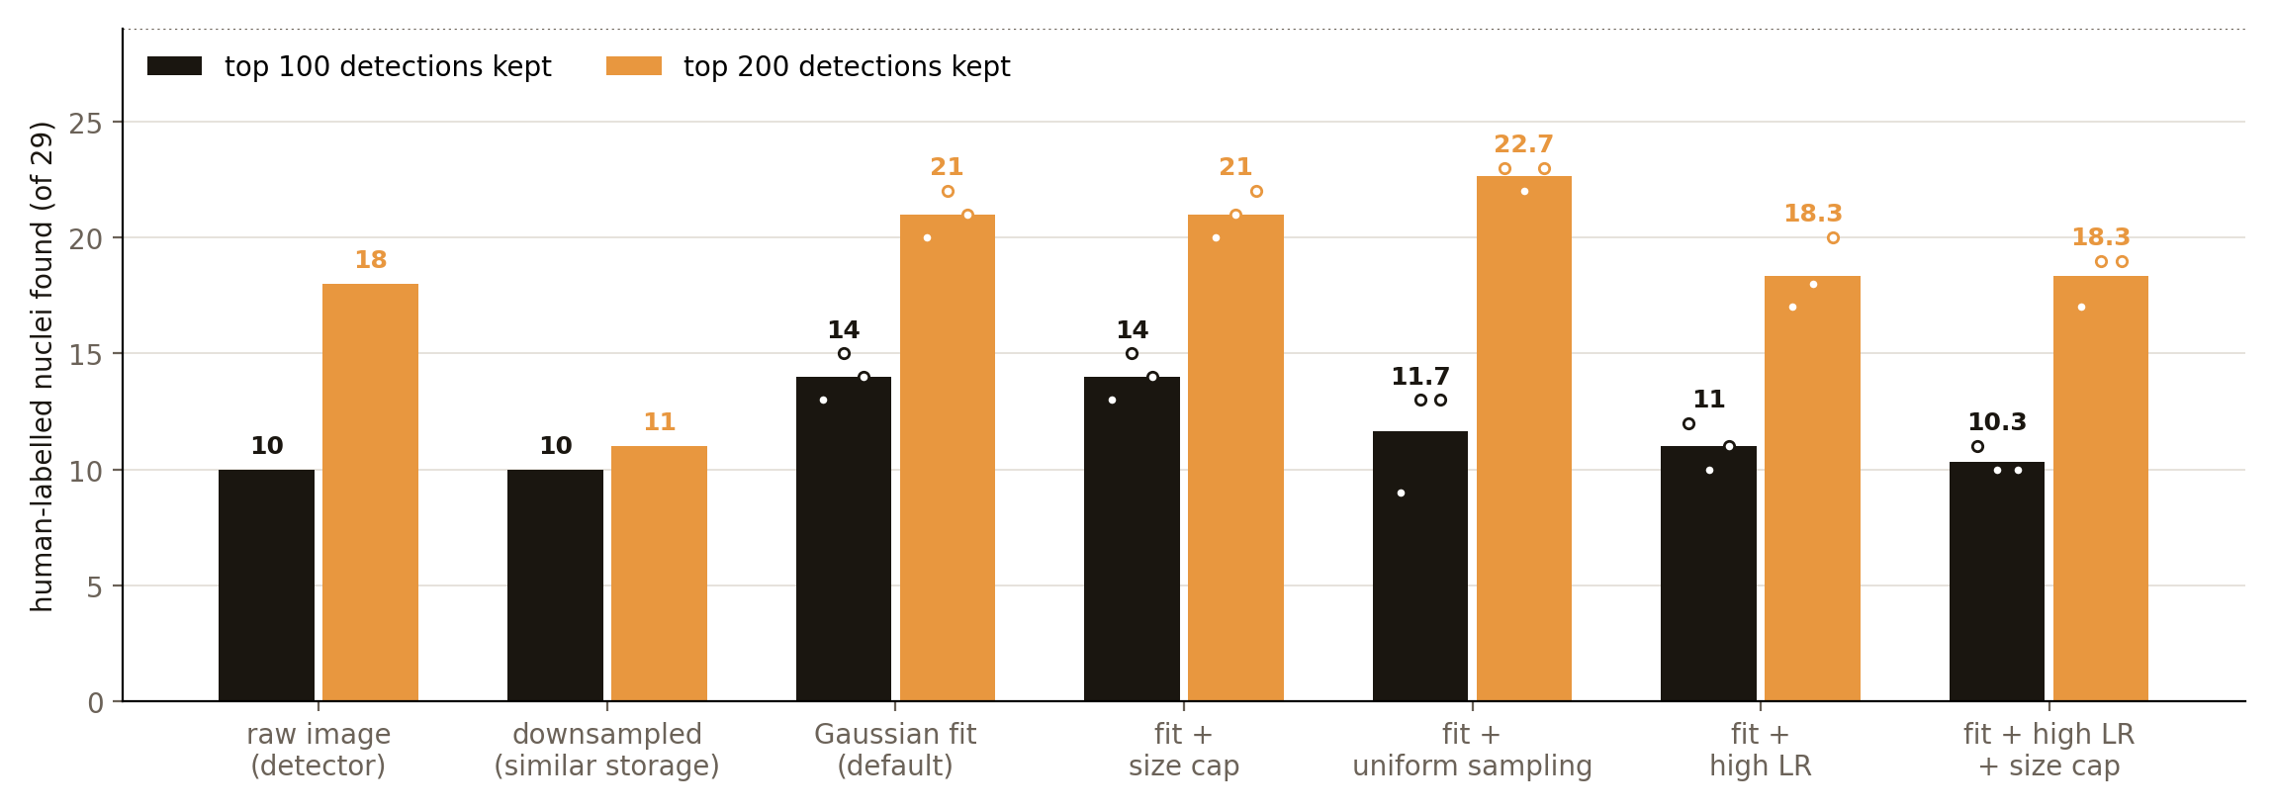
Final Check: Human-Labelled Nuclei
Drosophila crop, 29 nuclei marked by a person · every fit starts from the same detector candidates · fit 14 vs raw image 10 in the top 100 · mean of 3 seeds
Downsampled to similar storage (4,410 vs 5,500 numbers) it scores 17.9 dB vs 21.5 dB and finds 11/29 even in the top 200. But the raw detector, using all 457 candidates, finds 26/29, more than any fit. The size cap bound 2% of blobs and changed nothing; a high learning rate hurt; uniform sampling ranked worse in the top 100 (-2.3) and was unclear at 200 (+1.7). One nucleus = 3.4%; differences under ~3 nuclei are not resolvable.
Tribolium nuclei · 3D Gaussian splatting
9
Notes:
This is the check against a person's labels: 29 nuclei in a fruit-fly embryo crop. Every fit starts from the same detector candidates, so the only thing that differs is the fitting. We compare at the same number of detections, for example the top 100. The fit finds 14, the raw image 10. Downsampling to similar storage finds only 11 even in the top 200. So fitting sorts real nuclei higher. Honestly though: if the raw detector may use all 457 of its candidates, it finds 26, more than any fit. So this is better ranking, not a better detector. The size cap does nothing here, a higher learning rate made it worse, and uniform sampling ranked worse in the top 100. This is mean of 3 seeds.
If asked why we compare at the same number of detections: only some nuclei are labelled, so precision cannot be trusted, but at a fixed number of detections that bias is the same for every method, so the comparison is fair. If asked about noise: one nucleus is 3.4 percent, and we only call a difference real if it is about three nuclei and has the same sign in every seed.

Slide 10
What Doesn't Work Yet
Ours: faint and edge-of-crop nuclei are still missed most often; the size cap helps on average but made one of four regions worse.
!
Shared: fits are smoother than real tissue. 20× more Gaussians bought only +0.36 dB, so this is a representation limit, not a budget one.
!
Ours: small crops (24–33 nuclei), one frame, the Tribolium cap on one seed; human labels only on one Drosophila crop (29 nuclei).
!
Tested by us: once storage reaches ~10,000 numbers, plain downsampling matches Gaussians on image quality, so compression alone does not justify them.
!
Tribolium nuclei · 3D Gaussian splatting
10
Notes:
What still fails. Ours: faint and edge nuclei, and the cap made one region worse. Shared: the reconstruction is too smooth, and 20 times more blobs does not fix it. Our tests are small. And once you allow about ten thousand numbers, plain downsampling is just as good on image quality, so the case has to rest on finding nuclei.

Slide 11
Our Conclusion
What we observed
On Tribolium, capping blob size kept more faint detector-found nuclei (+6 of 31, 4 regions, 1 seed) at no PSNR cost. On 29 human-labelled Drosophila nuclei, fitted blobs ranked nuclei better than the raw image at the same number of detections (14 vs 10 in the top 100, mean of 3 seeds).
Image quality is the wrong yardstick
Our best-PSNR fit (uniform sampling, +0.4 dB) found fewer nuclei in the top 100 than the default fit (11.7 vs 14). A better picture is not a better nucleus list, so which metric you score decides which ideas survive.
What we have not shown
A win on a real task: using all 457 of its candidates, the raw-image detector finds 26 of 29, more than any fit (at most 23). Gaussian nucleus models with size limits already exist (TGMM, Amat et al. 2014); our part is the controlled diagnosis and the unit fixes.
Tribolium nuclei · 3D Gaussian splatting
11
Notes:
Three takeaways. What we saw: the size cap helps faint nuclei on Tribolium, and fitting ranks nuclei better on Drosophila. The yardstick matters: our fit with the best image quality found fewer nuclei in the top 100 than the default fit. What we have not shown: that this beats an ordinary detector. Gaussian nucleus models with size limits already exist, TGMM from the Keller lab in 2014, so our contribution is the careful testing and the unit fixes, not the idea.

Slide 12
Where This Stands
Anisotropic Gaussian fits of real nuclei, built on [colleague name]’s 399-fit archive and extended with held-out validation, unit-correct scoring, and one controlled intervention: the size cap.
Next: more human-labelled crops and seeds before any detector claim; every setting in microns.
Tribolium nuclei · 3D Gaussian splatting
12
Notes:
In one sentence: a working, honestly tested way to describe real nuclei with blobs, built on my teammate's archive. Next step: more human-labelled crops and more seeds before any claim of a better detector, with every setting in microns.

