Slide 1
Representing Tribolium Nuclei
with 3D Gaussian Splatting
Real light-sheet microscopy data, fitted with compact anisotropic Gaussians
MLCV Seminar · Team Project

Slide 2
The Goal
Replace a microscopy volume — millions of voxels — with a compact set of 3D Gaussian blobs.
Each Gaussian carries a position, a size, a shape, and a brightness.
If one Gaussian lands on one nucleus, a single fit gives you compression AND a cell list — for free.
a few hundred Gaussians
millions of voxels
Tribolium nuclei · 3D Gaussian splatting
2

Slide 3
Built on Prior Work
This recipe stands on a 399-fit experimental archive from a colleague on the project team, run before our validation work began.
1
57 experiments, 399 fits
A systematic sweep across parameterization, initialization, and budget — the largest single body of work behind this project.
2
Four-way parameterization sweep
Established full-anisotropic Gaussians (11 DOF, quaternion rotation) as the strongest representation, ahead of axis-aligned, learned-isotropic, and fixed-isotropic.
3
Minimum peak spacing at init: +9.21 dB
The single largest lever found anywhere in the archive — directly shaped how this work treats initialization.
4
Real-data ceiling: 25.93 dB
750 Gaussians, full 37M-voxel volume — the benchmark this project's own fits are measured against.
One idea tested and discarded there — scale/anisotropy regularization, −1.15 dB PSNR — is the direct ancestor of this project's headline result. See "Capping Gaussian Size."
Tribolium nuclei · 3D Gaussian splatting
3

Slide 4
The Recipe
1
Full anisotropic Gaussians
Colleague
Position + 3 independent scales + rotation + brightness. Not spheres.
2
Seed on detected nuclei first
Both
One Gaussian per detected nucleus before spending any budget on background.
3
Raise the position learning rate
This work
The framework default was too small for Gaussians to actually reach a nucleus.
4
Cap nucleus-Gaussian size
This work
~10 voxels, so a Gaussian stays compact instead of ballooning into background.
5
250 Gaussians, 3000 steps
Colleague
No need for thousands — this budget is enough for a ~24-nucleus region.
Tribolium nuclei · 3D Gaussian splatting
4

Slide 5
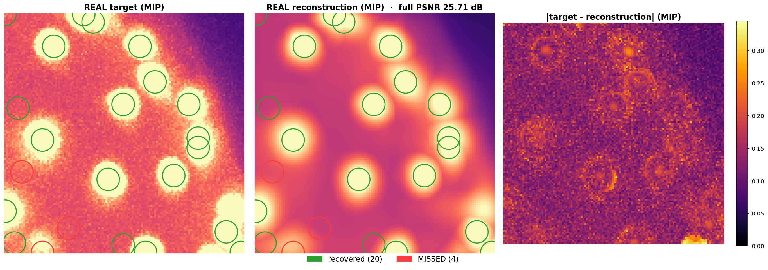
Real Data, Real Reconstruction
Real Tribolium light-sheet volume, 24 nuclei · PSNR 25.71 dB · 20/24 nuclei recovered · green = recovered, red = missed
Note, not hidden: the reconstruction is visibly smoother than the real tissue — fine texture is a genuine limitation.
Tribolium nuclei · 3D Gaussian splatting
5

Slide 6
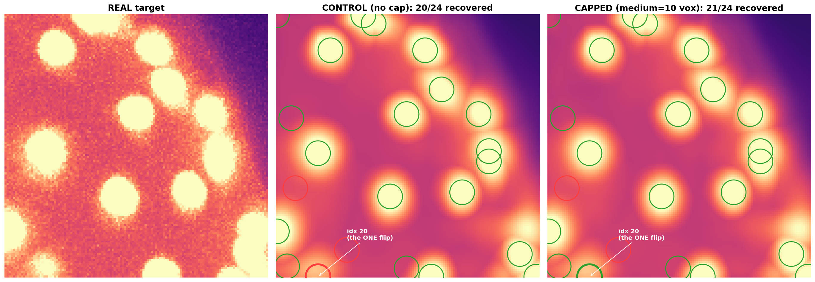
Capping Gaussian Size — Tested on the Same Data
Same 24 nuclei, same volume · 20/24 → 21/24 recovered · PSNR unchanged (25.71 → 25.70 dB)
Honest note: the one nucleus that flipped sits at the crop edge — a modest result on this single sample. The effect is stronger averaged across 4 regions: +0.21 recall on faint nuclei, at near-zero image-quality cost.
Tribolium nuclei · 3D Gaussian splatting
6

Slide 7
Ideal Parameters
The consolidated configuration — what to set, and where each choice came from.
Parameter | Value | Source
Parameterization | Full anisotropic (11 DOF / Gaussian) | Colleague's archive
Initialization | Coverage: one Gaussian per detected nucleus, then intensity-weighted support | Colleague's auto-tuner + this work
Candidate spacing (NMS) | ≈ 13 voxels (physical nucleus spacing) | Colleague's auto-tuner
Position learning rate | ≈ 0.05–0.1 (30–60× the framework default) | This work
Nucleus-Gaussian scale cap | 10 voxels — nucleus-seeded Gaussians only | This work
Gaussian budget K | ≈ 1 per nucleus + support (≈250 for 24 nuclei) | Colleague's budget sweep
Training iterations | 3000 | Colleague's archive
Batch sampling | 70% intensity-weighted / 30% uniform | Colleague's archive
Tribolium nuclei · 3D Gaussian splatting
7

Slide 8
Results Summary
25.7 dB
83–87%
250 Gaussians
~0 dB
reconstruction quality (real data)
nuclei recovered, real Tribolium ROI
~381× fewer numbers than raw voxels
reconstruction cost of the size-cap fix
Fit config: full-anisotropic parameterization · coverage init · position LR raised · scale cap = 10 vox · K=250 · 3000 iterations
Tribolium nuclei · 3D Gaussian splatting
8

Slide 9
What Doesn't Work Yet
Faint and edge-adjacent nuclei are still missed most often.
!
The reconstruction is visibly smoother than real tissue — fine texture is lost.
!
Tested on small regions (24–33 nuclei) — full-embryo scale is untested.
!
Compression alone doesn't beat simple downsampling at larger parameter budgets.
!
Tribolium nuclei · 3D Gaussian splatting
9

Slide 10
Our Conclusion
The representation works, honestly.
Real Tribolium nuclei can be represented by anisotropic 3D Gaussians at ~25–26 dB and ~85% recall, compressed ~380× — a real, working capability, not a promise.
The right metric changes the right answer.
An idea the archive discarded for costing PSNR — scale regularization — is the strongest lever once scored on nucleus recovery instead. Evaluation choice decided which ideas survived, not just which numbers moved.
Not every advantage held up.
Compression-only and tracking-by-persistence framings were tested against simple baselines and did not clearly win. The defensible case for this representation is reconstruction and detection together — not any single claim in isolation.
Tribolium nuclei · 3D Gaussian splatting
10

Slide 11
Where This Stands
A working, honestly-tested recipe for representing real Tribolium nuclei with 3D Gaussians — built on a colleague's 399-fit architecture, extended with a validation framework and one causally-tested improvement.
Next: scale the same recipe to the full embryo volume.
Tribolium nuclei · 3D Gaussian splatting
11

