Slide 1
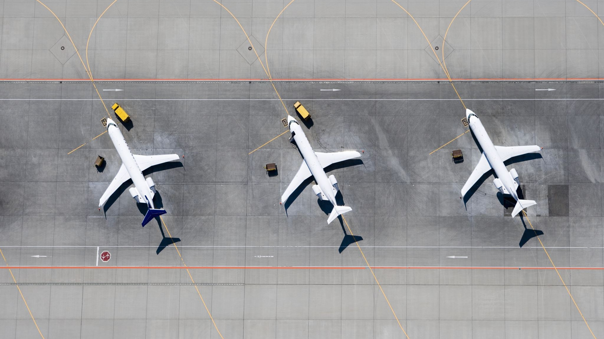
Airplane Crashes and Fatalities

Slide 2
Dataset
Year – From 1908 to 2023
Number of Incidents (5000 Incidents) 43 Crashes a year
Average number of
People aboard flight.
Passengers
Flight crew
Total Fatalities
Fatalities from passengers
Fatalities from flight crew
Fatalities from people on the ground

Slide 3
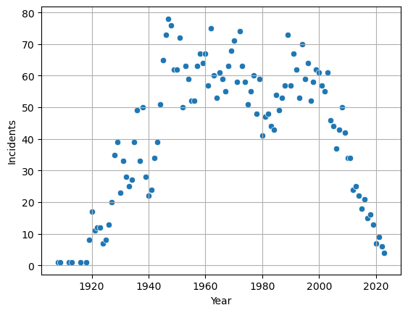
Airplane crashes over the years
The first part of the graph is associated with the growth and commercialization of the airline industry

Slide 4
What caused the steep decline in airline incidents after 1990?
GPS – In 1983 the GPS was invented and over the next 10 years it would revolutionize the way airplanes navigate especially in low visibility conditions.
GPS also allowed for better tracking and data collection!
In 1997, CAST (Commercial Aviation Safety Team) was formed. Taken from their website page, “The NCARC recommendation would ultimately lead to formation of the Commercial Aviation Safety Team (CAST), a government-industry team focused on reducing the fatality risk through data-driven risk prioritization methodology”

Slide 5
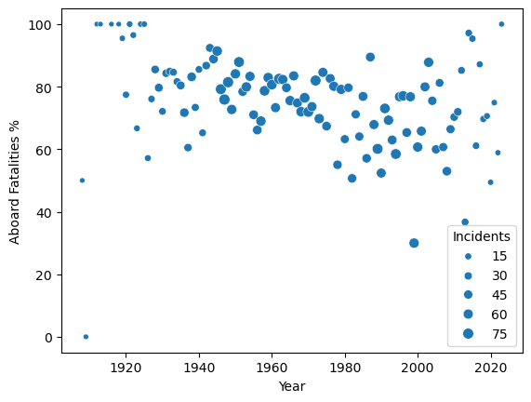
Percentage of people aboard plane dying per accident
There is some noticeable decrease over the years but not too drastic.
Average Fatality rate stays at 75%

Slide 6
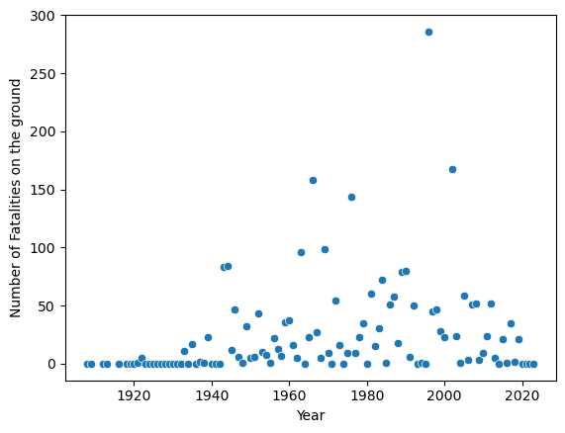
Total number of ground fatalities per year
The one outlier in 1996 is an African Air flight that failed to take-off properly and crashed right in the middle of Kinshasa in the Democratic Republic of Congo

Slide 7
Just kidding!!!!
The previous graph was missing one very significant outlier

Slide 8
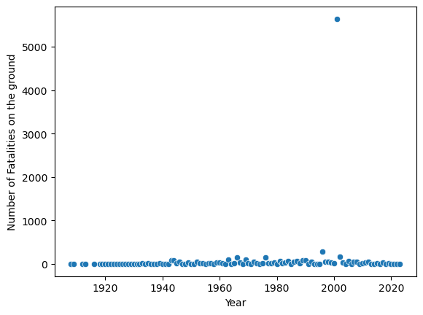
This is the previous graph with 9/11!

Slide 9
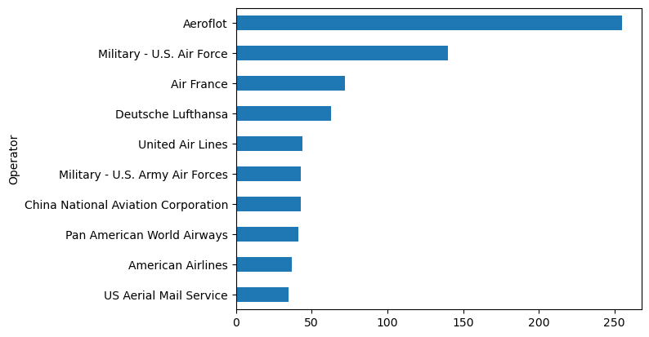
Operators responsible for the most incidents
There are over 2000 different operators, these are the top 10

Slide 10
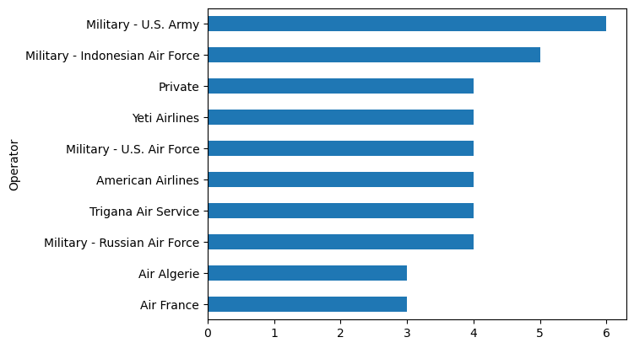
Operators after 2000

