Slide 1
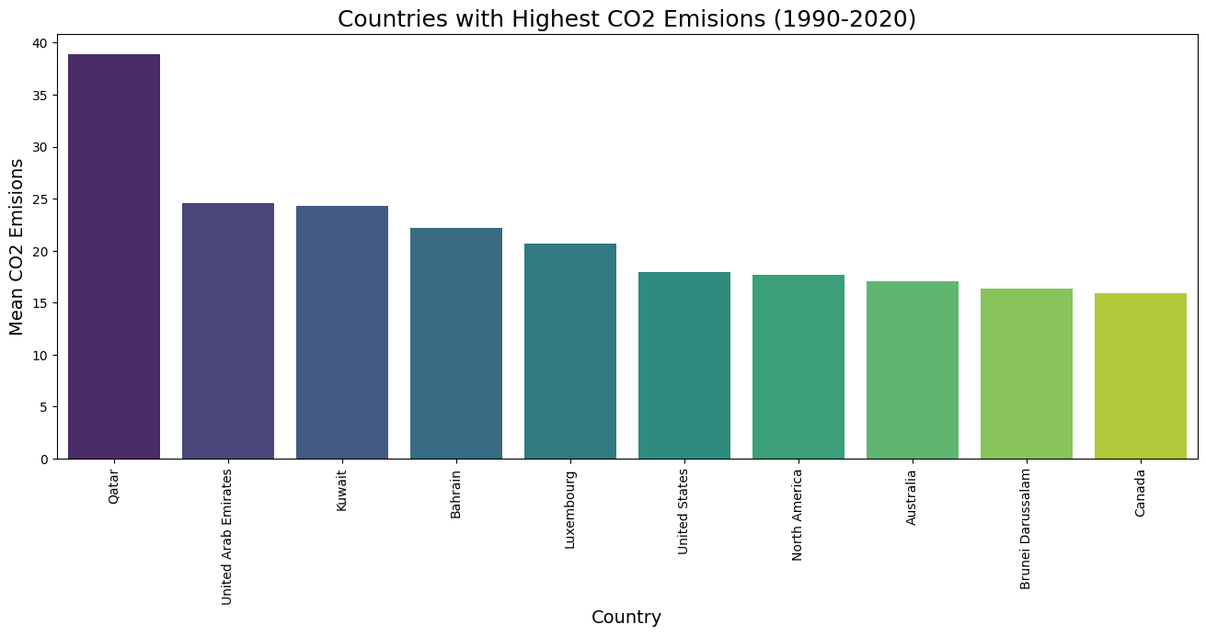
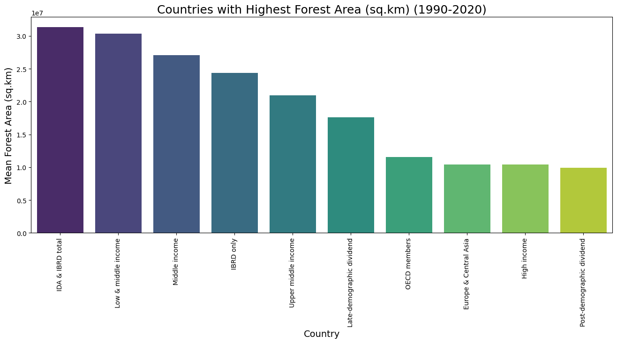
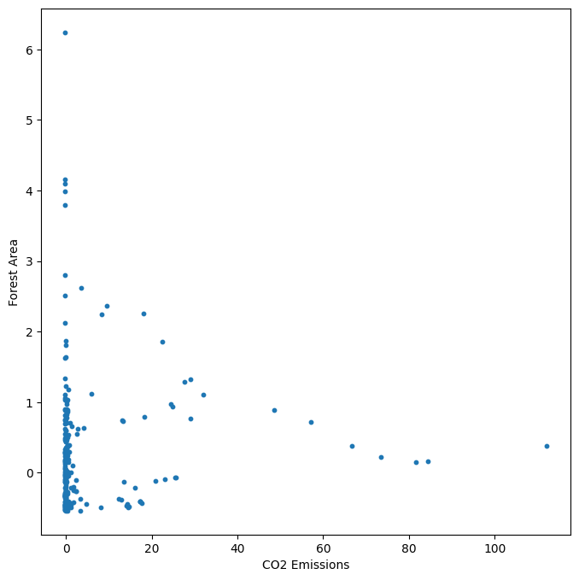
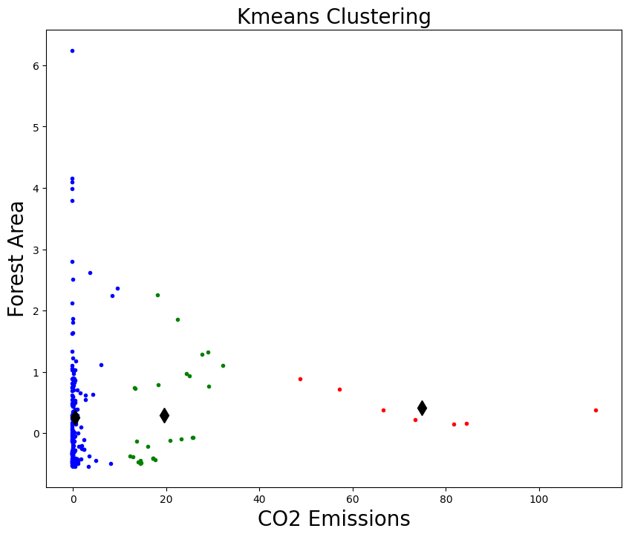
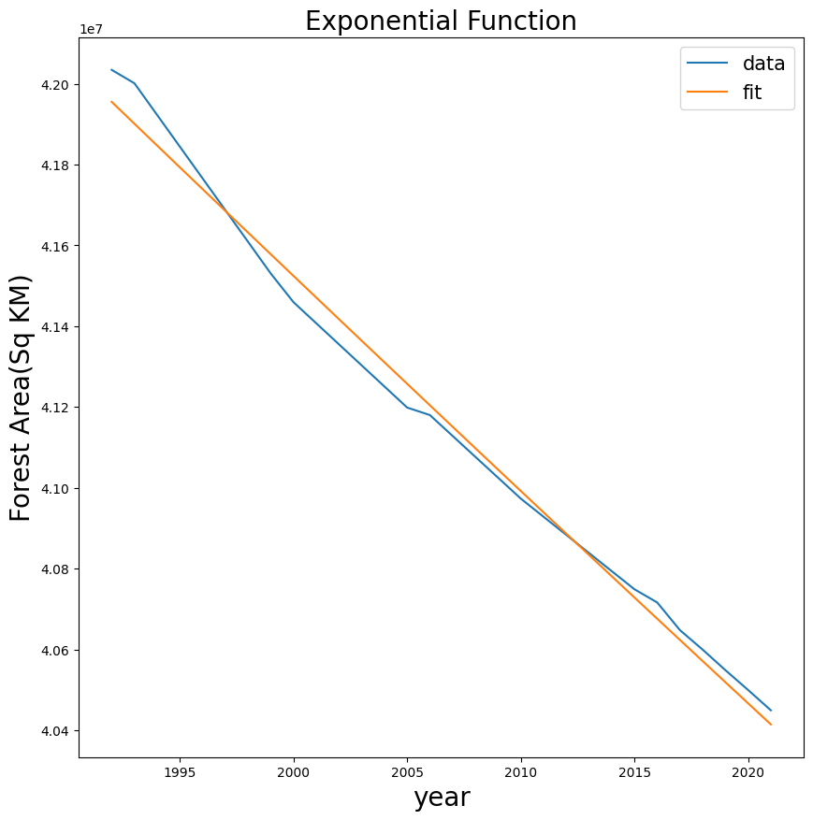
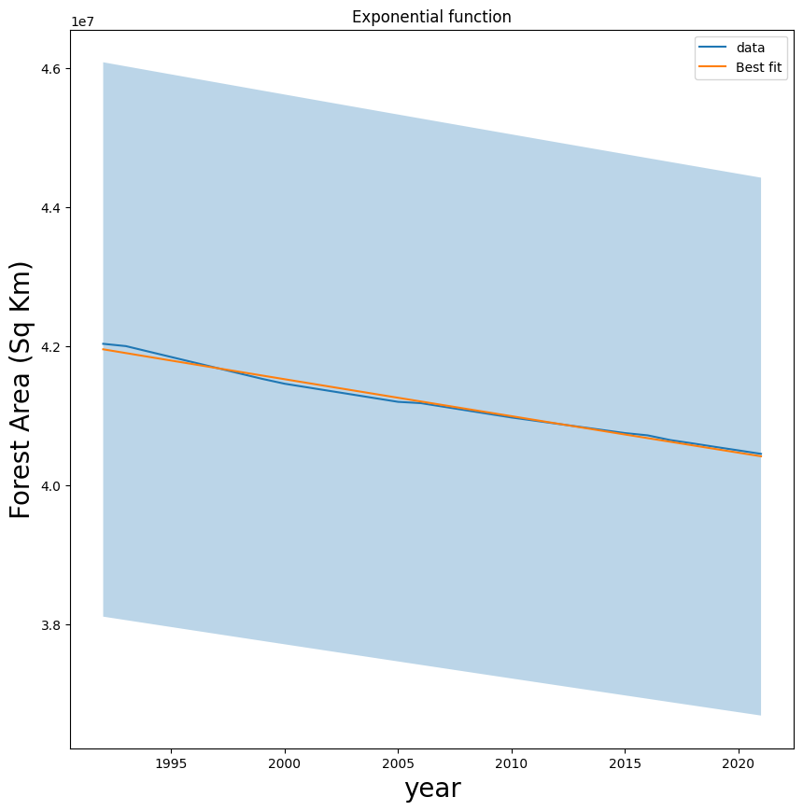
Exploring CO2 Emissions and Forest Area with K-means Clustering and Exponential Regressions
We investigates the impact of forest areas on CO2 emissions, a significant contributor to climate change. Utilizing data from various countries, we employs K-means clustering to group countries based on their CO2 emissions and forest area. Subsequently, exponential regression is used to analyze the relationship between these two variables, to find the valuable insights that how forest conservation efforts can help mitigate CO2 emissions and combat climate change.
Clustering:
Showing CO2 Emissions normalized data using scatter plot.
K-Means clustering of CO2 Emissions data using 3 clusters
Fitting:
Conclusion:
After looking at how much CO2 we're making over the years, it's clear that it keeps going up. One reason is that we're losing forests, which are great at soaking up CO2. To fix this, everyone, especially the big, developed countries, needs to start planting more trees. This will help us cut down on pollution and make the Earth healthier for all of us. It's something we all need to work together on.
Applied exponential regression analysis to the global forest area over the years.
Asad Sattar(22075848)
asadsattar77/Clustering-and-Fitting (github.com)

