Slide 1
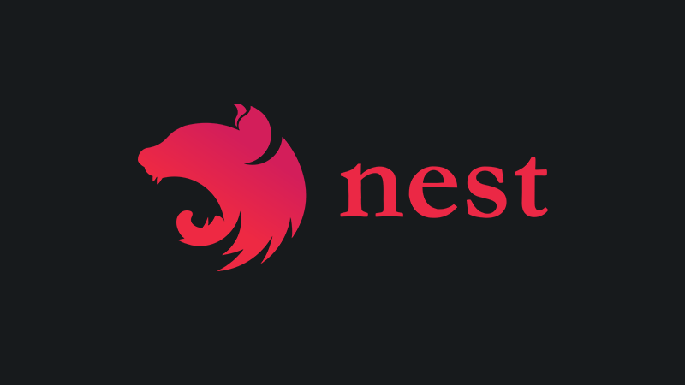
NestJs – A progressive Node.js framework
By Avraham Hamu & Asaf Naory

Slide 2
What are we going to learn?
1: JSON Web Token (JWT)
2: Fundamentals
General architecture (modules ,Controllers Providers )
Main features (Decorators ,Pipes, Exception, middleware)
3: Demo : simple CRUD
4: First walkthrough

Slide 3

What is JWT?

Slide 4

Why do we need JWT?
Once upon a time
Suppose you have a REST API (e.g. GET /orders) and you want to restrict access to authorized users only.
In the most naïve approach, the API would ask for a username and password; then it will be searched in a database for whether those credentials really exist. We check for authenticity.
Finally, it will be checked if the authenticated user is also authorized to perform that request. If both checks pass, the real API will be executed. It seems logical.

Slide 5
A problem of state…
The HTTP protocol is stateless, this means a new request (e.g. GET /order/42) won’t know anything about the previous one, so we need to reauthenticate for each new request (fig.1).

Slide 6
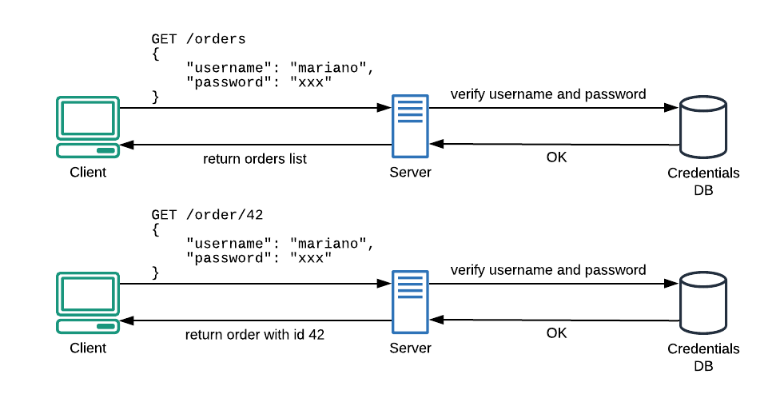
Notes:
Due to the stateless nature of HTTP protocol, every new API request needs a complete authentication.

Slide 7
The traditional way of dealing with this is the use of Server Side Sessions (SSS).
In this scenario, we first check for username and password; if they are authentic, the server will save a session id in memory and return it to the client. From now on, the client will just need to send its session id to be recognized (fig.2

Slide 8
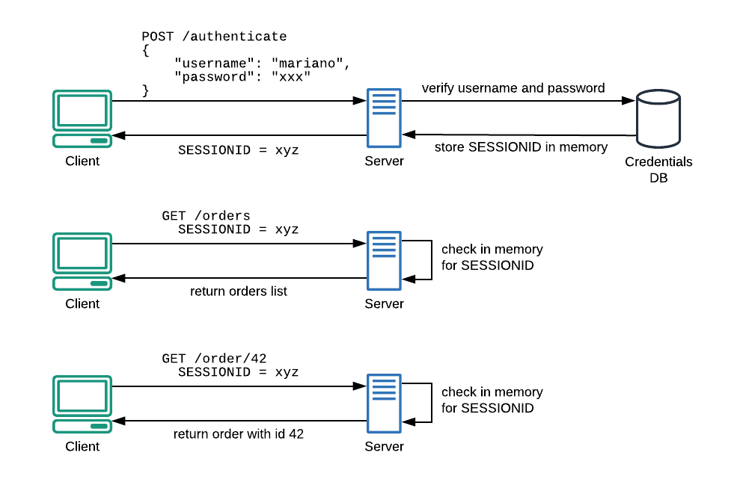
Notes:
Using SSS, we reduce the number of authentications towards the Credentials database.
This solution will fix a problem but it will create another one. Probably bigger.

Slide 9
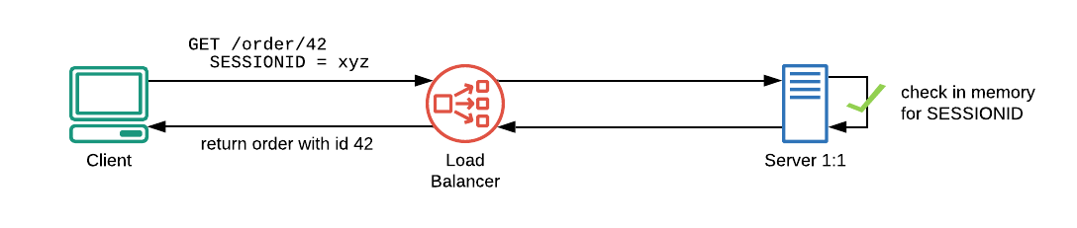
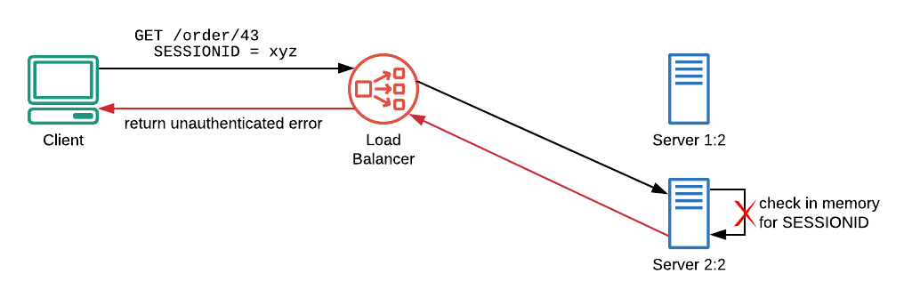
A problem of scale
Notes:
In the initial scenario, behind the load balancer, there’s just one server. When a client performs a request, using session id xyz, its record will surely be found in the server’s memory (fig.3).
Now imagine that the above infrastructure needs to scale. A new server (i.e. Server 2:2) will be added behind the load balancer and this brand new server will handle the next request issued by xyz client…
Unauthenticated! The brand new server has no xyz sessions in its memory, so the authentication process will fail.

Slide 10
To fix this, we have three main workarounds that can be used:
Synchronize sessions between servers — tricky and error-prone;
Use an external in-memory database — good solution, but it will add another component to the infrastructure;
Embrace the stateless nature of HTTP and search for a better solution!
JSON Web Token (JWT) is an open standard that defines a way for transmitting information –like authentication and authorization facts– between two parties: an issuer and an audience.
Notes:
Each token is self-contained, this means it contains all information needed to allow or deny any given requests to an API. To understand how we can verify a token and how authorization happens, we need to take a step back and look into a JWT

Slide 11
Anatomy of a JWT
A JSON Web Token is essentially a long encoded text string.
This string is composed of three smaller parts, separated by a dot sign. These parts are:
The header
A payload or body
A signature
header.payload.signature

Slide 12
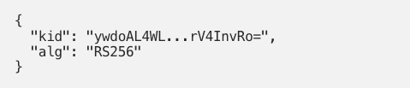
Header
The header section contains information about the token itself.
The following JSON explains which algorithm has been used to sign the token (alg) and which is the key (kid) that we need to use to validate it. One moment of patience, please, we will look into this soon. :)

Slide 13
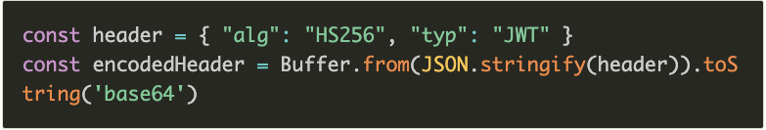
Header
We set the signing algorithm to be HMAC SHA256 (JWT supports multiple algorithms), then we create a buffer from this JSON-encoded object, and we encode it using base64.
The partial result is eyJhbGciOiJIUzI1NiIsInR5cCI6IkpXVCJ9.

Slide 14
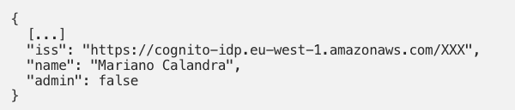
Body
The payload is the most important part of a JWT. It contains information (claims in JWT jargon) about the client:
The iss property is a registered claim, it represents the identity provider that issued the token (the issuer)— in this case, Amazon Cognito. Finally, we can add further claims based on our needs (e.g. admin claim).

Slide 15

Signature
The third part of the token is a hash that is computed following these steps:
join with a dot the encoded header and the encoded payload;
hash the result using the encryption algorithm specified in alg property of the header (in this case RS256) and a private key;
encode the result as Base64URL;

Slide 16
Validation
Since the token is self-contained, we own all the information needed for its validation. For example, we know the token has been signed using RS256 (alg property of the header) and a private key. Now we need to know how to get the right public key to perform the validation.
Notes:
Note: In asymmetric encryption, we all know that a public key is used to encrypt a message, whereas a private key is used to decrypt it. In a signing algorithm, this process is completely switched! Here the message (the data in the pseudo-code above) is signed using the private key and the public key is used to verify that the signature is valid.

Slide 17
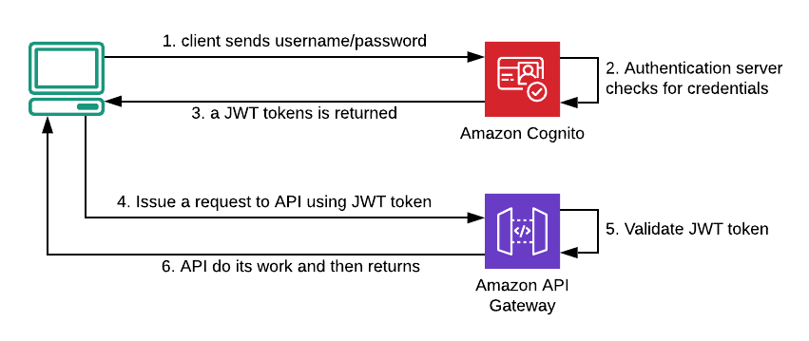
Let’s summarise…but let’s take a break before…
Notes:
At the first access, a client needs to contact the authentication server (Amazon Cognito here, but Microsoft, Salesforce or any other provider should be pretty similar), sending username and password to it. If credentials are valid, a JWT token will be returned to the client that will use it to request an API (in this example Amazon API Gateway endpoint).
In the above scenario (fig.5), API itself is the only responsible for token validation and it’s able to reject the request if the signature seems forged.
Going further Suppose a client wants to invoke a protected API to delete an order (e.g. DELETE /order/42) and this action should be only performed by administrators.
With a JWT in place, this operation is hard as add a custom claim to the payload body (i.e. the admin: true claim of the example above). When invoked, the API will first verify the signature authenticity and afterwards, it’ll check if admin claim is true.

Slide 18
In a nutshell
HTTP protocol is stateless, that means a new request won’t know anything about the previous one
Server Side Sessions was a solution to the statelessness of HTTP, but these, in the long run, were a threat to our scaling abilities;
JWT is self-contained, that means it contains every information needed to allow or deny any given requests to an API;
JWT is stateless by design, so we don’t have to fight with the stateless design of HTTP;
JWT is encoded, not encrypted have it in mind;
Notes:
Note: In asymmetric encryption, we all know that a public key is used to encrypt a message, whereas a private key is used to decrypt it. In a signing algorithm, this process is completely switched! Here the message (the data in the pseudo-code above) is signed using the private key and the public key is used to verify that the signature is valid.
A JWT is cryptographically signed (but not encrypted, hence using HTTPS is mandatory when storing user data in the JWT), so there is a guarantee we can trust it when we receive it, as no middleman can intercept and modify it, or the data it holds, without invalidating it.
The secret key must be saved on server, and if I want to use the same jwt to access two different servers, both servers should share the same private key between them

Slide 19
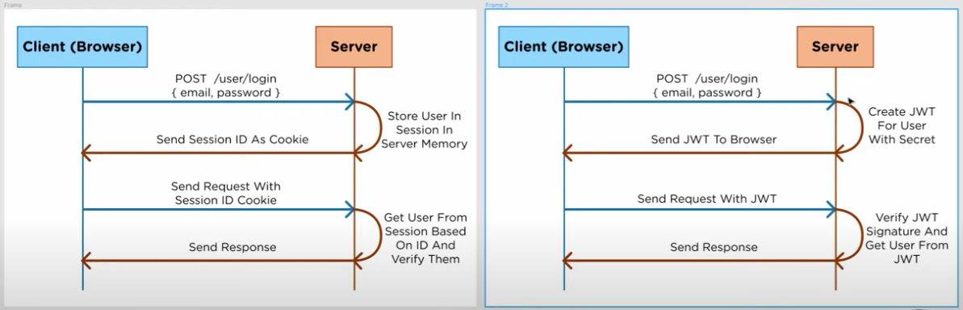
Notes:
https://www.youtube.com/watch?v=7Q17ubqLfaM&ab_channel=WebDevSimplified

Slide 20

Notes:
SHOW SEED 1.
SHOW GRAPHQL EXAMPLES 2.
SHOW NEW CODE . 3
.
RESTAPI example
https://www.howtographql.com/basics/1-graphql-is-the-better-rest/
PERFORMANCE
https://stackshare.io/stackups/expressjs-vs-nestjs
https://docs.nestjs.com/techniques/performance

