Slide 1
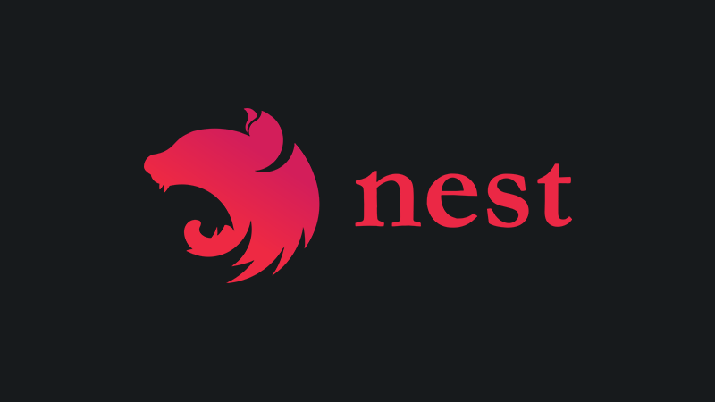
NestJs – A progressive Node.js framework
By Avraham Hamu & Asaf Naory

Slide 2
What are we going to learn?
1: Authentication
1.1: warning up exercise
2: JSON Web Token (JWT)
2.1: Exercise
3: Authorizations
4: Roles
5: Exercise

Slide 3

Authentication
Notes:
Authentication and authorization go hand-in-hand

Slide 4
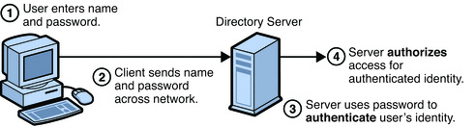
Different kind of authentication
1. Password-based authentication.

Slide 5
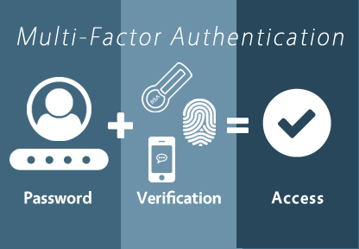
Different kind of authentication
2. Multi factor authentication.

Slide 6

Different kind of authentication
3. biometric authentication.

Slide 7
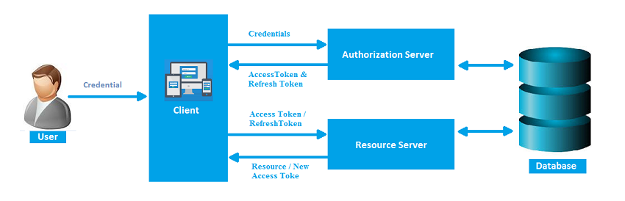
Different kind of authentication
4. Token-based authentication.

Slide 8
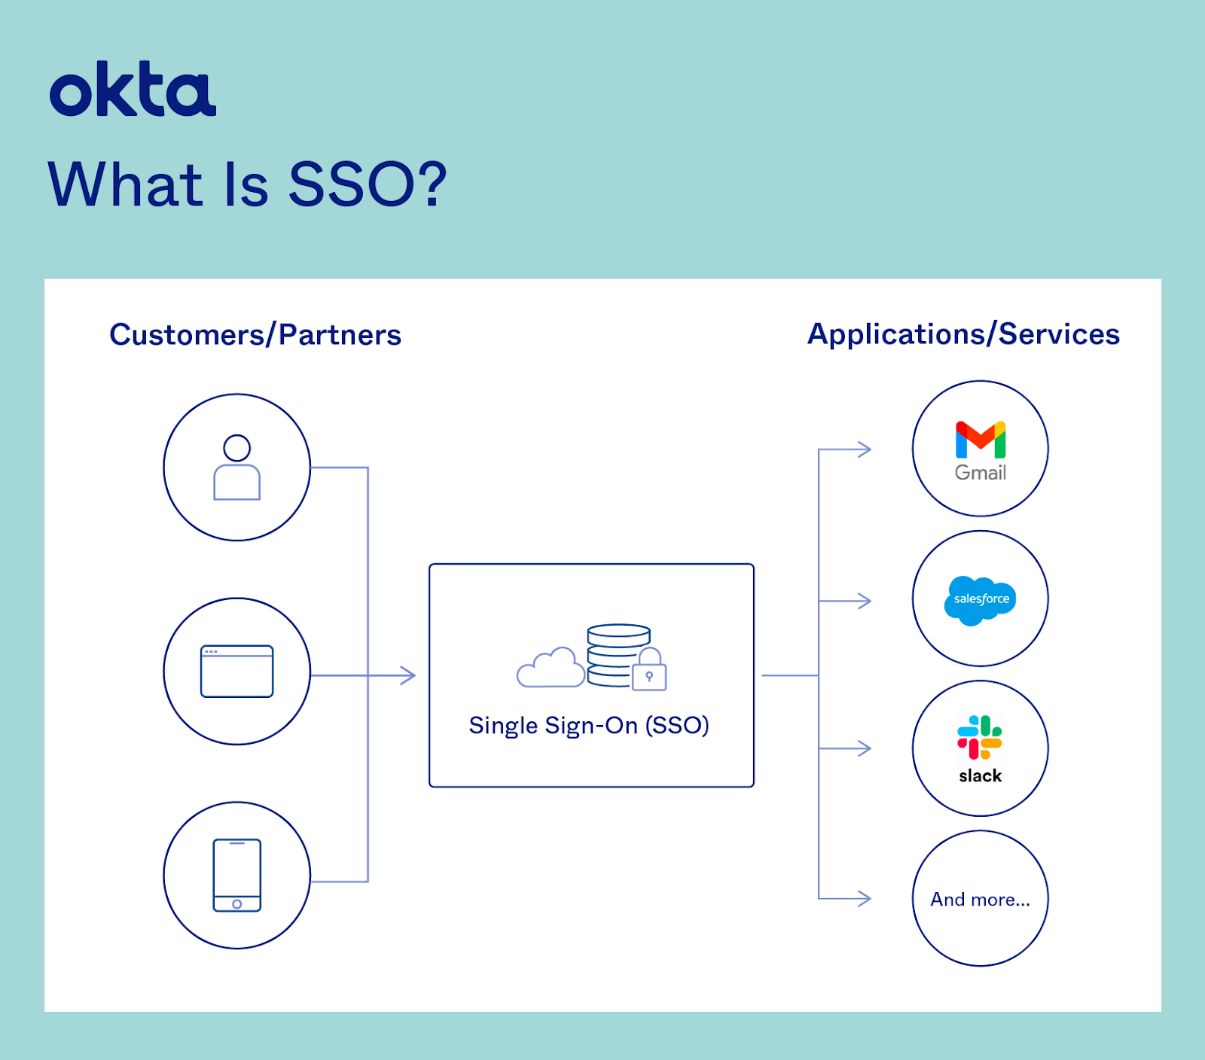
5. Single Sign-On (SSO)
Notes:
Single sign-on (SSO) is a user authentication tool that enables users to securely access multiple applications and services using just one set of credentials.

Slide 9

Authentications vs Authorization
Authentication and authorization might sound similar, but they are distinct security processes in the world of identity and access management (IAM).
Authentication confirms that users are who they say they are.
Authorization gives those users permission to access a resource.

Slide 10

Warm up exercices…
Notes:
https://github.com/asafnaory/nestjs-course/wiki/Authentication-hands-on-guide-%231

Slide 11
What is JWT?
Notes:
היום נלמד על jwt אבל לפני זה קצת היסטוריה

Slide 12
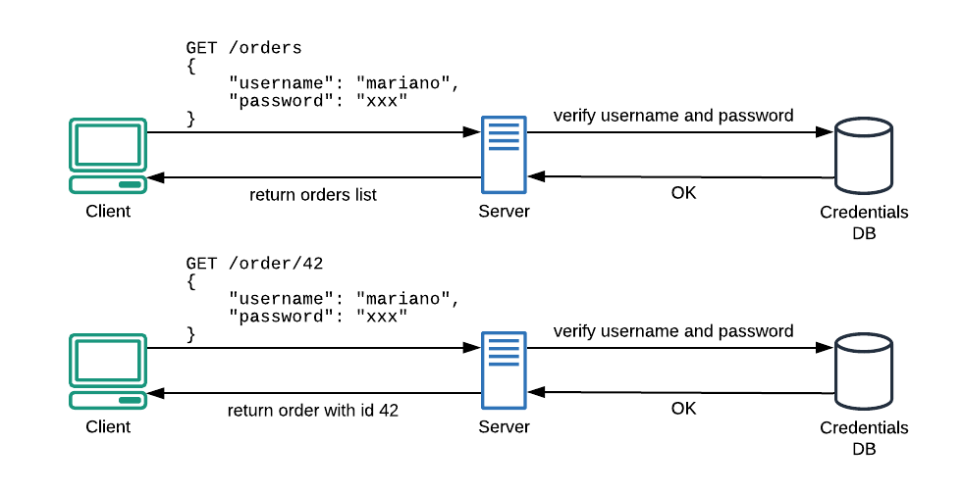
POST
POST
Notes:
בגלל אופי ה http protocol על כל בקשה נדרשת authentication חדשה

Slide 13
A problem of state…
The HTTP protocol is stateless, this means a new request (e.g. GET /order/42) won’t know anything about the previous one, so we need to reauthenticate for each new request (fig.1).

Slide 14
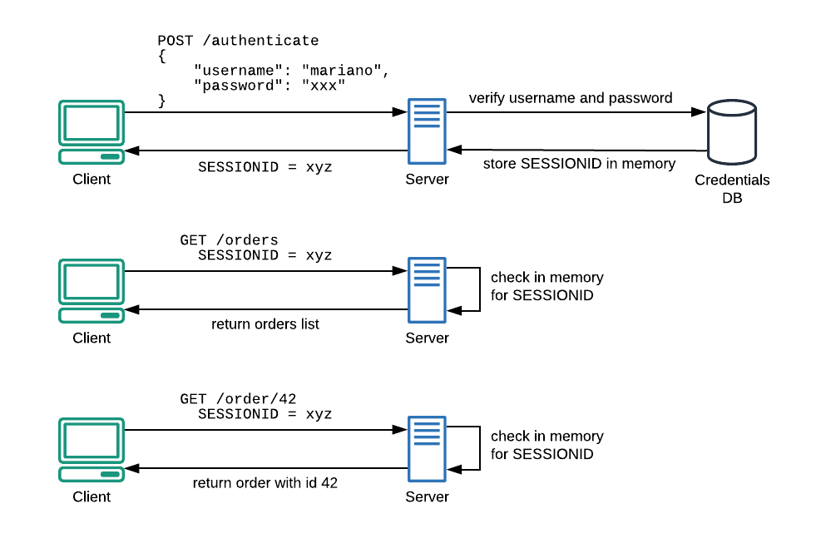
First solution: Session ID
Notes:
הדרך המסורתית להתמודד עם הבעיה היא ע״י שימוש ב server side session
בתסריט הזה אני בודקים קודם כל את שם משתמש וסיסמה - אם הם מאומתים השרת ישמור בזיכרון או בdatabase את session id ויחזיר אותו גם כן ל client
מעכשיו ואלאה כל בקשה ה client צריך לשלוח עם כל בקשה את אותו session id שהוא קיבל קודם לכן. (על מנת להיות מזוהה)
השימוש ב sss מאפשר לצמצם מספר הקריאות ל DB לצורך אימות של הבקשה
זה אמנן פוטר בעיה אחת אבל יוצר אחת אחרת – אולי יותר גדולה
The traditional way of dealing with this is the use of Server Side Sessions (SSS).
In this scenario, we first check for username and password; if they are authentic, the server will save a session id in memory and return it to the client.
From now on, the client will just need to send its session id to be recognized (fig.2)
Using SSS, we reduce the number of authentications towards the Credentials database.
This solution will fix a problem but it will create another one. Probably bigger.

Slide 15


Slide 16
Why do we need JWT?
We already have a working solution with SSS!!!
Notes:
אז למה צריכים jwt אם יש לנו כבר פיטרון שעובד עם הקוקיז?

Slide 17
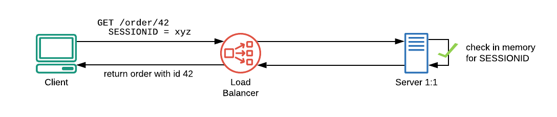
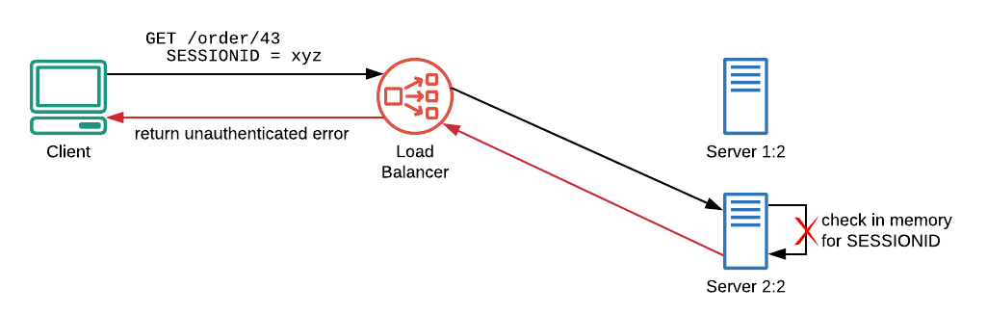
A problem of scale
Notes:
בתסריט המקורי מאחורי ה load balancer היה לנו רק שרת אחד – כאשר ה client שולח בקשה עם ה session id xyz קרוב לוודאי שהרישום שלו ימצא ב database ואז הוא יזוהה ויקבל את ה resource שלו
עכשיו תדמיינו שצריכים להרחיב את ה scaling הקיים ולהוסיף מספר שרתים.
השרת החדש יקבל לפי ה load balancer מספר בקשות מה client
אבל אין לו בזיכרון את ה session xyz ולכן מבחינתו ה client אינו מזוהה (401)
In the initial scenario, behind the load balancer, there’s just one server. When a client performs a request, using session id xyz, its record will surely be found in the server’s memory (fig.3).
Now imagine that the above infrastructure needs to scale. A new server (i.e. Server 2:2) will be added behind the load balancer and this brand new server will handle the next request issued by xyz client…
Unauthenticated! The brand new server has no xyz sessions in its memory, so the authentication process will fail.

Slide 18
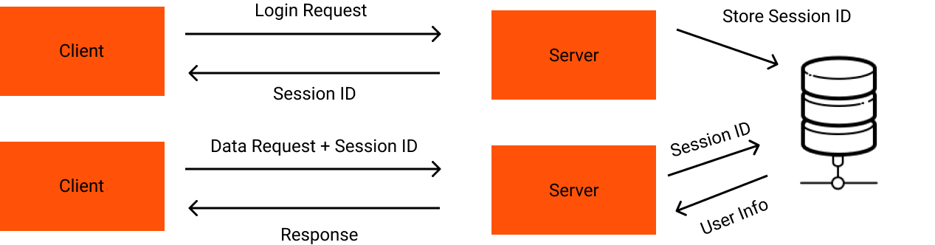
Notes:
על מנת לפתור את הבעיה קיימות מספר אפשרויות
אפשר לסנכרן בין השרתים

Slide 19
Notes:
להשתמש ב database חיצוני ואז חוזרים לבעיה המקורית – שכל בקשה תצטרך ל database חיצוני
To fix this, we have three main workarounds that can be used:
Synchronize sessions between servers — tricky and error-prone;
Use an external in-memory database — good solution, but it will add another component to the infrastructure;
Embrace the stateless nature of HTTP and search for a better solution!
JSON Web Token (JWT) is an open standard that defines a way for transmitting information –like authentication and authorization facts– between two parties: an issuer and an audience.
Each token is self-contained, this means it contains all information needed to allow or deny any given requests to an API. To understand how we can verify a token and how authorization happens, we need to take a step back and look into a JWT
כל המידע הדרוש נמצע אצל הקלייאנט - להבדיל מהשיטה הקודמת איפה שהשרת ידע הכל – עם jwt השרת לא יודע כלום – רק הקלייאנט מחזיק את כל המידע

Slide 20
POST
POST

Slide 21

Notes:
או אפשר לחפש פיתרון אחר יותר טוב!!
Jwt הוא סטנדרט שמתאר אופן שבו מועברים מידע בין שני צדדים - issuer and audience
הוא מבוסס תוקן שהוא self contained - הכוונה הוא מכיל כל המידע כדי שהשת יחליט אם היוזר מאושר או לא!
אנחנו מעבירים את הכוח בצד הclient
To fix this, we have three main workarounds that can be used:
Synchronize sessions between servers — tricky and error-prone;
Use an external in-memory database — good solution, but it will add another component to the infrastructure;
Embrace the stateless nature of HTTP and search for a better solution!
JSON Web Token (JWT) is an open standard that defines a way for transmitting information –like authentication and authorization facts– between two parties: an issuer and an audience.
Each token is self-contained, this means it contains all information needed to allow or deny any given requests to an API. To understand how we can verify a token and how authorization happens, we need to take a step back and look into a JWT

Slide 22

Some basics definitions
Encoding: process of putting a sequence of characters (letters, numbers, punctuation, and certain symbols) into a specialized format for efficient transmission or storage
Encryption: process of taking plain text, like a text message or email, and scrambling it into an unreadable format — called “cipher text.”
Private key Vs Public key: In asymmetric encryption, a public key is used to encrypt a message, whereas a private key is used to decrypt it.
Notes:
There are two types of encryption in widespread use today: symmetric and asymmetric encryption. The name derives from whether or not the same key is used for encryption and decryption.
Asymmetric actually means that it works on two different keys i.e. Public Key and Private Key. As the name describes that the Public Key is given to everyone and the Private key is kept private

Slide 23
Road map
clients will start by authenticating with a username and password
Once authenticated, the server will issue a JWT that can be sent as a bearer token in an authorization header on subsequent requests to prove authentication
We'll also create a protected route that is accessible only to requests that contain a valid JWT.

Slide 24
Anatomy of a JWT
A JSON Web Token is essentially a long encoded text string.
This string is composed of three smaller parts, separated by a dot sign. These parts are:
The header
A payload or body
A signature
header.payload.signature
Notes:
A well-formed JWT consists of three concatenated Base64url-encoded strings, separated by dots (.):
JOSE Header: contains metadata about the type of token and the cryptographic algorithms used to secure its contents.
JWS payload (set of claims): contains verifiable security statements, such as the identity of the user and the permissions they are allowed.
JWS signature: used to validate that the token is trustworthy and has not been tampered with. When you use a JWT, you must check its signature before storing and using it.

Slide 25
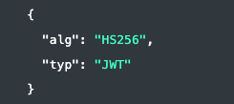
Header
The header section contains information about the token itself.
Algorithm is used to generate the signature
Token type (optionnal)
The header includes information about how the JWT claims set, the payload, is encoded.

Slide 26
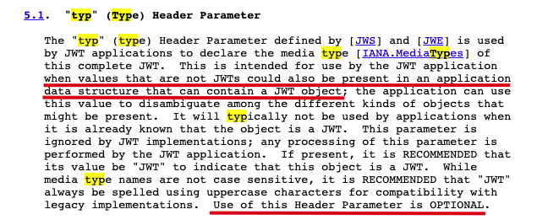
rfc7519

Slide 27
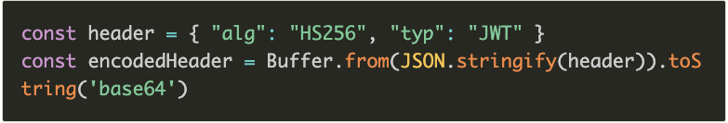
Header
We set the signing algorithm to be HMAC SHA256 (JWT supports multiple algorithms), then we create a buffer from this JSON-encoded object, and we encode it using base64.
The partial result is eyJhbGciOiJIUzI1NiIsInR5cCI6IkpXVCJ9.
Notes:
HS256 is a symmetric algorithm, meaning it uses a shared secret

Slide 28
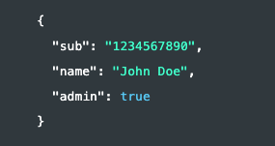
Body
The payload is the most important part of a JWT. It contains information (claims in JWT jargon – declaration?) about the client: in this example our entity is a user

Slide 29

Signature
The third part of the token is a hash that is computed following these steps:
join with a dot the encoded header and the encoded payload;
hash the result using the encryption algorithm specified in alg property of the header (in this case HS256) and a private key;
encode the result as Base64URL;
HS
Notes:
The signature is the header and payload (JWT claims set) encoded using the algorithm specified in the header. In our example above it would be the encoded header concatenated with the encoded JWT claims set encoded with the HMAC SHA-256 algorithm.
Signing is a cryptographic operation that generates a "signature”
Signature is used to check the origin of the message
HS256 and RS256 Scenario
These algorithms are NOT used to encrypt/decryt data. Rather they are used to verify the origin or the authenticity of the data. When Mary needs to send an open message to Jhon and he needs to verify that the message is surely from Mary, HS256 or RS256 can be used.
HS256 can create a signature for a given sample of data using a single key. When the message is transmitted along with the signature, the receiving party can use the same key to verify that the signature matches the message.
RS256 uses pair of keys to do the same. A signature can only be generated using the private key. And the public key has to be used to verify the signature. In this scenario, even if Jack finds the public key, he cannot create a spoof message with a signature to impersonate Mary.

Slide 30
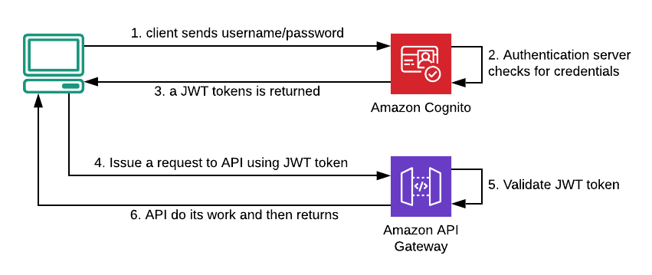
Let’s summarise…but let’s take a break before…
Notes:
At the first access, a client needs to contact the authentication server (Amazon Cognito here, but Microsoft, Salesforce or any other provider should be pretty similar), sending username and password to it. If credentials are valid, a JWT token will be returned to the client that will use it to request an API (in this example Amazon API Gateway endpoint).
In the above scenario (fig.5), API itself is the only responsible for token validation and it’s able to reject the request if the signature seems forged.
Going further Suppose a client wants to invoke a protected API to delete an order (e.g. DELETE /order/42) and this action should be only performed by administrators.
With a JWT in place, this operation is hard as add a custom claim to the payload body (i.e. the admin: true claim of the example above). When invoked, the API will first verify the signature authenticity and afterwards, it’ll check if admin claim is true.

Slide 31
In a nutshell
HTTP protocol is stateless, that means a new request won’t know anything about the previous one
Server Side Sessions was a solution to the statelessness of HTTP, but these, in the long run, were a threat to our scaling abilities;
JWT is self-contained, that means it contains every information needed to allow or deny any given requests to an API;
JWT is stateless by design, so we don’t have to fight with the stateless design of HTTP;
JWT is encoded, not encrypted have it in mind;
Notes:
A JWT is cryptographically signed (but not encrypted, hence using HTTPS is mandatory when storing user data in the JWT), so there is a guarantee we can trust it when we receive it, as no middleman can intercept and modify it, or the data it holds, without invalidating it.
The secret key must be saved on server, and if I want to use the same jwt to access two different servers, both servers should share the same private key between them

Slide 32
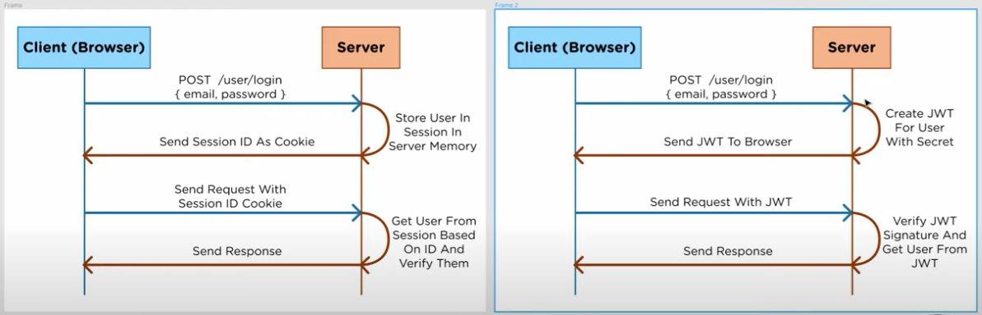
Notes:
https://www.youtube.com/watch?v=7Q17ubqLfaM&ab_channel=WebDevSimplified

Slide 33
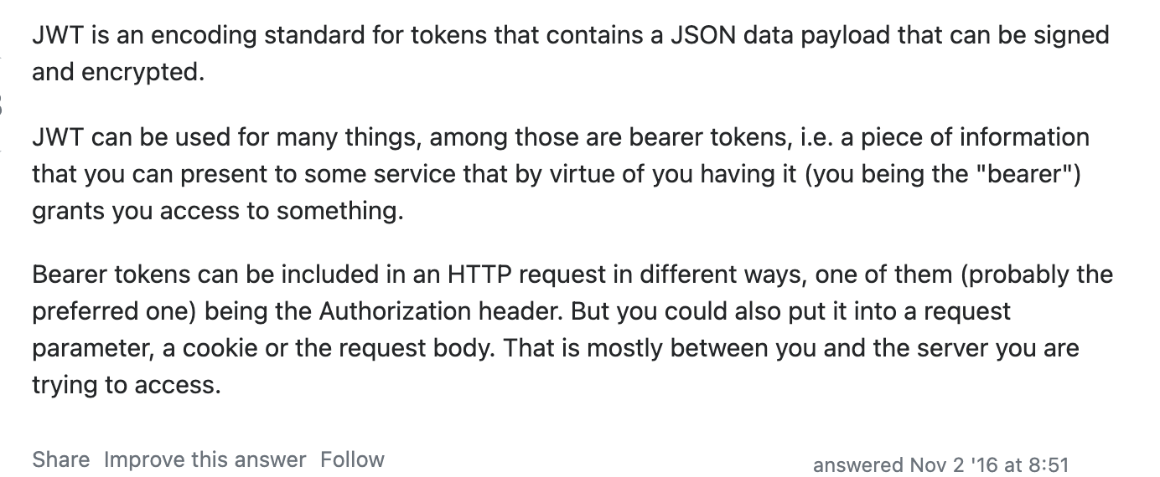
One more time…and let’s start coding…
https://www.youtube.com/watch?v=K6pwjJ5h0Gg
https://pragmaticwebsecurity.com/cheatsheets.html
Notes:
Problem of symetric encoding: https://www.pingidentity.com/en/company/blog/posts/2019/jwt-security-nobody-talks-about.html
https://taylor.callsen.me/shared-authentication-with-json-web-tokens/

Slide 34
Passport
Passport is the most popular node.js authentication library, well-known by the community and successfully used in many production applications
it abstracts the authentication process into a few basic steps that you customize based on the strategy you're implementing
Configuration:
A set of options that are specific to that strategy
A "verify callback", which is where you tell Passport how to interact with your user store
Notes:
Passport has a rich ecosystem of strategies that implement various authentication mechanisms. While simple in concept, the set of Passport strategies you can choose from is large and presents a lot of variety. Passport abstracts these varied steps into a standard pattern, and the @nestjs/passport module wraps and standardizes this pattern into familiar Nest constructs.
A set of options that are specific to that strategy. For example, in a JWT strategy, you might provide a secret to sign tokens.
A "verify callback", which is where you tell Passport how to interact with your user store (where you manage user accounts). Here, you verify whether a user exists (and/or create a new user), and whether their credentials are valid. The Passport library expects this callback to return a full user if the validation succeeds, or a null if it fails (failure is defined as either the user is not found, or, in the case of passport-local, the password does not match).

Slide 35
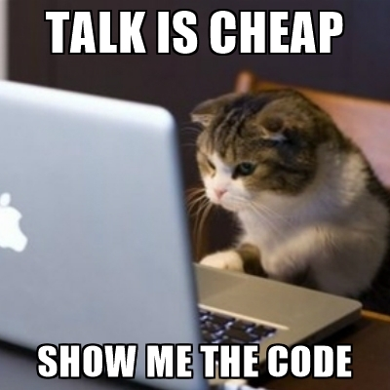

Slide 36
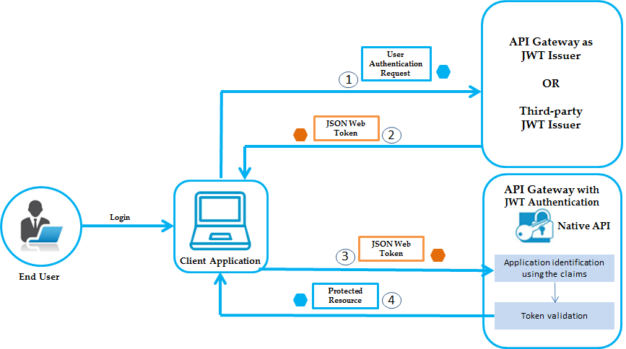

Slide 37
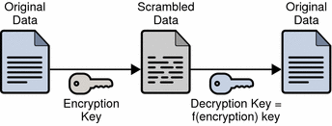
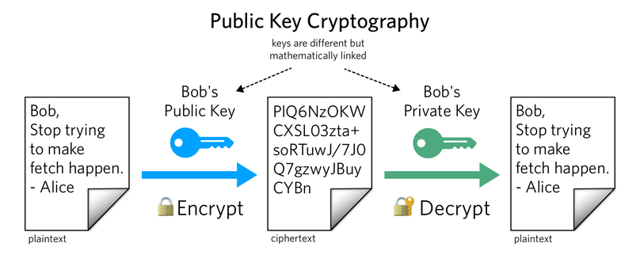
Notes:
Explain why do wee need symetric/asymetric. To solve pb of validating signtaure

Slide 38
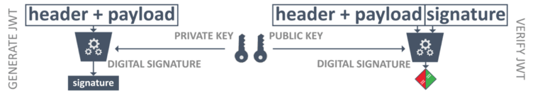
Validation
Since the token is self-contained, we own all the information needed for its validation. For example, we know the token has been signed using RS256 (alg property of the header) and a private key. Now we need to know how to get the right public key to perform the validation.
Notes:
// TODO translate
Modify this schema – with public key only, general shema with bank example
In a signing algorithm, this process is completely switched! Here the message (the data in the pseudo-code above) is signed using the private key and the public key is used to verify that the signature is valid.
An asymmetric signature uses a public/private key pair. Such a key pair possesses a unique property.
A signature generated with a private key can be verified with the public key.
And just as the name implies, the public key can be shared with other services.
As you can see, the issuer of the token only uses the private key. This implies that the private key can be kept in a confidential location, only known to the issuer of the JWT tokens. The public key can be widely distributed, so every consumer of the token can verify its integrity.
The algorithms that generate such a signature are indicated with the "RS" prefix, as stated in the sample token shown earlier

Slide 39
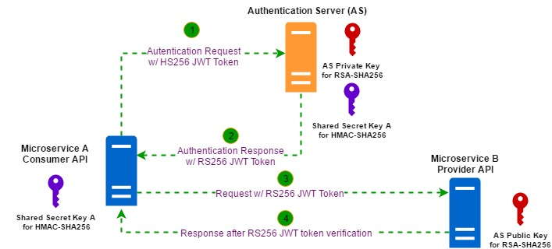
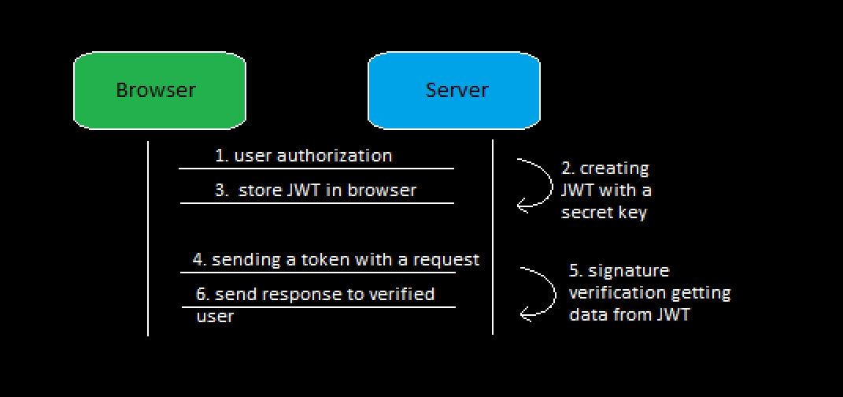
Notes:
Remove up schema

