Slide 1
Crime Analysis using Unsupervised Machine Learning Crime Analysis using Unsupervised Machine Learning
By Achraf Safsafi

Slide 2

Problem Understanding

Slide 3
Business Problem :
Dividing city zones into clusters similar to each other in terms of rate and type of crimes could help avoid some of the risks and crimes occurring in our society.

Slide 4
Objective :
The project aims to perform crime analysis using k-means clustering on the San Francisco crime dataset from 2014 to 2017.

Slide 5
Implementation Plan:
1) Problem understanding
2) Data understanding:
Describing data.
Exploring data.
3) Data preparation:
Cleaning data.
Selecting data.
4) Modeling:
K-means clustering.
5) Model evaluation

Slide 6

Data Understanding

Slide 7
Data Source & Description :
Column | Description
PdId | Unique Identifier for use in update and insert operations
IncidntNum | Incident number
Incident Code | Incident code
Category | Category of the crime incident
Descript | Description of the crime incident
DayOfWeek | Day of week
Date | The date of the crime incident
Time | Time of the crime incident
PdDistrict | Name of the Police Department District
Resolution | Resolution of the crime incident
Address | Street address of the crime incident
X | Longitude
Y | Latitude
location | Location of the crime incident
In this project, the dataset is obtained from data.sfgov.org. The data is published by the City and County of San Francisco. The dataset used for this project includes historical incident reports from 2014 to 2017 across all San Francisco's neighborhoods with 14 columns and 518160 rows , where each row is an incident report.

Slide 8
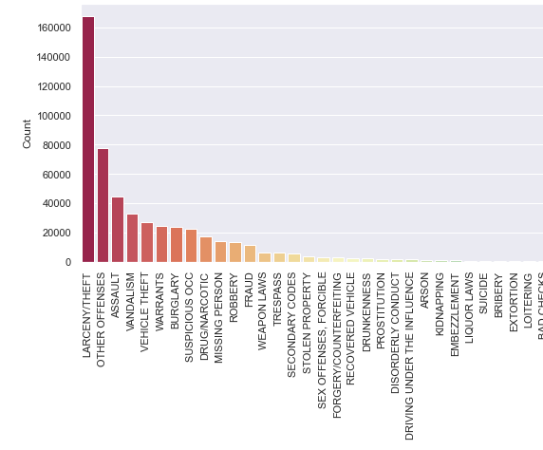
Data Exploration (1/3) :
Crime categories distribution in SF between 2014-2017
Larceny/Theft crime is considered the most crime type in that time, followed by crimes classified under the Other Offenses category then assault.

Slide 9
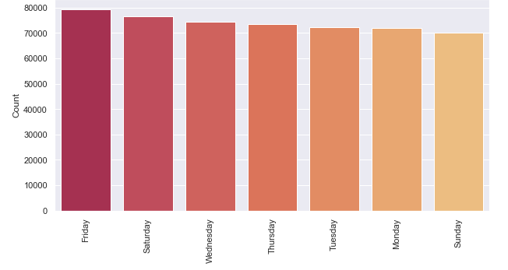
Data Exploration (2/3) :
Total number of crimes by weekday in San Francisco County between 2014-2017
The crimes occur throughout the week, but crime incidents are the highest Friday and Saturday.

Slide 10
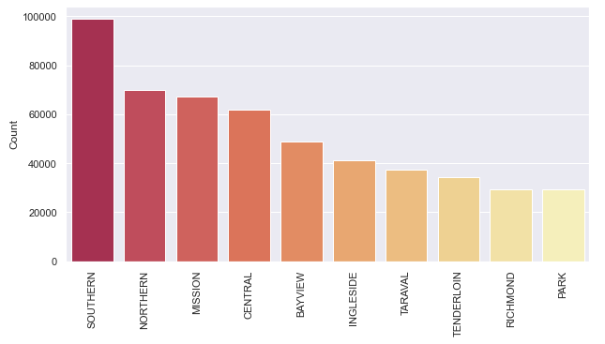
Data Exploration (3/3) :
Total number of crimes by districts in San Francisco between 2014-2017
The Southern District has the highest number of crime incidents between 2014 and 2017.

Slide 11

Data Preparation

Slide 12
Data selection:
The "NON-CRIMINAL" category is removed from the analysis because only criminal incident types would be analyzed.
Unneeded columns are removed.

Slide 13

Modeling

Slide 14
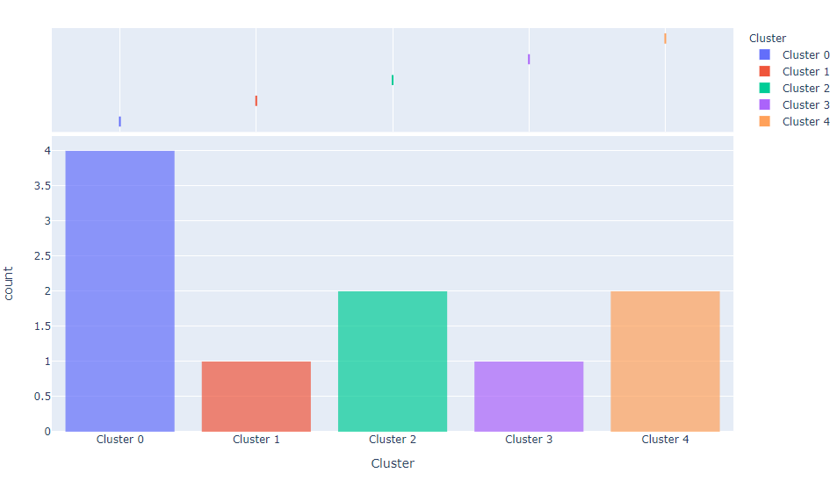
K-means clustering Algorithm:
The size of clusters
By applying K-means clustering, San Francisco city is divided into five similar areas based on the crime category and crime rates recorded between 2014 to 2017.

Slide 15

Evaluation

Slide 16
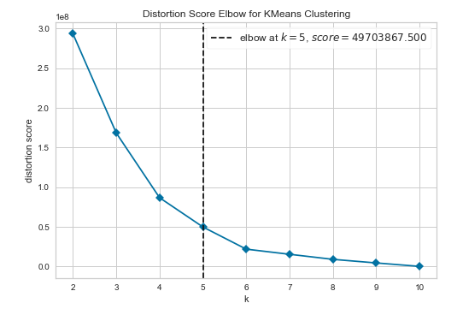
Model Evaluation :
The decision on the number of clusters K = 5 used in the K-means clustering model was based on the elbow methods evaluation metric.

Slide 17

RESULT & DISCUSSION

Slide 18
RESULT &
DISCUSSION (1/2) :
Total crime incident number by SF districts (2014-2017)
District | Cluster | Total crime incident number by district
Park | Cluster 0 | 29255
Richmond | Cluster 0 | 29340
Taraval | Cluster 0 | 37222
Tenderloin | Cluster 0 | 34123
Southern | Cluster 1 | 99124
Central | Cluster 2 | 61890
Northern | Cluster 2 | 70002
Mission | Cluster 3 | 67301
Bayview | Cluster 4 | 48654
Ingleside | Cluster 4 | 41248
Districts of cluster 0 have the lowest number of crimes, followed by districts of cluster 4, then districts of cluster 2. Districts of cluster 1 have the highest number of crimes in the period from 2014 to 2017 compared to all San Francisco's neighborhoods.

Slide 19

RESULT & DISCUSSION (2/2) :
Total crime incident number by SF districts (2014-2017)
Districts of cluster 0 have the lowest crime rates in around 90% of crime categories.
Cluster 1 has the highest number of crimes for around 42 %) of the crime types.
Cluster 2 districts reported crimes with significant numbers, but they are not the highest in all San Francisco areas.
Cluster 3 has the highest number of crimes for about 22% of the crime types.
Cluster 4 has the highest number of crimes for about 28 % of the crime types.

Slide 20
Thank you
Achraf Safsafi

