Slide 1
Speech Emotion Recognition
By Achraf Safsafi

Slide 2

Problem Understanding

Slide 3
Business Problem :
Recognizing the emotions behind the words would help to improve the audio-based interaction between us and computers.

Slide 4
Objective :
The project's goal is to find the best machine learning model that is best for speech emotion recognition.

Slide 5
Implementation Plan:
2) Data understanding
Describing data.
3) Data preparation
Encoding.
Exploring data.
1) Problem understanding
Normalization.
Feature extraction.
4) Modeling
5) Model evaluation

Slide 6

Data Understanding

Slide 7
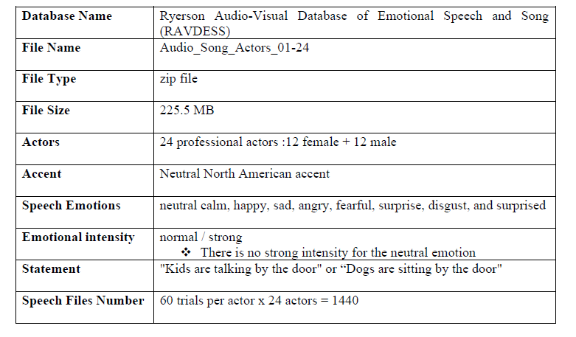
Data Source & Description :

Slide 8
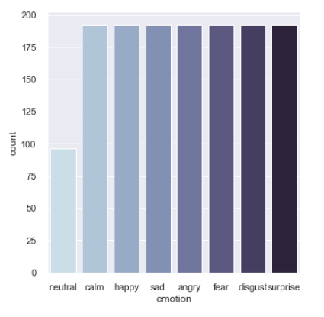
Label Distribution :
Data is balanced.

Slide 9

Data Preparation

Slide 10
Encoding:
angry: 0
calm: 1
disgust: 2
fear: 3
happy: 4
neutral: 5
sad: 6
surprise: 7

Slide 11
Feature Extraction :
Feature Extraction was done using Mel-frequency Cepstral Coefficients ( MFCC).

Slide 12
Splitting Data :
The dataset was split into training and testing sets with an 80:20 split.
All models were trained using stratified 10-fold cross-validation.

Slide 13

Modeling

Slide 14
Machine Learning Algorithms:
Model | Overall Accuracy (%)
Light Gradient Boosting Machine | 62
MLP Classifier | 64
Extra Trees Classifier | 64
Random Forest Classifier | 61

Slide 15
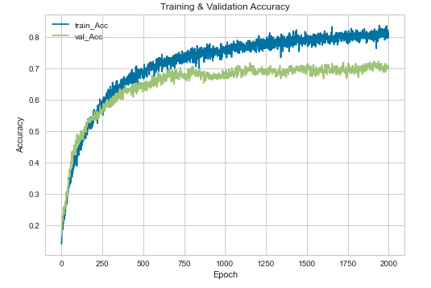
1D Convolutional Neural Network (1D-CNN) Model:

Slide 16

Evaluation

Slide 17
Model Evaluation :

Slide 18
Thank you
Achraf Safsafi

